Slide 2
Overview
School Finance & Recapture
HPISD Legislative Priorities
Actions of the 88th Legislature
Progress on Priorities
What’s Next?
Questions & Answers

Slide 3
How does school finance work?
The legislature sets the cost of each student through the basic allotment and other weighted formulas
The number of students who show up each day, combined with the formulas determine the size of the overall base budget
The school district has limited authority to add “enrichment pennies” to increase the budget
Local property taxes are used first to fund that budget. When they are insufficient, state aid fills the gap. If local property taxes produce more than the state-determined cost, the “excess” is recaptured.
Student Counts
Property Values
Tax Effort
Notes:
Before we get into what the Legislature did or might do that impacts schools, I thought it might be a good idea to give everyone a refresher of how school finance works in Texas. The building block of school finance formulas is the Basic Allotment. The Legislature sets that amount other funding weights that apply to it in law. It all depends on how many students show up each day—as school funding is based on Average Daily Attendance. On top of that “basic funding” in state law, school districts may locally adopt additional “enrichment pennies,” (which were intended to provide for additional local priorities, but all too often fund the basic requirements to operate a school district. And it is local property taxes that are first used to fund schools. If a school can’t collect enough, the state provides the rest, and if a district collects too much, the excess is recaptured. The box on the right tell you the main factors affecting school funding.

Slide 4
Formulas in state law determine the size of the glass (district’s entitlement) based on:
Basic Allotment
District characteristics
Student characteristics
Other additional funding not on a per-student basis (such as outcomes-based incentives)
District tax effort
Notes:
I typically illustrate it like this: think of this glass of water as what state law says your school district is entitled to. Every district has a different sized glass. You begin with the Basic Allotment, based on the number of students in attendance. More students? You have a bigger glass. Less students? The glass shrinks. Then the size of the glass may increase further based on certain district characteristics (small or mid-sized) and student characteristics (special education, economically disadvantaged, bilingual, etc.) and other funding such as transportation, teacher incentive allotment or outcomes bonuses. What a lot of people often forget is the role that the district’s tax effort plays in the size of your glass. If you increase your tax rate, it causes the size of the glass to grow. If the district reduces the rate (which is different than when the state does by providing tax relief), then the glass shrinks.

Slide 5
Local property taxes fill the glass first, and the state will fill in any space that is left.
Local Revenue in Excess of Entitlement is recaptured.
Notes:
So the first source of funding to fill your glass is local property taxes. If the district’s tax collections are not sufficient to fill the glass, then the state provides additional water to ensure every district’s glass is full. If the local property tax revenue is greater than the size of the glass, it spills out of the glass onto the table, and the state comes along with a big sponge and soaks up that “excess” through recapture. That overage is recapture.

Slide 6
To reduce recapture, you must either increase the size of your glass (entitlement) or reduce the amount of water flowing in (taxable values)
Notes:
If a district wants to reduce recapture, you must either increase the size of your glass (which is largely controlled by the legislature and the school finance formulas, but which a district has some limited control over through the local tax rate) or you reduce the amount of water flowing into the glass—which means either values are declining (which isn’t great for the local economy) or because the state has provided tax relief which means the district collects less in taxes without it causing the size of the glass to shrink. You either have to put less water in or you have to get a bigger glass.

Slide 7
What is recapture?
A method of equalizing varying degrees of property wealth among Texas school districts.
Known as “Robin Hood” due to “stealing from the rich”
Not necessarily giving to the poor
Notes:
And let’s all get a clear understanding of what recapture is: many of you might know this concept better as Robin Hood. That’s because when the concept was first introduced, a reporter for the Dallas Morning News (Terry Stutz) first equated it with the figure in folklore who “stole from the rich and gave to the poor.” The name stuck. Even though the concept to bring about equalization has changed over time. Recapture still means that property wealthy districts like Highland Park ISD are still required to send a portion of their wealth away. But rather than those dollars going directly to a school district with less resources, the recapture payment goes to the state for use in the Foundation School Program. As a result, the State is able to retain more of its own funding in General Revenue, rather the recapture payment resulting in other schools having additional funding, the state is who ends up with additional funding.

Slide 8
Notes:
When I travel the state and talk about recapture, one of the things I commonly hear is that the Legislature already fixed this problem via HB 3 in 2019. That’s what the campaign newsletters all said, right? And to answer that, I would say it is a matter of perspective. It’s true that the legislation in 2019 made it so that recapture didn’t get AS BAD as it otherwise would have been, but it didn’t really make things better.

Slide 9
Following passage of
SB 2 (88S2)
Following passage of HB 3 in 2019
Notes:
Here is a look at the total recapture collected statewide for the most recent 10 year period. You can see the dip that occurred after the passage of HB 3 in 2019, but you can also see that it quickly started running out control again. And you can see the result of the most recent action adopted by the Legislature to reduce property taxes that again results in a sizable dip. But still not better than pre-2019 levels.

Slide 10
Notes:
I also hear from some community members who say that they don’t mind recapture so much because it means that those funds benefit other schools in need. However, as we discussed when we talked about the definition of recapture, when your district pays more and more in recapture, it doesn’t mean that other schools have more money. In fact, they receive the same amount of funding to which school finance laws say they are entitled to receive, but the state doesn’t have to contribute as much as it otherwise would have.

Slide 11
The Appropriations Shell Game
Every two years, legislators underestimate the total amount that districts will pay in recapture. Then, when districts pay more than projected, legislators use those recapture dollars to replace other state funding that would have gone to schools.
SB 30, the Supplemental Appropriations Act, reduced spending for the Foundation School Program by $8.2 billion for FY 22-23. $2.4 billion of that is due to higher-than-expected recapture.
Notes:
We live in a state where the legislature meets every other year (thank goodness) and that means they adopt a two-year budget (based on estimates). Then they adopt a supplemental appropriations act as a “true-up” of those estimates based on actual numbers. The pattern we’ve seen is that the legislature adopts a budget that says recapture will be less than it actually is. They appropriate enough state funds to pay for public education with less recapture than is actually collected. Then they adopt a supplemental appropriations act in which the increased amount of recapture that was actually paid is recognized as a state savings that frees up state dollars to be spent on other things.

Slide 12
Notified Recapture Districts 2023
Recapture districts can be found in nearly every region of the state.
Districts that would have Excess Local Revenue for 2022-23 in:
Tier 1 & Tier 2
Tier 2 Only
Source: TEA Website 2023 Excess Local Revenue Notification List
Notes:
In terms of sharing dollars with other less fortunate districts, I will point out that recapture districts can be found in nearly every region of the state.

Slide 13
Top 10 Recapture Districts
Districts Paying the Most Recapture as Percent of Total M&O Tax Collections 2023-24
Districts Paying the Most Recapture 2023-24
 | School District | Recapture
1 | Austin ISD | $694,475,177
2 | Pecos-Barstow-Toyah ISD | $189,213,180
3 | Plano ISD | $156,872,880
4 | Wink-Loving ISD | $139,446,806
5 | Midland ISD | $107,896,521
6 | Eanes ISD | $93,423,375
7 | Rankin ISD | $91,265,536
8 | Highland Park ISD | $89,324,074
9 | Grady ISD | $59,050,664
10 | Glasscock County ISD | $53,952,771
School District | Recapture | % of collections
Rankin ISD | $91,265,536 | 84.4%
Grady ISD | $59,050,664 | 84.1%
Wink-Loving ISD | $139,446,806 | 84.1%
Sands CISD | $26,163,446 | 83.5%
Culberson County-Allamoore ISD | $48,047,027 | 82.3%
Pecos-Barstow-Toyah ISD | $189,213,180 | 81.9%
McMullen County ISD | $21,579,194 | 81.4%
Westhoff ISD | $6,558,462 | 81.2%
Kenedy County Wide CSD | $7,353,736 | 79.5%
Glassrock County ISD | $53,952,771 | 79.3%
Highland Park ISD | $89,324,074 | 60.8%
Source: TEA SOF Preliminary Data 2023-2024, accessed 9/11/2023
21
Notes:
And you can also see through this list of top 10s that not all recapture districts are those communities that someone would consider “wealthy.” That’s because equalization is based on property wealth and how much “local revenue in excess of entitlement” in district collects. Some of these districts educate high degrees of students in poverty. There is a difference in personal wealth and property wealth per student. The list on the left is ranked by total dollars paid in recapture, and the list on the right is ranked by the percent of total M&O collections subject to recapture. As you can see there are 8 districts that send more than 80% of their total collections to the state. HPISD ranks number 21 on that list, as you share 60.8% of your total M&O collections to the state. Neither of these are lists on which you want to be #1.

Slide 14
Notes:
And the final misperception I want to share with you today is the one I hear the most. If we could just pay less recapture, then we could have more money to keep in our district and serve students. However, that desire has more to do with wanting adequate funding to serve students and teachers. You can pay a lot less recapture—in fact HPISD is expected to pay almost $18 million less in recapture this year than last year. That’s a 16% reduction. However, the reason HPISD is paying less in recapture is because you are collecting less in property taxes, not because you have $18 million more to spend on students and teachers.

Slide 15
To reduce recapture, you must either increase the size of your glass (entitlement) or reduce the amount of water flowing in (taxable values)
Notes:
There are two ways you can reduce how much water spills outside your glass. You have to either get a bigger glass (by increasing the entitlement the state school finance formulas calculate—by increasing student counts/student characteristics that draw down additional funding weights or increasing your tax rate) OR you can reduce the amount of water flowing into the glass via reduced property values (which is not great for the local economy). The reduction in property taxes this year means that HPISD is putting less water into the glass, so you have less spill over. You were not given a bigger glass.

Slide 16
Notes:
On average, M&O tax rates will be reduced by over 18 cents cent statewide. That means that the total share of who pays shifts. The state was only paying to fill 36% of the glass, and now they are paying enough to fill 46% of the glass because property taxpayers have been asked to foot less of the bill. This is a shift in the source of funding, but not a shift in the total amount of funding available.

Slide 17
Source: Legislative Budget Board
Notes:
This graph is not one I developed. It’s from the Legislative Budget Board. I know, it’s a lot of information and the numbers are small. But the important part is the line with the diamonds. That represents constant dollars that have been adjusted for inflation and population growth. What you can clearly see is that in constant dollars, we are below the level of funding Texas schools enjoyed after the passage of school finance reform legislation in 2019. The overall funding amounts are the highest in Texas history, but I should hope so. After all, Texas public schools are educating more students than they ever have before.

Slide 18
What happens to school funding as property values grow?
Without formula increases, school funding per student is flat, even when property values, and therefore taxes, increase.
The rate of inflation has increased by 17.2% since 2019 (the last time Texas school funding formulas were adjusted).
Notes:
What we’ve seen over the past few years is an extraordinary amount of growth in the rate of inflation, but no growth in school finance formulas. That means that the funding for schools has remained flat—the size of the glass is the same year after year, yet the buying power of those dollars is almost 20% less than what that same amount was worth 4 short years ago. It’s for this reason that teachers and other school employees are desperate for a raise—it costs more to live now than it did a few years ago, so they are looking to districts to keep pace with that standard of living even though finances are flat.

Slide 19
Highland Park ISD
2023 Legislative Priorities
Obtain additional school funding to support student learning in HPISD; reduce impact of recapture
HPISD asks for state lawmakers to reduce the impact of recapture on school districts throughout the state of Texas by:
Providing property tax relief
Increasing the basic allotment
Allowing school districts to receive a discount by making early recapture payments
Allowing school districts to access additional golden pennies
Ensure accountability of public dollars
Preserve local decision-making

Slide 20
The Case for a
Inflation-Adjusted Basic Allotment
BA | Increase from Current BA | Two-Year Statewide Total Cost
$6,160 | -- | --
$6,260 | $100 | $1.443 billion
$6,360 | $200 | $2.896 billion
$6,460 | $300 | $4.353 billion
$6,560 | $400 | $5.812 billion
$6,660 | $500 | $7.272 billion
$6,760 | $600 | $8.732 billion
$6,860 | $700 | $10.194 billion
$6,960 | $800 | $11.656 billion
$7,060 | $900 | $13.118 billion
$7,160 | $1,000 | $14.581 billion
Adjusting the Basic Allotment for estimated inflation from 2019 through 2023 (17%) would mean a $1,000 increase.
Source: Consumer Price Index (CPI)

Slide 22
How it started
Notes:
So what happened during the 88th Regular Legislative Session? Lawmakers started with a record-setting surplus. And 140 days later…

Slide 23
How it ended
Notes:
They didn’t have much to show for it. They spent very little of their record-breaking surplus because they could not agree on the method by which to provide the largest tax cut in Texas history and the school funding and teacher pay raise bill (which really never proposed spending anywhere close to the amount needed to keep pace with inflation) failed to pass because the bill was held hostage with an unrelated private school voucher proposal. Therefore, the two biggest priorities expressed by state leaders failed to pass, and the money to spent on those priorities simply stays in the bank.

Slide 24
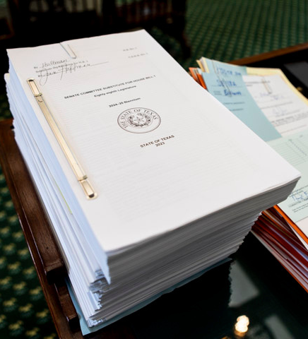
State Budget &
Appropriations
With a record-setting $32.7 billion surplus, lawmakers were poised to make historic investments in schools and property tax cuts.
HB 1 was touted as the biggest increase in state funding for public education in state history...but due to contingency riders, and legislation that did not pass, that isn't exactly true.
Notes:
The State budget bill is the only bill lawmakers MUST pass. And the bill they passed was touted as “the biggest increase in state funding for public education in state history,” but much of that money was contingent on the passage of bills that failed to pass, to lawmakers failed to make a big investment in schools.

Slide 25
"This budget spends $8.7 billion in new money for schools."
Notes:
This is the page from the budget bill that spells all that out. It would have spent nearly $8.7 billion, except it didn’t.

Slide 26
The Hostage Situation
Hostage Taking
(18 U.S.C. 1203) - Justice Department
Since a voucher bill failed to pass the House on its own merits, private school vouchers were added to one bill that could increase school funding in the Senate; once it returned to a House with vouchers attached, it was not allowed to pass.
The outcome of the hostage situation was that everyone lost, most especially Texas students.
Hostage taking is defined as the seizing or detention of an individual coupled with a threat to kill, injure or continue to detain such individual in order to compel a third person or governmental organization to take some action.
Notes:
What we saw during the legislative session was an old-fashioned hostage situation. After the House failed to pass a private school voucher bill, the Senate made it clear that no school funding bill could pass to provide raises for teachers or funding schools need for students unless that bill included Education Savings Accounts.

Slide 27
"This budget spends $8.7 billion in new money for schools."
 | In HB 1 2024-25 | Funding Available for 2024-25 | New Funding 2024-25
Curriculum/Instructional Materials (HB 1605) | $500M | $500M | $500M
School Safety (HB 3) | $300M | $300M | $300M
FSP Formula Funding Increases and Teacher Compensation (HB 100) | $3.997B
School Choice (Education Savings Accounts) | $500M
Virtual Education | $49.4M
TRS Active Care | $589M | $588.5M | $588.5M
Increase in Golden Penny Yield | $2.367B | $2.367B | $2.367B
New Instructional Facilities Allotment (NIFA) | $60M | $60M
Instructional Materials (IMTA) | $307M | $307M
TOTAL | $8.67 billion | $4.12 billion | $3.75 billion
Notes:
In this table, I walk through the numbers from which state leaders are making the statement at the top of the screen, but that I break it down on money that will actually flow to schools (not contingent on the passage of bills that failed to pass) and the column on the far right shows what is actually NEW money since some of those dollars are restorations of funding cuts state leaders applied to schools two years ago.

Slide 28
Lawmakers also provided $1.1 billion in school safety grants to help schools comply with new Safety & Security Standards
New Funding for HPISD from the 88th Legislative Session
School Safety Allotment
$151,142
Increases the School Safety Allotment from $9.72/ADA to $10/ADA and provides $15,000 per campus. SSA dollars must be spent on specific purposes spelled out in law, related to safety & security.
TOTAL INCREASE: 0.3%
$24 per student in Average Daily Attendance
Notes:
The $1.1 billion is one-time money to help school districts comply with the new standards which are expected to cost 3 times the amount of funding provided. This varies from district-to-district, and we have no way of knowing how the Texas Education Agency will distribute the funding at this time.

Slide 29
Property Taxes
In 2021, Texans experienced 6% growth statewide. In 2022, Texans experienced 19% growth statewide. For the reason, among others, property tax relief was the first priority among state leaders.
Notes:
Property tax relief was identified as the #1 priority of all state leaders, and they committed to spending at least half of the state’s surplus for that purpose.

Slide 30
Notes:
Again, as we discussed before, the property tax relief measures benefit taxpayers, but not schools. It is a shift in the method of funding, not the amount of total funding.

Slide 31
“This is the largest tax cut in Texas History,
and it injects billions of new dollars
into the state’s public education system."
Texas School Coalition Statement:
Those dollars do not reach classrooms and they do not give schools more money to pay teachers and meet other needs. It would be disingenuous for any legislator to claim that a vote for property tax relief is a vote to increase funding for Texas classrooms. Property tax relief is good, but it does not provide the net increase in resources that Texas public schools severely need.
Notes:
The words in blue are something said by Speaker Phelan and some members of the Texas House during the legislative session. We released a statement in response to that, just to set the record straight. It is important to remember that while property tax relief has its merits—its’s something we support—it is an investment that benefits taxpayers, not Texas students and teachers. It would be disingenuous for anyone to represent it as increased funding for Texas classrooms. I will note that Chairman Morgan Meyer, who was the author and sponsor of the property tax relief legislation understood this concept quite well and did not misrepresent it as some of his colleagues did.

Slide 33
The Largest Property Tax Cut in Texas History
$13.3 billion in tax relief (when combined with the $5.3B from the regular session, that’s $18 billion in property tax relief).
10.7 cents additional tax rate compression (+ current law)
$100,000 homestead exemption
New 20% appraisal cap on non-homestead real property valued at less than $5 million
$18 billion in tax relief
Expected to save average homeowner $1,300 per year, with slightly more for 65+
41% reduction in recapture statewide

Slide 34
Highland Park ISD Historic Property Values + M&O Tax Rates
Tax Rate
$1.04
Property Values in Billions
$0.97
$0.9564
$0.9610
$0.9078
$0.7227
*2023-24 value growth are preliminary estimates and subject to change.
Notes:
What you see on this chart are historic M&O property tax rates in HPISD and historic property values. You can see that the rate has been reduced each year as values increase. This year, you can expect an 18 cent reduction—that’s the 10.7 cents everyone received plus another 8 cents of relief.

Slide 35
Highland Park ISD M&O Property Tax Collections and Recapture
The 16% expected reduction in recapture is caused by the reduction in property tax collections.
Notes:
You can see that this graph illustrates exactly what we’ve been discussing. HPISD is expected to collect 10% less in less property taxes and that results in a 16% reduction in recapture.

Slide 36
Highland Park ISD
2023 Legislative Priorities
Obtain Additional School Funding to Support Student Learning in HPISD; Reduce Impact of Recapture
HPISD asks for state lawmakers to reduce the impact of recapture on school districts throughout the state of Texas by:
Providing property tax relief
Increasing the basic allotment
Allowing school districts to receive a discount by making early recapture payments
Allowing school districts to access additional golden pennies
Ensure accountability of public dollars
Preserve local decision-making

Slide 37
What options are available?
Budget Cuts
Reducing programs and services for students are never a popular option. Reductions in staff are even less desirable.
Deficit Budget
To avoid cuts districts can adopt a deficit budget and finance ongoing district operations from the fund balance. That reserve fund is for emergency and special purposes and funding will run out over time.
Voter Approval Tax Rate Election (VATRE)
Districts can seek voter approval to tax at a higher rate through a November election, but HPISD has limited pennies left, and remaining pennies of tax effort won’t deliver as much revenue due to recapture.
Legislative Appropriation
Legislators have funding available, but are they willing to spend it without passage of a private school voucher bill?

Slide 38
Fall special session expected
Governor Abbott is the only person who may call a special session, and he has promised one on school choice and education freedom in October
October:
Follows the conclusion of the impeachment trial
Allows for new school ratings to be released
Occurs before filing opens for the March 2024 Primary Election
Is open season for campaign fundraising

Slide 39
Get to know your HPISD Legislators
Senator Tan Parker
512-463-0112
tan.parker@senate.texas.gov
Chairman Morgan Meyer
512-463-0367
morgan.meyer@house.texas.gov

Slide 40
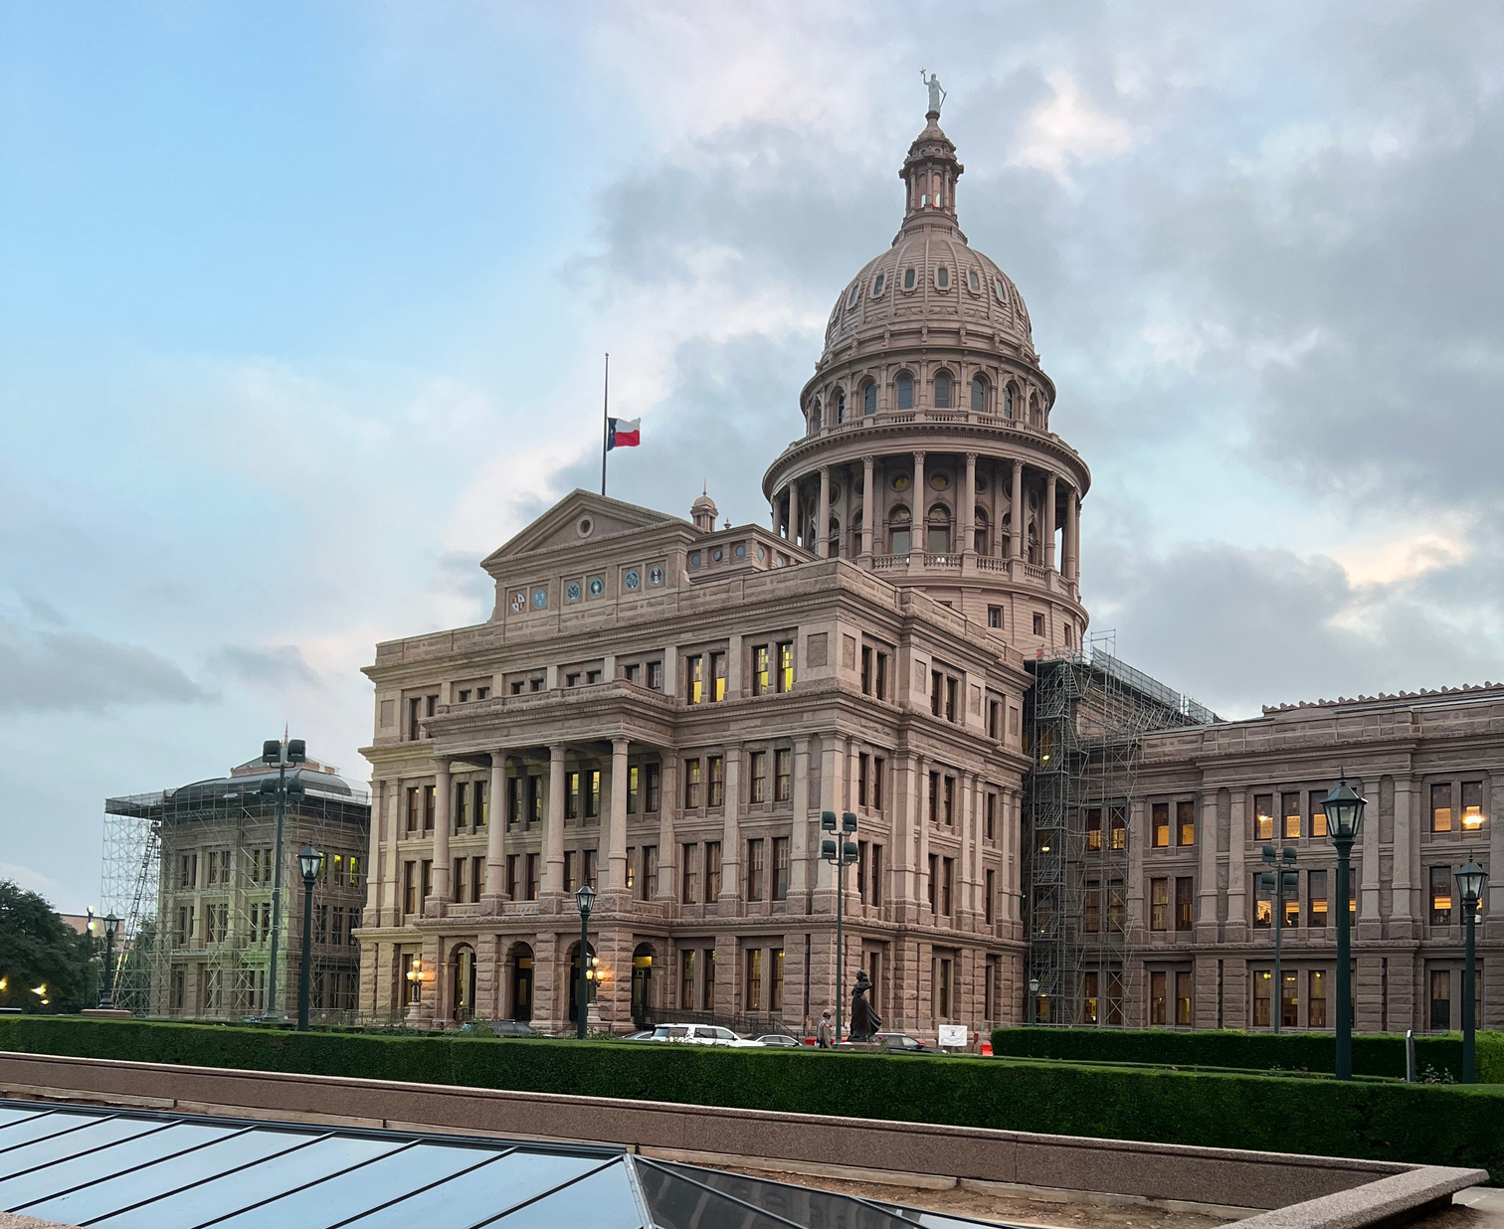
Questions?
Christy Rome
Executive Director
Texas School Coalition
christy@txsc.org
512-732-9072
www.txsc.org

