Slide 2
Overview
School Finance 101
AHISD Legislative Priorities
Actions of the 88th Legislature
Progress on Priorities
What’s Next?
Questions & Answers

Slide 3
How does school finance work?
The legislature sets the cost of each student through the basic allotment and other weighted formulas
The number of students who show up each day, combined with the formulas determine the size of the overall base budget
The school district has limited authority to add “enrichment pennies” to increase the budget
Local property taxes are used first to fund that budget. When they are insufficient, state aid fills the gap. If local property taxes produce more than the state-determined cost, the “excess” is recaptured.
Student Counts
Property Values
Tax Effort
Notes:
Before we get into what the Legislature did or might do that impacts schools, I thought it might be a good idea to give everyone a refresher of how school finance works in Texas. The building block of school finance formulas is the Basic Allotment. The Legislature sets that amount other funding weights that apply to it in law. It all depends on how many students show up each day—as school funding is based on Average Daily Attendance. On top of that “basic funding” in state law, school districts may locally adopt additional “enrichment pennies,” (which were intended to provide for additional local priorities, but all too often fund the basic requirements to operate a school district. And it is local property taxes that are first used to fund schools. If a school can’t collect enough, the state provides the rest, and if a district collects too much, the excess is recaptured. The box on the right tell you the main factors affecting school funding.

Slide 4
SCHOOL FINANCE 101
Formulas determine the size of the glass (district’s entitlement) based on:
Basic Allotment
District characteristics
Student characteristics
Other additional funding not on a per-student basis (such as transportation, teacher incentives)
District tax effort
Notes:
I typically illustrate it like this: think of this glass of water as what state law says your school district is entitled to. Every district has a different sized glass. You begin with the Basic Allotment, based on the number of students in attendance. More students? You have a bigger glass. Less students? The glass shrinks. Then the size of the glass may increase further based on certain district characteristics (small or mid-sized) and student characteristics (special education, economically disadvantaged, bilingual, etc.) and other funding such as transportation, teacher incentive allotment or outcomes bonuses. What a lot of people often forget is the role that the district’s tax effort plays in the size of your glass. If you increase your tax rate, it causes the size of the glass to grow. If the district reduces the rate (which is different than when the state does by providing tax relief), then the glass shrinks.

Slide 5
Local property taxes fill the glass first, and the state will fill in any space that is left.
Local Revenue in Excess of Entitlement is recaptured.
Notes:
So the first source of funding to fill your glass is local property taxes. If the district’s tax collections are not sufficient to fill the glass, then the state provides additional water to ensure every district’s glass is full. If the local property tax revenue is greater than the size of the glass, it spills out of the glass onto the table, and the state comes along with a big sponge and soaks up that “excess” through recapture. That overage is recapture.

Slide 6
To reduce recapture, you must either increase the size of your glass (entitlement) or reduce the amount of water flowing in (taxable values)
Notes:
If a district wants to reduce recapture, you must either increase the size of your glass (which is largely controlled by the legislature and the school finance formulas, but which a district has some limited control over through the local tax rate) or you reduce the amount of water flowing into the glass—which means either values are declining (which isn’t great for the local economy) or because the state has provided tax relief which means the district collects less in taxes without it causing the size of the glass to shrink. You either have to put less water in or you have to get a bigger glass.

Slide 7
What happens to school funding as property values grow?
Without formula increases, school funding per student is flat, even when property values, and therefore taxes, increase.
The rate of inflation has increased by 17.2% since 2019 (the last time Texas school funding formulas were adjusted).
Notes:
What we’ve seen over the past few years is an extraordinary amount of growth in the rate of inflation, but no growth in school finance formulas. That means that the funding for schools has remained flat—the size of the glass is the same year after year, yet the buying power of those dollars is almost 20% less than what that same amount was worth 4 short years ago. It’s for this reason that teachers and other school employees are desperate for a raise—it costs more to live now than it did a few years ago, so they are looking to districts to keep pace with that standard of living even though finances are flat.

Slide 8
Source: Legislative Budget Board
Notes:
This graph is not one I developed. It’s from the Legislative Budget Board. I know, it’s a lot of information and the numbers are small. But the important part is the line with the diamonds. That represents constant dollars that have been adjusted for inflation and population growth. What you can clearly see is that in constant dollars, we are below the level of funding Texas schools enjoyed after the passage of school finance reform legislation in 2019. The overall funding amounts are the highest in Texas history, but I should hope so. After all, Texas public schools are educating more students than they ever have before.

Slide 9
What that means for AHISD
A $3.5 million gap exists in the current school year for the district to achieve the same buying power as 2019—that doesn’t mean increased spending or improvements, but just maintaining the same buying power for dollars.

Slide 10
Alamo Heights ISD
2023 Legislative Priorities
Increase State funding and reduce the negative, unintended consequences of the “Robin Hood” system.
Change current State funding formulas to meet student needs.
Embrace tax transparency, support local control, and protect AHISD taxpayer dollars.
Balance State oversight with community-based accountability.

Slide 11
The Case for a
Inflation-Adjusted Basic Allotment
BA | Increase from Current BA | Two-Year Statewide Total Cost
$6,160 | -- | --
$6,260 | $100 | $1.443 billion
$6,360 | $200 | $2.896 billion
$6,460 | $300 | $4.353 billion
$6,560 | $400 | $5.812 billion
$6,660 | $500 | $7.272 billion
$6,760 | $600 | $8.732 billion
$6,860 | $700 | $10.194 billion
$6,960 | $800 | $11.656 billion
$7,060 | $900 | $13.118 billion
$7,160 | $1,000 | $14.581 billion
Adjusting the Basic Allotment for estimated inflation from 2019 through 2023 (17%) would mean a $1,000 increase.
Source: Consumer Price Index (CPI)

Slide 13
How it started
Notes:
So what happened during the 88th Regular Legislative Session? Lawmakers started with a record-setting surplus. And 140 days later…

Slide 14
How it ended
Notes:
They didn’t have much to show for it. They spent very little of their record-breaking surplus because they could not agree on the method by which to provide the largest tax cut in Texas history and the school funding and teacher pay raise bill (which really never proposed spending anywhere close to the amount needed to keep pace with inflation) failed to pass because the bill was held hostage with an unrelated private school voucher proposal. Therefore, the two biggest priorities expressed by state leaders failed to pass, and the money to spent on those priorities simply stays in the bank.

Slide 16
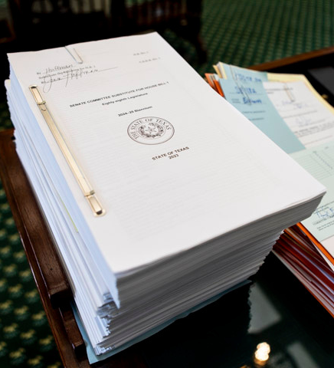
State Budget &
Appropriations
With a record-setting $32.7 billion surplus, lawmakers were poised to make historic investments in schools and property tax cuts.
HB 1 was touted as the biggest increase in state funding for public education in state history...but due to contingency riders, and legislation that did not pass, that isn't exactly true.
Notes:
The State budget bill is the only bill lawmakers MUST pass. And the bill they passed was touted as “the biggest increase in state funding for public education in state history,” but much of that money was contingent on the passage of bills that failed to pass, to lawmakers failed to make a big investment in schools.

Slide 17
"This budget spends $8.7 billion in new money for schools."
Notes:
This is the page from the budget bill that spells all that out. It would have spent nearly $8.7 billion, except it didn’t.

Slide 18
The Hostage Situation
Hostage Taking
(18 U.S.C. 1203) - Justice Department
Since a voucher bill failed to pass the House on its own merits, private school vouchers were added to one bill that could increase school funding, and it was not allowed to pass without vouchers attached.
The outcome of the hostage situation was that everyone lost, most especially Texas students.
Hostage taking is defined as the seizing or detention of an individual coupled with a threat to kill, injure or continue to detain such individual in order to compel a third person or governmental organization to take some action.
Notes:
What we saw during the legislative session was an old-fashioned hostage situation. After the House failed to pass a private school voucher bill, the Senate made it clear that no school funding bill could pass to provide raises for teachers or funding schools need for students unless that bill included Education Savings Accounts.

Slide 19
"This budget spends $8.7 billion in new money for schools."
 | In HB 1 2024-25 | Funding Available for 2024-25 | New Funding 2024-25
Curriculum/Instructional Materials (HB 1605) | $500M | $500M | $500M
School Safety (HB 3) | $300M | $300M | $300M
FSP Formula Funding Increases and Teacher Compensation (HB 100) | $3.997B
School Choice (Education Savings Accounts) | $500M
Virtual Education | $49.4M
TRS Active Care | $589M | $588.5M | $588.5M
Increase in Golden Penny Yield | $2.367B | $2.367B | $2.367B
New Instructional Facilities Allotment (NIFA) | $60M | $60M
Instructional Materials (IMTA) | $307M | $307M
TOTAL | $8.67 billion | $4.12 billion | $3.75 billion
Notes:
In this table, I walk through the numbers from which state leaders are making the statement at the top of the screen, but that I break it down on money that will actually flow to schools (not contingent on the passage of bills that failed to pass) and the column on the far right shows what is actually NEW money since some of those dollars are restorations of funding cuts state leaders applied to schools two years ago.

Slide 20
New Funding for AHISD
School Safety Allotment
$91,263
Increases the School Safety Allotment from $9.72/ADA to $10/ADA and provides $15,000 per campus. SSA dollars must be spent on specific purposes spelled out in law, related to safety & security.
Lawmakers also provided $1.1 billion in school safety grants to help schools comply with new Safety & Security Standards
TOTAL INCREASE: 0.2%
$20 per student in Average Daily Attendance
Notes:
The $1.1 billion is one-time money to help school districts comply with the new standards which are expected to cost 3 times the amount of funding provided. This varies from district-to-district, and we have no way of knowing how the Texas Education Agency will distribute the funding at this time.

Slide 21
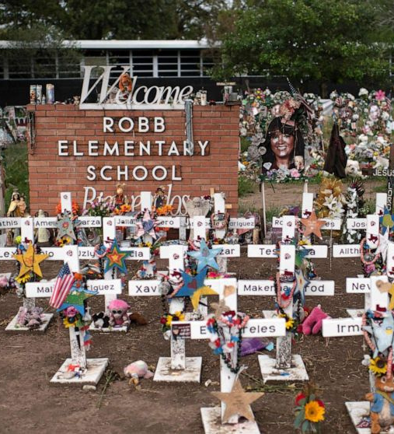
School Safety
HB 3 – School Safety
SB 838 – Panic Alert Devices
HB 1905 – Shared Safety Training
HB 473 – Parent Notice for Threat Assessment
SB 133 – No Pepper Spray for Young Children
Following the tragic loss in Uvalde, legislators worked on bills meant to improve safety in Texas schools. HB 3 requires an armed officer at every campus and provided $15,000 per campus to pay for those officers.

Slide 22
AHISD funding needed to implement new state school safety requirements
Requirement | Cost
Salaries for 5 SROs | $272,886
SRO Admin Support | $12,449
SRO Equipment | $18,375
TOTAL COST for SROs | $303,710
Annual cost for panic button devices & service | $61,333
TOTAL COST | $365,043
GAP BETWEEN STATE FUNDING & AHISD COST | -$273,780

Slide 23
Property Taxes
In 2021, Texans experienced 6% growth statewide. In 2022, Texans experienced 19% growth statewide. For the reason, among others, property tax relief was the first priority among state leaders.
Notes:
Property tax relief was identified as the #1 priority of all state leaders, and they committed to spending at least half of the state’s surplus for that purpose.

Slide 24
Notes:
When property tax relief is provided, it means that the overall local share of funding statewide shifts so that the state funds a greater share. But the glass is still the same size. So an investment in property tax relief at the state level means taxpayers can pay less money, but the schools still have the same amount of funding—they don’t receive less funding when people pay less in taxes because the state makes up the difference. But a larger state share of funding does not translate into more money for schools.

Slide 25
“This is the largest tax cut in Texas History,
and it injects billions of new dollars
into the state’s public education system."
Texas School Coalition Statement:
Those dollars do not reach classrooms and they do not give schools more money to pay teachers and meet other needs. It would be disingenuous for any legislator to claim that a vote for property tax relief is a vote to increase funding for Texas classrooms. Property tax relief is good, but it does not provide the net increase in resources that Texas public schools severely need.
Notes:
The words in blue are something said by Speaker Phelan and some members of the Texas House during the legislative session. We released a statement in response to that, just to set the record straight. It is important to remember that while property tax relief has its merits—its’s something we support—it is an investment that benefits taxpayers, not Texas students and teachers. It would be disingenuous for anyone to represent it as increased funding for Texas classrooms.

Slide 27
The Largest Property Tax Cut in Texas History
$13.3 billion in tax relief (when combined with the $5.3B from the regular session, that’s $18 billion in property tax relief).
10.7 cents additional tax rate compression
$100,000 homestead exemption
New 20% appraisal cap on non-homestead real property valued at less than $5 million
$18 billion in tax relief
Expected to save average homeowner $1,300 per year, with slightly more for 65+
41% reduction in recapture statewide

Slide 28
Alamo Heights ISD Historic Property Values + M&O Tax Rates
Tax Rate
$1.06
Property Values in Billions
$0.99
$0.9764
$0.9934
$0.9355
$0.768
*2023-24 value growth are preliminary estimates and subject to change.
Notes:
What you see on this chart are historic M&O property tax rates in AHISD and historic property values. You can see that the rate has been reduced each year as values increase. This year, you can expect a 16.75 cent reduction—that’s the 10.7 cents everyone received plus another 6 cents of relief.

Slide 29
Alamo Heights ISD M&O Property Tax Collections and Recapture
The 27% expected reduction in recapture is caused by the reduction in property taxes.

Slide 30
Alamo Heights ISD
2023 Legislative Priorities
Increase State funding and reduce the negative, unintended consequences of the “Robin Hood” system.
Change current State funding formulas to meet student needs.
Embrace tax transparency, support local control, and protect AHISD taxpayer dollars.
Balance State oversight with community-based accountability.

Slide 31
What that means for AHISD
A $3.5 million gap exists in the current school year for the district to achieve the same buying power as 2019—that doesn’t mean increased spending or improvements, but just maintaining the same buying power for dollars.
Notes:
We still haven’t solved this problem.

Slide 32
What options are available?
Budget Cuts
Reducing programs and services for students are never a popular option. Reductions in staff are even less desirable.
Deficit Budget
To avoid cuts districts can adopt a deficit budget and finance ongoing district operations from the fund balance. That reserve fund is for emergency and special purposes and funding will run out over time.
Voter Approval Tax Rate Election (VATRE)
Districts can seek voter approval to tax at a higher rate through a November election, but AHISD has limited pennies left, and remaining pennies of tax effort won’t deliver as much revenue due to recapture.
Legislative Appropriation
Legislators have funding available, but are they willing to spend it without passage of a private school voucher bill?

Slide 33
Fall special session expected
Governor Abbott is the only person who may call a special session, and he has promised one on school choice and education freedom in October
October:
Follows the conclusion of the impeachment trial
Allows for new school ratings to be released
Occurs before filing opens for the March 2024 Primary Election
Is open season for campaign fundraising

Slide 34
The Hostage Situation
Hostage Taking
(18 U.S.C. 1203) - Justice Department
Since a voucher bill failed to pass the House on its own merits, private school vouchers were added to one bill that could increase school funding, and it was not allowed to pass without vouchers attached.
The outcome of the hostage situation was that everyone lost, most especially Texas students.
Hostage taking is defined as the seizing or detention of an individual coupled with a threat to kill, injure or continue to detain such individual in order to compel a third person or governmental organization to take some action.
Notes:
And we’re likely back to exactly where we found ourselves in the Regular Session—the notion that you can’t have one without the other.

Slide 35
What those who favor Education Savings Accounts say:
What those oppose
private school vouchers say:
Parental rights should be prioritized so that parents have the freedom to choose whatever school they prefer for their child to attend.
$8,000 would be available in an education savings account for eligible students, for disbursement to a school or for educational services and materials at the discretion of the parent. Any additional amount required would be paid for by the parent.
Parents and best equipped and should decide how tax dollars are spent for their child.
Private schools are not required to accept these public funds or any student they do not wish to enroll.
Public tax dollars should fund public schools that have clear systems of academic and fiscal accountability in place.
Private schools do not have transparent accountability measures in place.
The diversion of public dollars to private schools would take needed resources out of public school classrooms, where special needs students and those who cannot afford to leave the public system need them most.
Vouchers would increase the burden of recapture on schools and taxpayers.
Other states have seen similar programs have detrimental effects on students and schools long-term.

Slide 36
Private school voucher programs in other states
Recent studies in Louisiana, Indiana, Ohio and the District of Columbia found that on average, students attending private schools with vouchers did less well on tests relative to their similar peers in public schools.
The projected cost of Arizona’s voucher program grew by 1,400% from the initial $65 million to $900 million in just two years’ time. 75% of students who initially applied for vouchers were not already enrolled in public schools.
New Hampshire’s voucher program was estimated to cost $130,000 in 2021 and it now costs $14.7 million.
Florida began by offering vouchers for students in special education in 1999, then expanded to families with low income, and in 2023, eligibility was expanded to all students in the state, for an estimated cost of $4 billion.
Texas budget officials estimated the proposed voucher plan would grow from a cost of $512 million in 2025 to more than $1 billion by 2028.

Slide 37
Key House Votes on Vouchers
The House took three different floor votes regarding private school vouchers during the 88th Regular Legislative Session. Two votes were in regards to a budget amendment prohibiting the use of state funds for private school vouchers, known as "The Herrero Amendment" for its author. The other was in regards to the House Public Education Committee's ability to meet for a last-minute voucher vote.
Motion to Table
The Herrero Amendment
Motion on Permission to Meet
Chairman Buckley moved to table The Herrero Amendment. The House rejected that proposal by a vote of 64 for and 71 against, allowing the vote on the amendment to happen.
Rep. Herrero proposed an amendment to HB 1 to prohibit the use of state funds for vouchers. The House adopted the amendment by a vote of 86-52.
Chairman Buckley sought permission for the Public Education Committee to meet on voucher bill SB 8, and Rep. Bailes objected to the motion. The House denied permission to meet by a vote of 65-76.
Record Vote 110
April 6, 2023
Record Vote 111
April 6, 2023
Record Vote 1464
May 10, 2023

Slide 38
“The 24”
House Republicans who voted FOR the Herrero anti-voucher amendment
Allison, Steve
Ashby, Trent
Bailes, Ernest
Bell, Keith
Burns, DeWayne
Clardy, Travis
Darby, Drew
Dean, Jay
Geren, Charlie
Holland, Justin
Kacal, Kyle
King, Ken
Kuempel, John
Lambert, Stan
Landgraf, Brooks
Murr, Andrew
Orr, Angelia
Price, Four
Raney, John
Rogers, Glenn
Shine, Hugh
Smith, Reggie
Spiller, David
VanDeaver, Gary
It requires 76 (currently 75) votes for a measure to prevail in the Texas House.
There are 64 Democrats in the Texas House, and all but one voted FOR the Herrero amendment (Rep. Harold Dutton voted Present).
The “white lighters” are Rs who voted Present: Buckley, Cook, DeAyala, Frazier, Cody Harris, Lujan, Phelan, Slawson, Thimesch, and Ed Thompson

Slide 39
Get to know your AHISD Legislators
Senator Donna Campbell
Senator José Menéndez
Rep. Steve Allison
Rep. Diego Bernal
Rep. Barbara Gervin-Hawkins

Slide 40
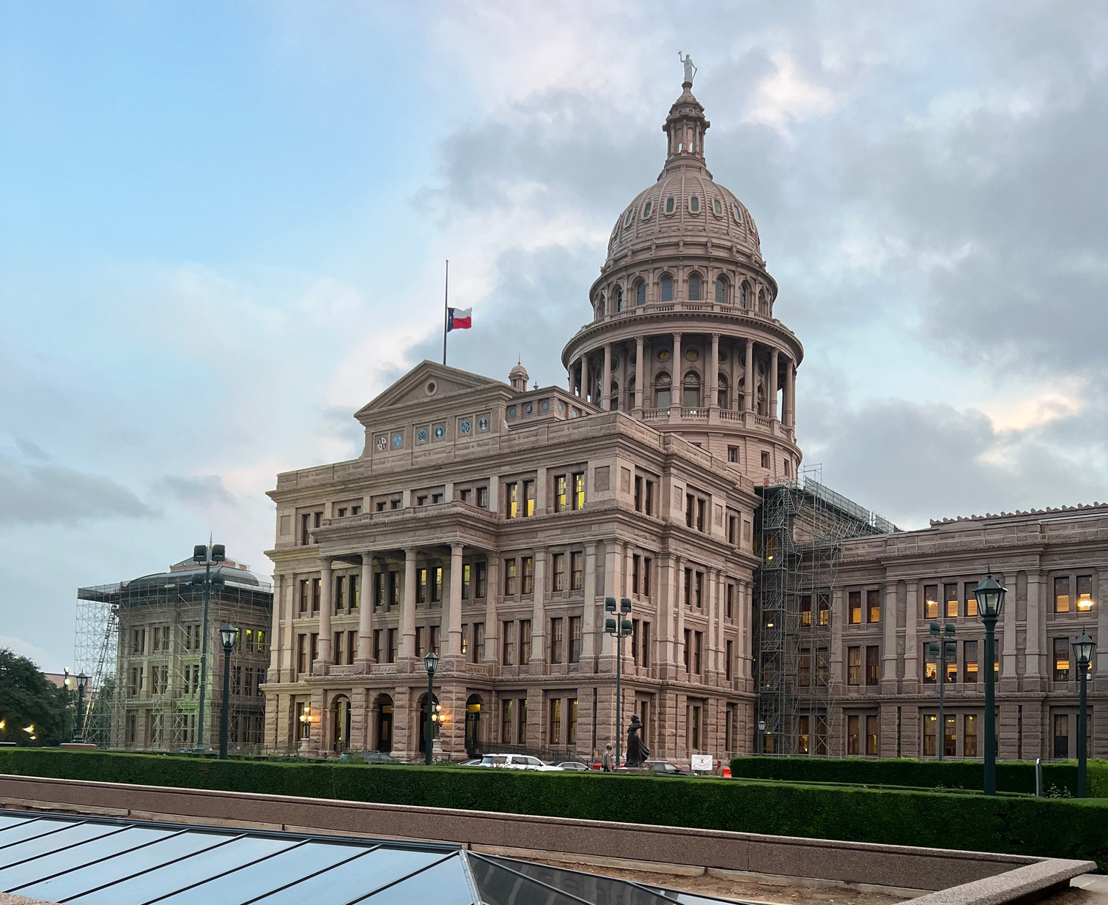
Questions?
Christy Rome
Executive Director
Texas School Coalition
christy@txsc.org
512-732-9072
www.txsc.org

