Slide 1



Post-Legislative Workshop
An overview of the 88th Regular Legislative Session and a preview of special called sessions to come...
June 13, 2023

Slide 2



Texas School Coalition
Priorities for the 88th Legislature
  Enable public schools to meet students' needs
  Control the cost of recapture
  Protect sustainability of public education funding
  Ensure public accountability of public dollars
  Preserve local decision-making

Slide 3
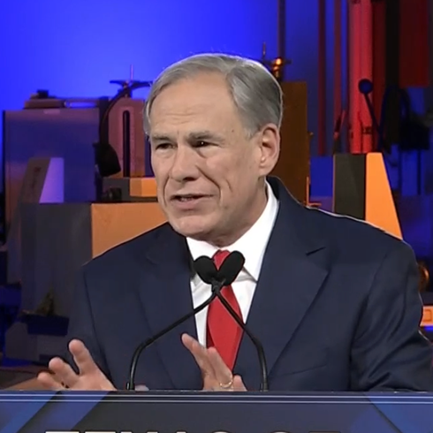
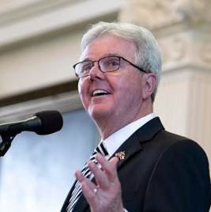

Big Three Priorities Relating to Education
Governor Greg Abbott
Lt. Gov. Dan Patrick
Speaker Dade Phelan
SB 3-5: Property Tax Relief
SB 8: Parent Empowerment/School Choice
SB 9: Teacher Bill of Rights/Teacher Pay
SB 10: 13th Check for TRS Retirees
SB 11: School Safety
SB 13: Protecting Children from Books
HB 2: Property Tax Relief
HB 3: School Safety
HB 5: Economic Development
HB 11: Teachers
HB 100: School Finance
HB 900: Rate Library Books
Cutting Property Taxes
School Choice
School Safety

Slide 4
By the numbers

Slide 5
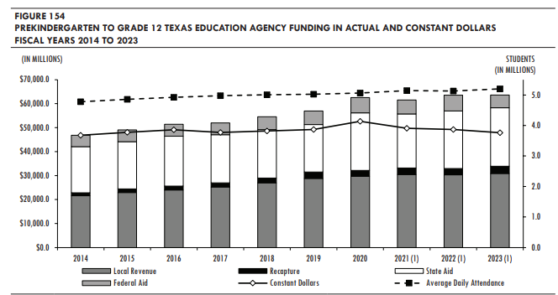
Source: Legislative Budget Board

Slide 6
The Case for a
Inflation-Adjusted Basic Allotment
BA | Increase from Current BA | Two-Year Statewide Total Cost
$6,160 | -- | --
$6,260 | $100 | $1.443 billion
$6,360 | $200 | $2.896 billion
$6,460 | $300 | $4.353 billion
$6,560 | $400 | $5.812 billion
$6,660 | $500 | $7.272 billion
$6,760 | $600 | $8.732 billion
$6,860 | $700 | $10.194 billion
$6,960 | $800 | $11.656 billion
$7,060 | $900 | $13.118 billion
$7,160 | $1,000 | $14.581 billion
Adjusting the Basic Allotment for estimated inflation from 2019 through 2023 (19.7%) would mean a $1,200 increase.
Source: Consumer Price Index (CPI)

Slide 7
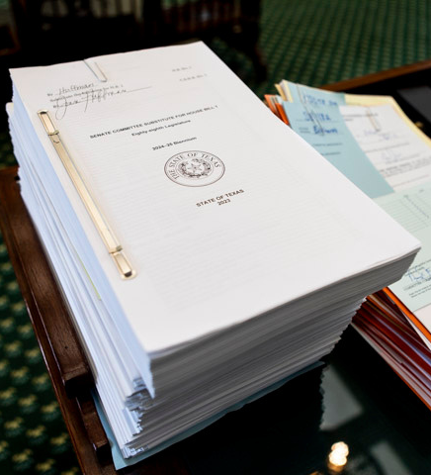
State Budget
Appropriations
HB 1 - General Appropriations Act
SB 30 - Supplemental Appropriations Act
HB 1 was touted as the biggest increase in state funding for public education in state history...but due to contingency riders, and legislation that did not pass, that isn't exactly true.

Slide 8
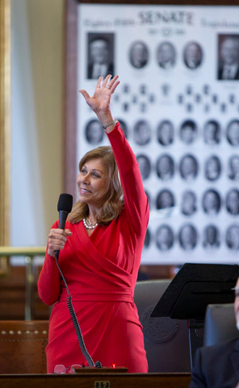
Supplemental Appropriations
SB 30 (Huffman/Bonnen) - supplemental appropriations for Fiscal Year 2023 totaling $7.36 billion in GR and $13.2 billion in all funds.
"Foundation School Program Adjustment" reduced TEA FSP funding by $8.4 billion due primarily to increased district property value growth, lower-than-anticipated ADA, and $2.4 billion in increased recapture
$1.1 billion for school safety initiatives
-$8.4 billion + $1.1 billion leaves public education $7.3 billion in the hole

Slide 11
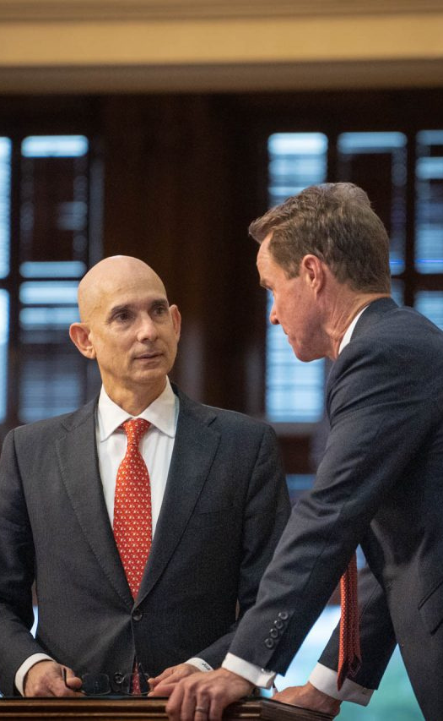
Public Education represents 35% of overall GR
General Appropriations
HB 1 (Bonnen/Huffman) - General Appropriations Act for the 2024-2025 biennium
$321.3 billion in All Funds
5.95% increase over previous biennium
$144.1 billion in General Revenue
10.53% increase over previous biennium
$50.4 billion in GR for Public Education
$8.9B (21.59%) increase over previous biennium
Except that the amount written in the GAA in 2021 was different, so it's actually a $3.9 billion (8%) increase compared to that.

Slide 12
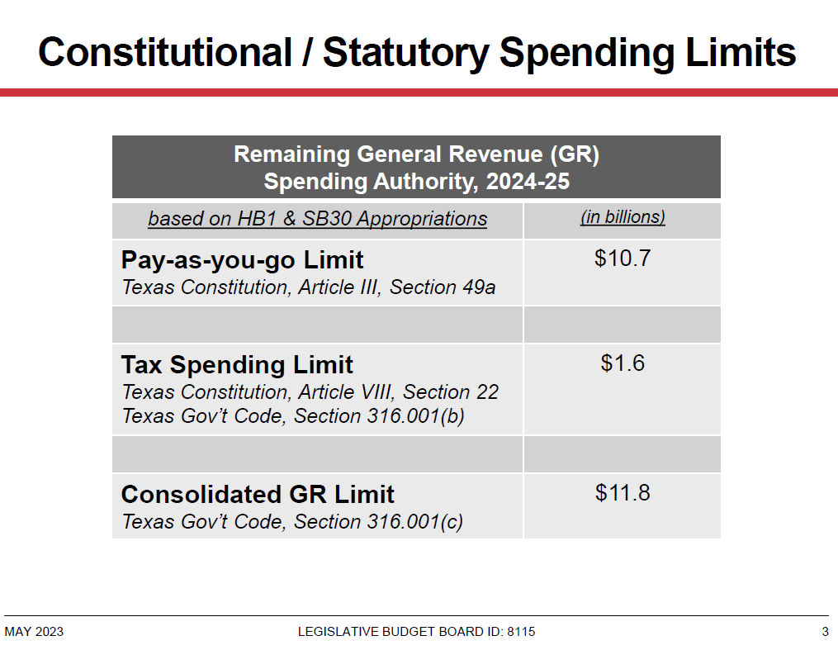

Slide 13
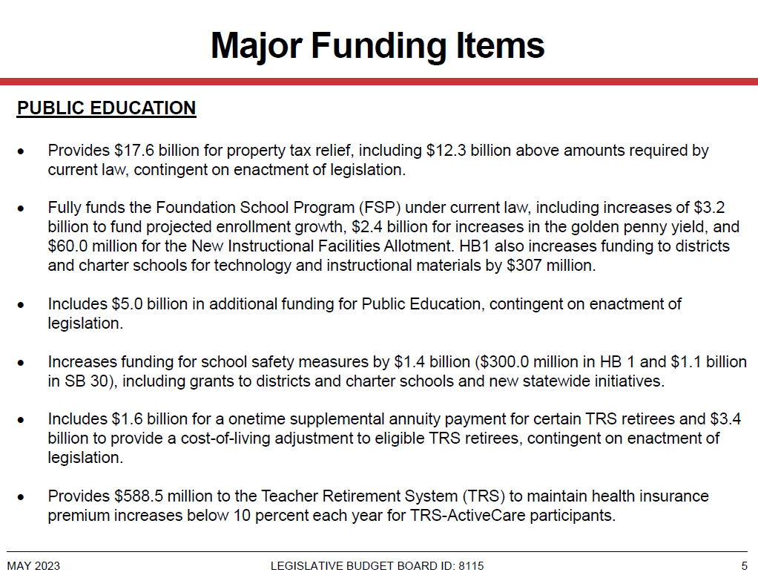

Slide 14
Provides $5.3 billion for property tax relief.
Restoration of cuts made last session.
Includes $500 million for state-approved curriculum.
This funding is for retirees, not operations of public schools
With this, premiums still expected to grow by 6.4%

Slide 15
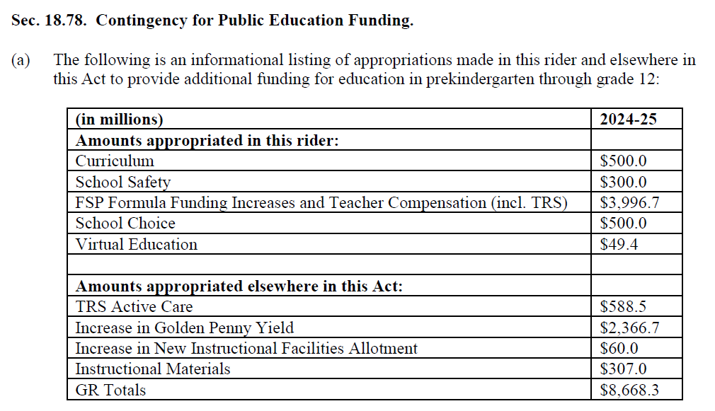
"This budget spends $8.7 billion in new money for schools."

Slide 16
"This budget spends $8.7 billion in new money for schools."
 | In HB 1 2024-25 | Funding Available for 2024-25 | New Funding 2024-25
Curriculum/Instructional Materials (HB 1605) | $500M | $500M | $500M
School Safety (HB 3) | $300M | $300M | $300M
FSP Formula Funding Increases and Teacher Compensation (HB 100) | $3.997B
School Choice (Education Savings Accounts) | $500M
Virtual Education | $49.4M
TRS Active Care | $589M | $588.5M | $588.5M
Increase in Golden Penny Yield | $2.367B | $2.367B | $2.367B
New Instructional Facilities Allotment (NIFA) | $60M | $60M
Instructional Materials (IMTA) | $307M | $307M
TOTAL | $8.67 billion | $4.12 billion | $3.75 billion

Slide 17

Golden Pennies
Districts still have a total of five Tier 2 golden pennies by a vote of the board, and the availability of eight golden pennies if approved through a VATR Election.
Increasing Yield
No longer linked to Austin ISD, golden penny yield (per penny, per WADA) is now linked to either 1.6% of the Basic Allotment (which hasn't changed), or the 96th percentile of property wealth (which certainly has), so legislators increased the yield accordingly, moving from the $98.56 where the yield was set in 2019 to:
  FY 24: $126.21
  FY 25: $129.52
Golden pennies are 100% free of recapture. A district with a per-penny yield above the new amounts will not see new money from this change.

Slide 18
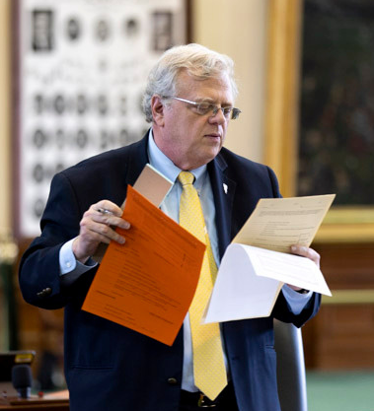
Property Taxes
  Tax Rates
  Failed Property Tax Proposals
  HB 4456 - No-New-Revenue Rate
  SB 2998 - Truth-in-Taxation
  HB 3273 - No more postcards
  HB 5 - Economic Development
If not for current law tax relief, there would be no tax relief at all from the session that promised to deliver the greatest property tax relief in state history.

Slide 19

Property Tax Rates
 | 2022-2023 | 2023-2024 under GAA as it stands today | Difference
Ceiling | $0.8941 | $0.7950 | -$0.0957
Floor | $0.8046 | $0.7155 | -$0.0891
Current law compression called for a $5.3 billion reduction (not contingent on any bill passing). Tax rates could be compressed further if lawmakers pass additional legislation during a special session.

Slide 20
Local vs. State Share Under Actions of 88R

Slide 21
What they said on tax relief during the Regular Session
Governor Greg Abbott
Lt. Gov. Dan Patrick
Speaker Dade Phelan
  SB 3: Increase Homestead Exemption to $70K & another $30K for 65+
  SB 4: Additional Tier 1 tax rate compression by widening ceiling-floor differential from 10% to 20%
  Business Personal Property Tax Exemption (no rendition if <$25K)
  Cost: $11.2 billion
  HB 2: Additional $0.15 of compression and 5% appraisal cap on all real property
    Cost: $12 billion
  Then, in CSSB 3: $100 homestead exemption, 5% appraisal cap, and $0.15 compression
    Cost: $16.3 billion
Reduce property taxes.

Slide 22
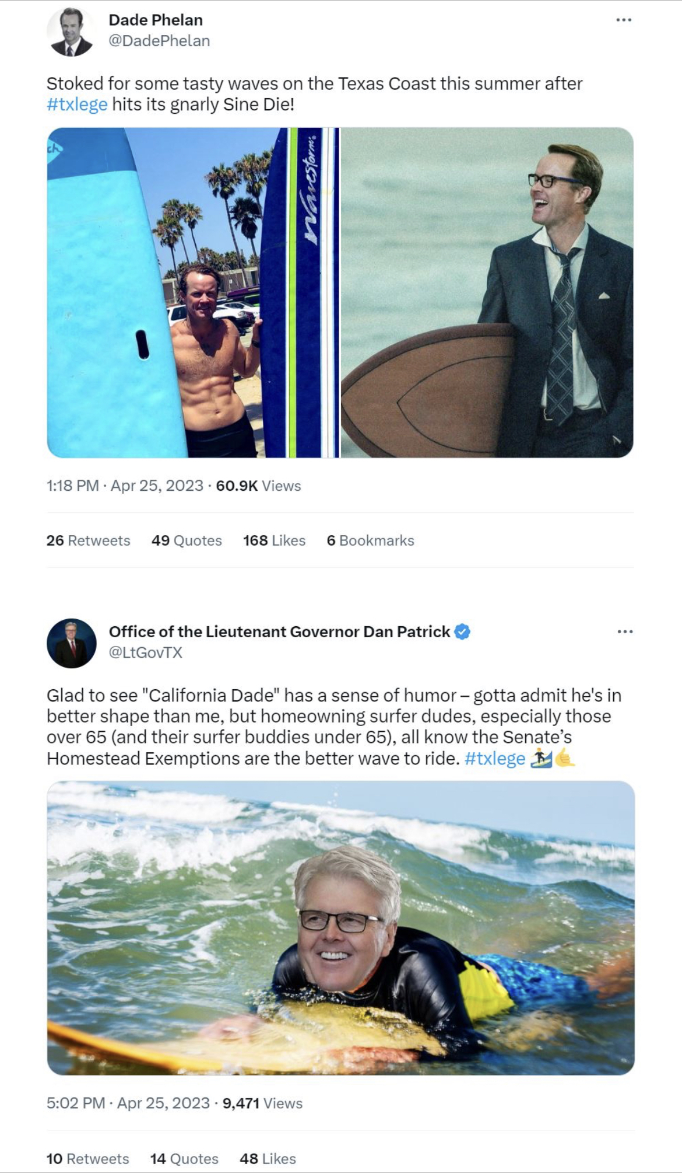

Slide 23
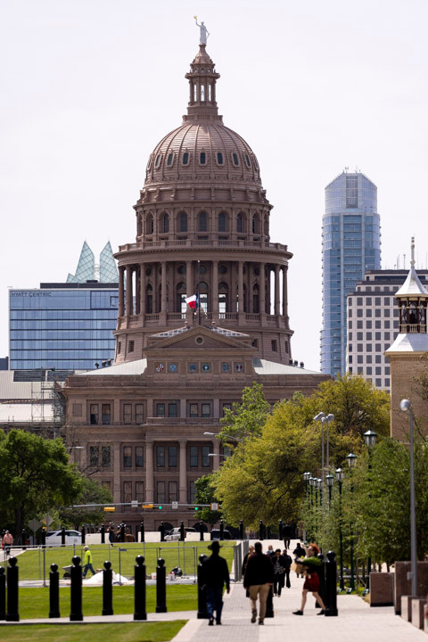
Property Tax bills that passed
HB 4456 (Harris/Bettencourt) - No-New-Revenue Rate
Corrects drafting error from 2019 that resulted in no clear definition of no-new-revenue M&O rate for schools. New definition aligns with “rate to maintain revenue” that accounts for the effect of state aid and recapture. Effective Tax Year 2024.
SB 1998 (Bettencourt/Shine) - Truth-in-Taxation
VETOED
requires that truth-in-taxation forms be posted with links to documentation for calculations and other supporting materials. Effective Tax Year 2024.
HB 3273 (Thierry/Bettencourt) - No more postcards
Eliminates the postcard requirement and simply requires the property tax website to be advertised in newspapers and the appraisal district site.

Slide 24
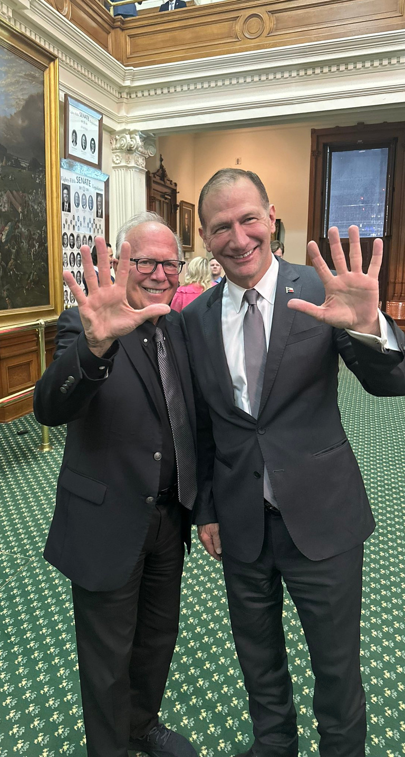
Economic Development - HB 5
(Hunter/Schwertner)
  “Texas Jobs, Energy, Technology, and Innovation Act” under Government Code 403 is the new Chapter 313.
  Provides for a value limitation of 50% of the market value (or 25% if located in a qualified opportunity zone) for qualifying entities.
  Eligible projects include manufacturing, research, development, high tech/technology, and dispatchable electric generation.
  Schools receive $30,000 to cover evaluation costs, and otherwise do not receive any payment from the agreement.
  If application received, school board must conduct public meeting within 30 days and provide notice of determination to Governor, applicant, and comptroller.
  Agreements would be between district, Governor, and applicant
  Signed by Governor

Slide 25
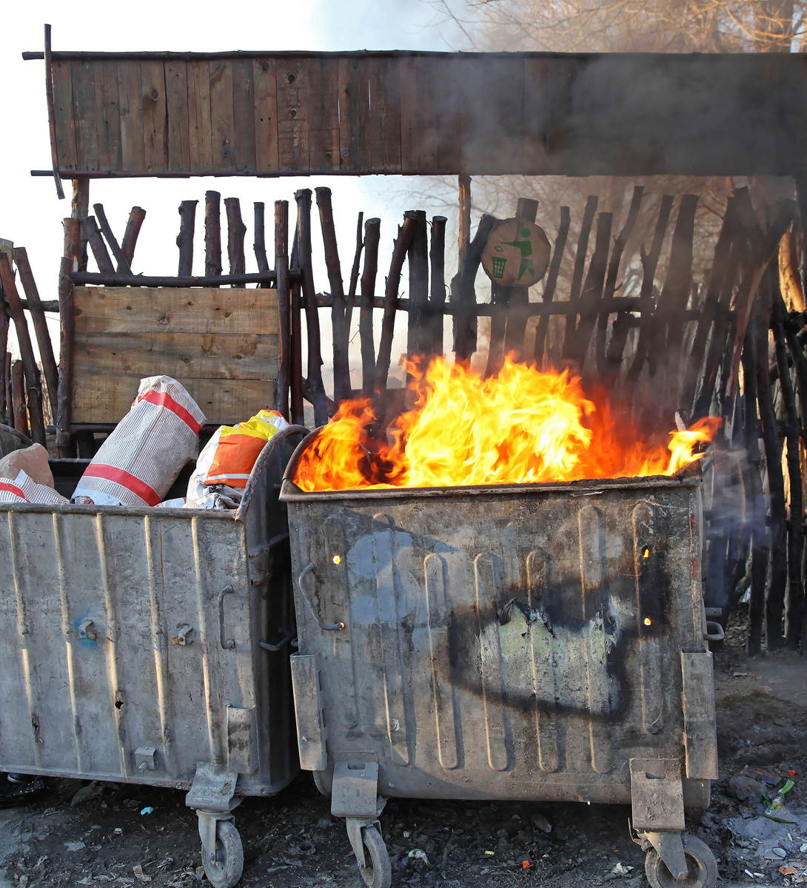
School Finance
HB 1605 - Instructional Materials Allotment
HB 3 - School Safety Allotment
HB 8 - Dual Credit Funding
HB 3708 - UIL for Non-Enrolled Allotment
HB 2209 - Rural Pathway Excellence Partnership
When the school finance bill was tied to private-school vouchers in a hostage situation, the whole thing went up in flames and very little passed in regards to school finance.

Slide 26

School finance bills that passed
HB 8 (VanDeaver/Creighton) - Dual Credit Funding
Provides allotment to direct funding to the THECB to cover the cost of tuition for low-income students in certain dual credit programs
HB 2209 (Lozano/Hinojosa) - R-PEP
Provides funding weight for participation in Rural Pathway Excellence Partnership (R-PEP) program of 1.15 applied to BA and small-size allotment for each disadvantaged student (1.11 weight for non-disadvantaged)
R-PEP outcomes bonus for graduates who attain postsecondary credential within 5 years--$1,500 per disadvantaged graduate, $750 per non-disadvantaged graduate, and additional $1,500 if student received special education services
Total FSP funding limited to $5 million per year (signed by Governor; effective immediately)

Slide 27

School finance bills that passed
HB 1605 (Buckley/Creighton) - Instructional Materials Allotment
(among other changes) establishes Instructional Materials Allotment (IMA) of $40 per enrolled student for the purchase of state developed/approved materials and $20 per enrolled student for specific open-source materials.
HB 3 (Burrows/Nichols) - School Safety Allotment
(among other components of the bill) increases the School Safety Allotment (SSA) from $9.72 per ADA to $10/ADA and provides $15,000 per campus.
HB 3708 (Buckley/Paxton) - UIL Allotment
Entitles a school district to an allotment of $1,500 per UIL activity in which a non-enrolled student participates (per student, per activity)

Slide 28
Your District’s Finances
Assumptions & Caveats
Models are run based on statewide data.
Different assumptions of key inputs including student counts, property values, and tax rates may produce results that vary significantly.
Estimates for growth in taxable value for each district for TY23 are based on statewide estimate of 4.43%.
Drivers of Changes
School Safety Allotment
Increase to the Golden Penny Yield
Other changes like R-PEP, UIL Allotment, and dual credit changes are not modeled due to unavailability of specific district data at this time
You will note that HB 1605 changes show up as a swap

Slide 29
Your District’s Finances
Things to Keep in Mind
Not everyone benefits from the increase to the golden penny yield:
  Districts with a yield above $126.21/$129.52 will not see a change, as that district benefits (or doesn’t) from their own property value growth, not the state yield.
  Formula Transition Grant districts won’t see a change in their bottom line in 23-24, as it is just a change in the method of finance that causes them to require less FTG to be kept whole.
Models are developed to show the changes from the 88th Regular Legislative Session relative to current law. Under current law, FTG and EWL Transition Grant will expire in 24-25, and that loss of funding will still occur, though perhaps a district will lose slightly less due to changes enacted by legislators.

Slide 30
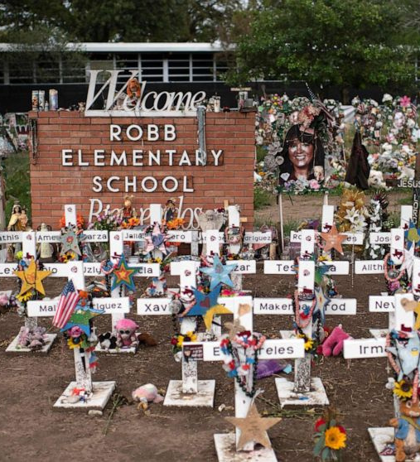
School Safety
HB 3 – School Safety
SB 838 – Panic Alert Devices
HB 1905 – Shared Safety Training
HB 473 – Parent Notice for Threat Assessment
SB 133 – No Pepper Spray for Young Children
HB 3623 – MOU for School Marshals
Following the tragic loss in Uvalde, legislators worked on bills meant to improve safety in Texas schools. Only time will tell if the steps taken will help prevent and protect students & staff from another tragedy.

Slide 31
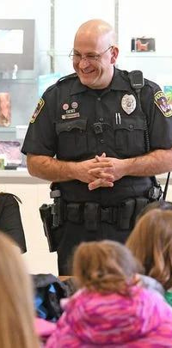
School Safety bills that passed
HB 3 (Burrows/Nichols) - Armed Officer Required
  Requires at least one armed security officer is present during regular school hours on each district campus.
  Must be peace officers or school resource officers.
  If school district is unable to comply due to lack of funding or qualified personnel, district can claim “good cause exception” and develop an alternative standard with which the district can comply, which may include providing a school marshal or other armed district employee with proper training.

Slide 32
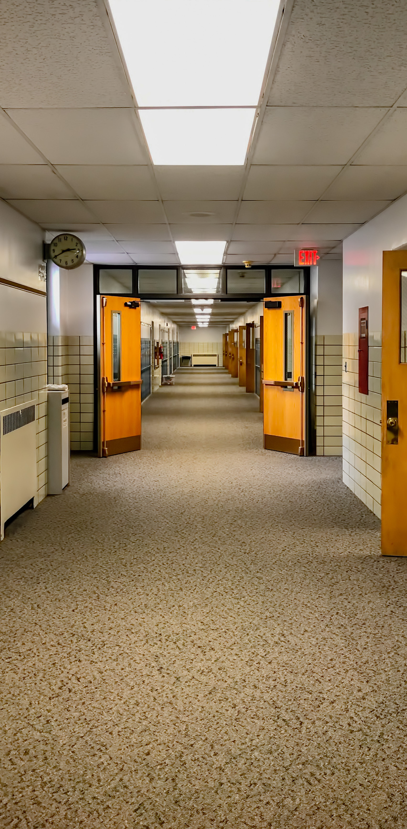
School Safety bills that passed
HB 3 (Burrows/Nichols) - School Safety Allotment
School Safety Allotment of $10/ADA (which will increase by $1 every time the BA increases by $50) plus $15,000 per campus.
  Securing school facilities, including perimeter fencing, exterior doors and windows, security film, security cameras (both existing and new), technology (including panic alert devices, radios, or wireless internet boosters)
  Employing security personnel such as officers, school marshals, or school safety director or other personnel to manage safety initiatives.
  Safety measures such as active shooter/emergency response training, prevention, counseling, mental health, threat reporting systems

Slide 33

School Safety bills that passed
HB 3 (Burrows/Nichols) - Coordination, Compliance & Training
  Coordination with local law enforcement – to include meetings, provisions of campus and school facility maps to first responders, and providing the opportunity of a walk-through of all facilities.
  Agency monitoring for compliance of safety requirements with audits and accountability consequences for non-compliance.
  Mental health training required for school staff that interact with students (with funding provided for travel, training fees, and compensation for time spent in training)
  Real time notification required: TEA must develop standards for providing real time electronic notice (text or email) regarding violent activity at a school to notify parents in a manner that protects student privacy.

Slide 34
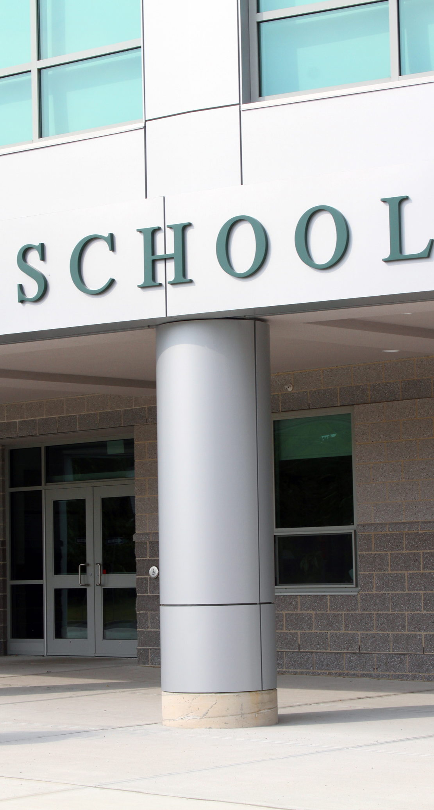
School Safety bills that passed
HB 3 (Burrows/Nichols) - Safety & Security Standards
  School Safety & Security Standards are to be followed and compliance must be documented; allows for a “good cause exception” if a district is unable to comply due to age, physical design, or location of the facility. If exception is claimed, the district must develop an alternative standard with which to comply. Schools may receive grant funding to help comply with standards.
  Prioritizes use of bond proceeds for safety & security standards:
    Allows bond proceeds to be used for compliance with school safety & security standards.
    If district is out of compliance with standards, bond proceeds must be used to bring district into compliance before bond proceeds may be used for the authorized purpose.

Slide 35
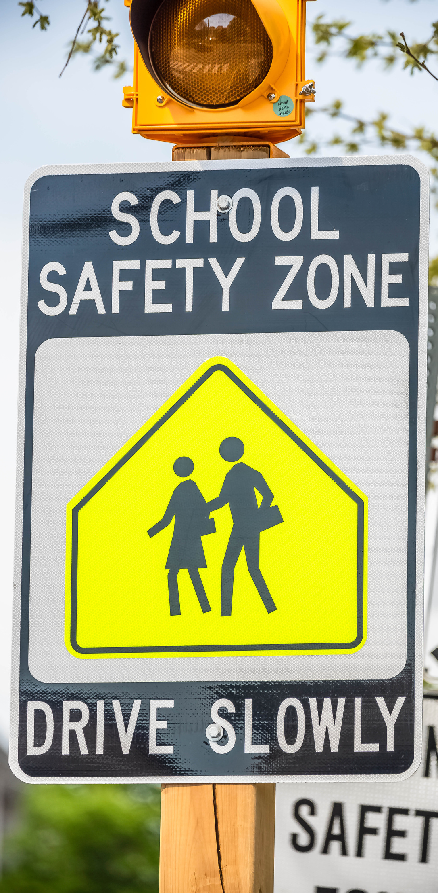
School Safety bills that passed
SB 838 (Creighton/Thierry) – Panic Alert Devices
Requires school districts provide panic alert devices in all classrooms
(signed by Governor; effective immediately)
HB 1905 (Talarico/West) – shared safety training
Allows school districts to provide (at no cost) safety training to employees of private schools, day-care facilities, and other providers of out-of-school care in the community
HB 3623 (Hefner/Middleton) – MOU for school marshals
Authorizes school district to enter into MOU with another public or private school to allow an appointed school marshal from that school to temporarily act as a school marshal at an event at the other entity in which both schools are participating

Slide 36
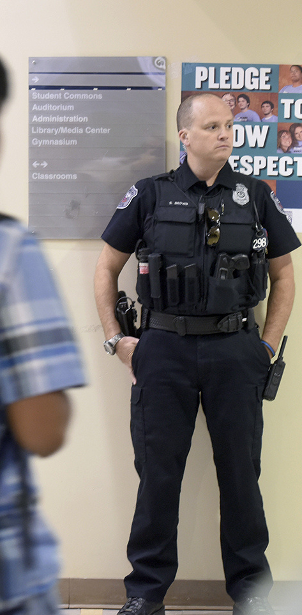
School Safety bills that passed
HB 473 – Parent notice for threat assessments
Requires parent notification before conducting threat assessment of a student and requires parent have ability to participate in assessment and submit information about the student. Parents must also be notified of threat assessment team’s findings
SB 133 (West/Hull) – no pepper spray for young kids
Prohibits peace officers performing security-related duties at a school from actively restraining or using chemical spray on a student 10 years of age or younger unless student poses serious risk to self or others.

Slide 37

Personnel
HB 2012 – teachers may display national motto
SB 1720 – confidential threat reporting
HB 63 – no anonymous child abuse reporting
HB 1789 – bus driver nepotism exemption
HB 2929 – Teacher continuing edu requirements
HB 4520 – Disqualifications for employment
Teacher certification
School Counselors
TRS/Retirees
On the heels of recommendations from the Teacher Vacancy Task Force, the 88th Legislative Session seemed it would be the time to make lots of changes to help teachers. So it seemed.

Slide 38

Personnel bills that passed
HB 2012 (Oliverson/Hull) – teachers may display national motto
Prohibits schools from prohibiting a teacher from displaying the national motto in their classroom. (signed by Governor; effective immediately)
SB 1720 (Kolkhorst/Lozano) – confidential threat reporting
Allows school employees to report potential threats to the school’s threat assessment team confidentially
HB 63 (Swanson/Sparks) – no anonymous child abuse reporting
Prohibits anonymous reporting of child abuse; those making a report of abuse or neglect must identify the source of information and provide contact information; if a mandatory report by school personnel, reporter’s business address and profession must be included

Slide 39

Personnel bills that passed
HB 1789 (Buckley/Flores) – bus driver nepotism exemption
Allows school bus drivers to be exempt from nepotism prohibitions for employment if approved by the school board (signed by Governor and effective)
HB 2929 (Lozano/West) – Teacher continuing edu requirements
Prohibits continuing education for teachers from requiring more than 25% of training that covers certain topics (to allow more teacher discretion over the topics covered), and that if a teacher chooses additional education on those topics, those hours count toward training requirements
HB 4520 (Harris/Bettencourt) – Disqualifications for employment
Adds conviction or deferred adjudication for the sale, distribution, or display of harmful material to a minor to the list of qualifying felonies that disqualify someone from employment with a school district

Slide 40

Teacher Certification bills that passed
SB 544 (Blanco/Moody) – Air Force teaching experience
Allows experience as instructor for the Community College of the Air Force to count towards requirements for teacher certification and for a temporary certificate to be granted
HB 621 (Shaheen/Hughes) – Military & first responder experience
Provides temporary teacher certification in CTE for military service members and first responders
HB 2729 (Harris/Creighton) – Pre-K teacher qualifications
Changes the qualifications for teaching Pre-K to be a “qualified teacher” rather than a “certified teacher”; individuals who meet another set of qualifications but lack certification can teach under the supervision of a certified teacher
HB 4363 (Kuempel/Hinojosa) – Future Texas Teachers Program
Establishes Future Texas Teachers scholarship program and requires district notification to students in grades 6-12

Slide 41

School Counselor bills that passed
SB 798 (Middleton/Buckley) – Teaching experience not required
Removes classroom teaching experience from being a requirement for certification as a school counselor
SB 763 (Middleton/Hefner) – Chaplains as School Counselors
Allows schools to employ volunteer chaplains to perform the duties of school counselors

Slide 42

TRS bills that passed
TRS ActiveCare Premiums for Active Members
$588.5 million appropriation to TRS ActiveCare insurance to help with health care premiums. Premiums are still expected to increase by 6.4% on average (up to as high as an increase of 12.7%
SB 1854 (Paxton/Lambert) – Optional Dental/Vision for Retirees
Optional plans offering dental and vision care will be available under TRS-Care for retirees in the future
SB 10 (Huffman/Bonnen) Cost-of-Living Increase for Retirees
Provides a one-time “13th check” of $2,400 for retirees aged 70-74 years and 47,500 for those 75 or older. Contingent on the passage of the constitutional amendment proposed in HJR 2, retirees who retired on or before August 31, 2020, will receive a cost-of-living increase:
  6% COLA for those retiring on or before 8/31/2001
  4% COLA for those retiring on or before 8/31/2013
  2% COLA for those retiring on or before 8/31/2020

Slide 43
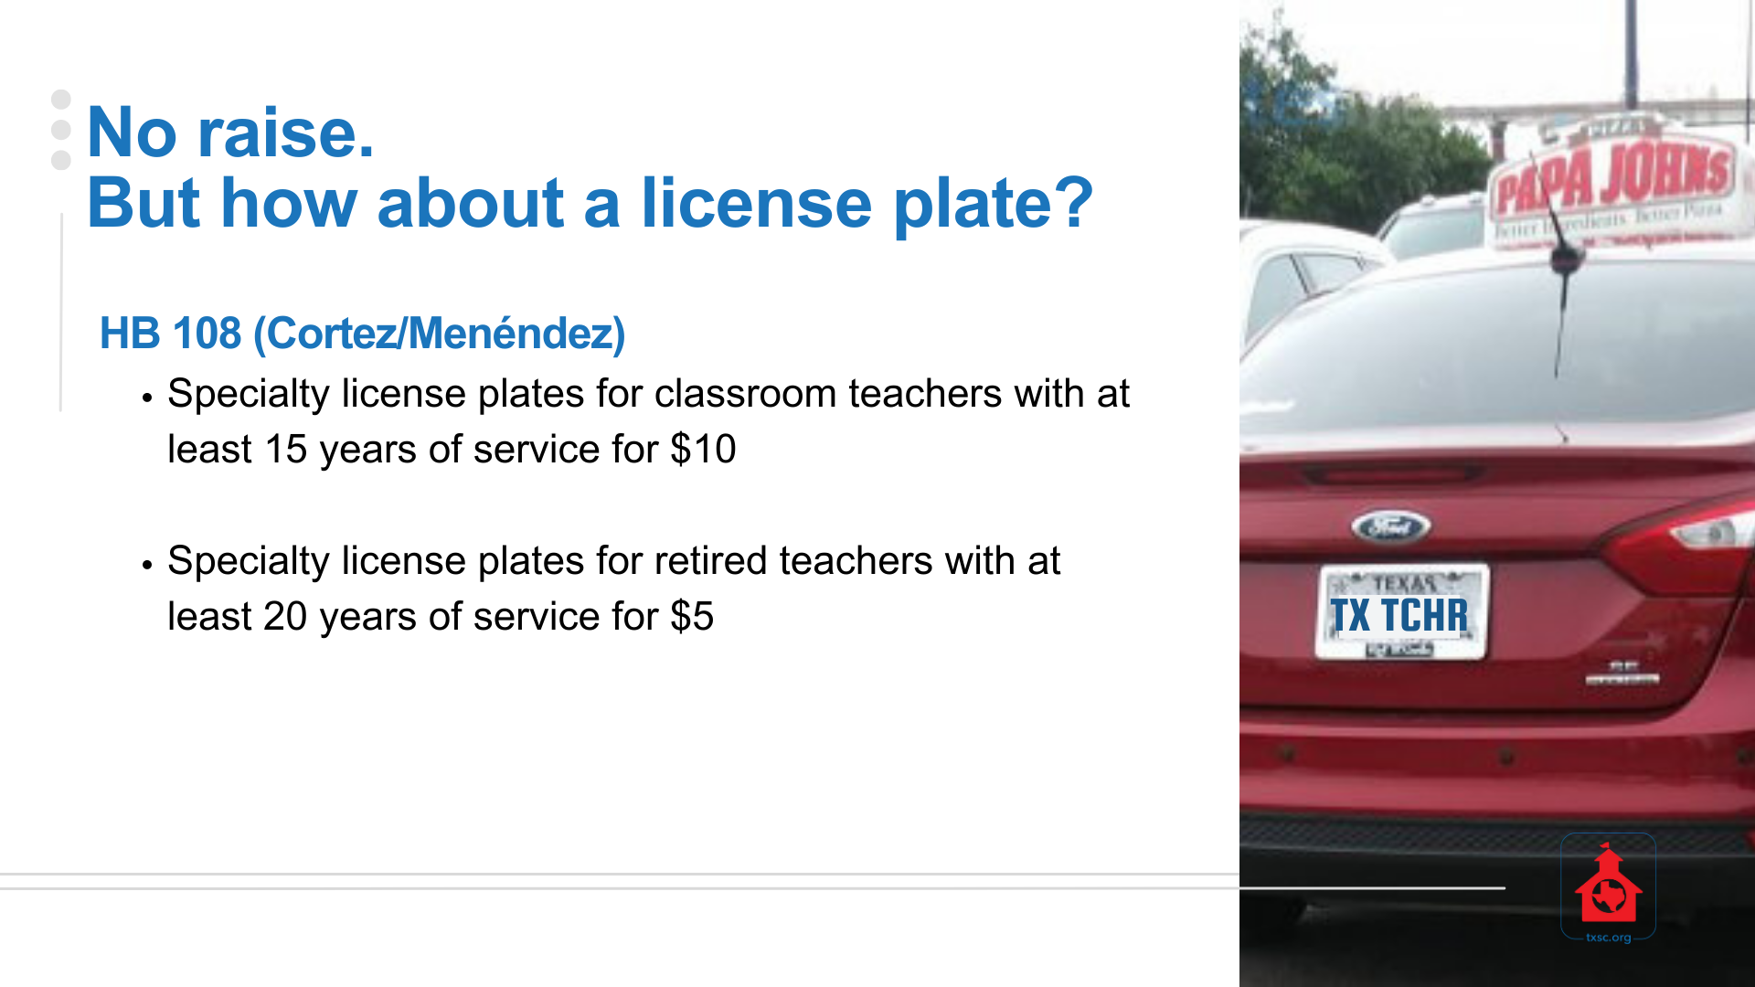
No raise.
But how about a license plate?
HB 108 (Cortez/Menéndez)
  Specialty license plates for classroom teachers with at least 15 years of service for $10
  Specialty license plates for retired teachers with at least 20 years of service for $5

Slide 44

Students
HB 3908 - Fentanyl abuse prevention awareness
HB 4375 – AED instruction
SB 68 - Career investigation day
HB 567 - The Crown Act
HB 114 – Optional DAEP removal for marijuana
Students are what it's all about. A few bills passed to protect the health and rights of students, as well as some which provides options that may be beneficial.

Slide 45

Student bills that passed
HB 3908 (Wilson/Creighton) – Fentanyl Abuse Awareness
Requires annual research-based instruction related to fentanyl abuse prevention and drug poisoning awareness to students in grades 6-12
HB 4375 (VanDeaver/Perry) – AED Instruction
Requires students in grades 7-12 to receive instruction on the use of automated external defibrillators
SB 68 (Zaffirini/Murr) – Career Investigation Day
Permits schools to excuse the absence of a student in grades 11-12 for a “career investigation day” to visit a professional workplace to determine interest in pursuing that field

Slide 46

Student bills that passed
HB 567 (Bowers/Miles) – The Crown Act
Prohibits a school from having a dress or grooming policy that discriminates against a hair texture or protective hairstyle commonly or historically associated with race
HB 114 (Thompson/Parker) – Optional removal for marijuana
Makes the removal of a student and placement in a DAEP optional for a student who possesses, uses, or is under the influence of marijuana on or within 300 feet of school property or at a school activity; instead, these students may complete a drug and alcohol awareness program

Slide 47

Parent Empowerment
HB 18 - Securing Children Online through Parental Empowerment
HB 1926 – Parent-directed $ for special edu
HB 3928 – Parent rights for dyslexia
HB 3803 – Parent choice grade/course repeats
HB 1212 – Parents excuse religious absences
HB 3917 – Alternatives for truancy fines
Bills relating to student transfers
Parents are the most important decision-maker in the life of a child (except when legislators deem they're not), and many laws were passed to empower parents.

Slide 48

Parent Empowerment bills passed
HB 18 (Slawson/Hughes)
Securing Children Online through Parental Empowerment (SCOPE) Act
Requires digital service providers to obtain parental consent before minors enter into agreements or share personal information/data if the platform allows sharing content on message boards, chat rooms, a landing page, channel, or feed (such as social media in many forms).
  "Digital service" means a website, an application, a program, or software that collects or processes personal identifying information with Internet connectivity.
  There are many exceptions for digital services provided by the state or a political subdivision, an institution of higher education, businesses governed by privacy laws, small businesses, and even digital services that primarily offer news content that allow chat and comments incidental to the main purpose of the service (unless the provider is responsible for “harmful material,” i.e. sexually explicit content)

Slide 49

Parent Empowerment bills passed
HB 18 (Slawson/Hughes)
Securing Children Online through Parental Empowerment (SCOPE) Act
  TEA to adopt standards for permissible electronic devices and software applications used by schools to minimize data collection and to ensure parental consent is required for use (other than the software application necessary for the administration of state assessments), and ensure software applications do not conduct mental health assessments without parent consent.
  TEA standards may also require the use of internet filters, require alternatives to social media be used, consider age when completing assignments, and may specify times when a student’s electronic device should be deactivated.
  Before transferring electronic devices to students, school districts must adopt rules about partnering with parents in cybersecurity and online safety, and electronic devices must have an internet filter that blocks pornography, obscene materials, and unsolicited downloads.

Slide 50

Parent Empowerment bills passed
HB 1926 (Hull/Paxton) – Parent-directed $ for special education
Repeals the expiration date from the Supplemental Education Services Program for students in special education to have an account with parent-directed funding for services
HB 3928 (Toth/Parker) – The Bekley Wilson Act
Requires school districts adopt a program for testing students for dyslexia and related disorders consistent with the Texas Dyslexia Handbook. Parents must be informed of rights under IDEA and 504 and receive updates on evaluation, as well as student progress at least once each grading period
HB 3803 (Cunningham/Paxton) – Grade/course repeats
Allows parents to choose to for their child repeat a grade level up to grade 8 (rather than 3); allows parents of high school students to choose for the student to repeat any course from the previous year (unless the student has satisfied all requirements for graduation)

Slide 51

Student Absences bills passed
HB 1212 (Jetton/Kolkhorst) – Parent-excused religious absences
Prohibits schools from requiring note from clergy member or religious leader to excuse a student’s absence for observance of religious holy day; note from parent is sufficient to excuse the absence (signed by Governor; effective immediately)
HB 3917 (Buckley/Middleton) - Alternatives for truancy fines
Allows for truancy fines or other punitive measures to be waived if the parent completes an alternative requirement by the school district to attend counseling, trainings, programs, or other services designated by the school district within a certain time

Slide 52

Student Transfer bills passed
HB 2892 (Buckley/Middleton) – Transfers for military families
  Requires school districts to transfer a child of an active military service member or reserve member to another campus within the district or to another district upon request as requested
  Transportation for the student is not required
  Signed by Governor and effective 2023-24
HB 1959 (Noble/King) – Transfers for children of peace officers
  Requires school districts to transfer children of a peace officer to another campus in the district or to another district if the receiving district agrees
  Transportation is not required
  Applies 2023-24
  Signed by Governor and effective immediately

Slide 53

Charter School bills that passed
HB 2102 (Goldman/Paxton) - Notice of charter campus
Written notice of new charter campus must be provided 36 months (rather than 18) before it is expected to open. Allows charter holder to submit request for approval of expansion up to 36 months before expansion would be effective
HB 1707 (Klick/Hughes) - "Charter school equity"
Political subdivisions must consider charter schools the same as they consider school district for purposes of zoning, permitting, utility services, etc.
SB 1647 (Parker/Hefner) - Dropout Recovery Charters
Allows charters (not just school districts) to use a dropout recovery education program and would allow a district or charter school to use an education management organization to provide alternative education programs for students at risk of dropping out either in-person, remotely, or hybrid method

Slide 54
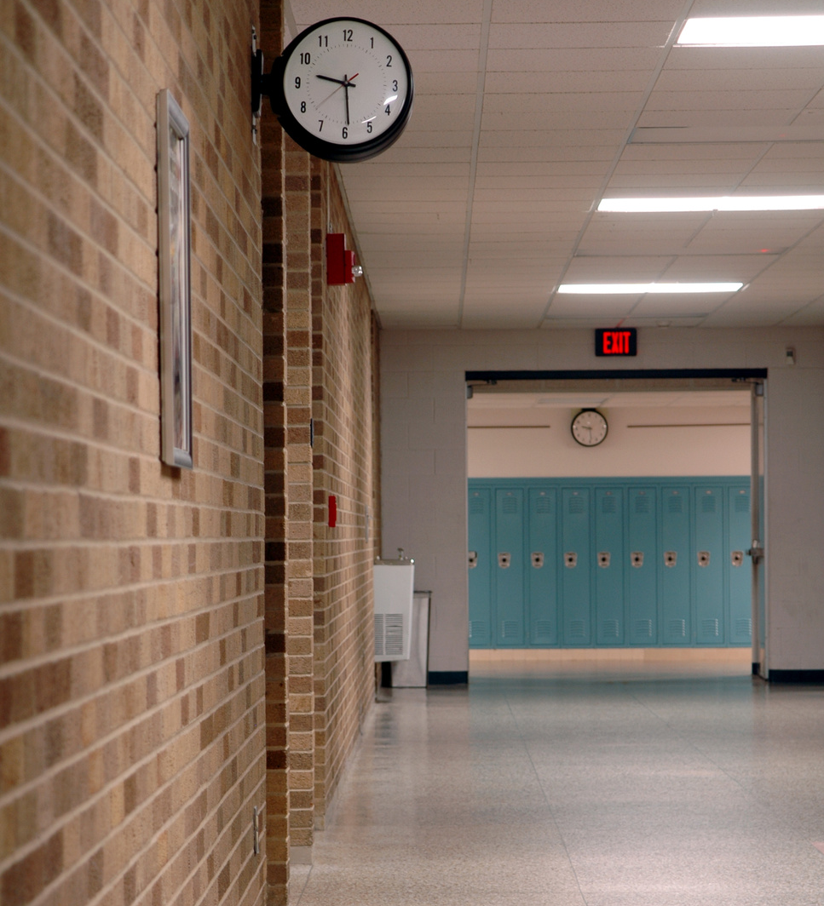
Admin/Governance
SB 1008 – Proof of residence for military
HB 3033 – Public Information Requests
SB 294 – Epi-pen and asthma medication
SB 629 – Opioid antagonists administration
SB 29 – No more COVID-19 mandates
UIL-related bills
Here is a mixed bag of bills that relate to how we operate schools, ranging from enrollment, PIRs, administration of medication, and a ban on government mandates.

Slide 55

Administrative bills that passed
SB 1008 (Flores/Buckley) – Proof of residence for military
Extends the deadline by which active military families must provide proof of residence to enroll in school from 10 days after arrival to 90 days after arrival. (Signed by Governor, effective immediately)
HB 3033 (Landgraf/Zaffirini) – Public Information Requests
Requires a governmental body to respond, as soon as practicable, but no later than 30 days after the attorney general issued an opinion on a public information request. Defines business days and nonbusiness days (when administrative offices are closed) for PIRs.

Slide 56
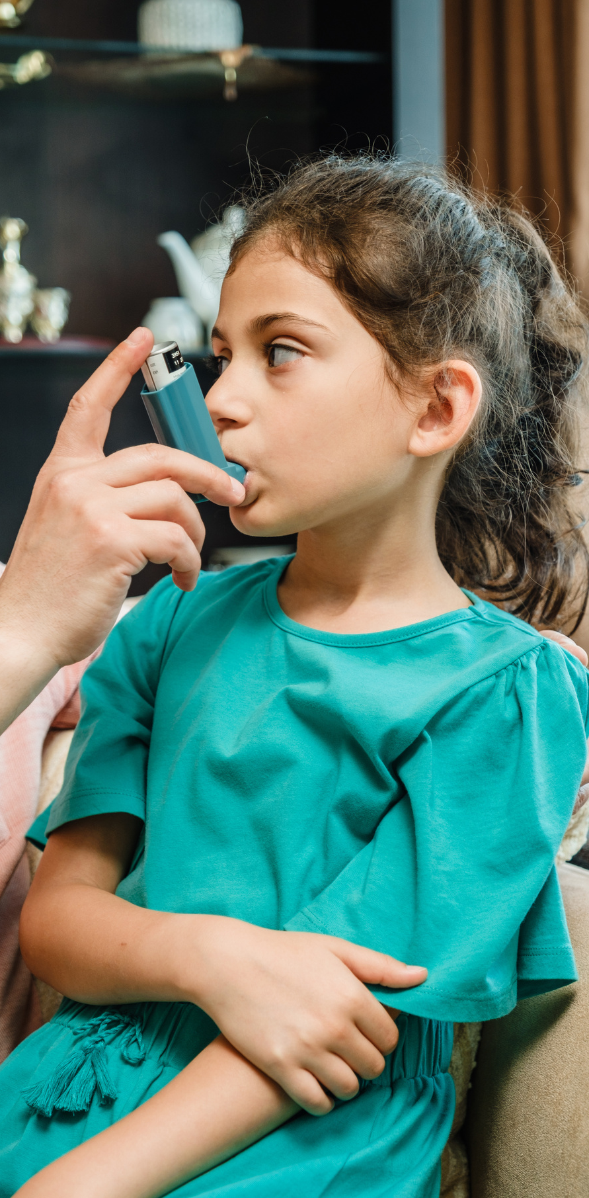
Administrative bills that passed
SB 294 (Johnson/Klick) – Epi-Pen and Asthma medication
Allows authorized and trained school personnel and volunteers to administer medication for respiratory distress (caused by asthma, allergic reaction, etc.). Requires parental consent, but also lack of consent does not preclude administration of medication in good faith. School employees may not be compelled to participate. (Signed by Governor, effective immediately)
SB 629 (Menéndez/Talarico) – Opioid antagonists administration
Permits administration of opioid antagonists in schools; training of staff is required, as is reporting; provides immunity for good faith administration of medication
SB 29 (Birdwell/Lozano) – No more COVID-19 mandates
Prohibits government mandates to prevent the spread of COVID-19 that require masks, vaccinations, or the closure of a business or school

Slide 57
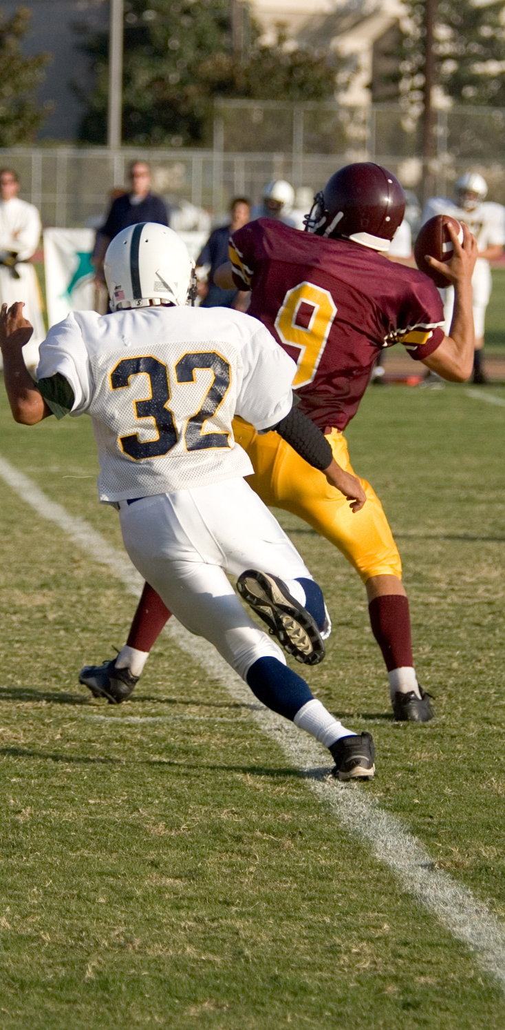
UIL bills that passed
HB 3708 (Buckley/Paxton) - UIL Allotment
Entitles a school district to an allotment of $1,500 per UIL activity in which a non-enrolled student participates (per student, per activity)
HB 699 (Frank/Paxton) - League Classification
Requires that the UIL universally apply the same student enrollment calculation formula for league classification, regardless of whether a school allows non-enrolled students to participate or not
HB 2482 (Guillen/LaMantia) - Be Kind to Referees
Prohibits a spectator of a UIL competition who has engaged in violent conduct causing injury of a sports official from attending any future such activities

Slide 58

Assessments
HB 1416 – HB 4545 clean-up
HB 1225 – Paper format assessments
HB 1883 – Alternative assessment dates
In a legislative session that included a surprise bill proposing a complete revamp to the entire system of state assessments, we don't see many changes to our clearly imperfect system.

Slide 59

Assessment bills that passed
HB 1416 (K. Bell/Paxton) – “HB 4545 clean-up”
Eliminates requirement for accelerated learning committee, requires at least 15 hours of accelerated instruction for students who fail state assessments; if student performs significantly below satisfactory levels, 30 hours required. Increases student-to-teacher ratios to four students per teacher (rather than 3) and allows some exceptions to this requirement; accelerated instruction is only required for one subject (district is to prioritize); provides for parent opt-out.
HB 1225 (Metcalf/Zaffirini) – Paper format assessments
Allows up to 3% of students in a district to take state assessments using a paper format at the request of a parent. (signed by Governor; effective immediately)
HB 1883 (Bhojani/Kolkhorst) – Alternative assessment dates
Requires districts provide alternative assessment dates if a student was absent on an assessment date to observe a religious holy day or period

Slide 60

Curriculum & Instruction
HB 1605 – Instructional Materials
HB 900 – School Library Standards
SB 2124 – Advanced Mathematics
HB 2209 – Rural Pathway Excellence Partnership
SB 2294 – Early High School Graduation
With all the concern expressed about library books and other instructional materials available in schools, the state's answer was more state control and standards. They also passed some incentives for certain choices and more advanced options.

Slide 61

Curriculum & Instruction bills passed
HB 1605 (Buckley/Creighton) – Instructional Materials
  TEA to create open resource instructional materials program for district use
  Requires posting and parent access to instructional materials
  Provides funding incentive for use of state-developed/approved materials: $40 per-enrolled student for the procurement of state-approved instructional materials deposited into IMTA account (unused balance rolls forward);
  Additional “up to” $20 per enrolled student deposited into IMTA account to cover actual cost of printing and shipping of Open Education Resource Instructional Materials
HB 900 (Patterson/Paxton) – School Library Standards
  Requires Texas State Library and Archives Commission to develop standards for school library collections.
  Requires school library vendors rate books & prohibits sexually-explicit materials
  Requires parent permission for students to check out sexually-relevant materials
  Requires districts review sexually-relevant materials at least every two years against the district’s policies.

Slide 62

Curriculum & Instruction bills passed
HB 2209 (Lozano/Hinojosa) – Rural Pathway Excellence Partnership
  Requires TEA to establish Rural Pathway Excellence Partnership (R-PEP) program to incentivize and support rural college and career pathway partnerships and expand opportunities for underserved students
  For districts with less than 1,600 ADA
  Provides funding weight of 1.15 applied to BA and small-size allotment for each disadvantaged student (1.11 weight for non-disadvantaged)
  R-PEP outcomes bonus for graduates who attain postsecondary credential within 5 years--$1,500 per disadvantaged graduate, $750 per non-disadvantaged graduate, and additional $1,500 if student received special education services;
  Total FSP funding limited to $5 million per year
  Signed by Governor; effective immediately

Slide 63

Curriculum & Instruction bills passed
SB 2124 (Creighton/Howard) – Advanced Mathematics
Establishes an opt-out policy to otherwise automatically enroll students performing in the top 40% on 5th grade state assessments (or a local measure) into accelerated math in sixth grade to improve chances of gaining access to Algebra I in eighth grade. (signed by Governor; effective immediately)
SB 2294 (Creighton/Kuempel) – Early high school graduation
Expands participation in Texas First Early High School Completion Program and Texas First Scholarship Program to any public institution of higher education; requires school districts to allow a student to graduate and receive a high school diploma, rather than authorizing issuance of a high school diploma to a student under the standards of the program

Slide 64

Fruits & Vegetables
  HB 3991 – First Friday in April is Texas Fruit & Vegetable Day in schools
  HB 3144 – Designates October Fentanyl Poisoning Awareness Month
  SB 2069 – Reduces requirements to post signs regarding human trafficking (eliminates them for private schools)
  HB 1825 - Expands authority to consume & sell alcoholic beverages on school grounds to include a county within two miles of two or more stadiums with capacity of at least 40,000 people

Slide 65

Bills that did NOT pass
Get ready...this list is a long. There were a lot of bills that didn't pass. Some we assumed would pass, some we were surprised did not pass, and some we hoped and prayed would not pass.

Slide 66

Bills that did NOT pass
  HB 100 – School Finance
  SB 8 – Education Savings Accounts
  SB 418/HB 890 – Open-enrollment transfers
  SB 9/HB 11 - Teacher Pay & Rights
  SB 1814 – Minimum I&S Rate Required
  Elections bills of any kind including:
    November bond elections
    SB 1252 – Adding THIS IS A TAX INCREASE to VATRE ballots
    SB 2205 – removing THIS IS A TAX INCREASE from bond ballots
  4-day school week ban
  Virtual Education
  SB 1515 - Ten Commandments poster required
  HB 3028/SB 2088 - Early Payment Discount for Recapture
  Taxparency

Slide 67
Big Three Priorities Relating to Education
Governor Greg Abbott
Lt. Gov. Dan Patrick
Speaker Dade Phelan
SB 3-5: Property Tax Relief
SB 8: Parent Empowerment/School Choice
SB 9: Teacher Bill of Rights/Teacher Pay
SB 10: 13th Check for TRS Retirees
SB 11: School Safety (as HB 3)
SB 13: Protecting Children from Books
HB 2: Property Tax Relief
HB 3: School Safety
HB 5: Economic Development
HB 11: Teachers
HB 100: School Finance
HB 900: Rate Library Books
Cutting Property Taxes
School Choice
School Safety

Slide 68
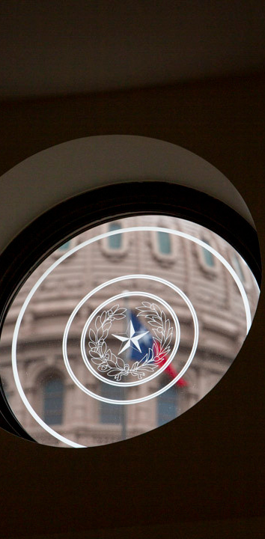
House Bill 100 (King/Creighton)
House Version
  Increased Basic Allotment by $90 in FY24 and $140 in FY 25, and applied an inflation adjustment to the Basic Allotment
  Compensation: at least 50% of funding increase for compensation (75% for teachers/25% staff), and modified/increased Minimum Salary Schedule
  Continued the Formula Transition Grant until 2029-30
  Provided prepayment discount for recapture
  Increased Small & Mid-sized Allotment, Transportation, and completely revamped special education funding weights; also moved funding weights to an enrollment-based system
  Allowed 6 golden pennies by a vote of the board, without election
Total cost: $5.4 billion

Slide 69
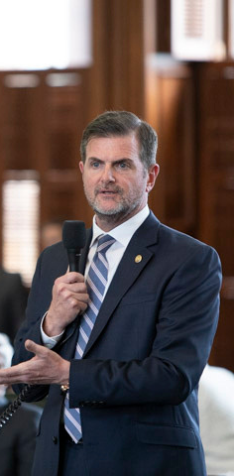
House Bill 100 (King/Creighton)
Senate Version
  Increased Basic Initial Allotment by $50
  Compensation: at least 50% of funding increase for pay raises, and modified/increased Minimum Salary Schedule
  Hold harmless protection for FTG districts paying recapture
  Increased Small & Mid-sized Allotment and completely revamped special education funding weights, and increased comp ed weights
  Full-scale Education Savings Account (ESA) voucher program
  Open-enrollment student transfer provisions between districts and campuses
  Prohibition of a 4-day week (unless district is small of already offers)
Total cost: $4.4 billion

Slide 70
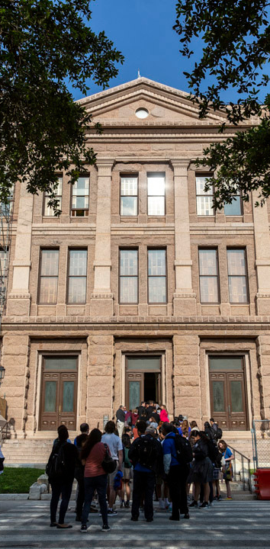
Education Savings Accounts
Public dollars for public schools
  Public tax dollars should fund public schools that have clear systems of academic and fiscal accountability in place.
  Private schools do not have transparent accountability measures in place.
  The diversion of public dollars to private schools would take needed resources out of public school classrooms.
  Vouchers would increase the burden of recapture on schools and taxpayers.
  Local board elections provide a level of local accountability for traditional school districts that charter and private schools lack.
Why not start small?
Other states started with pilot programs (which grew exponentially after the proverbial "camel's nose was under the tent."), but Governor Abbott said he would veto a special education-only program and call lawmakers back for a special session.

Slide 71

The Hostage Situation
Hostage Taking
(18 U.S.C. 1203) - Justice Department
Since a voucher bill failed to pass the House on its own merits, private school vouchers were added to one bill that could increase school funding, and it was not allowed to pass without vouchers.
The outcome of the hostage situation was that everyone lost, most especially Texas students.
Hostage taking is defined as the seizing or detention of an individual coupled with a threat to kill, injure or continue to detain such individual in order to compel a third person or governmental organization to take some action.

Slide 72

What happens when everyone loses?
Public dollars for public schools
  No increased funding for the Basic Allotment
  Unless your district is growing, dipping into reserves, and/or adopting deficit budget, very hard to give teachers and school staff pay increases, much less keep pace with inflation.
  More teachers are leaving the profession due to competitive offers outside the profession and/or lack of respect for the profession.
  Districts relying on the Formula Transition Grant face very real and detrimental cuts in 2024-25 when that funding expires.

Slide 73
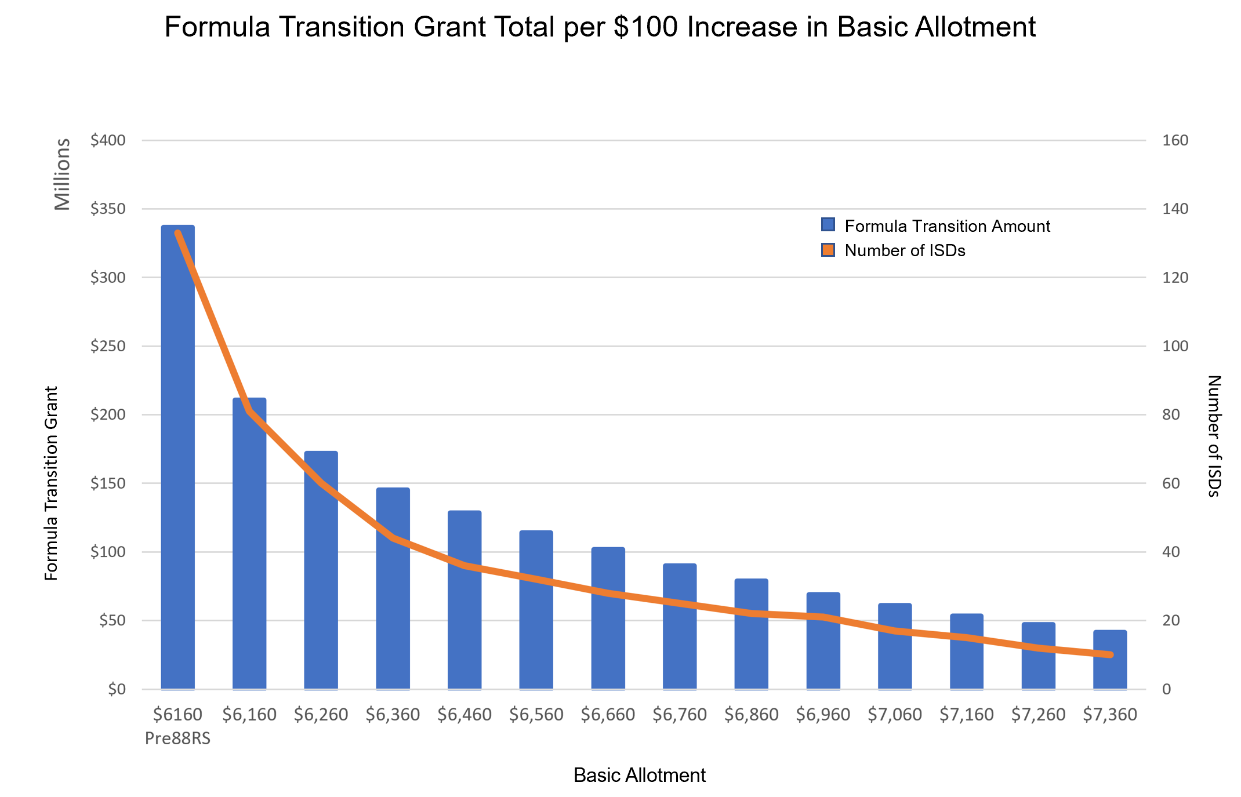
Even with a $100 increase to the BA, over 60 districts still require FTG to continue to avoid cuts.
A $7,360 BA would cost $17.5 billion for the biennium, and 10 districts would still require FTG to avoid cuts.

Slide 74

Special Session(s)
The First Called Session of the 88th Legislature has two items on the call:
  PROPERTY TAXES: Legislation to cut property-tax rates solely by reducing the school district maximum compressed tax rate
  BORDER SECURITY: Penalties for smuggling of persons and operating a stash house
Tax cuts
Vouchers
We're in the first special session, with the promise of more to come. They can't agree on the one thing they all agree on most, so what will that mean for other issues?

Slide 75

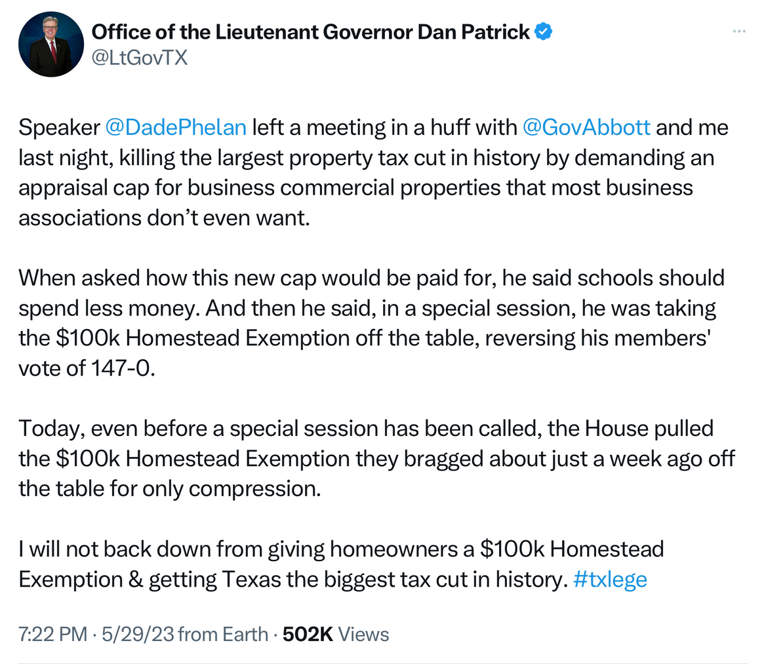
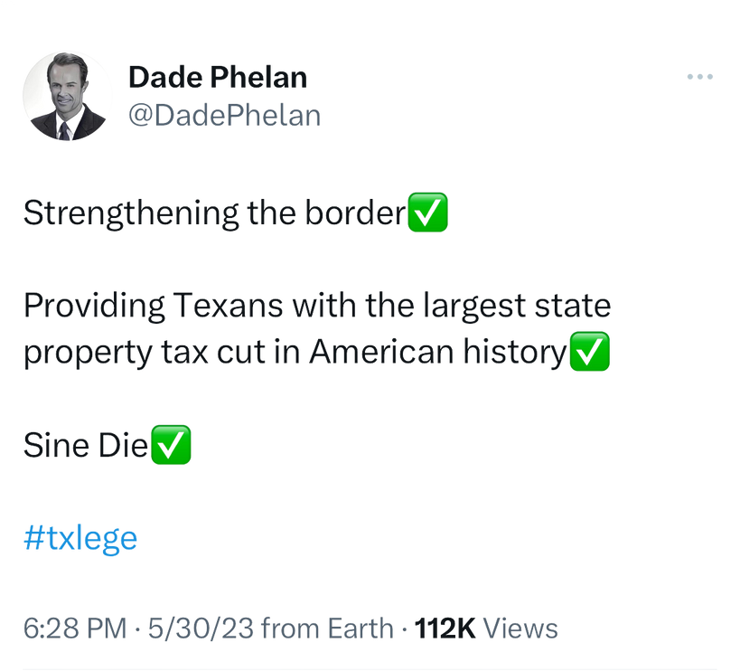
Communicating by Tweet

Slide 76
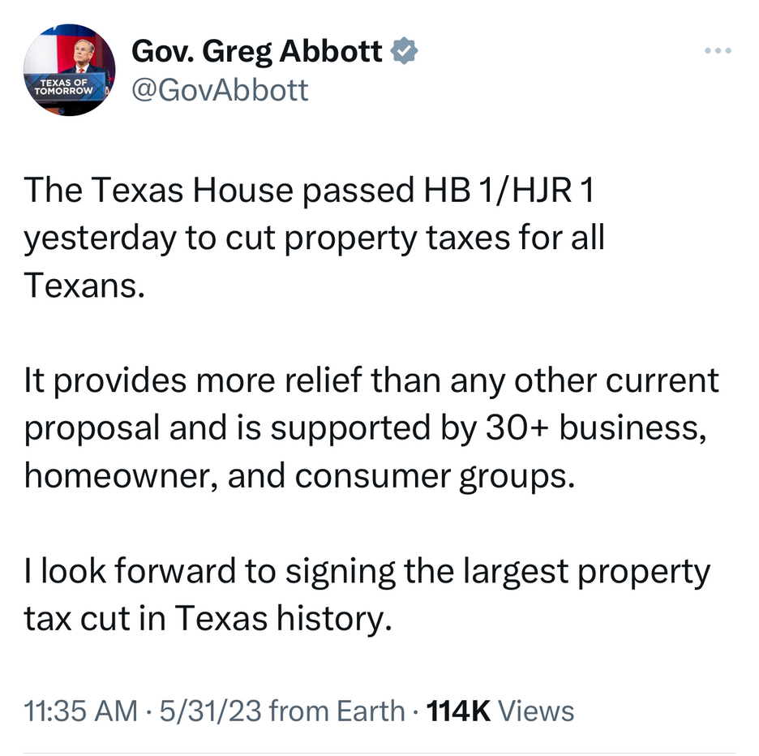
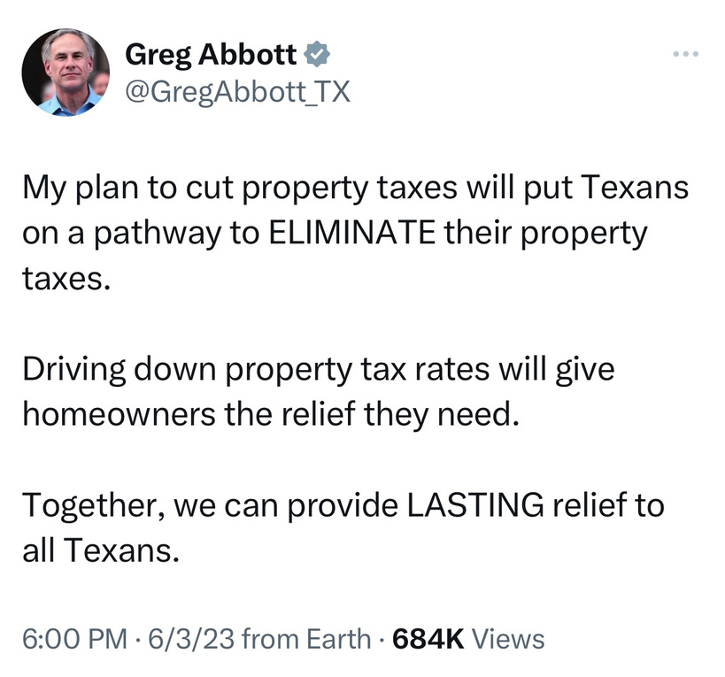
Communicating by Tweet

Slide 77
What they're saying on tax relief during the Special Session
Governor Greg Abbott
Lt. Gov. Dan Patrick
Speaker Dade Phelan
Compress M&O Property Tax Rates
Eventually eliminate M&O property taxes entirely
  Increase Homestead Exemption to $100K
  Compress M&O tax rate by $0.10
Cost: $12.13 billion
Compress M&O tax rates by $0.162
Cost: $12.36 billion

Slide 78

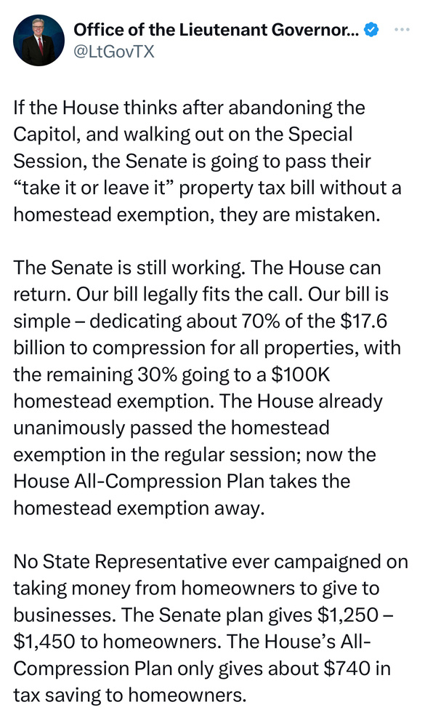
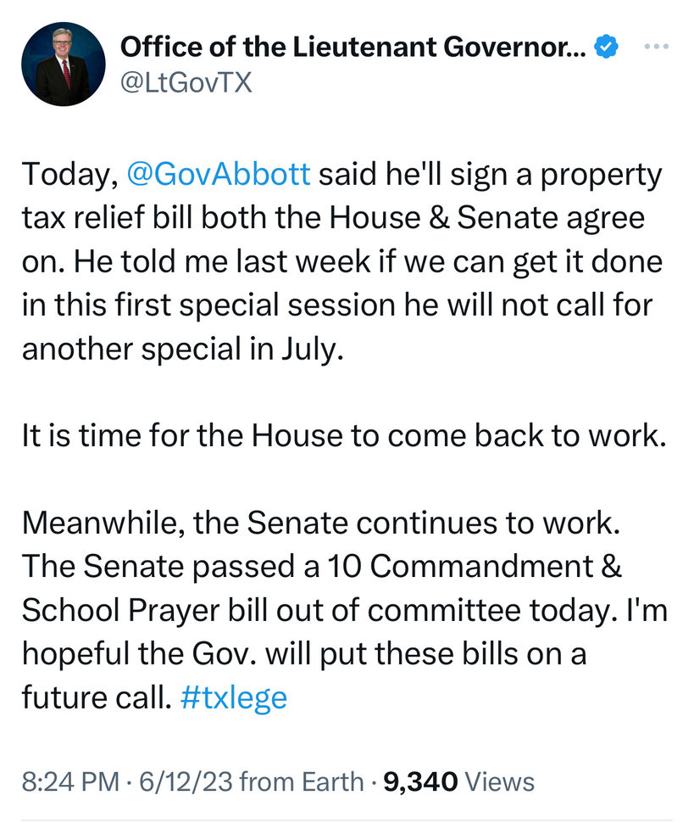
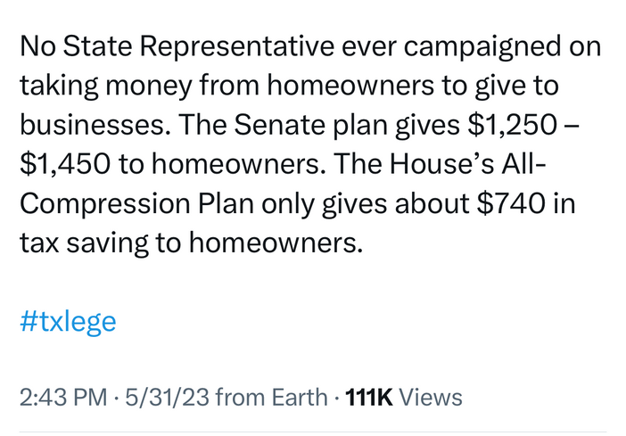
Communicating by Tweet

Slide 79
Senate Plan vs. House Plan
Recapture
Statewide Total Recapture
Recapture Districts
 | FY 2024 | FY 2025
Current Law (after 88R) | $4,461,175,021 | $4,799,825,165
Senate Plan | $2,769,237,952 | $2,849,811,896
House Plan | $2,418,903,741 | $2,591,050,073
FY 2024 | FY 2025
218 | 222
178 | 175
183 | 190
Both proposals reduce recapture by more than 40%. The two plans spend virtually the same amount, and differ in how it is spent. That equates to a difference of $300-350 million in recapture and makes a difference to 5-15 school districts.

Slide 80

Special Session: The Second Act
  Eventually they will come to some agreement on property taxes. Eventually.
  Governor Abbott has promised multiple special sessions, and all but promised one on vouchers.
  What other items will be added to the call?
  Will schools have a shot at additional funding?
  The Lt. Governor has a wish list of items to be added to the call:
    Teacher Pay Raise
    Prayer Time in Public Schools
    Ten Commandments in Schools
    Virtual Education
    And of course, School Choice

Slide 81
Key House Votes on Vouchers
The House took three different floor votes regarding private school vouchers during the 88th Regular Legislative Session. Two votes were in regards to a budget amendment prohibiting the use of state funds for private school vouchers, known as "The Herrero Amendment" for its author. The other was in regards to the House Public Education Committee's ability to meet for a last-minute voucher vote.
Motion to Table
The Herrero Amendment
Motion on Permission to Meet
Chairman Buckley moved to table The Herrero Amendment. The House rejected that proposal by a vote of 64 for and 71 against, allowing the vote on the amendment to happen.
Rep. Herrero proposed an amendment to HB 1 to prohibit the use of state funds for vouchers. The House adopted the amendment by a vote of 86-52.
Chairman Buckley sought permission for the Public Education Committee to meet on voucher bill SB 8, and Rep. Bailes objected to the motion. The House denied permission to meet by a vote of 65-76.
Record Vote 110
April 6, 2013
Record Vote 111
April 6, 2013
Record Vote 1464
May 10, 2013

Slide 82
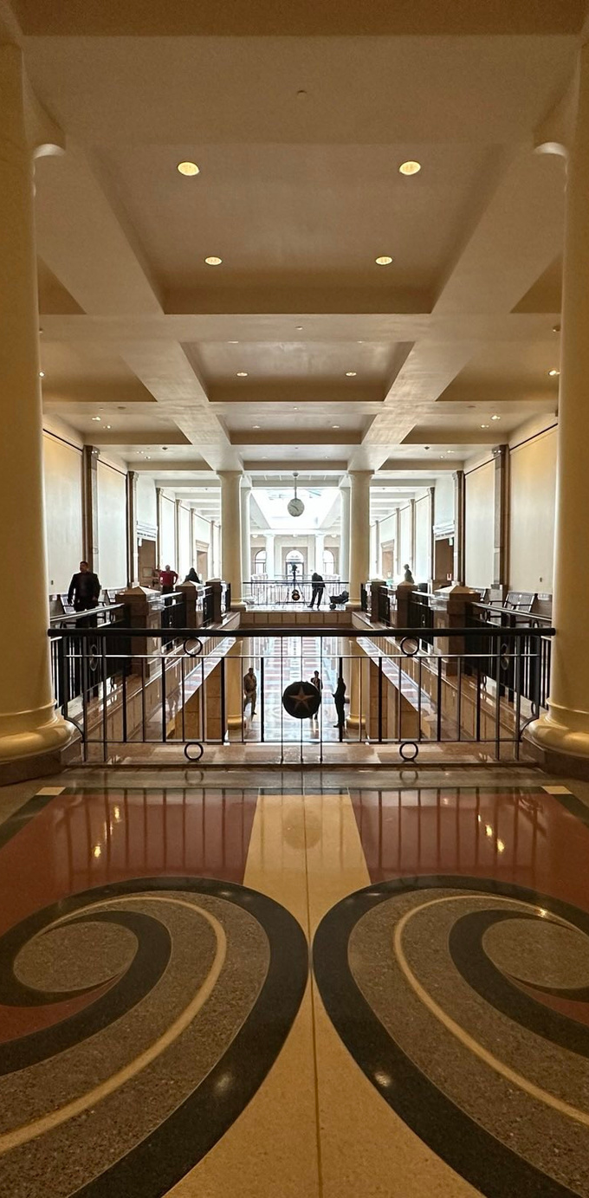
Will the House hold?
  In the 149-member House, it requires 75 votes to win.
  79 members of the House consistently sided with public schools on the key voucher votes this session.
  18 of the 86 who voted FOR the Herrero Amendment, then voted to allow the House Public Education Committee to meet on the voucher bill (which could be for a number of reasons)
  Previous votes matter, but if circumstances change, so can the votes.

Slide 83
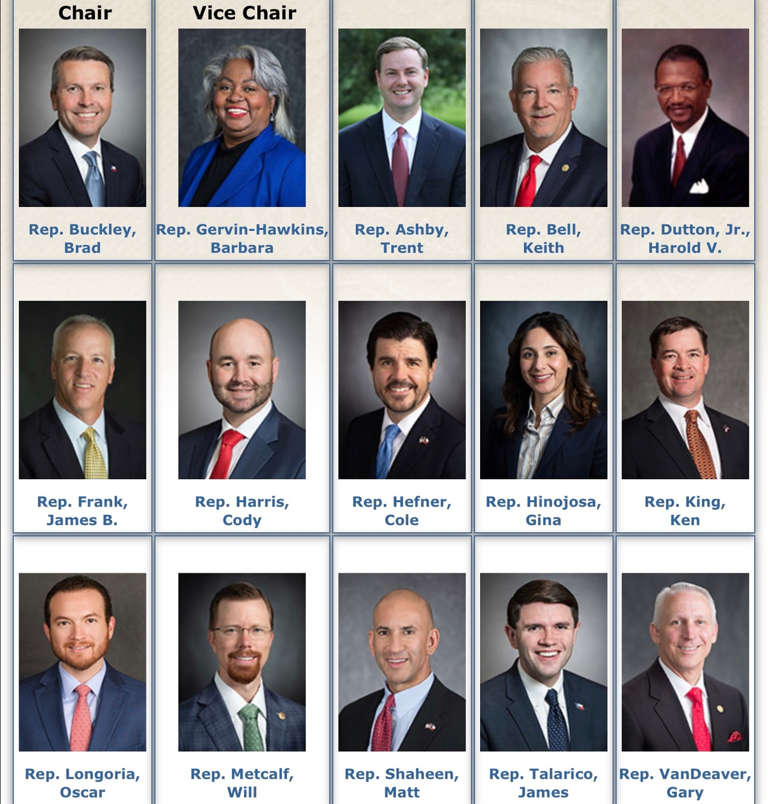
House Select Committee
on Educational Opportunity & Enrichment

Slide 84
The 24
Allison, Steve
Ashby, Trent
Bailes, Ernest
Bell, Keith
Burns, DeWayne
Clardy, Travis
Darby, Drew
Dean, Jay
Geren, Charlie
Holland, Justin
Kacal, Kyle
King, Ken
Kuempel, John
Lambert, Stan
Landgraf, Brooks
Murr, Andrew
Orr, Angelia
Price, Four
Raney, John
Rogers, Glenn
Shine, Hugh
Smith, Reggie
Spiller, David
VanDeaver, Gary

Slide 85

The Spin Cycle
Being armed with the facts is the only way to keep your bearings in the spin cycle.
And now we find ourselves in “the spin cycle” when every legislator goes home (eventually) to tell their voters all they did on their behalf and why they should re-elect them for another session inside the pink dome.

Slide 86
"This budget spends $8.7 billion in new money for schools."
 | In HB 1 2024-25 | Funding Available for 2024-25 | New Funding 2024-25
Curriculum/Instructional Materials (HB 1605) | $600M | $600M | $600M
School Safety (HB 3) | $300M | $300M | $300M
FSP Formula Funding Increases and Teacher Compensation (HB 100) | $3.997B
School Choice (Education Savings Accounts) | $500M
Virtual Education | $49.4M
TRS Active Care | $589M | $588.5M | $588.5M
Increase in Golden Penny Yield | $2.367B | $2.367B | $2.367B
New Instructional Facilities Allotment (NIFA) | $60M | $60M
Instructional Materials (IMTA) | $307M | $307M
TOTAL | $8.7 billion | $4.2 billion | $3.9 billion

Slide 87
“The Legislature increased funding by $400 per student."
 | Biennial Appropriation | Funding Per Year | Per ADA/Per Year Statewide
Increase in Golden Penny Yield | $2,400,000,000 | $1,200,000,000 | $233
Curriculum/Instructional Materials (HB 1605) | $500,000,000 | $250,000,000 | $49
School Safety (HB 3) | $300,000,000 | $150,000,000 | $29
TRS Active Care | $588,500,000 | $294,250,000 | $57
NIFA Restoration | $60,000,000 | $30,000,000 | $6
IMTA Restoration | $307,000,000 | $153,500,000 | $30
TOTAL | $4,144,500,000 | $2,066,750,000 | $403

Slide 88
“This is the largest tax cut in Texas History,
and it injects billions of new dollars
into the state’s public education system."
Texas School Coalition Statement:
Those dollars do not reach classrooms and they do not give schools more money to pay teachers and meet other needs. It would be disingenuous for any legislator to claim that a vote for property-tax relief is a vote to increase funding for Texas classrooms. Property-tax relief is good, but it does not provide the net increase in resources that Texas public schools severely need.

