Slide 1
May 1, 2023

Slide 2
Enable public schools to meet students' needs
Control the cost of recapture
Protect sustainability of public education funding
Ensure public accountability of public dollars
Preserve local decision-making
Notes:
Here are the legislative priorities set out for the Coalition prior to the start of the 88th legislative session, and the purpose of this presentation is to walk you through where we stand on each of these.

Slide 3
Increase Basic Allotment to address cost of inflation
Support increased funding through Golden Penny Yield, Cost of Education & Transportation Adjustments, enrollment-based funding
Provide increased funding for school safety and staff salary increases in a manner that allows local district discretion to meet local needs
Notes:
First and foremost, we are working to ensure schools have the funding required to enable them to meet the needs of students. Quite frankly, we will take additional resources in almost any way we can get them, but our preference is to see an increase to the Basic Allotment. We also recognize the need for increased funding for the purpose of school safety.

Slide 4
Since 2019, the Basic Allotment remains at the same level: $6,160
14.5% increase
CPI data through December 2022 retrieved from Data.Texas.Gov
Notes:
The reason why schools need an increase to the Basic Allotment so badly is that since the last time the Basic Allotment was increased, the rate of inflation has increased by 14.5%. That greatly diminishes the buying power dollars have compared to where we were four years ago. Schools are struggling to keep pace with retaining and recruiting staff as well keeping up with the increased cost of supplies and materials.

Slide 5
Appropriations Bills
General Appropriations Act – HB 1 includes:
$2.5 billion for enrollment growth
$2.4 billion to increase the golden penny yield
$5 billion for other school funding increases
FY 23: $98.56
FY 24: $126.21
FY 25: $129.52
Uses for $5 billion in House:
Teacher compensation
Teacher Incentive Allotment
Basic Allotment
School Safety
IMTA
Special Education
Uses for $5 billion in Senate:
SB 8: Private School Vouchers
SB 9: Teacher Compensation
SB 11: School Safety
SB 2565: IMTA
SB 1474: Special Education
Note: Each $100 increase in the BA costs $1.4 billion for the biennium
Notes:
Where we stand on the topic of additional funding is that both chambers are in agreement on the dollars they intend to spend, though not necessarily on how to spend the dollars. The budget bills in both chambers fully fund enrollment growth and they increase the yield on the golden pennies, as required by law. This increase will deliver new dollars to many schools. Most recapture districts will see a funding increase from the increased yield. Others will not benefit from this change, but those are the districts for whom their local yield is higher than the state, so they will hopefully benefit from the growth in their local values to deliver additional funding.
Then there is the $5 billion set aside for increased funding for public education. As you can see from the lists here, the House and Senate have differing priorities for how to spend the $5 billion and what strings may be attached. In some sessions, an additional $5 billion would have really been something to celebrate, but in a session where lawmakers have $33 billion, and a session where the effects of inflation drive up the need for additional dollars so much, it seems that the majority of additional funding will likely come with specific strings attached, rather that to help schools meet unmet needs. To put things in perspective, when you back into a number by looking at how much they intend to spend on stated priorities with strings, it really doesn’t allow for much of an increase to the Basic Allotment to meet unmet needs.

Slide 6
Teacher Compensation Increases
Senate Bill 9
For the 2023-24 school year:
$2,000 for each teacher/nurse/counselor/librarian in districts with 20,000 or more enrolled
$6,000 for each teacher/nurse/counselor/librarian in districts with fewer than 20,000 enrolled
House Bill 100
Significant increase to the Minimum Salary Schedule with salary transition grant
$90 increase to BA in FY24 and another $50 in FY25; 50% must go towards compensation increases (at least 75% for teachers/nurses/counselors/librarians, 25% for other staff)

Slide 7
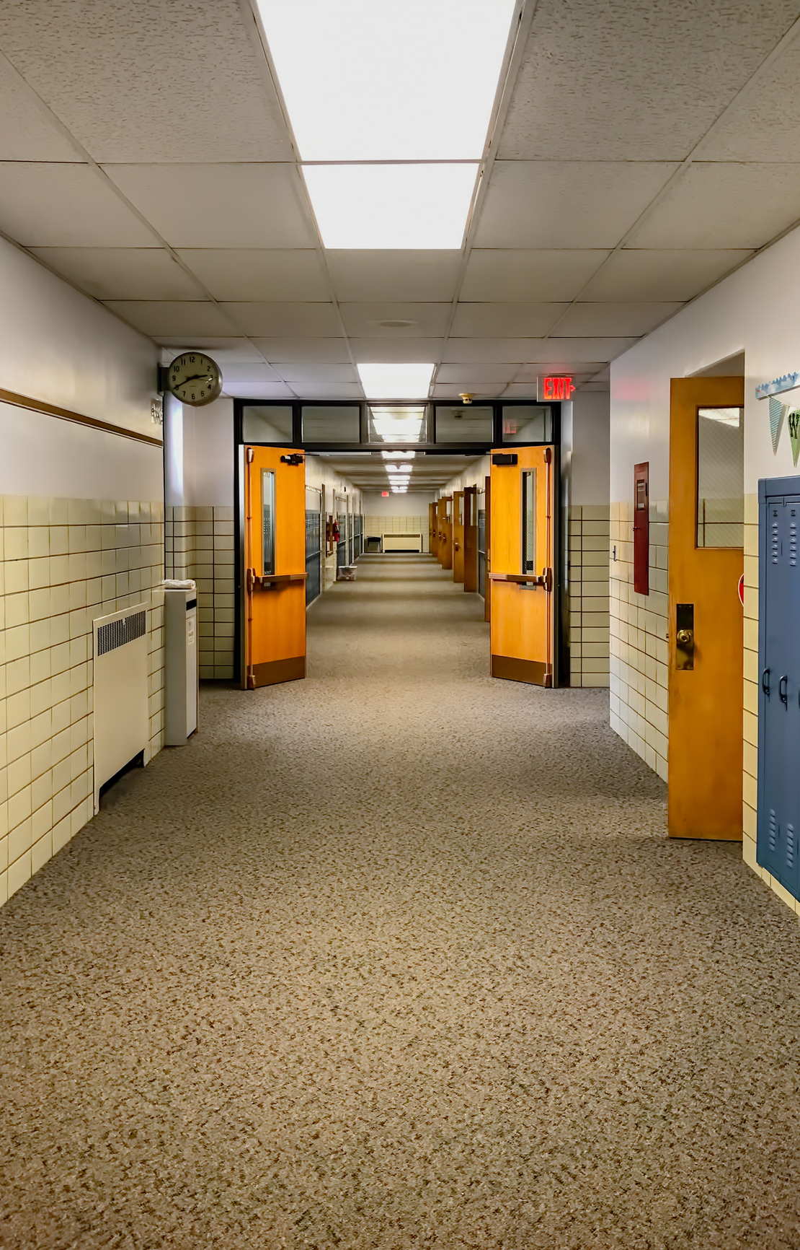
School Safety Funding
SB 30 (Supplemental Appropriations Act)
Senate: $60 million/House: $1.6 billion for safety in current school year
Senate Bill 11 (Nichols)
School Safety Allotment is $15,000-$16,800 per campus
TEA monitoring/sanctions; restrictions for technology purchases; truancy changes
House Bill 3 (Burrows) - $293 million
$100/ADA School Safety Allotment + $15,000 per campus
Requires armed security officer on each campus; restrictions for technology purchases; TEA monitoring/audits/sanctions; bond proceeds spent on safety 1st
House Bill 13 (Ken King) - $1.7 billion
$100/ADA School Safety Allotment
Allows more local control; requires mental health training; school guardian stipends

Slide 8
Reduce and control the increase of recapture
Increase the Basic Allotment
Stop the shell game and be transparent about where recapture dollars go
Provide the option to pay recapture early, with the incentive of an early payment discount
Oppose any measure that increases recapture

Slide 9
Total Recapture 1994-2023
Source: 1994-202 TEA Summary of Finance data; *2023 from Comptroller’s Biennial Revenue Estimate issued January 9, 2023, and 2024-2025 from Introduced version of HB 1 (88R).

Slide 10
The Appropriations Shell Game
In 2021, supplemental appropriations reduced funding for the FSP by $5.2 billion for FY 20-21. $1.4 billion of that was due to higher-than-expected recapture.
In 2023, SB 30 reduces FSP funding by $8.2 billion. $2.4 billion due to higher-than-expected recapture.
Every two years, legislators underestimate the total amount that districts will pay in recapture. Then, when districts pay more than projected, legislators use those recapture dollars to replace other state funding that would have gone to schools.
Notes:
We live in a state where the legislature meets every other year (thank goodness) and that means they adopt a two-year budget (based on estimates). Then they adopt a supplemental appropriations act as a “true-up” of those estimates based on actual numbers. The pattern we’ve seen is that the legislature adopts a budget that says recapture will be less than it actually is. They appropriate enough state funds to pay for public education with less recapture than is actually collected. Then they adopt a supplemental appropriations act in which the increased amount of recapture that was actually paid is recognized as a state savings that frees up state dollars to be spent on other things.

Slide 11
Recapture: Appropriations vs. Actual
Appropriated vs. Actual Recapture
$2.4 billion of the $8.2 billion reduction to the FSP in SB 30 is due to higher-than-expected recapture.

Slide 12
Support balanced approach to continued property tax relief that is sustainable over time
Protect districts from loss of funding due too expiration of Formula Transition Grant
Support measures to provide increased revenue to provide for increased school funding and ongoing property tax relief

Slide 13
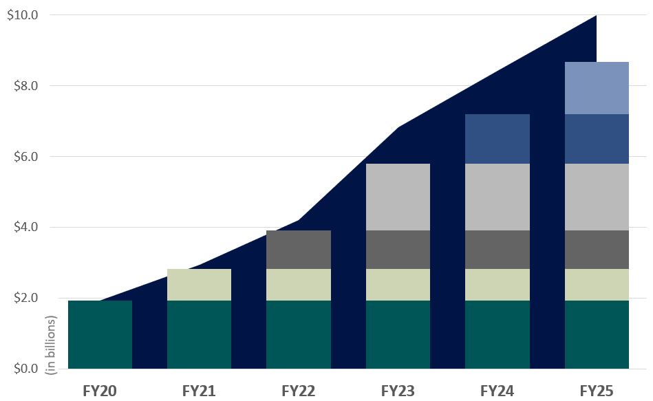
Cost of Tax Rate Compression
Year | Pennies Compressed | Cost (in billions)
2019-20 | $0.07 | $1.92
2020-21 | $0.03 | $0.90
2021-22 | $0.03 | $1.09
2022-23 | $0.05 | $1.89
Comptroller’s Estimates are Statutorily Required October 1st of even-numbered years & March 1st odd-numbered years
$0.035
$0.035
$0.035
The columns show the original cost of each round of compression at the time it occurs.
The area behind the columns shows the cumulative cost of compression. Cumulative cost is higher because of growth in the tax base over time and represents the difference between Tier 1 local share at the Tax Year 2018 Tier 1 rate vs Tier 1 local share at the Tier 1 Rate (MCR) for the year shown.
The cumulative number of pennies “purchased” through compression is shown below the graph.
$0.05
$0.05
$0.05
$0.03
$0.03
$0.03
$0.03
$0.03
$0.03
$0.03
$0.03
$0.03
$0.07
$0.07
$0.07
$0.07
$0.07
$0.07
Amounts for FY24 & FY25 are hypothetical and are based on long-term value growth trend
$0.07
$0.10
$0.13
$0.18
$0.22
$0.25

Slide 14
Tax Rate Compression
HB 3 (2019) set ongoing tax rate compression in place tied to either statewide or local property values (whichever is growing faster).
A ceiling exists for school districts with the highest rate so their tax rates continue to be compressed.
A floor exists to prevent school district tax rates from falling lower than 90% of the tax rate ceiling.

Slide 15
Property Tax Relief
House Bill 2
Additional $0.15 of compression
5% appraisal cap on all real property
Cost of HB 2 + current law: $17.3 billion
Reduces recapture by $4.5 billion for the biennium
Senate Bills 3, 4, & 5
Increases Homestead Exemption to $70K & to $30K for 65+
Additional Tier 1 tax rate compression
Business Personal Property Tax Exemption (no rendition if <$25K)
Cost of SB 3, 4, & 5 + current law: $16.5 billion
Reduces recapture by at least $1 billion

Slide 16
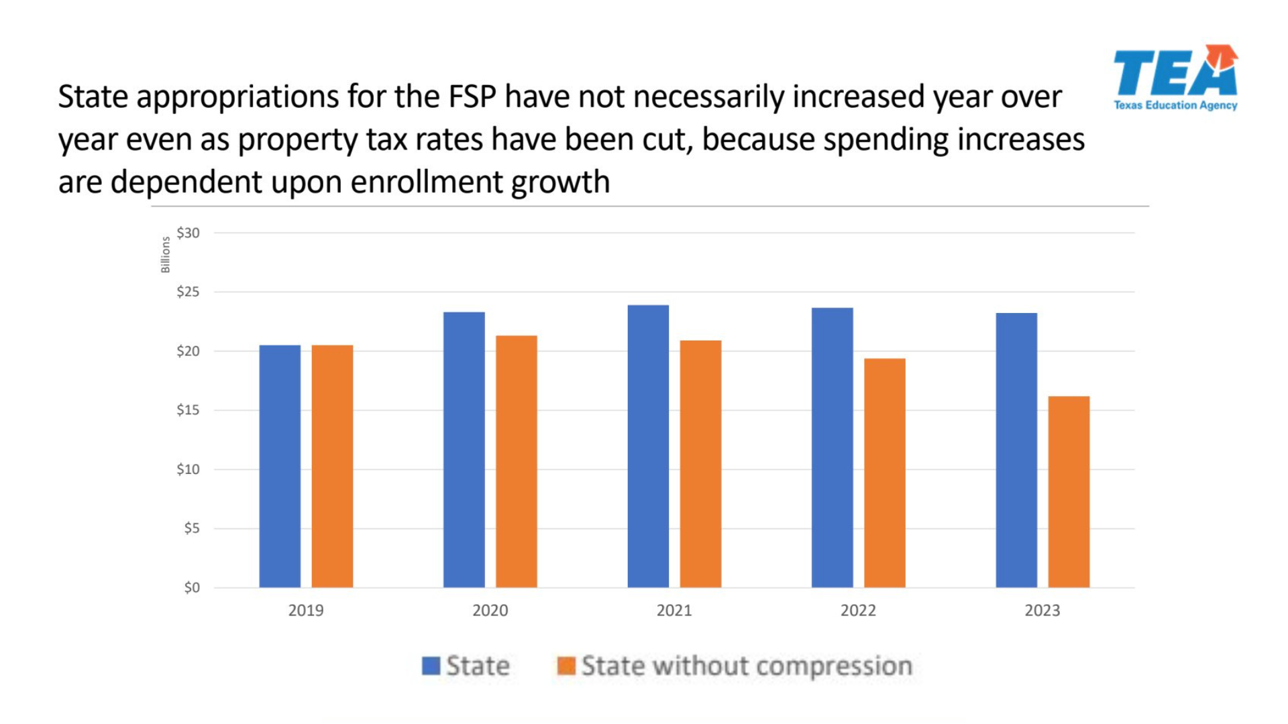
State
State without compression
Notes:
This chart from TEA isolates the state investment in schools compared to state funding for schools with the investment in property tax relief removed. Student enrollment isn’t increasing by quite as rapid of a pace, but it does continue to increase, while state support for schools (without property tax relief) does not.

Slide 17
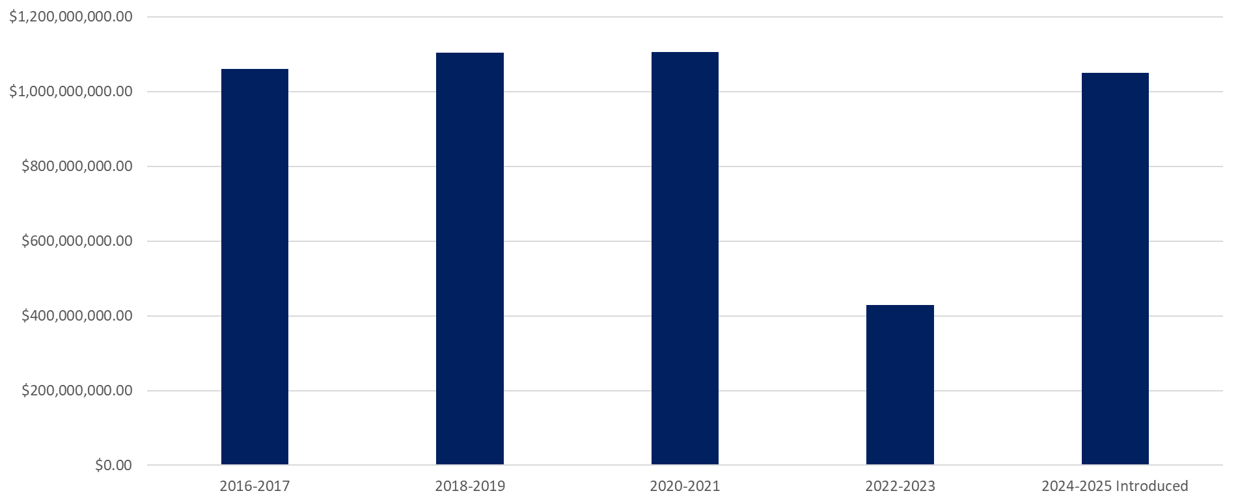
Instructional Materials Funding
Budget Bill: TIMA Appropriation by Session

Slide 18
Formula Transition Grants
HB 3 provided for districts to be entitled to at least a 3% gain compared to funding under the old law (pre-HB 3)
228 school districts and charter schools currently rely on FTG funding, for more than what the $400 million cap allows.
FTG expires following the 2023-24 school year, setting up school districts for a funding loss in fall 2024.
Salary increase requirements that accompanied the 3% funding increase do not expire when the funding does, and new compensation increases could be required without new funding to pay for them.
HB 100 includes extension of expiration date to 2029-30

Slide 19
Oppose private school vouchers, scholarships, or tax credits in any form.
Maintain authority of locally-elected trustees
Support increased transparency for taxpayers
Improve clarity of ballot language for voters

Slide 20
Education Savings Accounts
Senate Bill 8
Participating student would receive $8,000 per year to be used for private school education, overseen by “educational assistance organization.”
School districts with 20,000 or fewer students, would receive $10,000 for the first two years a student participates in the program.
Provides constraints around districts transfer policies, including eliminating tuition, regulating reasons for rejecting transfers

Slide 21
Support governance through locally-elected trustees
Support the elimination of unfunded mandates and guard against the creation of new mandates
Oppose measures that seek to limit local elections
Oppose measures that seek to control or limit school district fund balances
Support economic development incentives in which school districts have discretion and the ability to negotiate a means to grow the local economy

Slide 22
Economic Development Agreements – HB 5
With Chapter 313 expired, new agreements needed
HB 5 allows for agreements with school boards deciding whether to offer tax abatement to attract entities for the purpose of economic development and jobs
Schools to receive share of tax savings
Notes:
This bill has passed the House and is headed to the Senate.

Slide 23
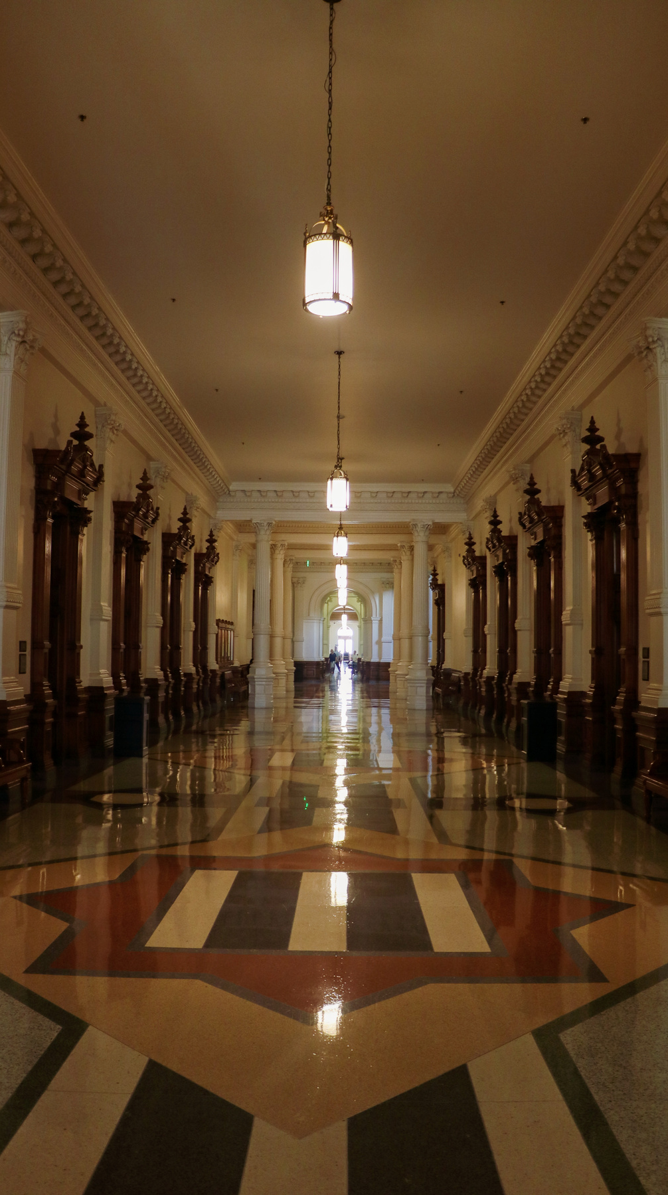
Thank you!
Christy Rome
Executive Director
Texas School Coalition
512-732-9072
Christy@txsc.org
www.txsc.org

