Slide 8
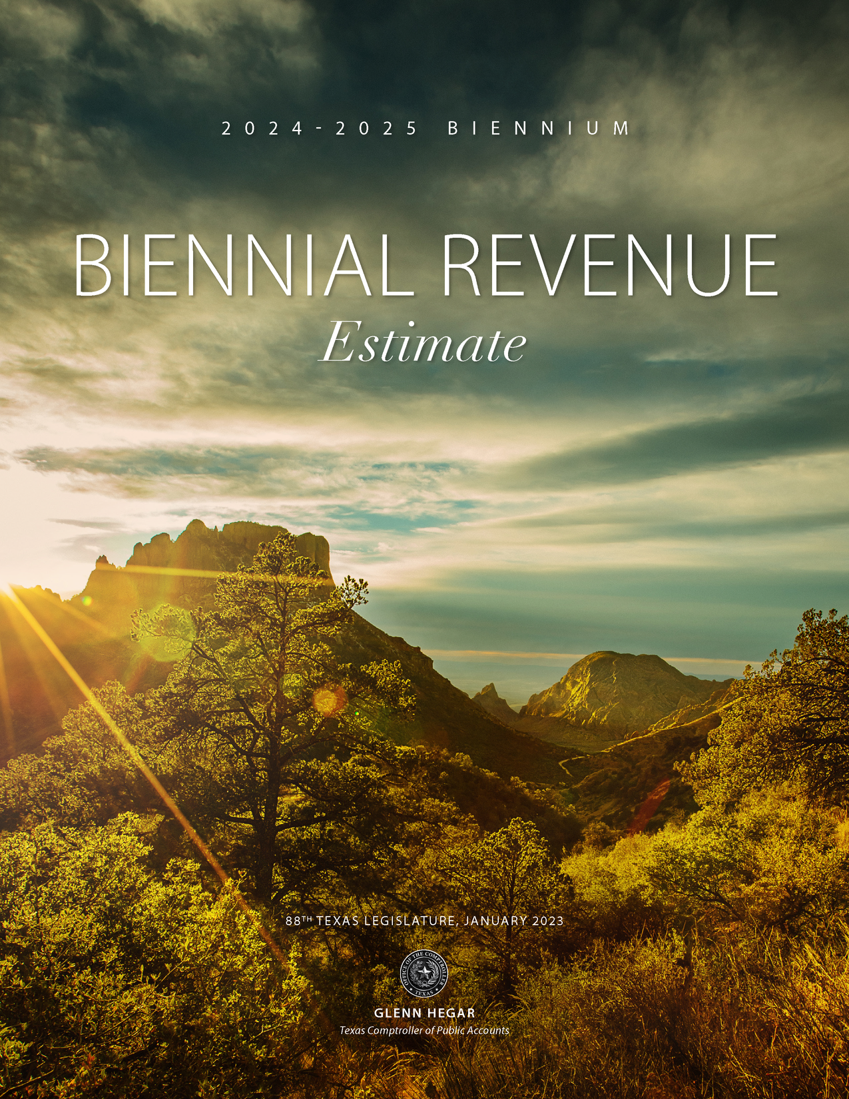
Comptroller Glenn Hegar issued the Biennial Revenue Estimate (BRE), telling lawmakers how much they have to spend.

Slide 9
Texas has a $33 billion surplus!

Slide 10
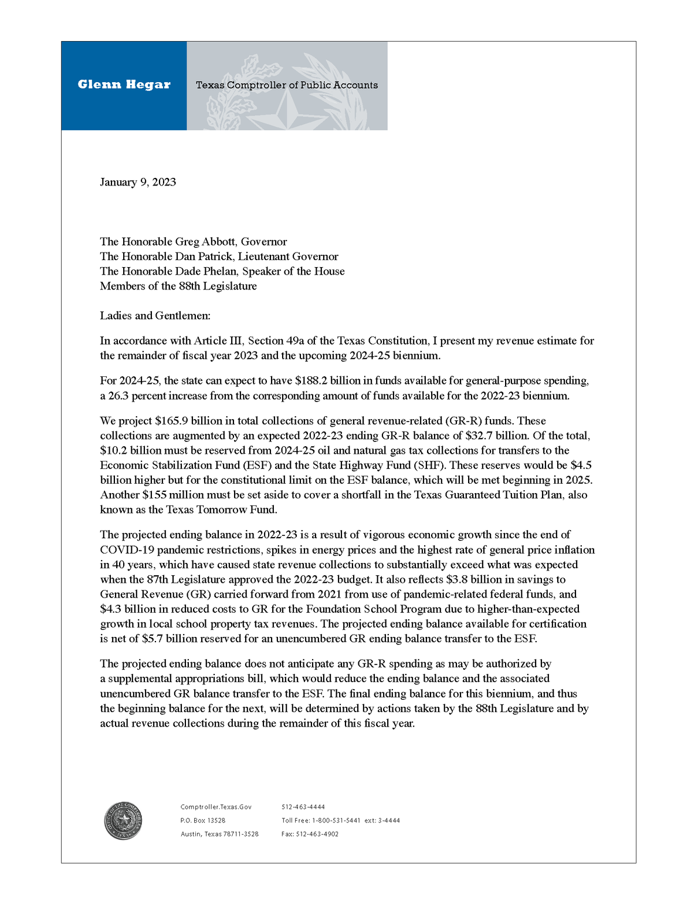
We can likely expect a reduction of $4.3 billion from the FSP in the supplemental appropriations bill

Slide 12
The Appropriations Shell Game
Every two years, legislators underestimate the total amount that districts will pay in recapture. Then, when districts pay more than projected, legislators use those recapture dollars to replace other state funding that would have gone to schools.
In 2021, supplemental appropriations reduced spending for the Foundation School Program by $5.2 billion for FY 20 and 21.
$1.4 billion of that was due to higher than expected recapture.
Notes:
We live in a state where the legislature meets every other year (thank goodness) and that means they adopt a two-year budget (based on estimates). Then they adopt a supplemental appropriations act as a “true-up” of those estimates based on actual numbers. The pattern we’ve seen is that the legislature adopts a budget that says recapture will be less than it actually is. They appropriate enough state funds to pay for public education with less recapture than is actually collected. Then they adopt a supplemental appropriations act in which the increased amount of recapture that was actually paid is recognized as a state savings that frees up state dollars to be spent on other things.

Slide 13
Recapture: Appropriations vs. Actual
Appropriated vs. Actual Recapture
About half of the $4.3 billion reduction to the FSP is due to higher-than-expected recapture.

Slide 14
Total Recapture 1994-2023
Source: 1994-202 TEA Summary of Finance data; *2023 from Comptroller’s Biennial Revenue Estimate issued January 9, 2023, and 2024-2025 from Introduced version of HB 1 (88R).

Slide 16
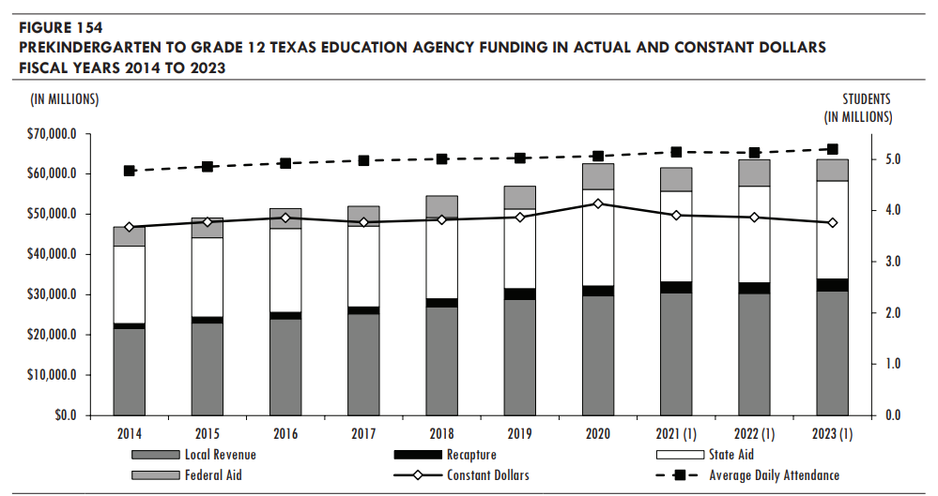
Source: Legislative Budget Board Fiscal Size Up

Slide 17
14.5% increase
CPI data through December 2022 retrieved from Data.Texas.Gov

Slide 18
Recapture has grown by 84% since initial HB 3 reduction
+84%
-5%
Source: TEA Summary of Finance data
* Near Final numbers used for 2022; Figures from the Comptroller’s Biennial Revenue Estimate for 2023

Slide 21
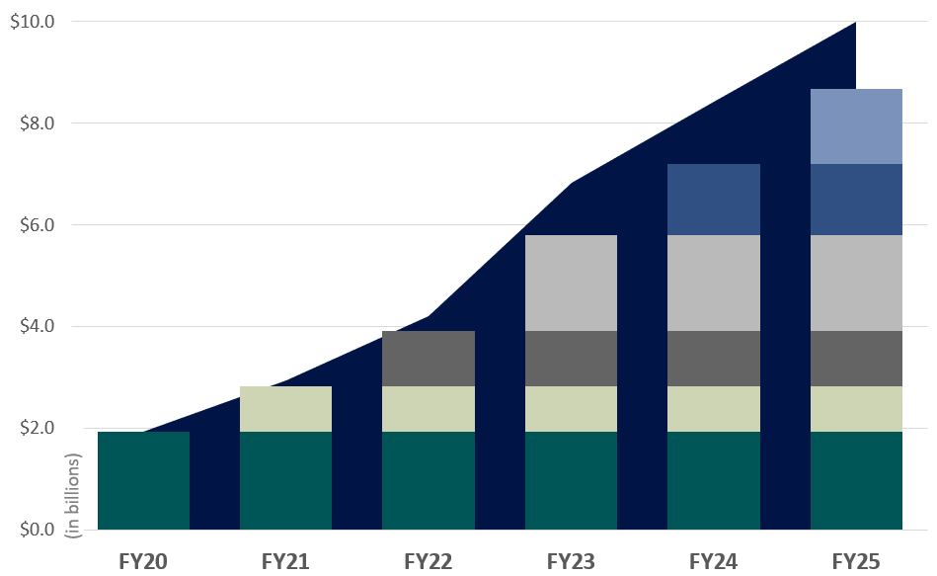
Cost of Tax Rate Compression
Year | Pennies Compressed | Cost (in billions)
2019-20 | $0.07 | $1.92
2020-21 | $0.03 | $0.90
2021-22 | $0.03 | $1.09
2022-23 | $0.05 | $1.89
Comptroller’s Estimates are Statutorily Required October 1st of even-numbered years & March 1st odd-numbered years
$0.035
$0.035
$0.035
The columns show the original cost of each round of compression at the time it occurs.
The area behind the columns shows the cumulative cost of compression. Cumulative cost is higher because of growth in the tax base over time and represents the difference between Tier 1 local share at the Tax Year 2018 Tier 1 rate vs Tier 1 local share at the Tier 1 Rate (MCR) for the year shown.
The cumulative number of pennies “purchased” through compression is shown below the graph.
$0.05
$0.05
$0.05
$0.03
$0.03
$0.03
$0.03
$0.03
$0.03
$0.03
$0.03
$0.03
$0.07
$0.07
$0.07
$0.07
$0.07
$0.07
Amounts for FY24 & FY25 are hypothetical and are based on long-term value growth trend
$0.07
$0.10
$0.13
$0.18
$0.22
$0.25

Slide 22
Local vs. State Share of the Foundation School Program
Source: Legislative Budget Board Summary of SB 1; February 6. 2023

Slide 23
What we know from the base budget bills
$15 billion for property tax relief ($5 billion to pay for current law relief and $10 billion for new relief)
Both signal increased spending for pub ed, but only $4 billion remains under spending limit

Slide 25
Notified Recapture Districts 2023
Recapture districts can be found in nearly every region of the state.
Districts that would have Excess Local Revenue for 2022-23 in:
Tier 1 & Tier 2
Tier 2 Only
Source: TEA Website 2023 Excess Local Revenue Notification List

Slide 26
Top 10 Recapture Districts
Possible Allies
Districts Paying the Most Recapture as Percent of Total M&O Tax Collections 2022-23
Districts Paying the Most Recapture 2022-23
 | School District | Recapture
1 | Austin ISD | $874,991,079
2 | Pecos-Barstow-Toyah ISD | $211,454,956
3 | Plano ISD | $207,009,990
4 | Houston ISD | $206,255,810
5 | Midland ISD | $174,128,656
6 | Wink-Loving ISD | $149,578,484
7 | Eanes ISD | $121,708,382
8 | Highland Park ISD (Dallas) | $104,477,232
9 | Rankin ISD | $97,790,896
10 | Round Rock ISD | $88,844,042
School District | Recapture | % of collections
Wink-Loving ISD | $149,578,484 | 88%
Rankin ISD | $97,790,896 | 88%
Grady ISD | $63,397,346 | 87%
Pecos-Barstow-Toyah ISD | $211,454,956 | 85%
Glasscock County ISD | $52,044,230 | 85%
Culberson County-Allamoore ISD | $50,674,057 | 84%
Westhoff ISD | $7,160,946 | 84%
Kenedy County Wide CSD | $8,858,019 | 82%
Port Aransas ISD | $28,332,542 | 80%
McMullen County ISD | $23,550,294 | 80%
Source: TEA SOF Preliminary Data 2022-2023, accessed 2/8/2023
Notes:
So who can we look to that shares a similar plight? Who could be allies as we work towards change? This is what the Texas School Coalition is all about—bringing districts with common plights together to work towards change.

Slide 27
Questions?
Christy Rome
Executive Director
Texas School Coalition
512-732-9072
Christy@txsc.org

