Slide 2
Enable public schools to meet students' needs
Control the cost of recapture
Protect sustainability of public education funding
Ensure public accountability of public dollars
Preserve local decision-making

Slide 3
Increase Basic Allotment to address cost of inflation
Support increased funding through Golden Penny Yield, Cost of Education & Transportation Adjustments, enrollment-based funding
Provide increased funding for school safety and staff salary increases in a manner that allows local district discretion to meet local needs

Slide 4
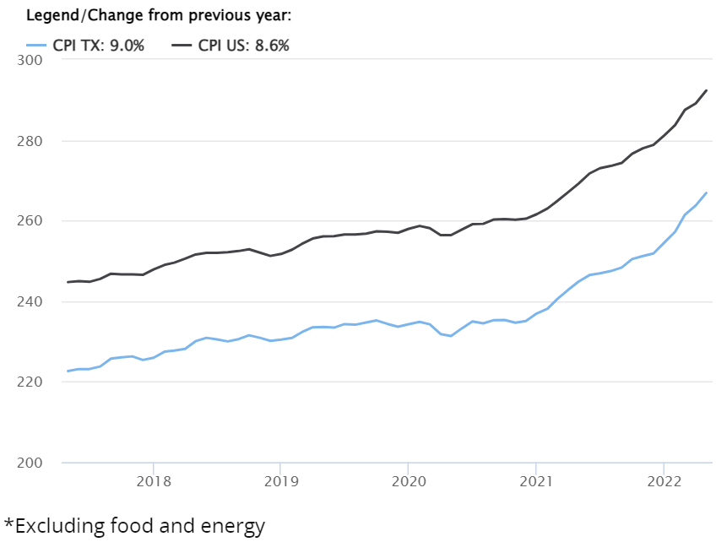
Increased cost due to general inflation is borne by the district (absent formula changes).
Inflation
Source: US Bureau of Labor Statistics and Texas Comptroller of Public Accounts

Slide 5
12% increase
CPI data through July 2022 retrieved from Data.Texas.Gov

Slide 6
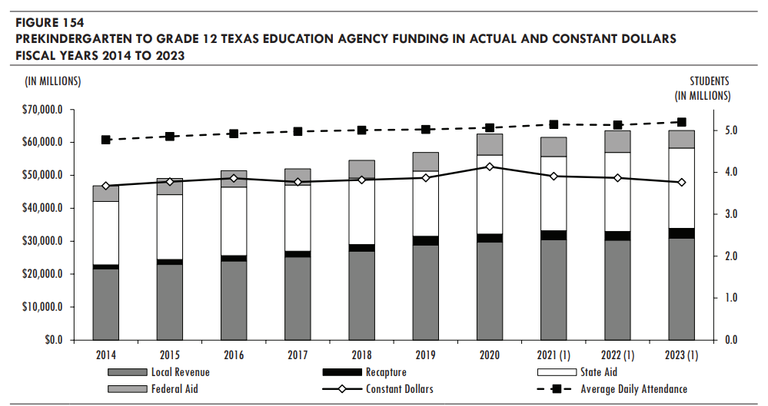
Source: Legislative Budget Board Fiscal Size Up

Slide 7
Biennial Cost to Increase Basic Allotment
Billions
HB 3 was supposed to deliver $11.6 billion for the biennium (split between new $ and tax compression); was actually $6.4 billion after $5.2 billion FSP reduction in 2021.
$700 increase would keep pace with inflation.
Price tag: $10.5 billion

Slide 9
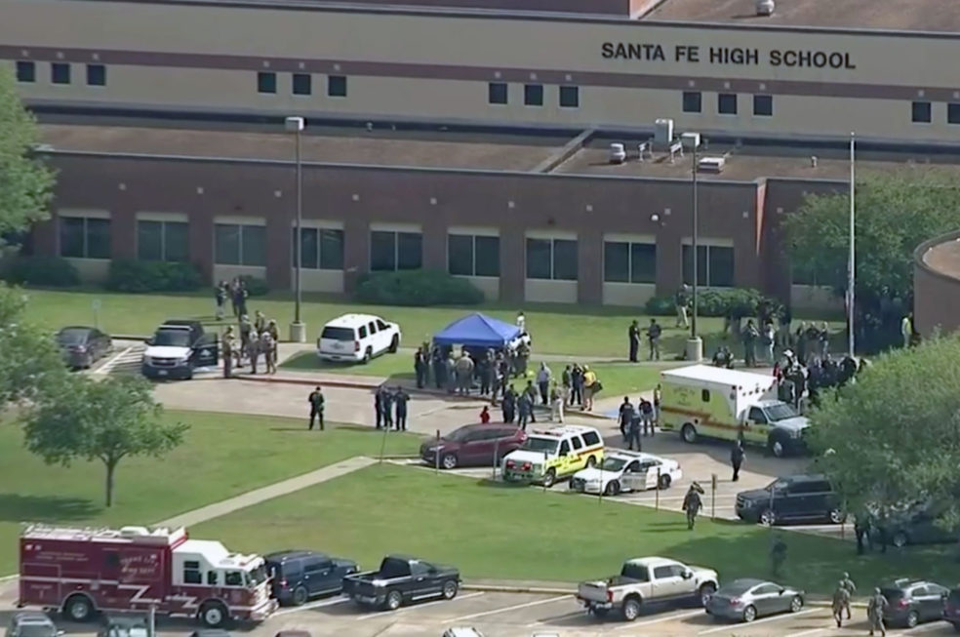
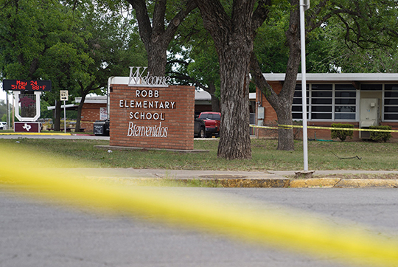
School Safety Allotment – SB 11 (2019)
The School Safety Allotment delivers $9.72 per ADA.
Santa Fe ISD received a total of $38,463 from the School Safety Allotment in SY 2021-22.
Uvalde ISD received a total of $34,625 from the School Safety Allotment in SY 2021-22.
Notes:
To be fair, I don’t know what amount of money would be enough.

Slide 10
Reduce and control the increase of recapture
Increase the Basic Allotment
Stop the shell game and be transparent about where recapture dollars go
Provide the option to pay recapture early, with the incentive of an early payment discount
Oppose any measure that increases recapture

Slide 11
Statewide Recapture 1994-2023
Tax Rate Compression
Tax Rate Compression
Source: TEA Summary of Finance data; *2022 and 2023 figures are preliminary data
Notes:
This graph shows recapture amounts from 1994 (the first year of recapture) through the estimates for the total in the current school year. We exceeded $3 billion for the first time in state history in 2022. (paid by 158 of the more than 1,000 school districts).

Slide 12
Recapture has grown by 30% since initial HB 3 reduction
+30%
-5%
Source: TEA Summary of Finance data
* Near Final numbers used for 2022; Preliminary figures for 2023

Slide 13
Tax Rate Compression
HB 3 (2019) set ongoing tax rate compression in place tied to either statewide or local property values (whichever is growing faster).
A ceiling exists for school districts with the highest rate so their tax rates continue to be compressed.
A floor exists to prevent school district tax rates from falling lower than 90% of the tax rate ceiling.

Slide 14
Recapture: Appropriations vs. Actual
$1.4 billion more than appropriated
Updated Estimated Amount

Slide 15
Annual Recapture Reduction Caused by Increase to the Basic Allotment
-4 -6 -10 -21 -25 -29 -33
Rule of thumb: Every $100 increase to the Basic Allotment reduces recapture by about $100 million.
Reduction in number of districts paying recapture at any level.

Slide 16
Legislators with 50% or more of voting-age population residing in Chapter 49 District
Texas Senate
Texas House
11
35%
48
32%

Slide 17
Support balanced approach to continued property tax relief that is sustainable over time
Protect districts from loss of funding due too expiration of Formula Transition Grant
Support measures to provide increased revenue to provide for increased school funding and ongoing property tax relief

Slide 18
Formula Transition Grants
HB 3 provided for districts to be entitled to at least a 3% gain compared to funding under the old law (pre-HB 3)
In the 2021-2022 school year, 160 school districts and charter schools (including 25 Coalition districts) received the FTG, for what turned out to be about $234 million.
FTG expires after five years, setting up school districts for a funding loss following the 2023-24 school year in fall 2024.
Salary increase requirements that accompanied the 3% funding increase do not expire when the funding does.

Slide 19
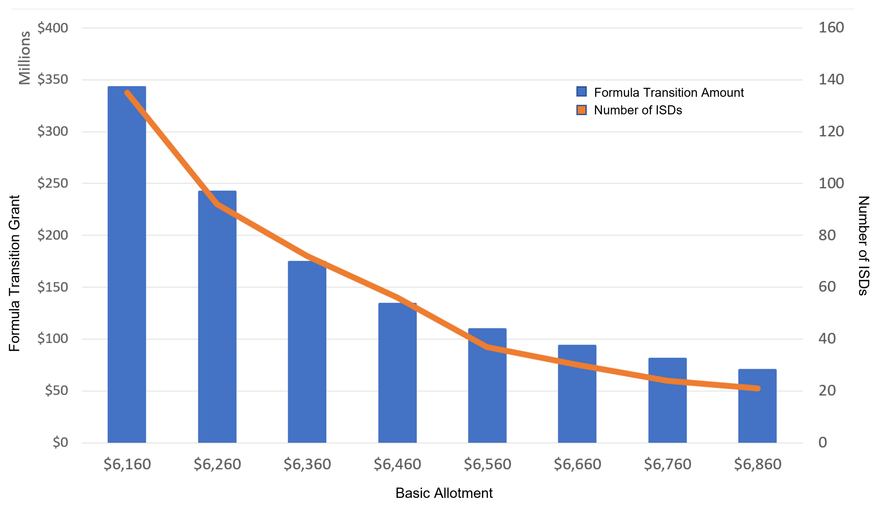
Formula Transition Grant Total per $100 Increase in Basic Allotment

Slide 20
Oppose private school vouchers, scholarships, or tax credits in any form.
Maintain authority of locally-elected trustees
Support increased transparency for taxpayers
Improve clarity of ballot language for voters

Slide 21
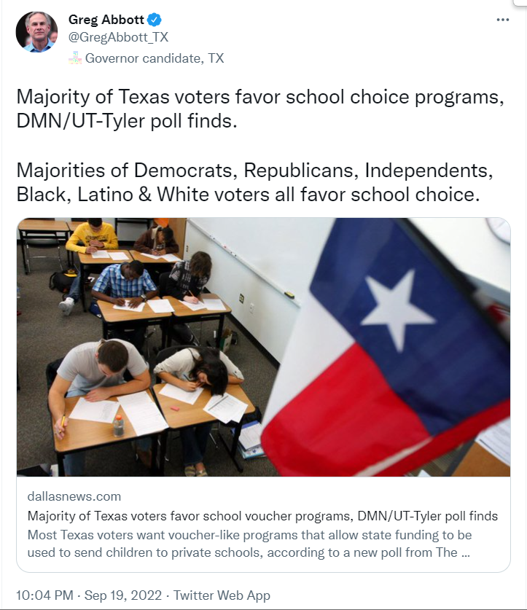
Governor Greg Abbott
May 2022
“Empowering parents means giving them the choice to send their children to any public school, charter school or private school with state funding following the student.”

Slide 22
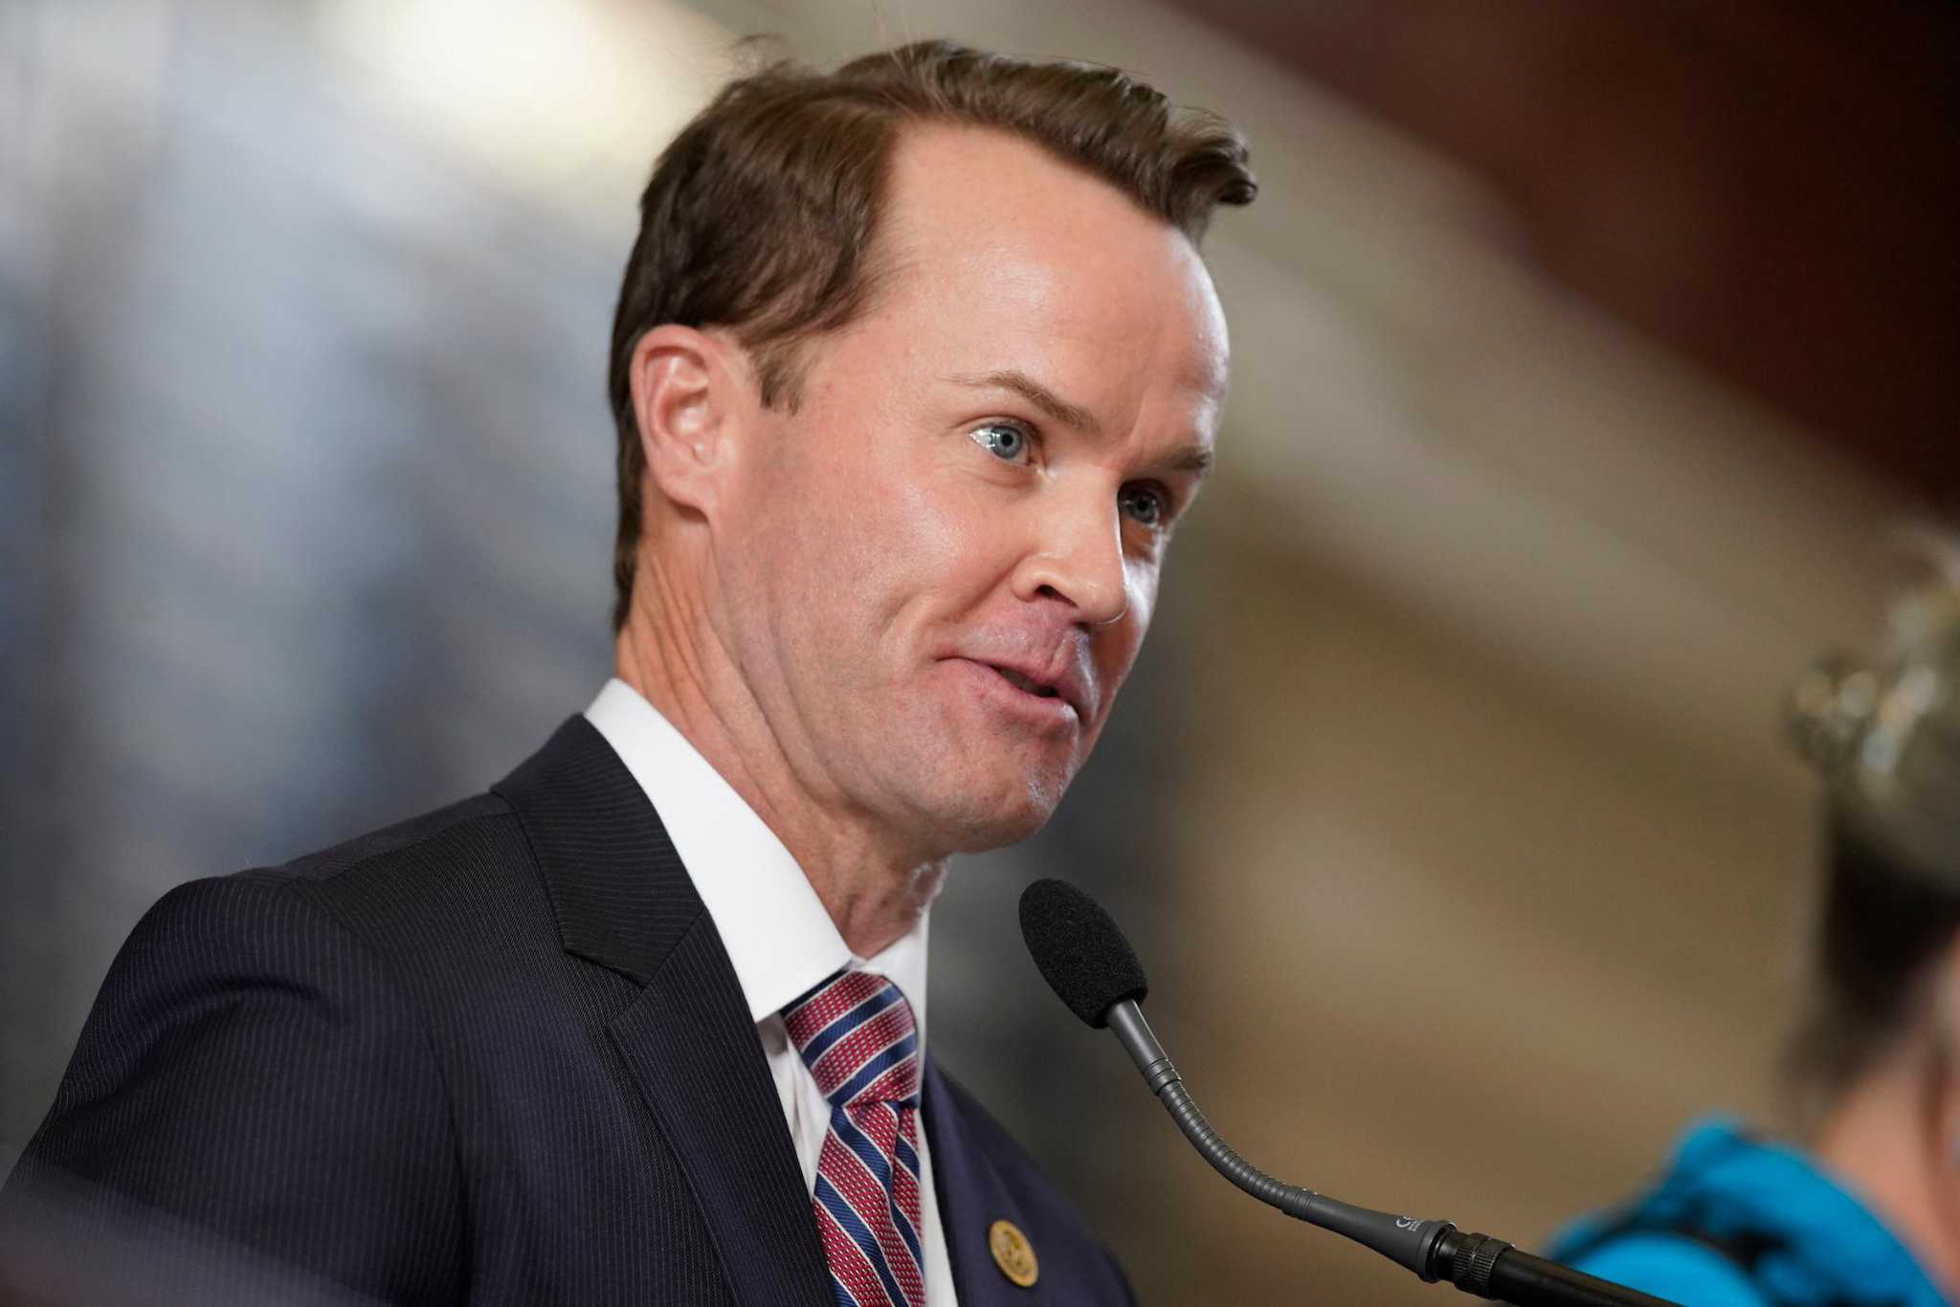
Speaker Dade Phelan
May 2022
“The delta’s pretty large on school choice, on getting it across the finish line.”

Slide 23
Support governance through locally-elected trustees
Support the elimination of unfunded mandates and guard against the creation of new mandates
Oppose measures that seek to limit local elections
Oppose measures that seek to control or limit school district fund balances
Support economic development incentives in which school districts have discretion and the ability to negotiate a means to grow the local economy

Slide 24
$27 billion surplus projected

Slide 25
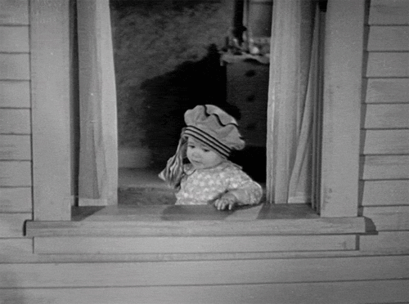
How might they spend a $27 billion surplus?
Hypothetical Spending | Biennial Cost
Additional Cost of Current Law Tax Compression | $4 billion
Cost of additional 15 cents of compression | $9 billion
Increase Basic Allotment by $700 | $10.5 billion
TOTAL | $23.5 billion
Other priorities remain: TRS, School Safety, Special Education, School Facilities, etc. Plus Highways, The Grid, Health & Human Services (mental health, foster care, etc.)

