Slide 1


Slide 2
Statewide Recapture 1994-2022
2019
(HB 3) tax compression
2006
(HB 1) tax compression
Source: TEA Summary of Finance data
* Preliminary estimated amount
Notes:
This graph shows recapture amounts from 1994 (the first year of recapture) through the estimates for the total in the current school year. Recapture will exceed $3 billion in 2023—for the first time ever.

Slide 3
Sources of State Revenue
Comparable Sources of State Revenue | FY 2021
Sales Taxes | $36,052,599,315
Motor Vehicle Sales & Rental Taxes | $5,732,852,494
Franchise Tax | $4,529,829,616
Motor Fuel Taxes | $3,597,622,182
Oil Production Tax | $3,449,131,602
Net Lottery Proceeds | $2,954,627,489
Insurance Taxes | $2,699,643,241
Natural Gas Production Tax | $1,568,541,762
Alcoholic Beverages Taxes | $1,525,923,232
Year | Recapture
2020 | $2,558,297,385
2021 | $2,970,048,067
2022* | $3,226,149,066
Source: TEA Summary of Finance; 2022 is Preliminary.
https://comptroller.texas.gov/transparency/open-data/dashboards.php
Notes:
Just to put things in perspective.

Slide 4

Recapture has grown by over 20% since initial HB 3 reduction
+20%
-5%
Source: TEA Summary of Finance data
* Preliminary estimated amount

Slide 5
The Top Tens
Top Ten Districts Paying the Most Recapture as Percent of Total M&O Tax Collections
Top Ten Districts Paying the Most Recapture
 | School District | Recapture
1 | Austin ISD | $791,389,490
2 | Houston ISD | $302,746,565
3 | Plano ISD | $207,239,972
4 | Dallas ISD | $140,486,418
5 | Midland ISD | $129,073,485
6 | Highland Park ISD | $108,759,349
7 | Pecos-Barstow-Toyah ISD | $106,744,467
8 | Eanes ISD | $106,468,805
9 | Wink-Loving ISD | $74,488,295
10 | Spring Branch ISD | $64,687,853
School District | Recapture | % of collections
Glasscock County ISD | $32,815,360 | 86%
Wink-Loving ISD | $74,488,295 | 86%
Rankin ISD | $48,075,718 | 85%
Grady ISD | $25,893,380 | 84%
McMullen County ISD | $22,206,023 | 80%
Kenedy County Wide CSD | $7,486,310 | 80%
Pecos-Barstow-Toyah ISD | $106,744,467 | 79%
Palo Pinto ISD | $4,123,707 | 76%
Regan County ISD | $35,964,795 | 75%
Port Aransas ISD | $20,091,230 | 74.7%
Source: TEA Preliminary Data, 2021-2022, as of June 6, 2022

Slide 6

COST OF EDUCATION ADJUSTMENT
The cost of doing business is much greater in certain districts, yet formulas don't account for that when calculating entitlement.
Possible Solutions
STOP THE SHELL GAME
Ensure money paid for recapture benefits schools, rather than just generating a state savings.
PROVIDE EARLY PAYMENT DISCOUNT
HB 3 repealed the 4% early payment discount; but corporate taxpayers still enjoy such discounts.
INCREASE TRANSPARENCY FOR TAXPAYERS
Ensure taxpayers know where their dollars are going (and the real reason for budget increases).
Notes:
Here are four possible solutions that could help (and to be fair, many more…that’s why we’re here today). They aren’t the only solutions, but it will hopefully start the conversation. This first one has to do with the cost of education. This is an adjustment that was once made in the school finance formulas, but it was never updated and was eventually repealed. The Legislature agreed to study it and revisit the issue later, but then they ignored the report that was issued in January 2021 (https://tea.texas.gov/sites/default/files/hb3-transportation-report.pdf). Adopting such an adjustment would increase the size of the glass.
Next, we could stop the shell game and ensure that if additional dollars are paid in recapture that it results in additional dollars for schools (on top of entitlement funding).
Remember when we used to have an early payment discount? Prior to the passage of HB 3 in 2019, you could receive a discount of 4% off your recapture if you paid it early. What if we brought back that discount? After all, corporate taxpayers receive a discount if they pay their sales tax early. That’s a pass through just like this one. And the state would benefit from having those dollars early rather than having to borrow funds. It’s a win-win and probably the cheapest way the state could reduce recapture.
Finally, we can increase transparency for taxpayers so that everyone is aware of where their dollars are going. This heightened awareness could help lead to reforms down the road.

Slide 7

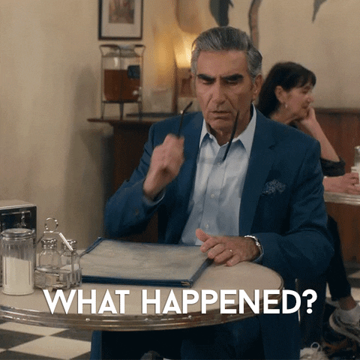
CEI was repealed in 2019 by HB 3, to be studied in 2020. Report was paid for and provided January 12, 2021.
https://tea.texas.gov/sites/default/files/hb3-transportation-report.pdf

Slide 8

The Appropriations Shell Game
Every two years, legislators underestimate the total amount that districts will pay in recapture. Then, when districts pay more than projected, legislators use those recapture dollars to replace other state funding that would have gone to schools.
In 2021, supplemental appropriations reduced spending for Foundation School Program by $5.2 billion for FY 20 and 21.
$1.4 billion of that was due to higher than expected recapture.
Notes:
We live in a state where the legislature meets every other year (thank goodness) and that means they adopt a two-year budget (based on estimates). Then they adopt a supplemental appropriations act as a “true-up” of those estimates based on actual numbers. The pattern we’ve seen is that the legislature adopts a budget that says recapture will be less than it actually is. They appropriate enough state funds to pay for public education with less recapture than is actually collected. Then they adopt a supplemental appropriations act in which the increased amount of recapture that was actually paid is recognized as a state savings that frees up state dollars to be spent on other things.

Slide 9
Recapture: Appropriations vs. Actual

Slide 10
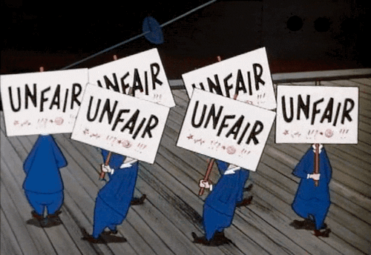
Penalty of recapture
FIRST rating penalty due to high cash on hand requirements for recapture payments
Budget postings show increases--but increases due to recapture don’t result in more spending and are not within the district’s control

Slide 11
Annual Recapture Reduction Caused by Increase to the Basic Allotment
-4 -6 -10 -21 -25 -29 -33
Rule of thumb: Every $100 increase to the Basic Allotment reduces recapture by about $100 million.
Reduction in number of districts paying recapture at any level.

Slide 12
8.7% increase

Slide 13
Biennial Cost to Increase Basic Allotment
$600 increase would keep pace with inflation.
Billions

Slide 14
Comparing the costs
 | Annual Reduction to Recapture | Biennial State Cost
Increase BA by $100 | $116 million | $1.4 billion
4% Early Payment Discount | $130 million | $260 million

Slide 15
Formula Transition Grants
HB 3 provided for districts to be entitled to at least a 3% gain compared to funding under the old law (pre-HB 3)
In the 2021-2022 school year, 160 school districts and charter schools (including 25 Coalition districts) received the FTG, for what turned out to be about $300 million.
FTG expires after five years, setting up school districts for a funding loss following the 2023-24 school year in fall 2024.
Salary increase requirements that accompanied the 3% funding increase do not expire when the funding does.

Slide 16
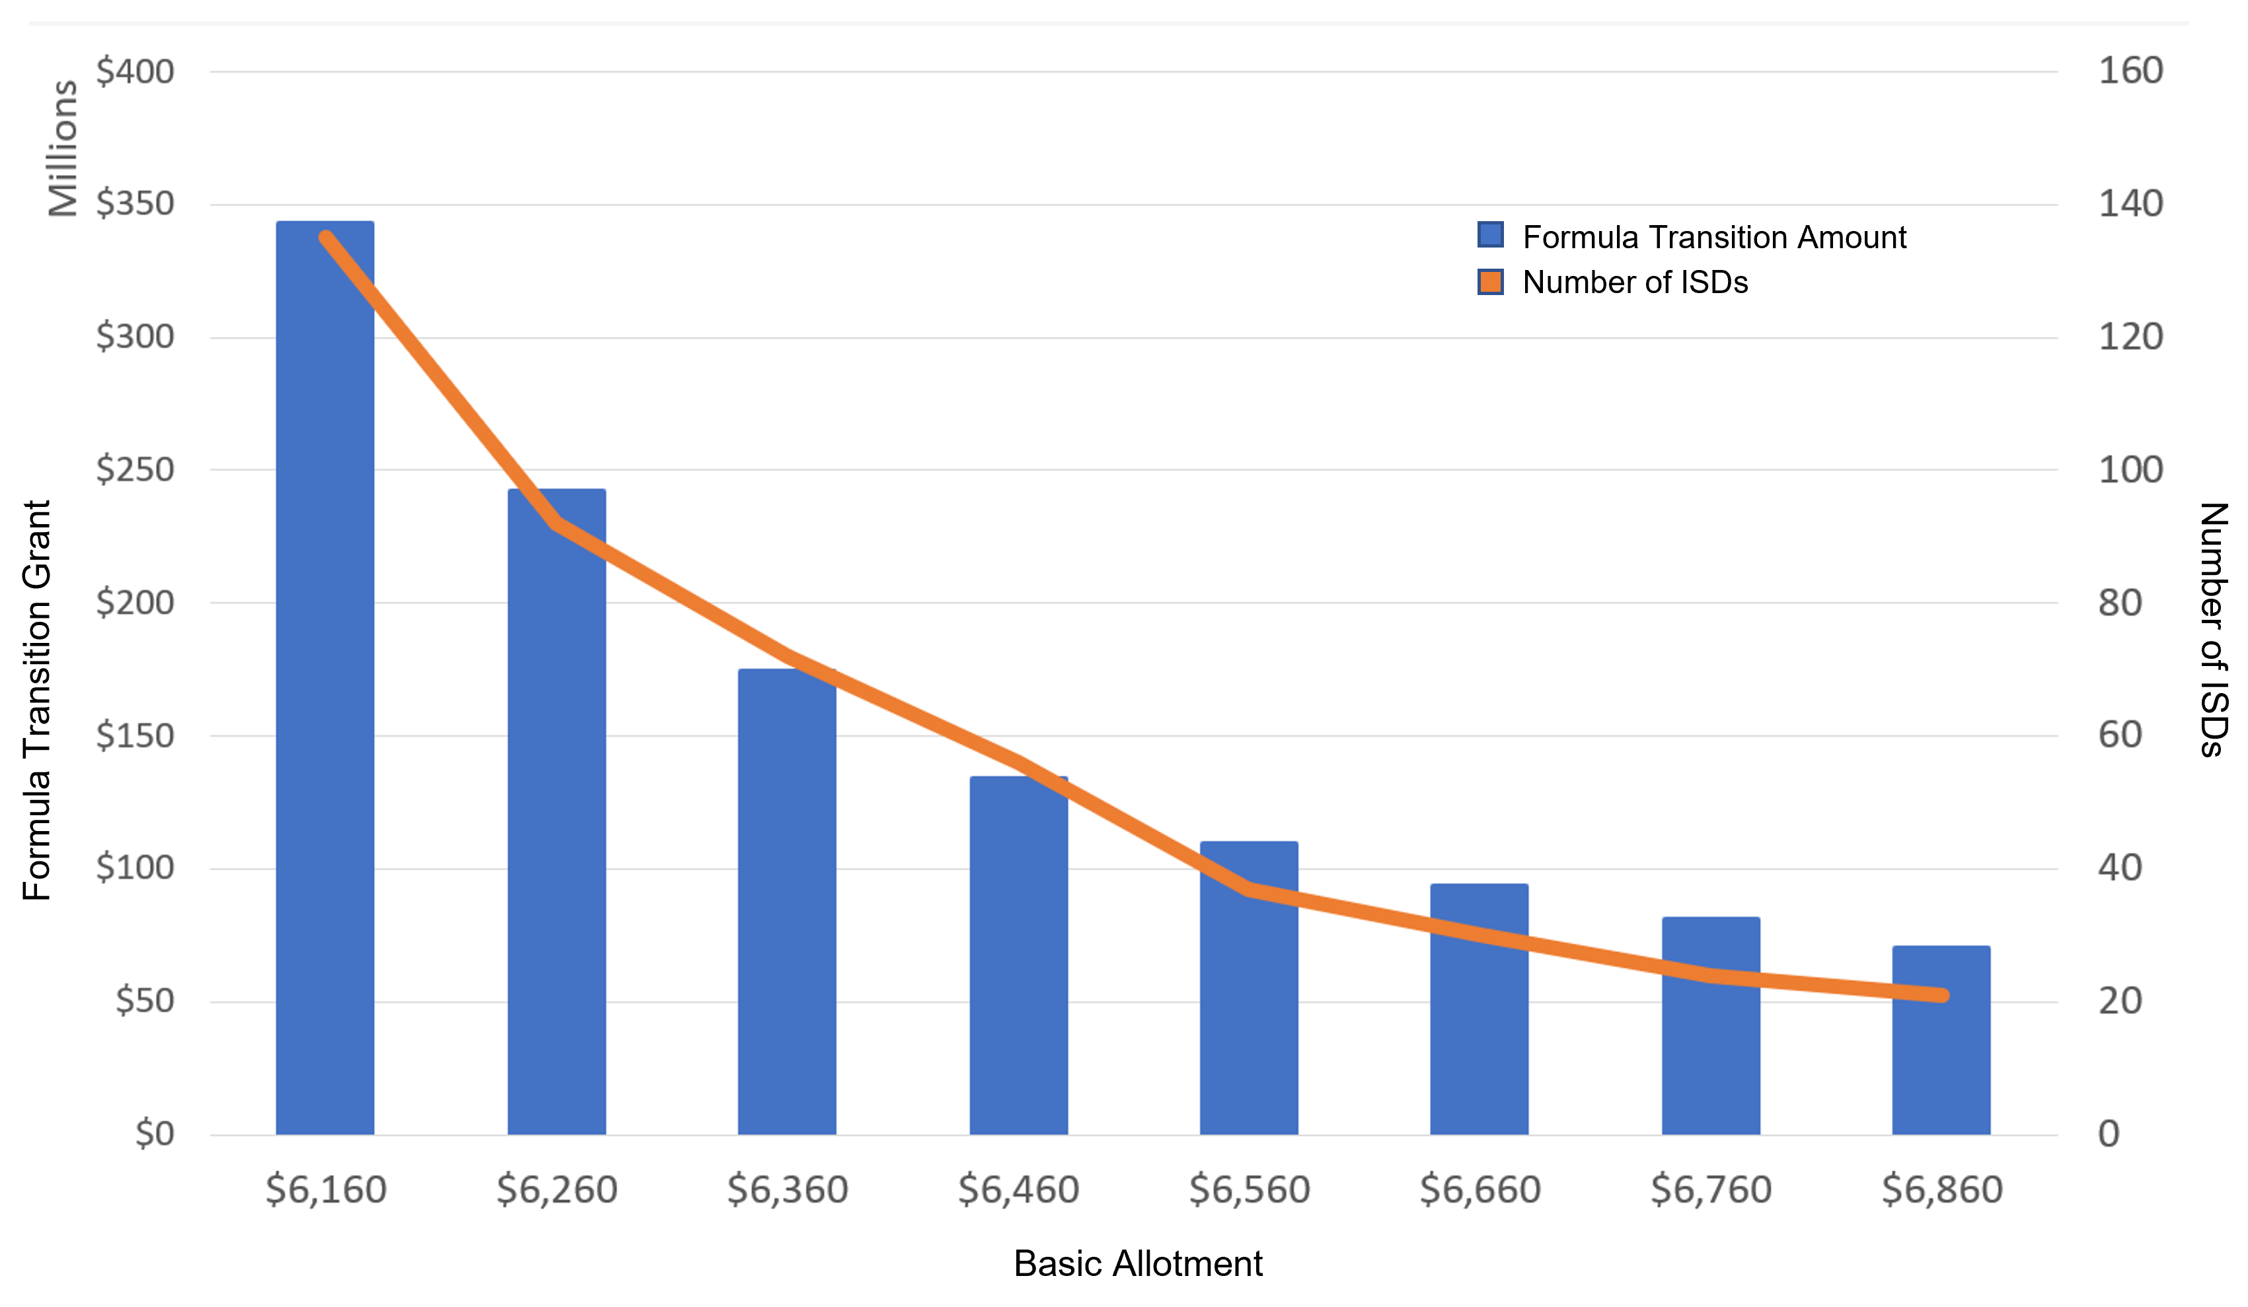
Formula Transition Grant Total per $100 Increase in Basic Allotment

Slide 17
Biennial Cost to Increase Basic Allotment
Billions
HB 3 was supposed to deliver $11.6 billion for the biennium (split between new $ and tax compression); was actually $6.4 billion after $5.2 billion FSP reduction in 2021.

Slide 18

Chapter 313
Chapter 313 of the Tax Code will expire December 1, 2022.
Attempts to extend the sunset date failed in the Senate
Opposition to including renewable energy
Economic Development Incentives likely to return, but in what form?

Slide 19
Fund Balances
Champion for fund balance reforms is retiring, but concerns remain among returning legislators
Assign and designate what is needed for your district
Make strategic choices with ESSER dollars

Slide 20
Voter-Approval Tax Rate (VATR) Elections
Without legislative help, many districts look to local taxpayers
VATR Election must occur in November (following adoption of tax rate)
Timing considerations
Efficiency audit not required in 2022, will be required in 2023 (baring another disaster)

Slide 21
Voter-Approval Tax Rate Elections Outcomes
42% approval rate in 2020 (5 of 12)
79% approval rate in 2021 (15 of 19)
2 districts saw approval for additional 12 cents in 2021, while most sought to access 2-3 pennies
Notes:
Overall, we saw a MUCH higher approval rate. Looking at the tax rates proposed for adoption, I noticed something comparing the years. While we saw some districts in both years pursue both a rate that was 12-13 cents higher vs. some that were 2-3 pennies more, we saw more districts attempt the much higher rate in 2020 and fail compared to the vast majority of districts in 2021 that sought access to 2-3 golden pennies. Additionally, given the effect of ongoing tax rate compression, there were a number of districts for which the 2-3 cent increase (sometimes combined with I&S and sometimes not) still produced a lower overall tax rate than the previous year, and that was an easier sell with voters.

Slide 22
Percent of Bond Measures Carried or Defeated

Slide 23
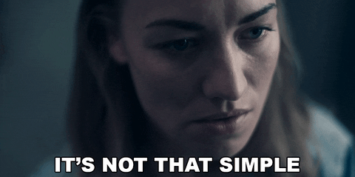
THIS IS A PROPERTY TAX INCREASE
As added in 2019, Education Code 45.003 (b-1):
  The ballot proposition under Subsection (b) must include the following statement: "THIS IS A PROPERTY TAX INCREASE."

Slide 24
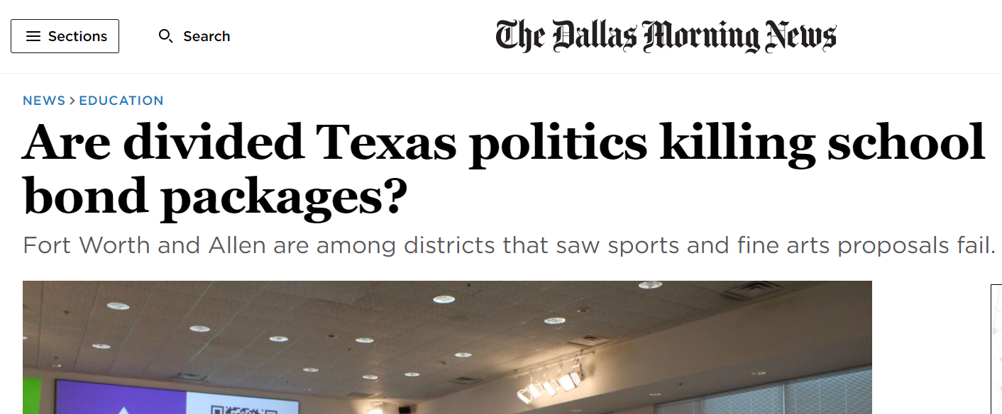
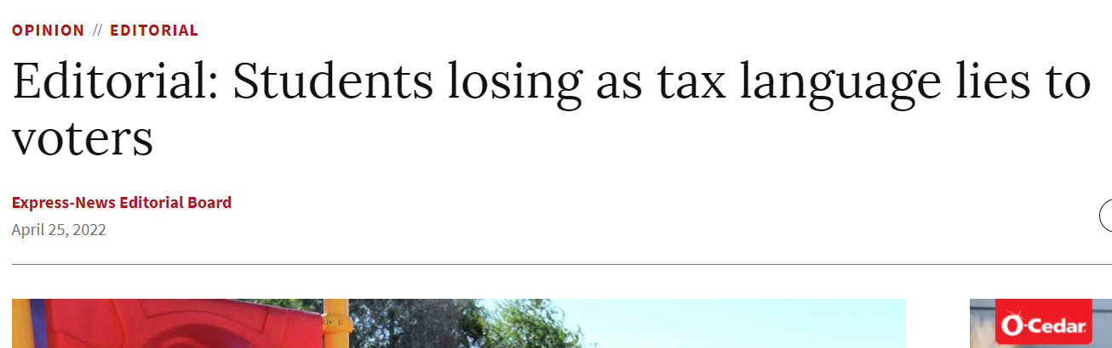

Slide 25
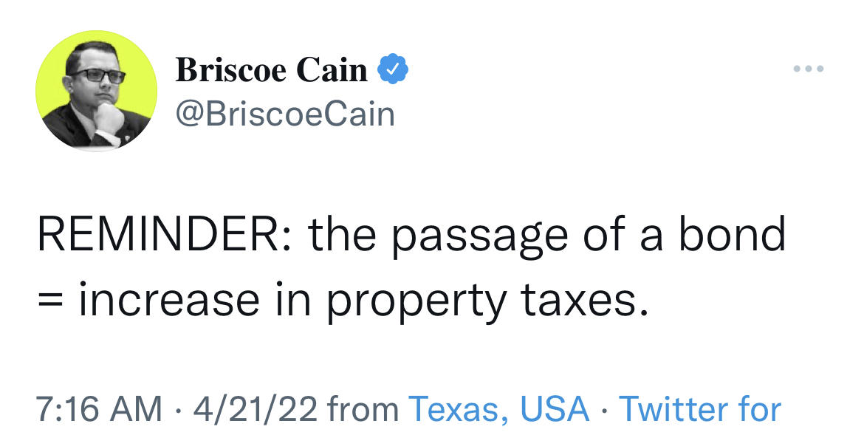
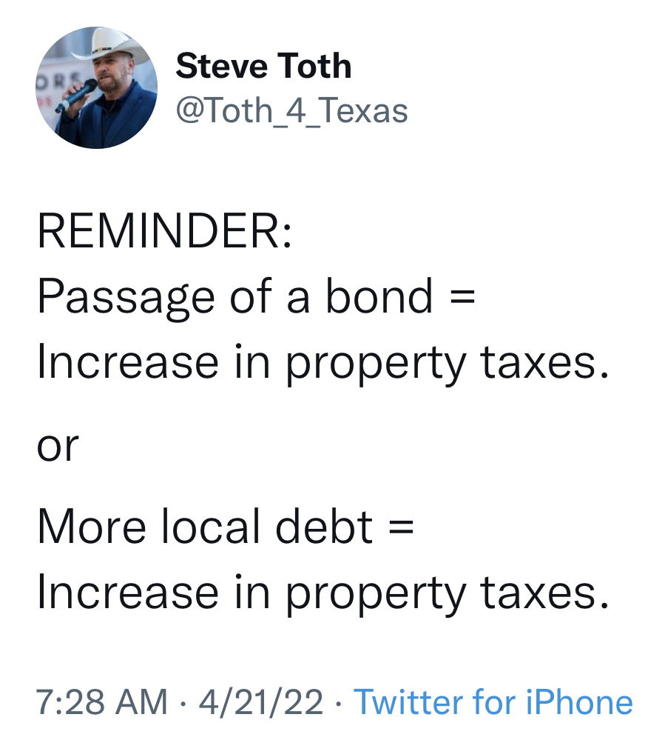
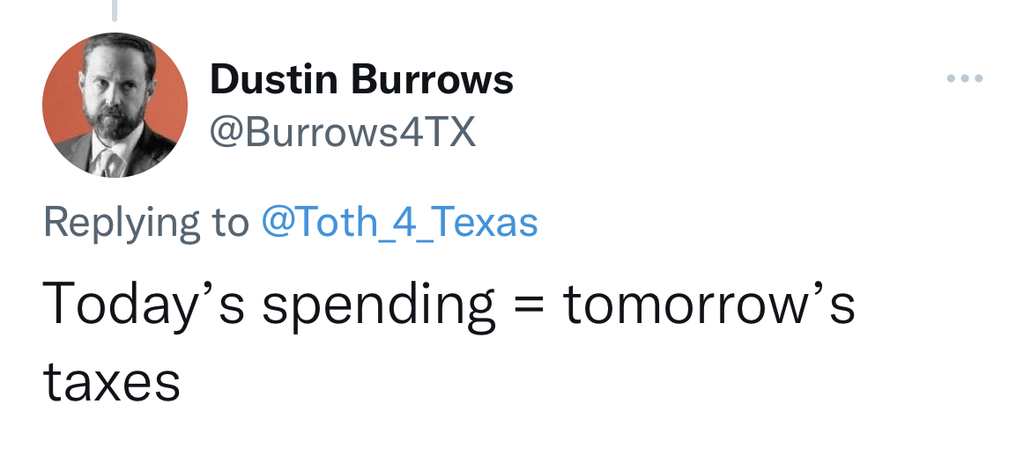
THIS IS A PROPERTY TAX INCREASE

Slide 26
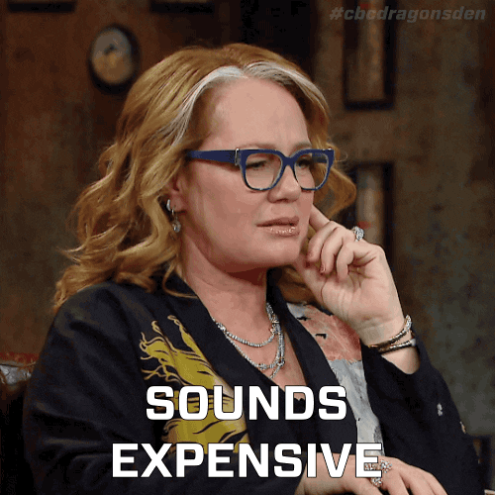
Increased Demands
HB 4545 accelerated instruction and tutoring requirements
Teacher and staff shortages
School safety

Slide 27
Total Enrollment vs. Charter School Enrollment
 | FY 16 | FY 17
Total Enrollment (including charters) | 4,954,033 | 5,038,494
Charter School Enrollment | 235,360 | 260,663
3% growth
 | FY 22 | FY 23
Total Enrollment (including charters) | 5,131,468 | 5,167,995
Charter School Enrollment | 362,930 | 395,079
52% growth
 | Total Enrollment | Charter Enrollment
Difference in FY17 and FY 23 | 129,501 | 134,416
Notes:
You can compare 16 & 17 to 22 & 23. And while you see a 3% growth in enrollment overall, you have a 52% growth in charter school enrollment since the time that Mike Morath became commissioner. When you look at the difference in total enrollment (because the total enrollment figures include charters), total enrollment in the state during that same time grew by 129,501 students while charter school enrollment alone grew by more than that. Total enrollment grew by less than what charter school enrollment grew by in that time. Let that sink in.

Slide 28
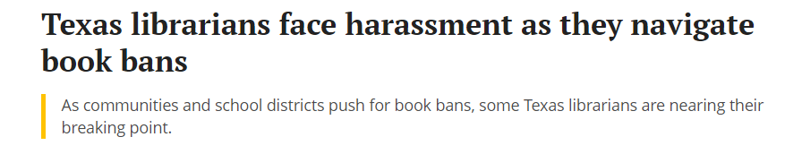
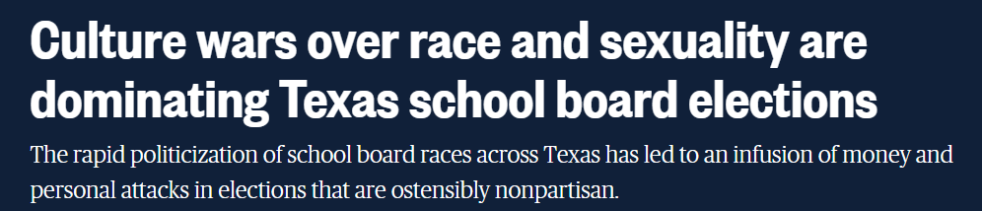
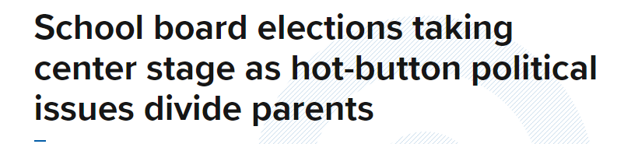

Slide 29


Slide 30
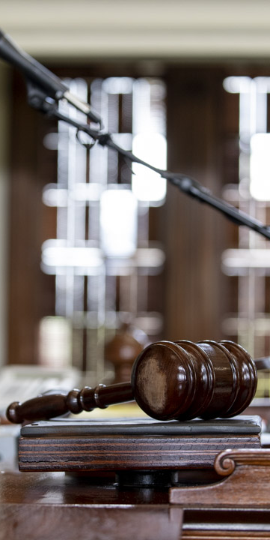
What to Expect in the 88th
THE MORE THINGS CHANGE,
THE MORE THEY STAY THE SAME…
Despite high turnover, don’t expect much to change
New maps ensure Republican control in both chambers
New priorities will determine the road map
Less rural representation may pave the way for private school vouchers
Notes:
But someone will step forward and fill those seats. And while many of the people may change, we aren’t expecting much else will. As you could see on that list of folks retiring or running elsewhere, we’re losing some moderate and rational thinkers. Those folks are likely to replaced with individuals who are more extreme (regardless of their political leanings, we expect newly elected members to be either more conservative or more liberal in most cases than who they are replacing)

Slide 31
What to Expect in the 88th
BUDGET SURPLUS
Money. You can expect lots of money.
How will they spend $12 billion+? You can bet on some increased property tax compression.
Will it be enough to address inflation?
Will it be sustainable long-term?

Slide 32
What to Expect in the 88th
TEMPTATION OF STATE CONTROL
Republican leaders no longer champion local control
Trust is gone
Will school district elections see changes?
Local government limitations, yet increased focus on empowering parental decisions
Notes:
We saw again and again this session the theme of eroding local control. State leaders tend to forget that the same folks that elect them to the offices they hold select who serves at the local level. They don’t trust voters to make good choices at the local level and they certainly don’t trust local elected leaders to make the right decision. Thus, we see an increase of more and more state control of things—in schools and elsewhere. In large part, I attribute that to the loss of trust between state leaders and local school officials. That’s something we have to work to rebuild. While it may seem easier for them to make decisions in a vacuum and not consult with those back home (or bother to case what those at home think), the easy decision is often not the best decision. While they may not trust local officials or local voters, they do seem to implicitly trust parents and want to empower them more and more (except the parents they disagree with—not them).

Slide 33
What to Expect in the 88th
CONTINUED CULTURE WARS
Concerns over library books that are pornographic likely to continue (only this time with legislation!)
Curriculum controls likely to strengthen.
Continued emphasis on parent empowerment.
What will 2023’s “bathroom bill” be?

Slide 34
What to Expect in the 88th
EMPHASIS ON TEACHERS
The last time additional state funding was provided, it came with strings tied to teacher salary increases
Less than half of districts are participating in teacher incentives, but might they be expanded?

Slide 35
What to Expect in the 88th
ECONOMIC DEVELOPMENT INCENTIVES
Chapter 313 was not renewed during the 87th Legislative Session; will expire December 31, 2022.
Attempt to address in third special session fizzled.
Incentives will likely be on the table in 2023, but are not likely to be as advantageous to schools.
Notes:
A couple of you asked about an update of where we stand with Chapter 313 agreements. As you know, that chapter of the tax code was not renewed and therefore set to expire at the end of 2022. There was an attempt to propose a two year extension during the third special session, and ultimately it was determined that the same obstacle from the regular session remained in the special session. So I think we can expect a blank slate for economic development deals in 2023, and I don’t think those incentives will be very beneficial to schools, which means they will rarely be used. Stay tuned…it’s still a long road ahead of us on that one.

Slide 36
What to Expect in the 88th
SCHOOL SAFETY
The School Safety Allotment of $9.72/student wasn’t enough to protect students and teachers in Uvalde. How much spending would have been enough?
Policy changes likely to require more hardening of school buildings and other measures to increase safety.

Slide 37
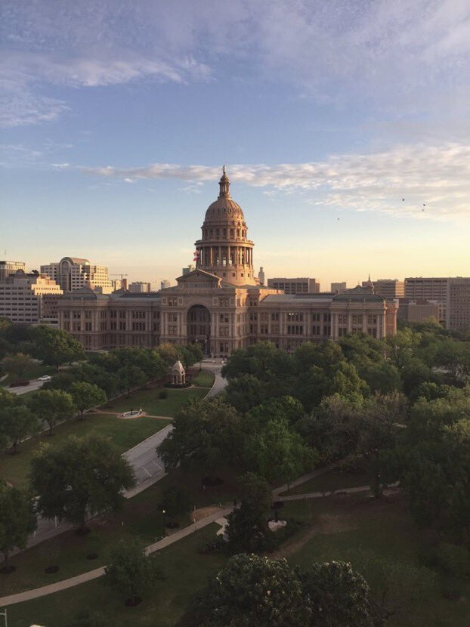
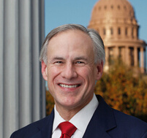
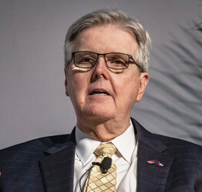
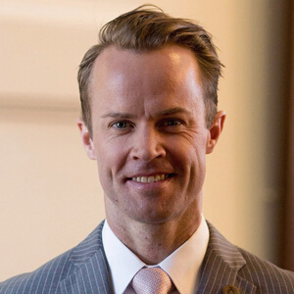
LEADERSHIP
GOVERNOR GREG ABBOTT
Current approval ratings are low, but will that matter in the 2022 election?
LT. GOVERNOR DAN PATRICK
It's Dan Patrick's Senate, and he makes the rules.
He had 31 goals in 2021, and he accomplished 26.
SPEAKER DADE PHELAN
The original “Phelan 83” has dwindled some, but he is on track for his second session as Speaker.

Slide 38
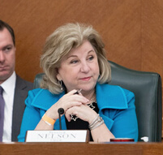
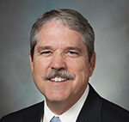

LIEUTENANTS
SENATE FINANCE CHAIR
SENATOR JANE NELSON
Nelson is stepping down after serving in the Senate since 1993 & as Finance Chair since 2017.
SENATE EDUCATION CHAIR
SENATOR LARRY TAYLOR
Taylor, as he has chaired the Senate Education Committee since 2017, but he won’t return in 2023.
HOUSE PUBLIC EDUCATION CHAIR
REP. HAROLD DUTTON
After 24 years on the committee, he finally became Chair. But will he stay in that position?

Slide 39
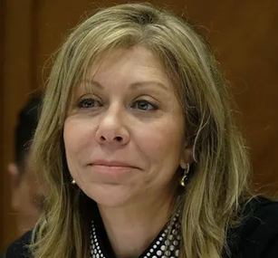
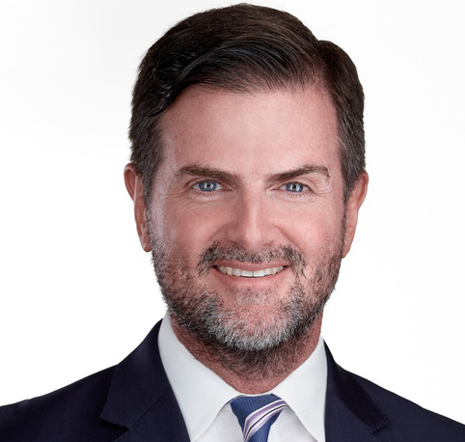
LIEUTENANTS
SENATE FINANCE CHAIR
SENATOR JOAN HUFFMAN
Huffman previously led State Affairs and Redistricting. Now she has been tapped to lead Finance.
SENATE EDUCATION CHAIR
SENATOR BRANDON CREIGHTON
Higher Education and Education have been combined into one committee led by Creighton.
Notes:
We went from Jane to Joan.

Slide 40
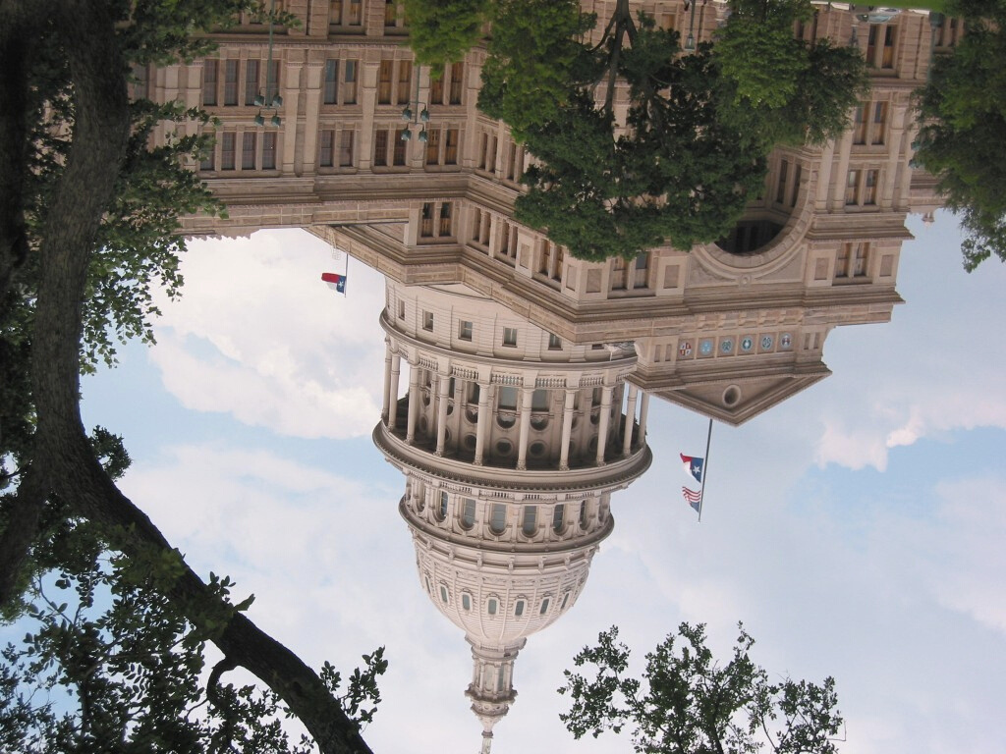
Legislative Turnover
REDISTRICTING
Redistricting typically brings changes in party break-down, in people, and in the schools they represent.
RETIREMENTS
Six announced retirements in Senate and 27 in the House. Plus two House members had their retirement decided by voters. (So far)
CHAIRMANSHIP CHANGES
Several key chairs have announced retirements, and more could change.
Notes:
This is the time when we redraw the maps every 10 years, and that means that legislative districts are going to change. That typically brings some of the highest amounts of turnover you might see between sessions. You know what else does that? This toxic legislative cycle we’ve been living through (and we’re not done yet), and we expect quite a few more to come.
And just as changes in personalities can change the dynamics and outcome of a session, so can the composition of chairmanships.

Slide 41
Legislative Turnover
Session/Year | Freshman House Members | Freshman Senate Members
83rd/2013 | 41 | 5
84th/2015 | 24 | 8
85th/2017 | 22 | 3
86th/2019 | 27 | 6
87th/2021 | 16 | 4
88th/2023 | 29 (so far) | 6
Notes:
Just to put things in perspective about the impact redistricting can have, you can see the turnover numbers from the last time we had new maps in 2013. We can probably expect similar numbers in the House this time around, and I would not be surprised if we saw the number in the Senate grow a bit higher as well.

Slide 42
Legislative Turnover
NOT RETURNING TO THE TEXAS SENATE
Dawn Buckingham (R-Lakeway)
Eddie Lucio (D-Brownsville)
Jane Nelson (R-Flower Mound)
Kel Seliger (R-Amarillo)
Larry Taylor (R-Friendswood)
Notes:
And while numbers of new members are important, it is also important to note who is stepping down. On this list of five, you have senators that rank 3rd, 4th, and 7th in terms of seniority. This is a big deal. Lucio served in the Senate for 30 years, Nelson for 28, and Seliger for 17. Taylor has been in the Senate since 2013, but served for many years in the House before that. It’s a loss of a lot of institutional knowledge.

Slide 43
Legislative Turnover
NOT RETURNING TO THE TEXAS HOUSE
Kyle Biedermann (R-Fredericksburg)
Jeff Cason (R-Bedford)
John Cyrier (R-Lockhart)
Jake Ellzey (R-Waxahachie)
John Frullo (R-Lubbock)
Dan Huberty (R-Humble)
Phil King (R-Weatherford)
Matt Krause (R-Fort Worth)
Lyle Larson (R-San Antonio)
Ben Leman (R-Iola)
Mayes Middleton (R-Wallisville)
Jim Murphy (R-Houston)
Chris Paddie (R-Marshall)
Tan Parker (R-Flower Mound)
Scott Sanford (R-McKinney)
Phil Stephenson (R-Wharton)
James White (R-Hillister)
Michelle Beckley (D-Carrollton)
Garnet Coleman (D-Houston)
Jasmine Crockett (D-Dallas)
Joe Deshotel (D-Beaumont)
Alex Domiguez (D-Brownsville)
Art Fierro (D-El Paso)
Celia Israel (D-Austin)
Eddie Lucio, III (D-Brownsville)
Ina Minjarez (D-San Antonio)
Leo Pacheco (D-San Antonio)
Eddie Rodriguez (D-Austin)
John Turner (D-Dallas)
Notes:
5 of the 29 are retiring chairmen. At least 4 more on this list have been chairs in the past.

Slide 44
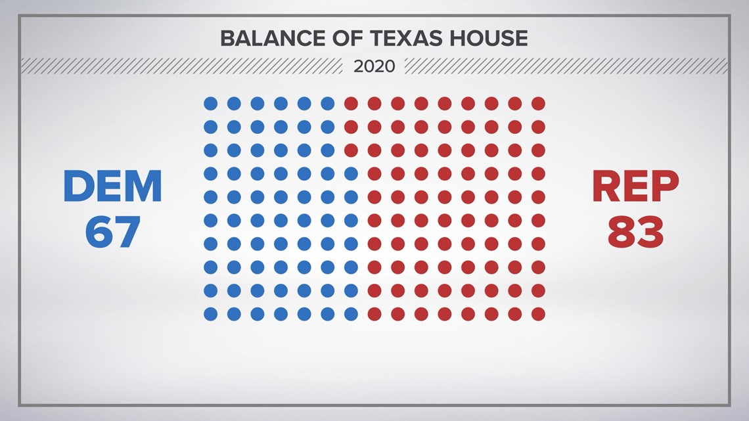

Partisan balance not likely to change
Texas House of Representatives
Texas Senate
2021
44% to 55% split likely to remain
2-3 seats may be in play
42% to 58% split likely to remain
13-18 split should hold steady

Slide 45
Legislators with 50% or more of voting-age population residing in Chapter 49 District
Texas Senate
Texas House
11
35%
48
32%

Slide 46
Friends in the Senate?
Senate District | Senator in 88th | Party | % Pop 18+ in Ch 49
14 | Sarah Eckhardt | D | 99%
12 | Tan Parker | R | 94%
25 | Donna Campbell | R | 82%
8 | Angela Paxton | R | 64%
16 | Nathan Johnson | D | 63%
13 | Borris Miles | D | 63%
30 | Drew Springer | R | 60%
23 | Royce West | D | 58%
11 | Mayes Middleton | R | 51%
15 | John Whitmire | D | 50%
5 | Charles Schwertner | R | 50%
5 Democrats
6 Republicans
3 Freshmen
3 Chairs

Slide 47
Friends in the House?
Legislator | Party | % 18+ in Ch 49
Vikki Goodwin | D | 100%
Donna Howard | D | 100%
Gina Hinojosa | D | 100%
James Talarico | D | 100%
Ben Bumgarner | R | 100%
Kronda Thimesch | R | 100%
HD 70 | R | 100%
Venton C. Jones | D | 100%
Morgan Meyer | R | 100%
John Bryant | D | 100%
Ann Johnson | D | 100%
John Bucy | D | 100%
Christina Morales | D | 100%
Giovanni Capriglione | R | 100%
Maria Luisa "Lulu" Flores | D | 100%
Carrie Isaac | R | 100%
Legislator | Party | % 18+ in Ch 49
Shawn Thierry | D | 99%
Steve Toth | R | 99%
Julie Johnson | D | 99%
Sheryl Cole | D | 97%
Mano DeAyala | R | 97%
Ellen Troxclair | R | 96%
Rafael Anchia | D | 96%
Steve Allison | R | 96%
Tom Craddick | R | 93%
Terry Wilson | R | 90%
Toni Rose | D | 85%
Jolanda Jones | D | 84%
Richard Hayes | R | 82%
Frederick Frazier | R | 81%
Dennis Paul | R | 81%
Lynn Stucky | R | 81%

Slide 48
Friends in the House?
Legislator | Party | % 18+ in Ch 49
Christian "Manuel" Hayes | D | 79%
Matt Shaheen | R | 79%
Jared Patterson | R | 78%
Will Metcalf | R | 76%
Justin Holland | R | 75%
Ana-Maria Ramos | D | 75%
Teresa Leo-Wilson | R | 74%
Jeff Leach | R | 74%
Gene Wu | D | 72%
Nate Schatzline | R | 71%
Alma Allen | D | 64%
Greg Bonnen | R | 62%
John Raney | R | 60%
Andrew Murr | R | 60%
Caroline Harris | R | 59%
Candy Noble | R | 56%
20 Democrats
28 Republicans
16 Freshmen
5 Chairs, (including Appropriations+ Ways & Means)
Speaker Phelan: 30%

Slide 49
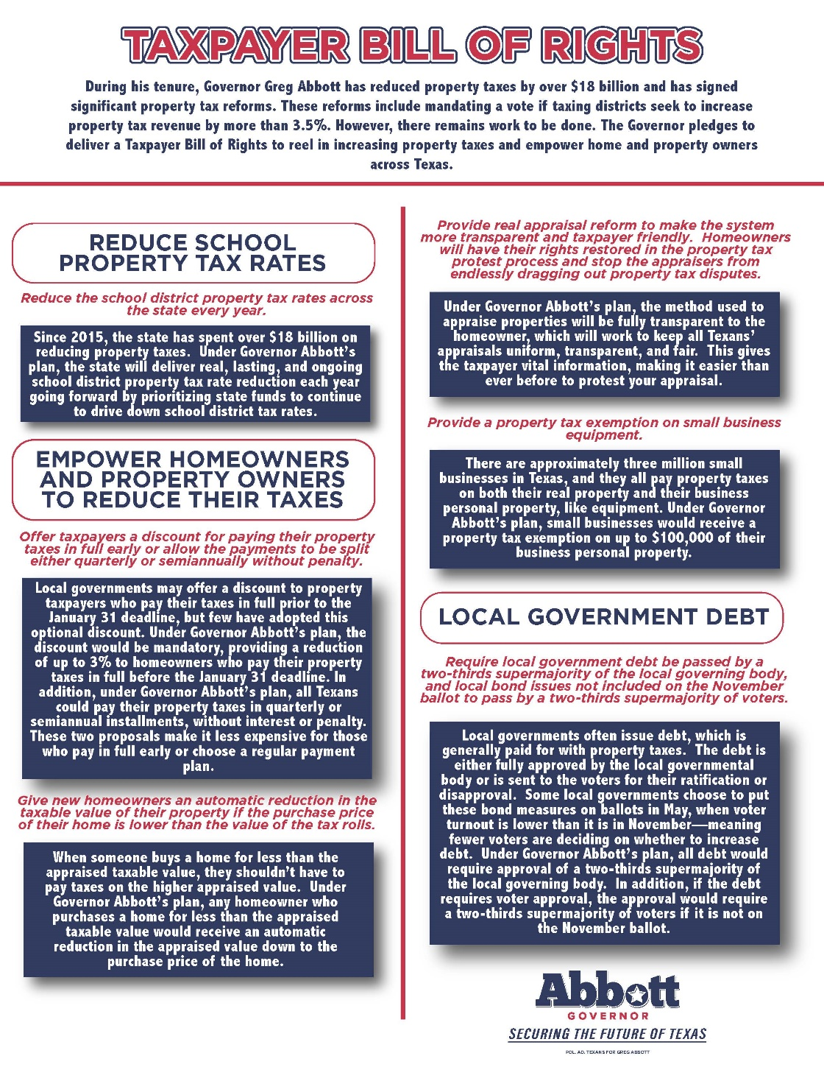
Governor Abbott’s Taxpayer Bill of Rights
Reduce school district property tax rates every year
Offer taxpayers discount for paying property taxes in full early or allow split payments without penalty
Real appraisal reform that restores rights of homeowners
Property tax exemption on small business equipment
Require local government debt by passed by two-thirds majority of local governing body and propositions on May ballot must be passed by two-thirds of voters

Slide 50
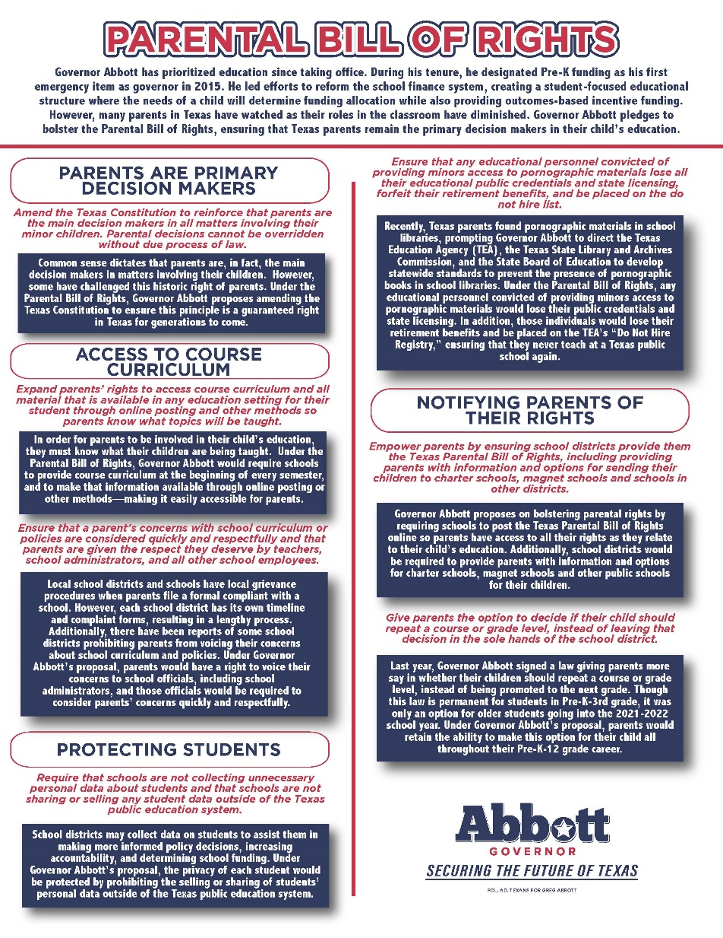
Governor Abbott’s Parental Bill of Rights
Amend Texas Constitution to reinforce that parents are the main decision makers in all matters involving their minor children.
Expand parents’ rights to access course curriculum and all material
Ensure that a parent’s concerns with school curriculum or policies are considered quickly and respectfully and that parents are given the respect they deserve
Ensure schools are not collecting unnecessary personal data about students and that schools are not sharing or selling any student data
Ensure that any educational personnel convicted of providing minors access to pornographic materials lose all their educational public credentials and retirement benefits
Provide Texas Parental Bill of Rights with information and options for sending the children to charter schools, magnet schools and schools in other districts.
Give parents the option to decide if their child should repeat a course or grade level, instead of leaving that decision in the sole hands of the school district.

Slide 51
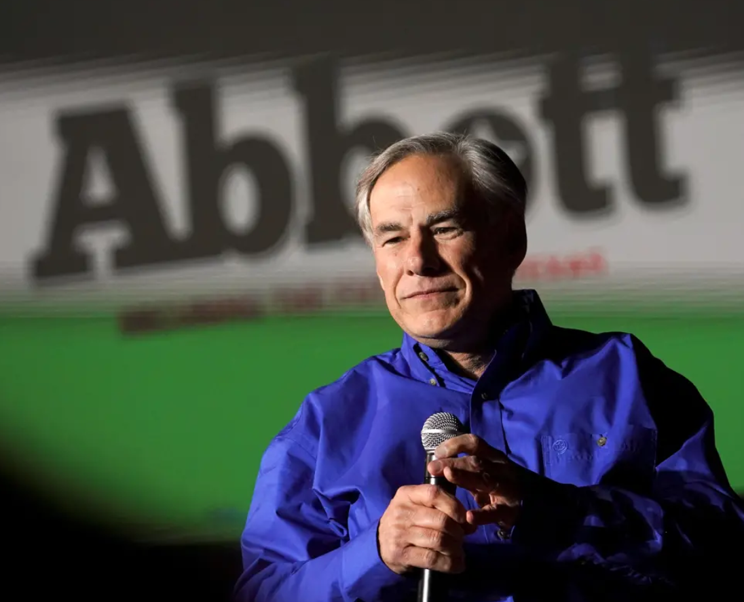
Governor Greg Abbott
May 2022
“Empowering parents means giving them the choice to send their children to any public school, charter school or private school with state funding following the student.”

Slide 52
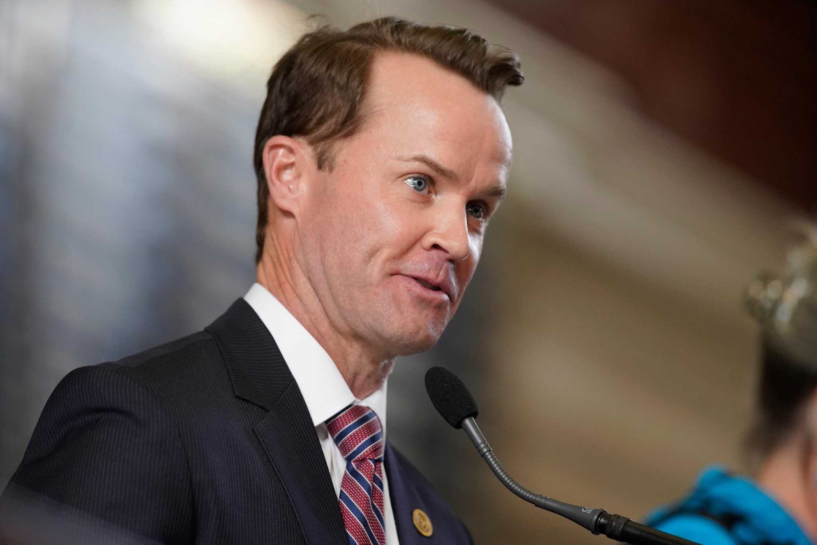
Speaker Dade Phelan
May 2022
“The delta’s pretty large on school choice, on getting it across the finish line.”

Slide 53


Slide 54
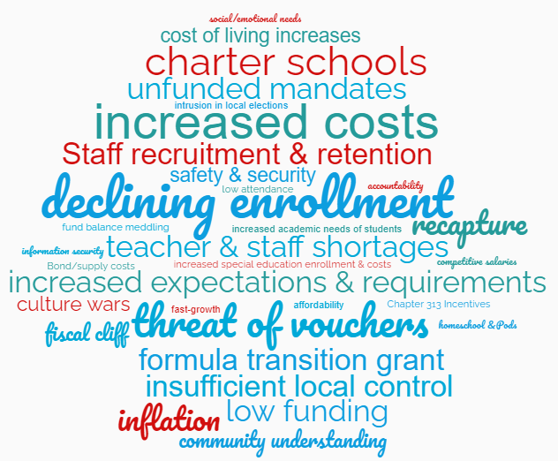
CHALLENGES

Slide 55
Most commonly identified challenges
Teacher & staff shortages/retention & recruitment
Declining enrollment
Low funding & increased costs/inflation
Threat of vouchers/charter schools
Insufficient local control
Expiring formula transition grants
Recapture
Safety & Security

Slide 56
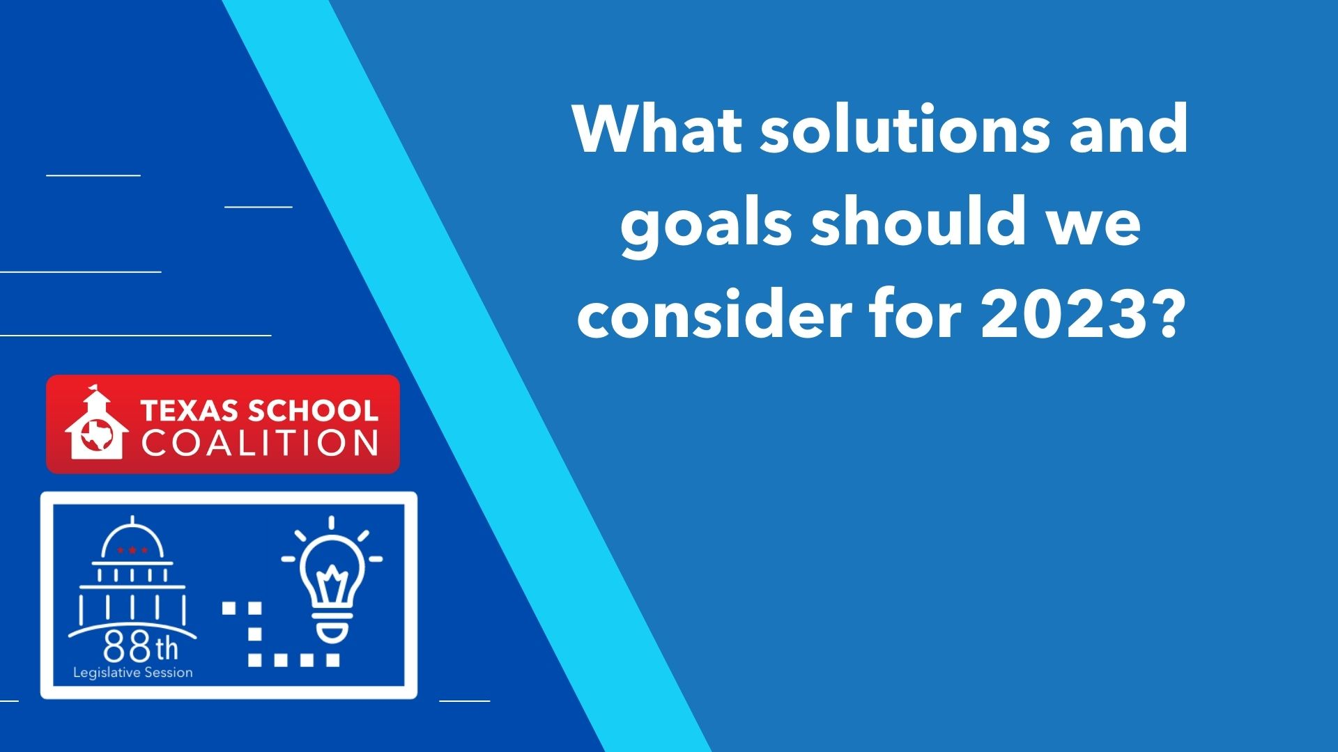

Slide 57
Solutions/Goals with Highest priority indicated
Continuation of Formula Transition Grant
Increase Basic Allotment in relation to property values (statewide)
Keep public dollars in public schools where publically accountable
Reach national average for per-student funding by 2030
Cap on recapture
Enrollment-based funding (with attendance requirements)
Early payment discount incentive for recapture

Slide 58
Solutions/Goals with next level of priority
Bring back (updated) CEI
Special Education Funding Increase
Mental Health Allotment
Increased dollars and flexibility for school safety allotment
Accountability for charters
Taxparency
Recapture flexibility

Slide 59
Other Solutions/Goals
Recapture above estimate stays in public education
Fully fund Instructional Materials Allotment
Recapture reduction for economically disadvantaged students
Perform cost of education study with unfunded mandates, cost of living, and student population
Increase teacher pipeline (Future Teacher and Micro credentials)
Inflation Adjustment
Local control/ preserve flexibility

Slide 60
Offense vs. Defense
Continue of Formula Transition Grant
Increase Basic Allotment
Increase funding to reach national average by 2030
Place a cap on recapture
Shift to enrollment-based funding
Provide an early payment discount incentive for recapture
Bring back CEI
Protect against vouchers (Keep public dollars in public schools where publicly accountable)
Protect against increased recapture
Protect local control
Protect board authority for fund balances
Protect against attacks on bond and VATR elections intended to make them more difficult to pass
Protect against new mandates

Slide 61
Matching challenges with solutions
CHALLENGES
SOLUTIONS
Teacher & staff shortages
Declining enrollment
Low funding & increased costs
Vouchers/charter schools
Insufficient local control
Formula transition grants
Recapture
Safety & Security
Continue FTG
Increase BA
Public Accountability for $
National average by 2030
Cap on recapture
Enrollment-based funding
Early payment discount

