Slide 1
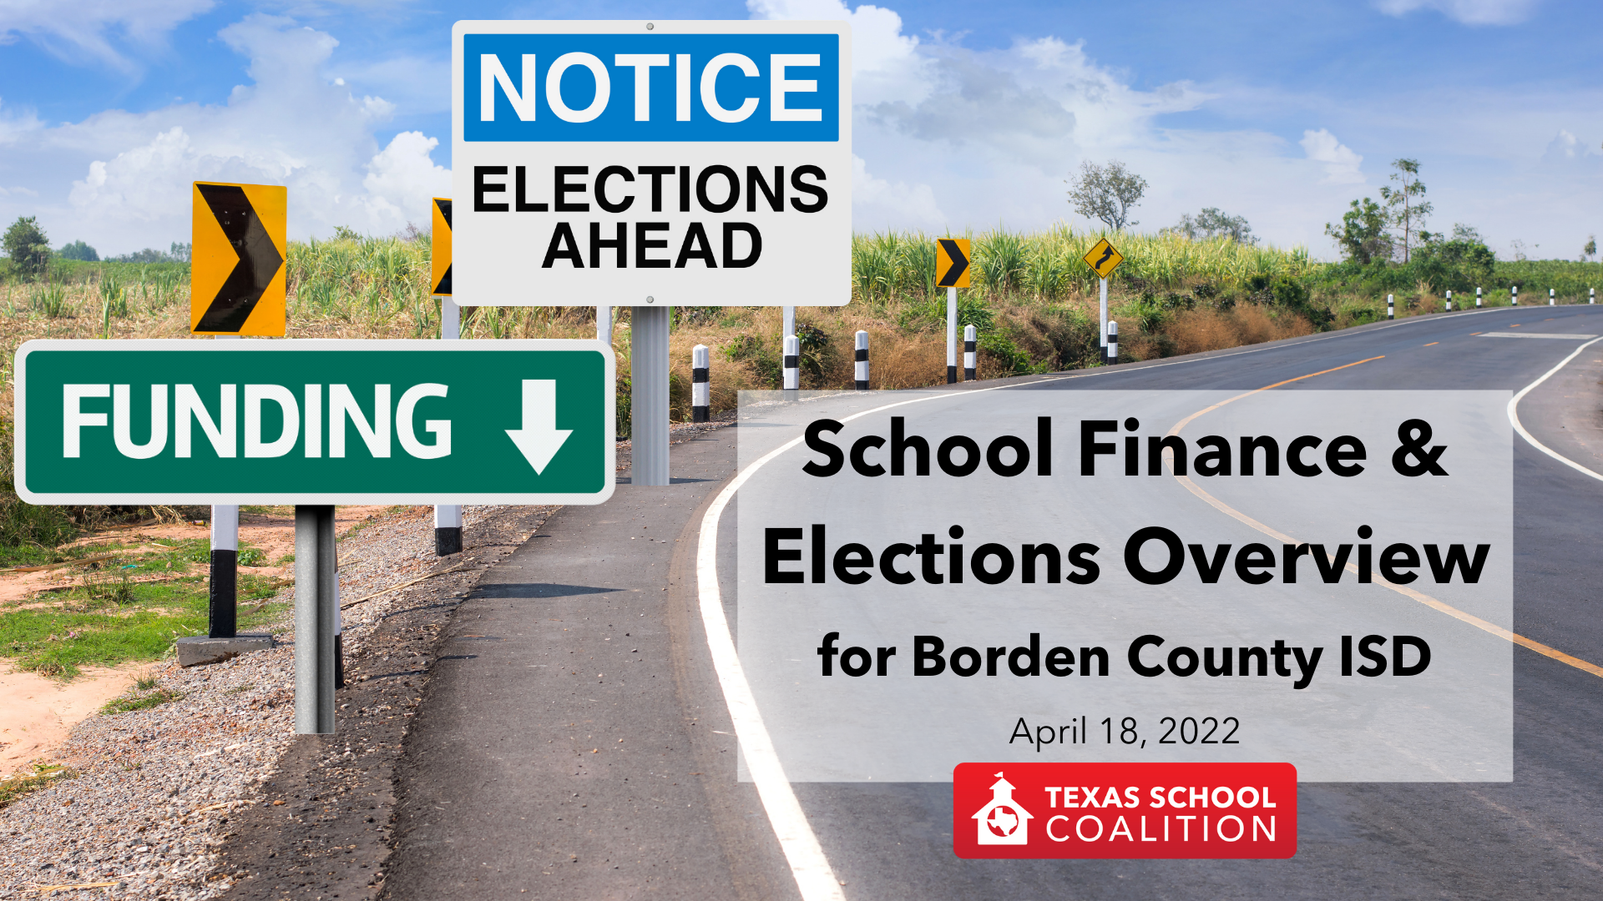
School Finance & Elections
Overview for Borden County ISD
April 18, 2022

Slide 2
School funding losses for Borden County ISD
Additional State Aid for Tax Reduction (ASATR) – expired in 2018
Additional state aid for property value decline – only available/funded in 2018 and 2019
1992 Hold Harmless – repealed by HB 3 in 2019 and replaced by Equalized Wealth Transition Grant (EWTG), which is phased out by 20% every year until it is eliminated in 2025 school year
Notes:
Since 2017 Borden County has lost or will lose three temporary provisions of school finance funding .
The first, Additional State Aid for Tax Reduction (ASATR) was intended to pay for local tax compression after 2006 when tax rates were compressed by 1/3. This provision expired in 2018.
In 2018 and 2019 the district received state aid for property value decline, which lasted only for the 2018-19 state fiscal biennium.
In 2020 the district lost a hold harmless provision limiting recapture, this was replaced by a temporary transition grant, the Equalized Wealth transition grant, however this grant is being phased out and will be eliminated for the 2025 school year.
State and Local revenue available to the district averaged $5.5 million for 2010 to 2017 but is estimated to be just $3.9 million by 2025

Slide 3
Borden County ISD FSP Funding 2016-2025
Notes:
As you can see here, the overall funding for Borden County ISD is expected to take nose dive as you come off the transitional funding from the now repealed 92 hold harmless. Because of the way changes were implemented in 2019, this is not expected to be one of those 1-2 swings you have become accustomed to living through due to being an oil and gas district. The only benefit you now receive from that is on your values for your I&S rate and your golden pennies.

Slide 4
Maintenance & Operations Tax Rate
Tier 2 – “Copper Pennies”
Up to 9 copper pennies available with election
Subject to higher rate of recapture – 75% recaptured
Tier 2 – “Golden Pennies”
Currently taxing at $0.05 of a possible $0.08 (with election)
NOT subject to recapture - $89,600 per penny expected in 22-23
Tier 1 – “Silver Pennies”
Currently taxing at $0.9164 Tier 1 rate
Rate will continue to be compressed over time ($0.8046 expected for 2022-23 school year), but does have an “equity floor”
Revenue in excess of entitlement recaptured at a rate of about 57% ($32,000/penny yield now, $38,700/penny expected 22-23)
Notes:
The bar on the left here is intended to be proportional to the pennies available to you in each of these options. We’re going to begin at the bottom [CLICK] what I refer to as the silver pennies. Golden penny yield is $98.56 for other districts, but golden pennies are worth more in Borden County ISD (will grow in value if property values increase, and could also become less valuable if they decline). Copper Penny Yield is $49.28/penny/WADA

Slide 5
Voter-Approval Tax Rate (VATR)
Higher of:
Tier 2 Enrichment Rate from previous year or
5 Cents
District’s Maximum Compressed Rate (MCR) for Tier 1 (determined by TEA)
VATR
2021 | $0.92 | $0.05 | $0.97
2022 | $0.80 | $0.05 | $0.85
Notes:
The calculation of VATR involves taking the MCR for Tier 1, which is calculated by TEA once they receive data from the district and your chief appraiser regarding value growth in the district. Then you add the higher of either Tier 2 enrichment rate from the previous year or 5 cents (those numbers are the same for you—5). [CLICK] This table helps put real numbers to those terms—from both the current year and a projected estimate for the year to come. Current projections for the district show 17% growth in values. That level of growth will compress the district’s tax rate about as low as it can possibly go. Even if growth doesn’t continue and values decline again as soon as the very next year, the compression to your tax rate (paid for by the state through a reduction in your Tier 1 recapture) remains.

Slide 6
BCISD Maintenance & Operations Tax Rate
Expected tax rate compression, based on preliminary data showing 17% value growth.
$1.04
$1.04
$0.97
$0.97
$0.85
$0.88
Notes:
If you look at the history of your tax rate (which by the way, I could have taken the chart as far back as 2007 and you would have seen $1.04 across the board). Following passage of HB 3 in 2019, tax rates began to be compressed. You can see how your M&O tax rate is declining. And with current estimates for value growth, a large reduction is expected this year.

Slide 7
Voter-Approval Tax Rate Election (VATRE)
If a district needs to adopt a tax rate that exceeds VATR, it will automatically trigger an election, seeking voter approval for the higher rate
VATR Elections must occur on the November election date
If the proposed rate is not approved by voters, then the district must adopt the lower VATR
Notes:
While you have no control over your Tier 1 rate, you do have control over your Tier 2 rate (pending the approval of voters.

Slide 8
Golden Pennies
Total of 8 available (5 by vote of Board; remaining 3 through VATR election)
100% free of recapture
In 2022-23, expected to be worth $89,600 per penny
Value of golden pennies tied to property values—they increase when values increase and lose value when property values decline

Slide 9
BCISD Maintenance & Operations Tax Rate
$1.04
$1.04
$0.97
$0.97
$0.85
$0.88

Slide 10
Golden Pennies
 | Collections Increase | Recapture Increase | Net Increase
3 cent increase | $268,848 | $0 | $268,848
9 cent increase | $806,542 | $608,361 | $198,181
12 cent increase | $1,075,390 | $608,361 | $467,029
Estimate based on current projections for 2022-2023 school year.

Slide 11
Golden and Copper Pennies
 | Collections Increase | Recapture Increase | Net Increase
3 cent increase | $268,848 | $0 | $268,848
9 cent increase | $806,542 | $608,361 | $198,181
12 cent increase | $1,075,390 | $608,361 | $467,029
Estimate based on current projections for 2022-2023 school year.

Slide 12
Borden County ISD FSP Funding 2016-2025

Slide 13
BCISD FSP Funding with 3-cent 2022 VATRE
Assumes ongoing $500,000 in Ch 313 reimbursement for 2022-2025

Slide 14
VATR Election Considerations
Efficiency Audit required prior to election (but not this year)
Years with growth may allow election to approve lower rate
Timing tied to November election can be tricky
Texas Legislature could make changes in 2023

Slide 15
Voter-Approval Tax Rate Elections (VATRE) Results
2020
2021
Arlington ISD
Eanes ISD
Fort Worth ISD
Franklin ISD
Pringle-Morse CISD
Alamo Heights ISD
Alto ISD
Comal ISD
Godley ISD
Highland Park ISD
Lake Travis ISD
Mansfield ISD
Needville ISD
Pampa ISD
Pearland ISD
11. Plemons-Stinnett-Phillips CISD
12. Rankin ISD
13. Victoria ISD
14. White Settlement ISD
15. Wink-Loving ISD
ADOPTED
Garland ISD
Junction ISD
Needville ISD
Northwest ISD
Pearland ISD
Plemons-Stinnett-Phillips CISD
Rains ISD
Liberty ISD
New Diana ISD
Pflugerville ISD
Rains ISD
FAILED
Notes:
We saw a larger number of VATR Elections proposed and a larger percentage of them pass. You can see on this list that some districts that had failed elections in 2020 tried again this year and were able to adopt a higher rate on the 2nd attempt. One district (Rains ISD) was not so fortunate.

Slide 16
Voter-Approval Tax Rate Elections Outcomes
42% approval rate in 2020 (5 of 12)
79% approval rate in 2021 (15 of 19)
2 districts saw approval for additional 12 cents in 2021, while most sought to access 2-3 pennies
Notes:
Overall, we saw a MUCH higher approval rate. Looking at the tax rates proposed for adoption, I noticed something comparing the years. While we saw some districts in both years pursue both a rate that was 12-13 cents higher vs. some that were 2-3 pennies more, we saw more districts attempt the much higher rate in 2020 and fail compared to the vast majority of districts in 2021 that sought access to 2-3 golden pennies. Additionally, given the effect of ongoing tax rate compression, there were a number of districts for which the 2-3 cent increase (sometimes combined with I&S and sometimes not) still produced a lower overall tax rate than the previous year, and that was an easier sell with voters.

Slide 17
Types of tax rates/elections – M&O vs. I&S
Maintenance & Operations (M&O) | Interest & Sinking (I&S)
Must adopt M&O tax rate to cover expenses of the district’s budget; if necessary revenue for that exceeds VATR, election is required. | Districts must adopt I&S tax rates if the district has debt that was approved by voters through a bond election.
VATR Election in November. | Bond Election in May or November.
May be used for ongoing operations or one-time big purchase/repairs. May be saved in district fund balance, but not for the purpose of avoiding bond election/tax swap. | May be used for bonded indebtedness approved by voters for construction or repair of facilities, buses, technology, or other large purchases/equipment.
May not be used for any purposes prohibited by law. | May not be used for purposes other than debt approved by voters, such as ongoing expenses for staff salaries.
Except golden pennies, subject to recapture. | NOT subject to recapture.

Slide 18
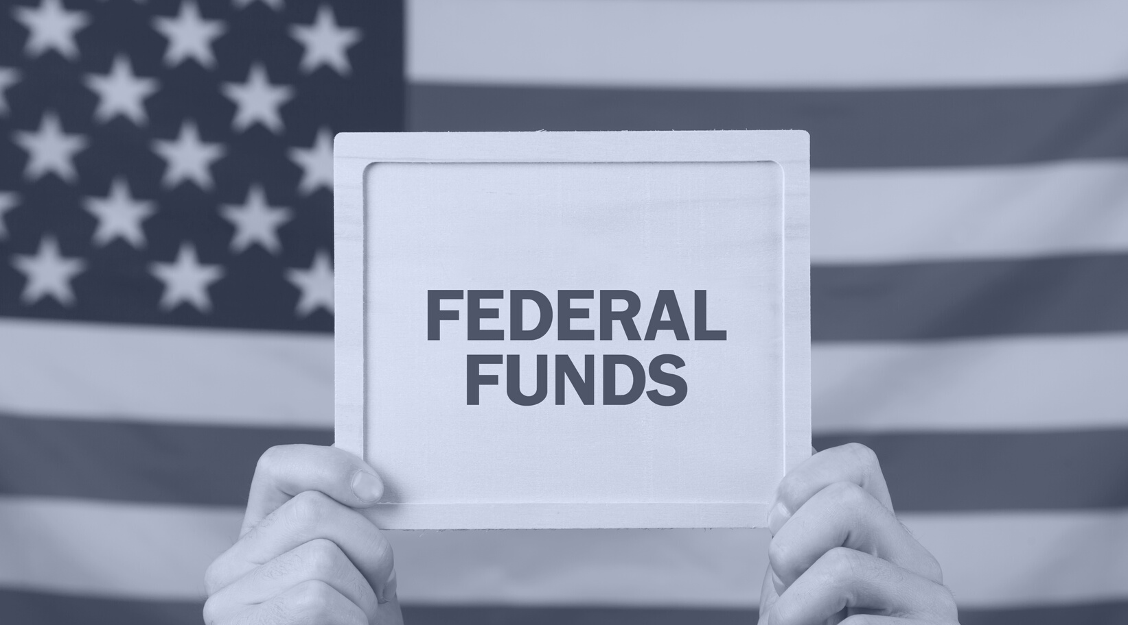
Questions?
Christy Rome
Texas School Coalition
512-732-9072
christy@txsc.org
Notes:
Happy to answer any questions.

