Slide 1
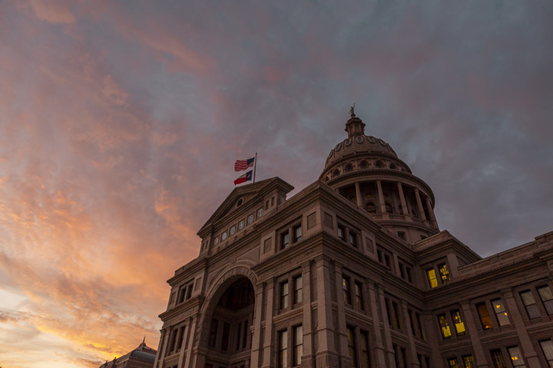
Fall 2021 Update
November 17, 2021

Slide 2
Thank you to our Sponsors!

Slide 3
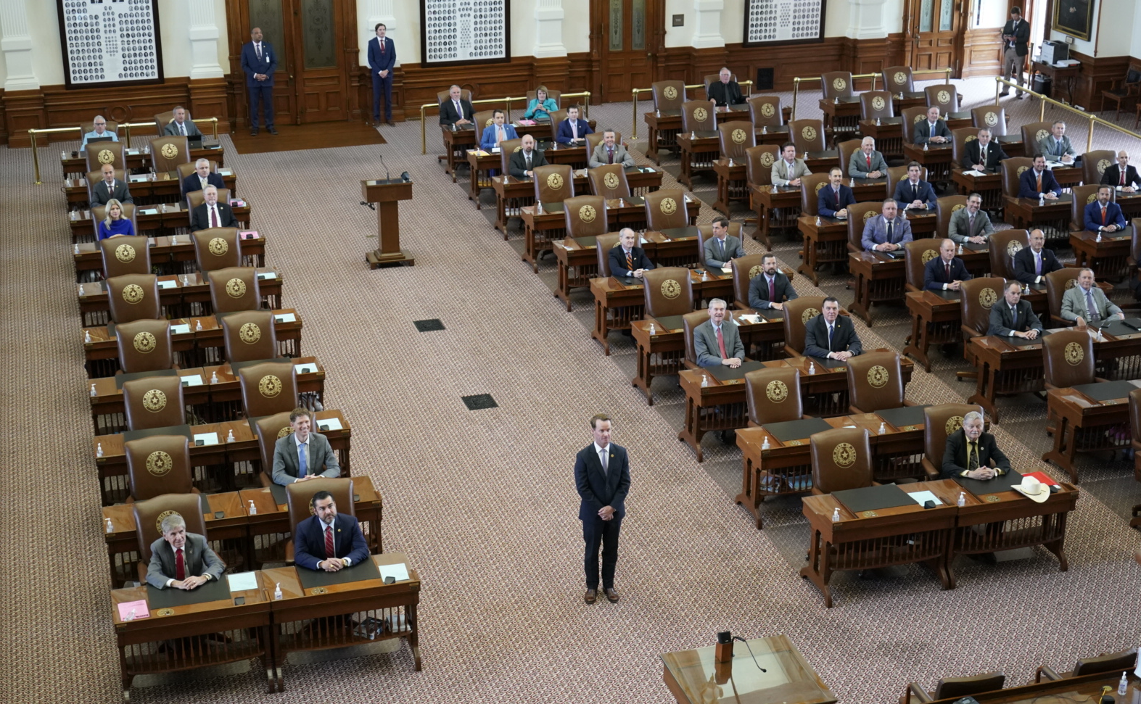
Notes:
I think this photo pretty well captures how the Regular session ended, what the first called special session looked like (and at least half of the second called session). But then everyone eventually came home and they got back to business. Maybe this is the reason legislative appropriations are not based on Average Daily Attendance like schools…

Slide 4
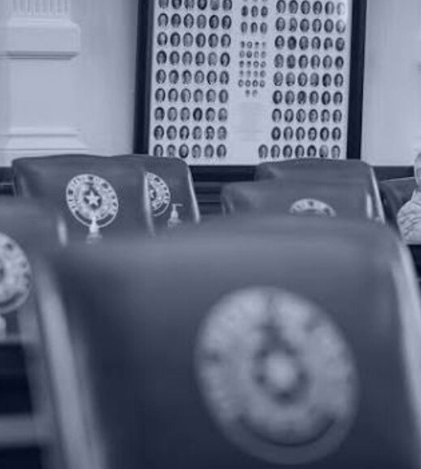
Second Called Special Session
August 7 - September 2
Notes:
The second special began with an equally empty House chamber at first. But then a quorum was achieved and the House began to conduct business. Eventually the elections bill over which members of both parties had some very strong feelings passed and was signed into law. And only after that bill passed did the legislature finally approve of appropriations to continue the legislative branch of government.

Slide 5
Education/school finance bills passed in 2nd Special Session
SB 3 (Hughes/Huberty), anti-Critical Race Theory (CRT)
SB 7 (Huffman/Rogers), the "13th check" for TRS retirees
SB 8 (Bettencourt/Meyer) homestead exemption tax refund for certain homebuyers
SB 9 (Huffman/Dutton) instruction, materials & policies for prevention of child abuse, family violence, and dating violence (requires a parental opt-in)
SB 12/SJR 2 (Bettencourt/Meyer) - property tax rate compression for those on frozen levy (once approved by voters in May 2022).
SB 15 (Taylor/Keith Bell), funding for remote instruction
Notes:
Here is a quick recap of what passed that affects schools in some way during the 2nd special session. The election bill isn’t listed here; while changes to elections certainly affect schools, there was nothing in the bill that singles schools out or impacts school elections in any way that doesn’t impact all elections in general.

Slide 6
Property Tax Relief
SB 8 allows for proportional refund of $25,000 homestead exemption for persons who purchase their home after January 1 of a tax year. Provides additional state aid to make up for lost property tax revenue.
SB 12 provides for a reduction of the frozen levy to reflect property tax compression since 2019, contingent on SJR 2.
SJR 2 takes constitutional amendment for adjustment to frozen levy to the voters for approval in May 2022.
Notes:
Legislators also passed property tax relief bills in the 2nd special. All of these were by Bettencourt and sponsored by Meyer. SB 8 addressed the issue of a homebuyer who purchased a home that was not previously receiving a homestead exemption, as it was not owner occupied before. That homeowner then had to pay higher taxes in the first partial year of ownership before they could apply for the exemption. Now they will be entitled to a refund for their proportional share of the taxes—that refund will be funded by the state.
All of these bills were heard on the first Saturday of the first special session in July. Remember that picture I showed you? Well, I testified for the property tax relief THAT THE STATE SHOULD PAY FOR, not school districts. And Senator Bettencourt listened and amended the bill with our language. The bills didn’t pass in the first special. But when they came back in the second special (and did pass), he filed them with our language providing funding, and that is what ultimately passed. They provided all of five minute’s notice for the hearing on these bills in the second session, and there was no way for me to make it there in time to testify then. So the lesson here is that when presented with an opportunity to weigh in on an issue, take it. You never know if you will get the opportunity again or not.
The last two bills on the list here affect the elderly (65 and older) and disabled on the frozen tax levy. Those folks did not benefit from the tax relief offered through HB 3 in 2019 (because their taxes were frozen). Now, under SB 12 they will be entitled to the same tax relief as everyone else if the constitutional amendment proposed through SJR 2 is adopted in May. Because of the requirement for voter approval, this change will not take effect until tax year 2022.
Again, our recommended language was added to ensure that it is fully funded by the state and will not result in a loss of funding for districts.

Slide 7
SB 15 – Remote Learning
Allows districts rated C or better to receive funding for up to 10% of eligible enrolled students in a remote learning program
Allows synchronous, asynchronous and blended programs
Authorizes MOUs between districts
Accountability for virtual programs must be separate
Teachers may not be required to teach remote & in-person simultaneously
Students are not eligible for funding if they were remote 50% last year and:
Did not pass state assessment in 2021 (or local equivalent if did not take STAAR);
Had more than 10 unexcused absences in 6-month period; or
Did not earn grade of C or higher in courses in foundation curriculum
Allows certain existing programs to continue without enrollment cap
September 1, 2023 expiration date
Notes:
The clock ran out on HB 1468 in the regular session and it looked like all hope was lost. But a bill was finally passed that allows schools to receive ADA funding for up to 10% of enrolled students (if eligible, more on that in a few). The bill that passed doesn’t allow the same degree of local control on this that we had hoped for, but it does open a door of possibility that wasn’t there before. Districts that were operating programs before this new law were in effect will receive funding for eligible students in the program meets requirements. Districts can partner for remote offerings. Remote programs will be treated as a separate campus for accountability purposes. Lots of provisions were added to the bill to protect against students who might be unsuccessful or not as well served in a remote program. These changes do not impact those programs previously operating under the Virtual School Network. The bill also allows a few select full-time virtual programs to continue without the 10% enrollment cap.

Slide 8
Student funding eligibility under SB 15
Notes:
You have to perform a lot of checks to ensure that a student is eligible for funding under SB 15. Some of this information, you may not even have. TEA will be providing a list through TEAL to help districts obtain this information for students who may be new to their district. It’s also challenging because you may not have a clear knowable answer for a parent about whether their child qualifies when they call to inquire.

Slide 9
Lt. Governor Dan Patrick’s 31 Priorities
Passed in 87R
Passed in 2nd Special
SB 1 – The State Budget
SB 2 – ERCOT Reform
SB 3 – Power Grid Stability
SB 4 – Star Spangled Banner Protection Act
SB 5 (HB 5) – Statewide Broadband Access
SB 6 – Pandemic Liability Protection Act
SB 8 – The Heartbeat Bill
SB 9 (HB 1280) – Abortion Ban Trigger
SB 13 – Oil & Gas Investment Protection
SB 15 – Ban Sale of Personal Data from Certain State Agencies
SB 17 (HB 19) – Protect Texas Trucking
SB 18 (HB 1500) – Protect Second Amendment Businesses
SB 19 – Stop Corporate Gun Boycotts
SB 20 – Second Amendment Protections for Travelers
SB 22 – First Responders Pandemic Care Act
SB 23 – Stop Local Police Defunding
SB 24 – Law Enforcement Transparency Act
SB 25 – Family Nursing Home Visitation Rights
SB 26 (HB 1239) – Protect Our Freedom to Worship
SB 30 – Remove Racist Restrictions from Real Estate Deeds
SB 1 – Election & Ballot Security
HB 20 – Protect Free Speech on Social Media
SB 6 – Bail Reform
SB 15 – Expanding Virtual Learning
Failed to Pass
Stop Taxpayer Funded Lobbying
Appellate Court Reorganization
Business Freedom and Uniformity Act
Protect State-held Personal Data
Charter School Equity Act
Fair Sports for Women & Girls
Senate Redistricting Act
Notes:
Following the 2nd special, let’s check back in on where the Lt. Governor’s priorities stand now…

Slide 10
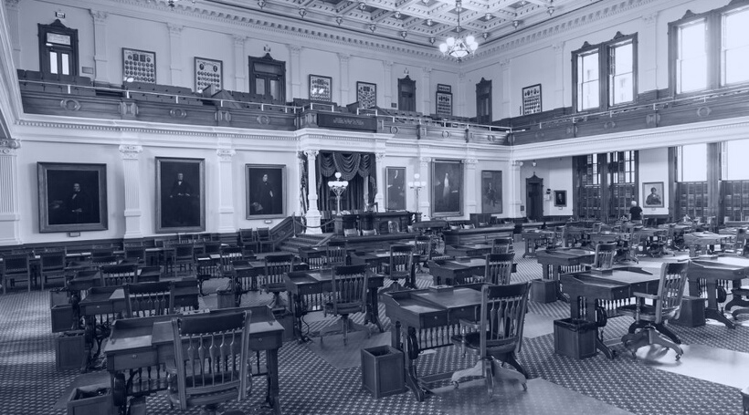
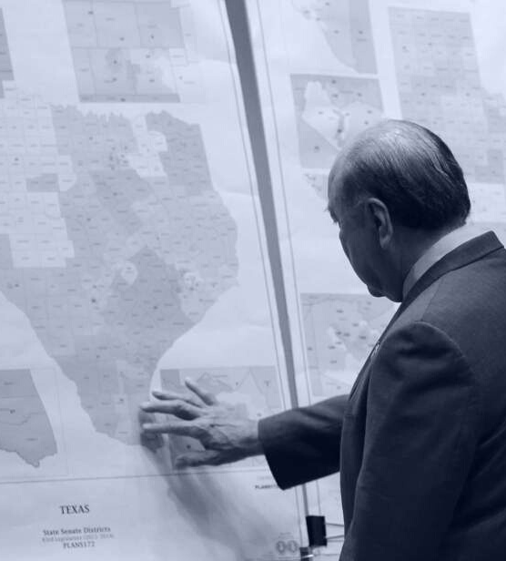
Third Called Special Session
September 20 - October 18
Notes:
So then we had the third called session, which began and ended with everyone present.

Slide 11
Bills passed in the 3rd Special Session
HB 1 (Hunter/Huffman), new Texas House map
SB 4 (Huffman/Hunter), new Texas Senate map
SB 6 (Huffman/Hunter), new US Congressional map for Texas
SB 7 (Huffman/Hunter), new SBOE map
SB 5 (Lucio/Patterson) - penalties for unlawful restraint of dog
SB 52 (Creighton/Bonnen), $600 million in Tuition Revenue Bonds for higher education

Slide 12
Education/school finance bills passed in 3rd Special Session
SB 8 (Nelson/Bonnen), Appropriation of $13.3 billion in federal funds, including $500 million for broadband and $286 million for TRS-Care and TRSActiveCare
HB 25 (Swanson/Perry), UIL athletic participation to be based on participant’s sex at birth
SB 1/SJR 2 (Bettencourt/Meyer), proposed constitutional amendment increased homestead exemption for school property taxes to $40K, with hold harmless for schools

Slide 13
Lt. Governor Dan Patrick’s 31 Priorities
Passed in 87R
Passed in 2nd Special
SB 1 – The State Budget
SB 2 – ERCOT Reform
SB 3 – Power Grid Stability
SB 4 – Star Spangled Banner Protection Act
SB 5 (HB 5) – Statewide Broadband Access
SB 6 – Pandemic Liability Protection Act
SB 8 – The Heartbeat Bill
SB 9 (HB 1280) – Abortion Ban Trigger
SB 13 – Oil & Gas Investment Protection
SB 15 – Ban Sale of Personal Data from Certain State Agencies
SB 17 (HB 19) – Protect Texas Trucking
SB 18 (HB 1500) – Protect Second Amendment Businesses
SB 19 – Stop Corporate Gun Boycotts
SB 20 – Second Amendment Protections for Travelers
SB 22 – First Responders Pandemic Care Act
SB 23 – Stop Local Police Defunding
SB 24 – Law Enforcement Transparency Act
SB 25 – Family Nursing Home Visitation Rights
SB 26 (HB 1239) – Protect Our Freedom to Worship
SB 30 – Remove Racist Restrictions from Real Estate Deeds
SB 1 – Election & Ballot Security
HB 20 – Protect Free Speech on Social Media
SB 6 – Bail Reform
SB 15 – Expanding Virtual Learning
Passed in 3rd Special
HB 25 - Fair Sports for Women & Girls
SB 4 - Senate Redistricting Act
Failed to Pass
Stop Taxpayer Funded Lobbying
Appellate Court Reorganization
Business Freedom and Uniformity Act
Protect State-held Personal Data
Charter School Equity Act

Slide 14
Property Tax Relief SB 1 (Bettencourt/Meyer)
SENATE VERSION
HOUSE VERSION
Reduced all MCRs by about 6 cents in 2022, with rates reverting back following year
Prohibited VATR Elections in 2022
Added new language on the ballot comparing rate if TRE passed vs. if it does not pass
“If the adopted tax rate is not ratified, the (name of school district) may not adopt a tax rate that exceeds ____ (insert the school district ’s voter-approval tax rate)."
Provided a one-time payment to homeowners (expected to be roughly $535 per homestead)
(Paid for with federal funds)

Slide 15
Property Tax Relief SB 1 (Bettencourt/Meyer)
The version that passed
Increases homestead exemption for school property taxes by $15,000 (from $25,000 to $40,000)
Hold harmless ensures no schools lose funding (M&O and I&S for debt issued by September 1, 2021)
To take effect in Tax Year 2022, if SJR 2 is approved by voters in May 2022
Expected to cost more than the estimated $355 million, and to reduce recapture by $84 million statewide

Slide 16
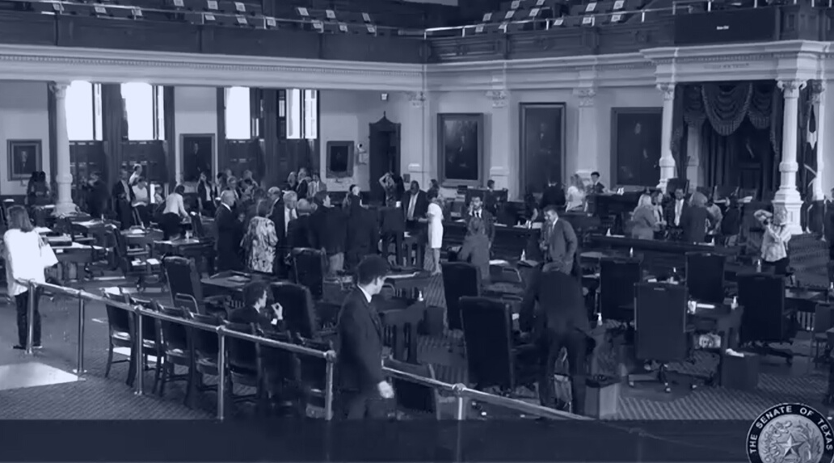
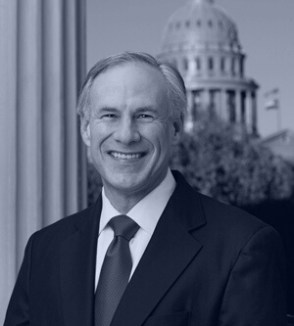
Fourth Called Special Session?
January 2022?
We sure hope not.

Slide 17
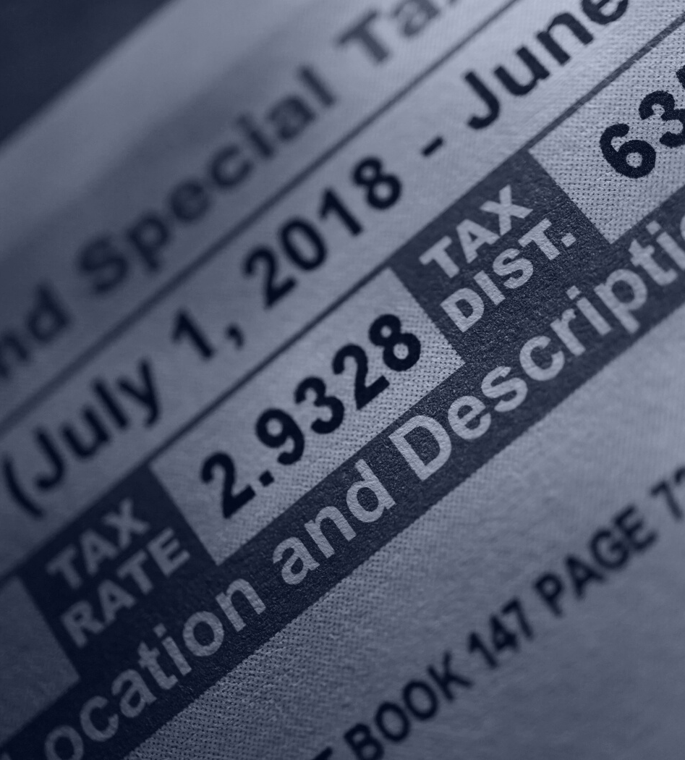
Property Taxes
The state of property taxes and effects of rate compression
Notes:
Enough of that, let’s talk about a more uplifting subject…property taxes.

Slide 18
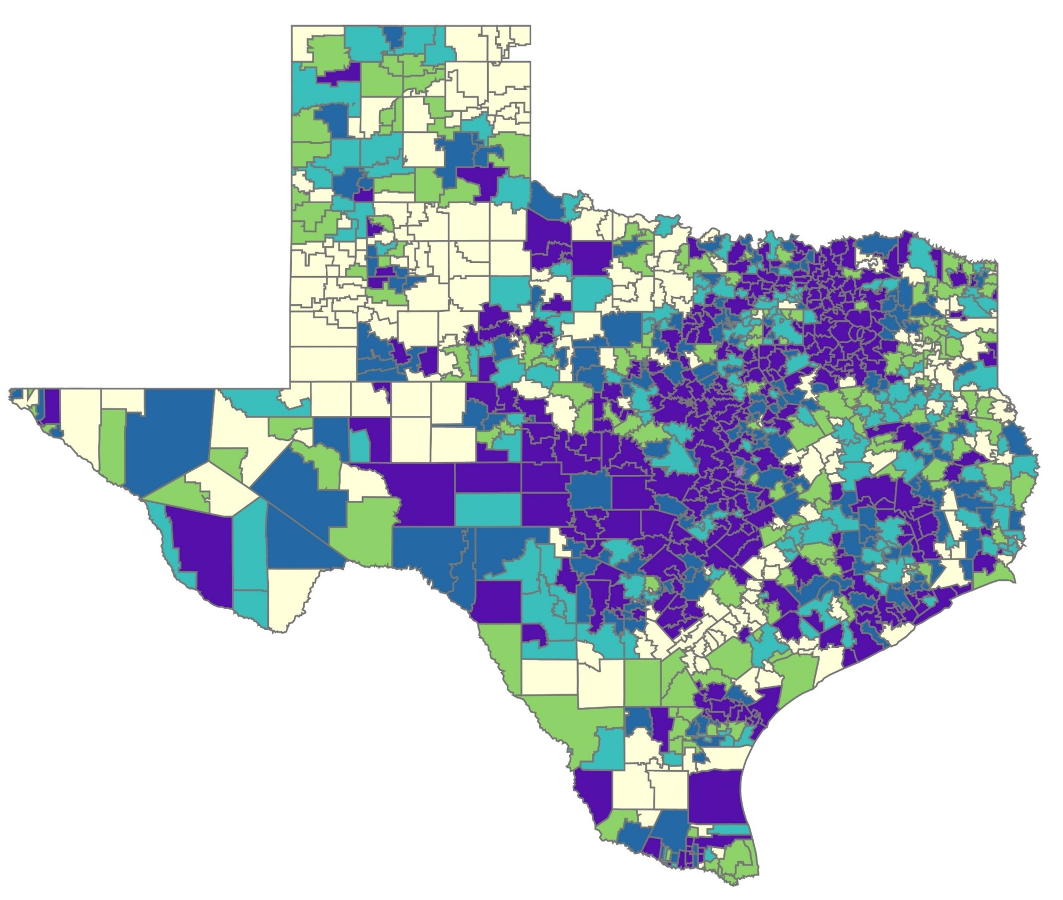
TAX RATE COMPRESSION: 2020 vs 2021
PRELIMINARY
$0.9164
475 districts
$0.8908 – 0.9163
$0.9134
207 districts
181 districts
$0.8821 – 0.9133
$0.8665 – 0.8907
153 districts
152 districts
$0.8248 – 0.8664
$0.8521 – 0.8820
169 districts
134 districts
$0.8221 – 0.8520
$0.8247
72 districts
173 districts
$0.8220
314 districts
©2021 Texas Association of School Business Officials. All rights reserved. Do not duplicate or distribute without express permission.
Notes:
Here are the maps produced by TASBO comparing tax rates statewide to show how compression put in place by HB 3 is working. Tax rates are being compressed, and that compression will continue. The increase in the Homestead Exemption will slow the increase in taxable values some; there may be some districts that don’t see as much change in their tax rate and provide relief through the increased homestead exemption but not much decrease in rate. Districts with heavy concentrations of residential taxpayers may not see much relief for their corporate taxpayers. Districts with more of a mix/heavy concentration of corporate taxpayers will likely still say rates compress. We think statewide, compression will continue.

Slide 19
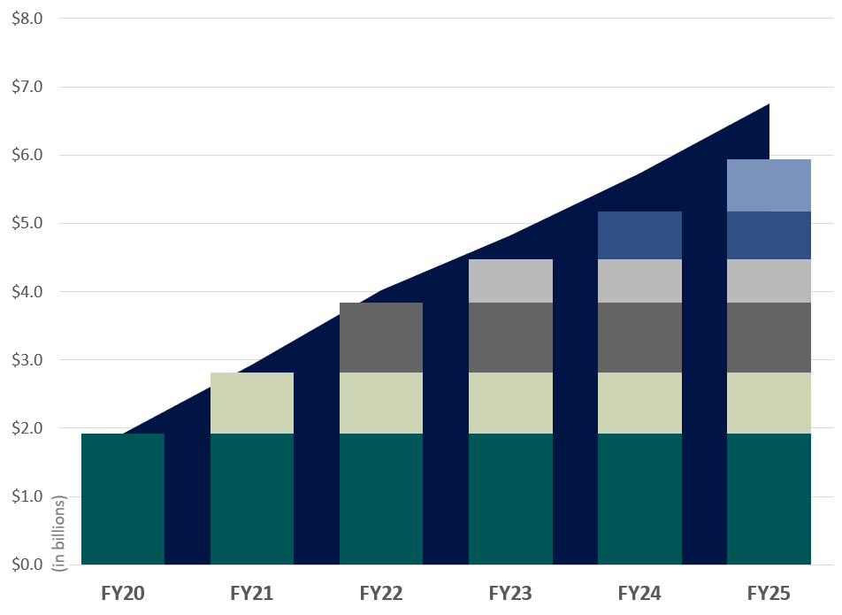
PRELIMINARY Cost of Tax Rate Compression
Year | Pennies Compressed | Cost (in billions)
2019-20 | $0.07 | $1.92
2020-21 | $0.03 | $0.90
2021-22 | $0.03 | $1.06
$0.02
$0.02
$0.02
$0.02
$0.02
$0.02
$0.03
$0.03
$0.03
$0.03
The columns show the original cost of each round of compression at the time it occurs.
The area behind the columns shows the cumulative cost of compression. Cumulative cost is higher because of growth in the tax base over time. The cumulative number of pennies “purchased” through compression is shown below the graph.
$0.03
$0.03
$0.03
$0.03
$0.03
$0.07
$0.07
$0.07
$0.07
$0.07
$0.07
$0.07
$0.10
$0.13
$0.15
$0.17
$0.19
©2021 Texas Association of School Business Officials. All rights reserved. Do not duplicate or distribute without express permission.
Notes:
You’ve seen this before and now it has been updated with the most recent preliminary data. It was derived based on conservative estimates, so the change with the homestead exemption did not change these numbers. The cost of continued tax rate compression continues to climb. And that means that state resources are going to be dedicated towards paying for that rather than investing in things like increasing the basic allotment or providing any new resources for schools. Investing $2-$4 billion in temporary tax relief on top of this compression doesn’t contribute to the sustainability of our system. How are we going to be able to afford this when the legislature adopts the budget for 24-25 when they convene in 2023?

Slide 20
Voter-Approval Tax Rate Elections (VATRE)
2020
2021
Arlington ISD
Eanes ISD
Fort Worth ISD
Franklin ISD
Pringle-Morse CISD
Alamo Heights ISD
Alto ISD
Comal ISD
Godley ISD
Highland Park ISD
Lake Travis ISD
Mansfield ISD
Needville ISD
Pampa ISD
Pearland ISD
11. Plemons-Stinnett-Phillips CISD
12. Rankin ISD
13. Victoria ISD
14. White Settlement ISD
15. Wink-Loving ISD
ADOPTED
Garland ISD
Junction ISD
Needville ISD
Northwest ISD
Pearland ISD
Plemons-Stinnett-Phillips CISD
Rains ISD
Liberty ISD
New Diana ISD
Pflugerville ISD
Rains ISD
FAILED
Notes:
We saw a larger number of VATR Elections proposed and a larger percentage of them pass. You can see on this list that some districts that had failed elections in 2020 tried again this year and were able to adopt a higher rate on the 2nd attempt. One district (Rains ISD) was not so fortunate.

Slide 21
Voter-Approval Tax Rate Elections (VATRE)
42% approval rate in 2020 (5 of 12)
79% approval rate in 2021 (15 of 19)
2 districts were approved to access an additional 12-13 cents
Most sought to access 2-3 Tier II pennies
Notes:
Overall, we saw a MUCH higher approval rate. Looking at the tax rates proposed for adoption, I noticed something comparing the years. While we saw some districts in both years pursue both a rate that was 12-13 cents higher vs. some that were 2-3 pennies more, we saw more districts attempt the much higher rate in 2020 and fail compared to the vast majority of districts in 2021 that sought access to 2-3 golden pennies. Additionally, given the effect of ongoing tax rate compression, there were a number of districts for which the 2-3 cent increase (sometimes combined with I&S and sometimes not) still produced a lower overall tax rate than the previous year, and that was an easier sell with voters.

Slide 22
November 2021 Bond Elections
59% of 63 districts passed at least one proposition
47% of 111 proposed propositions were approved
60% of the total dollar amount proposed was approved ($5.25 billion)
Typical approval rates hover around 80% (or higher)
Notes:
Bond elections didn’t enjoy quite the same passing rate. We’re still assessing the reasons for that, but here are a few theories: first: the tide has turned and many voters share the same line of thinking as the members of the Senate Finance Committee in that video that I shared of their hearing regarding property tax relief. Or maybe the timing played a role and voting taxpayers are still uncertain economic times (during which they heard schools got a boatload of money). I think the bigger reason is potentially that the laws state leaders put into effect to make bonds more difficult to pass are doing the job they intended.

Slide 23
November 2021 Bond Elections by Purpose
Purpose | Number Proposed | Approval Rate | Amount Approved | % of Total $ Approved
School Building | 62 | 55% | $5.04 billion | 65%
Athletics | 30 | 23% | $24 million | 5%
Technology | 9 | 89% | $170 million | 83%
Recreational Facility | 4 | 50% | $16.5 million | 15%
Fine Arts | 4 | 0% | $0 | 0%
Refunding | 2 | 0% | $0 | 0%
Notes:
Because when you break the propositions down by purpose, they help shed a little light on how wildly unpopular bond propositions were that had to do with athletics construction and improvement. Same could be said for fine arts. Now these results don’t tell any district necessarily how things will play out in their community, but knowing and understanding the trends are important. I will also say that as we surveyed the many communities with propositions in this last election, some did an excellent job of communicating with voters, and some did not. Communication is important.

Slide 24
Voter Turnout (among registered voters)
Election Date | Statewide Election Type | Statewide Turnout
November 2017 | Constitutional Amendment | 6%
March 2018 | Gubernatorial Primary | 17% (10% R; 7% D)
November 2018 | Gubernatorial | 53%
November 2019 | Constitutional Amendment | 12%
March 2020 | Presidential Primary | 25% (12% R; 13% D)
November 2020 | Presidential | 67%
November 2021 | Constitutional Amendment | 9%
Notes:
I offer these numbers to you just to illustrate the fact that the turnout in this November election was pretty low compared to what we’ve become accustomed to. These are statewide numbers, so turnout in your community may look a little different.
Also because we’re about to talk about turnover in the Texas Legislature and until the 2020 Presidential election there were those that say “turnout leads to turnover” right up until the point that it didn’t (not in Texas anyway). Voters caused greater turnover in 2018, when while turnout was still relatively high, it was considerably less than in 2020. So it isn’t just about sheer numbers. What matters most are voters who take it seriously. Voters who research and vote for candidates that align with their values—whatever those values may be. That is more important than voting willy nilly so you can post a photo of your “I voted” sticker on social media.
Some of these bond and VATRE elections were VERY close and determined by 2-3 votes in some cases. It matters who shows up to vote.

Slide 25
Planning for the
88th Legislative Session
Notes:
Regardless of how many special sessions we had following the 87th Legislative Session, the 88th Legislative Session is still just as many days away and will begin in January 2023.

Slide 26
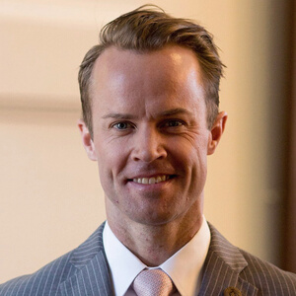
LEADERSHIP
GOVERNOR GREG ABBOTT
Current approval ratings are at an all-time low, but will that matter in the 2022 election?
LT. GOVERNOR DAN PATRICK
It's Dan Patrick's Senate, and he makes the rules.
He had 31 goals in 2021, and he accomplished 26.
SPEAKER DADE PHELAN
The original “Phelan 83” has dwindled some.
Will he be elected Speaker again in 2023?
Notes:
At this point in time, we are not certain that the Big Three will remain the same. Abbott has drawn both primary and general election opponents, and his approval ratings are at an all-time low. The Lt. Governor has drawn a few opponents as well. Even so, I would say that if Abbott and Patrick want to return, then they likely will.
Then we have Speaker Phelan, who was first elected to that post in January 2021, after he declared support from 83 of this colleagues two days after the November 2020 election. That list of his original 83 has dwindled to 72 after the retirements that have been announced so far, and it’s safe to say that he’s lost the support of some of the Democrats on that original list of 83. It takes 76 votes to be elected Speaker. Will he achieve the number necessary for re-election to that post?
It’s safe to say that education was not a priority for any of the Big Three in 2021. Will that change for 2023?

Slide 27
LEADERSHIP
GOVERNOR GREG ABBOTT
Current approval ratings are at an all-time low, but will that matter in the 2022 election?
Notes:
When it comes to the Governor’s race, Greg Abbott is not alone in the primary or general election.

Slide 28
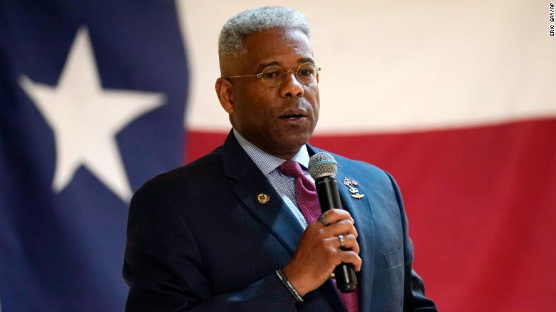
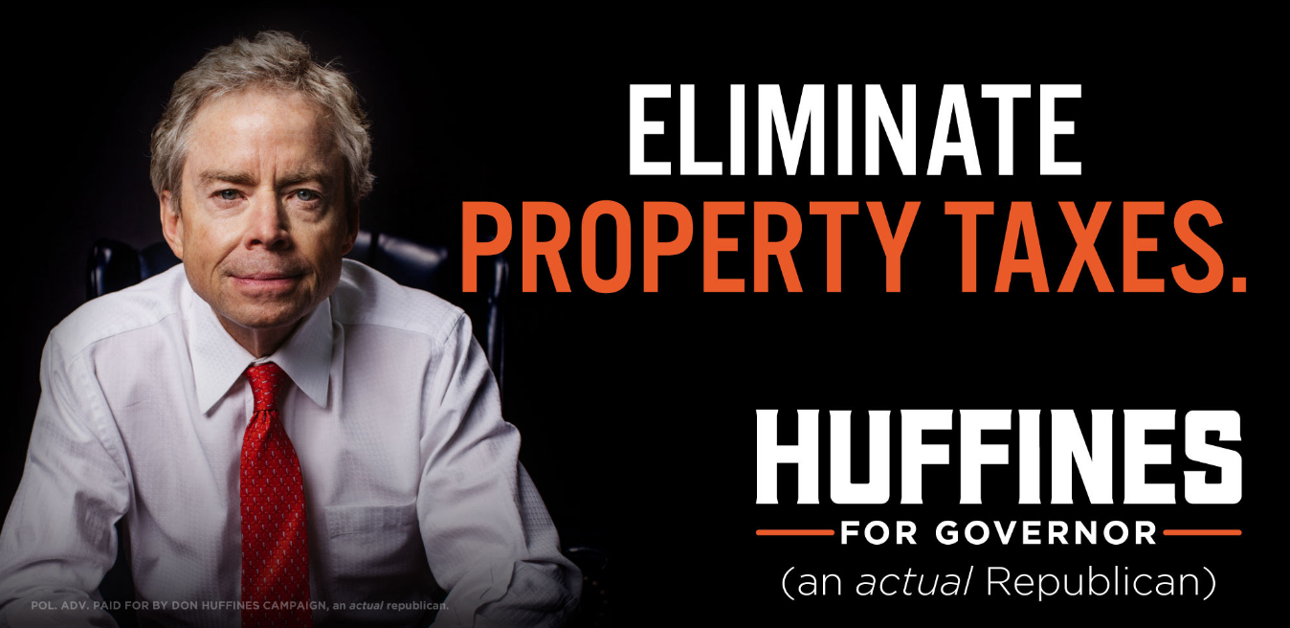
GOVERNOR’S RACE
GOVERNOR GREG ABBOTT
Notes:
In the Primary, [CLICK] he’s going to face the likes of this guy, and [CLICK] former Republican Party Chairman Allen West, who is perhaps best known for his recent bout with COVID. And then [CLICK] no one who has been driving on I-35 lately can forget about former State Senator Don Huffines.

Slide 29
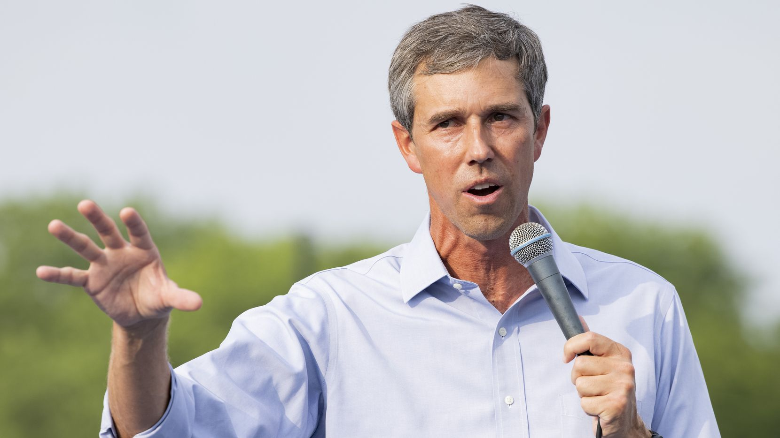
GOVERNOR’S RACE
Notes:
Then in the General Election Abbott is likely to face Democratic challenger Beto O’Rourke (who just reported raising $2 million in the first 24 hours of his campaign), and maybe even this guy, because McConaughey hasn’t ruled it out. Alright, alright, alright.

Slide 30
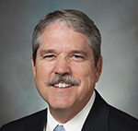
LIEUTENANTS
SENATE FINANCE CHAIR
SENATOR JANE NELSON
Nelson is stepping down after serving in the Senate since 1993 & as Finance Chair since 2017.
SENATE EDUCATION CHAIR
SENATOR LARRY TAYLOR
All things education are touched by Taylor.
HOUSE PUBLIC EDUCATION CHAIR
REP. HAROLD DUTTON
After 24 years on the committee, he finally became Chair. What a Chair he was.
Notes:
Even if the Big Three remain the same, there may be some changes in regards to their lieutenants. Senator Jane Nelson has announced her retirement, so we will certainly have a new chair of Senate Finance. If he chooses to return, Senator Taylor is certainly expected to maintain his post. On the House side, two chairmen have already announced their impending retirements. If the Speaker changes, chairmanship posts will change as well. But even if there is consistency with Speaker Phelan, it’s not all that unlikely that we may see someone different named as Chair of the House Public Education Committee in 2023.

Slide 31
Legislative Turnover
REDISTRICTING
Redistricting typically brings changes in party break-down, in people, and in the schools they represent.
RETIREMENTS
As of November 17, 2021:
Four announced retirements in Senate and 22 in the House.
CHAIRMANSHIP CHANGES
Several key chairs have announced retirements, and more could change.
Notes:
This is the time when we redraw the maps every 10 years, and that means that legislative districts are going to change. That typically brings some of the highest amounts of turnover you might see between sessions. You know what else does that? This toxic legislative cycle we’ve been living through (and we’re not done yet). Unfortunately, some of the most solid and thoughtful members have already announced retirements, and we expect quite a few more to come.
And just as changes in personalities can change the dynamics and outcome of a session, so can the composition of chairmanships.

Slide 32
Legislative Turnover
Session/Year | Freshman House Members | Freshman Senate Members
83rd/2013 | 41 | 5
84th/2015 | 24 | 8
85th/2017 | 22 | 3
86th/2019 | 27 | 6
87th/2021 | 16 | 4
88th/2023 | 22 (so far) | 4 (so far)
Notes:
Just to put things in perspective about the impact redistricting can have, you can see the turnover numbers from the last time we had new maps in 2013. We can probably expect similar numbers in the House this time around, and I would not be surprised if we saw the number in the Senate grow a bit higher as well.

Slide 33
Legislative Turnover
NOT RETURNING TO THE TEXAS SENATE
Dawn Buckingham (R-Lakeway)
Eddie Lucio (D-Brownsville)
Jane Nelson (R-Flower Mound)
Kel Seliger (R-Amarillo)
Notes:
And while numbers of new members are important, it is also important to note who is stepping down. On this list of four, you have senators that rank 3rd, 4th, and 7th in terms of seniority. This is a big deal. Lucio served in the Senate for 30 years, Nelson for 28, and Seliger for 17.

Slide 34
Legislative Turnover
NOT RETURNING TO THE TEXAS HOUSE
Phil King (R-Weatherford)
Matt Krause (R-Fort Worth)
Tan Parker (R-Flower Mound)
Eddie Rodriguez (D-Austin)
James White (R-Hillister)
Celia Israel (D-Austin)
Michelle Beckley (D-Carrollton)
Kyle Biedermann (R-Fredericksburg)
John Cyrier (R-Lockhart)
John Frullo (R-Lubbock)
Dan Huberty (R-Humble)
Lyle Larson (R-San Antonio)
Ben Leman (R-Iola)
Eddie Lucio, III (D-Brownsville)
Jim Murphy (R-Houston)
Chris Paddie (R-Marshall)
Scott Sanford (R-McKinney)
John Turner (D-Dallas)
Leo Pacheco (D-San Antonio)
Jake Ellzey (R-Waxahachie)
Joe Deshotel (D-Beaumont)
Notes:
And here are the 22 names of those we know are not returning to the Texas House.

Slide 35
Legislative Turnover
NOT RETURNING TO THE TEXAS HOUSE
Phil King (R-Weatherford)
Matt Krause (R-Fort Worth)
Tan Parker (R-Flower Mound)
Eddie Rodriguez (D-Austin)
James White (R-Hillister)
Celia Israel (D-Austin)
Michelle Beckley (D-Carrollton)
Kyle Biedermann (R-Fredericksburg)
John Cyrier (R-Lockhart)
John Frullo (R-Lubbock)
Dan Huberty (R-Humble)
Lyle Larson (R-San Antonio)
Ben Leman (R-Iola)
Eddie Lucio, III (D-Brownsville)
Jim Murphy (R-Houston)
Chris Paddie (R-Marshall)
Scott Sanford (R-McKinney)
John Turner (D-Dallas)
Leo Pacheco (D-San Antonio)
Jake Ellzey (R-Waxahachie)
Joe Deshotel (D-Beaumont)
Notes:
Five of the 22 names are currently chairs of committees that are stepping down. And as you are fully aware, there are several long-serving members on this list that have served as influential chairmen in the past. There are some true friends of education, and in particular the Texas School Coalition and it is unclear who will fill those seats and the roles that they played.
One other thing to mention as we talk about changes in the Texas House is that Chairman Ryan Guillen switched parties and became a Republican this week, which further solidified the Republican control of the House.

Slide 36
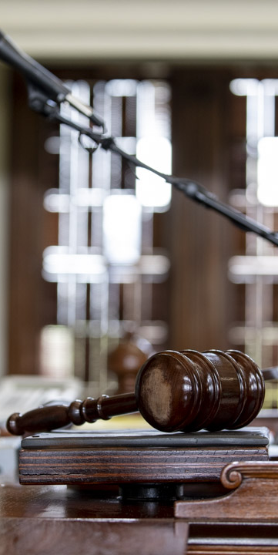
What to Expect in the 88th
THE MORE THINGS CHANGE,
THE MORE THEY STAY THE SAME…
Despite high rate of turnover, don’t expect much to change
Maps drawn to ensure Republican control in both chambers
New priorities will determine the road map
Notes:
But someone will step forward and fill those seats. And while many of the people may change, we aren’t expecting much else will. As you could see on that list of folks retiring or running elsewhere, we’re losing some moderate and rational thinkers. Those folks are likely to replaced with individuals who are more extreme (regardless of their political leanings, we expect newly elected members to be either more conservative or more liberal in most cases than who they are replacing)

Slide 37
What to Expect in the 88th
TEMPTATION OF STATE CONTROL
Republican leaders no longer champion local control
Trust is gone
Local government limitations, yet increased focus on empowering parental decisions
Notes:
We saw again and again this session the theme of eroding local control. State leaders tend to forget that the same folks that elect them to the offices they hold select who serves at the local level. They don’t trust voters to make good choices at the local level and they certainly don’t trust local elected leaders to make the right decision. Thus, we see an increase of more and more state control of things—in schools and elsewhere. In large part, I attribute that to the loss of trust between state leaders and local school officials. That’s something we have to work to rebuild. While it may seem easier for them to make decisions in a vacuum and not consult with those back home (or bother to case what those at home think), the easy decision is often not the best decision. While they may not trust local officials or local voters, they do seem to implicitly trust parents and want to empower them more and more (except the parents they disagree with—not them).

Slide 38
What to Expect in the 88th
ECONOMIC DEVELOPMENT INCENTIVES
Chapter 313 was not renewed during the 87th Legislative Session; will expire December 31, 2022.
Attempt to address in third special session fizzled.
Incentives will likely be on the table in 2023, but are not likely to be as advantageous to schools.
Notes:
A couple of you asked about an update of where we stand with Chapter 313 agreements. As you know, that chapter of the tax code was not renewed and therefore set to expire at the end of 2022. There was an attempt to propose a two year extension during the third special session, and ultimately it was determined that the same obstacle from the regular session remained in the special session. So I think we can expect a blank slate for economic development deals in 2023, and I don’t think those incentives will be very beneficial to schools, which means they will rarely be used. Stay tuned…it’s still a long road ahead of us on that one.

Slide 39
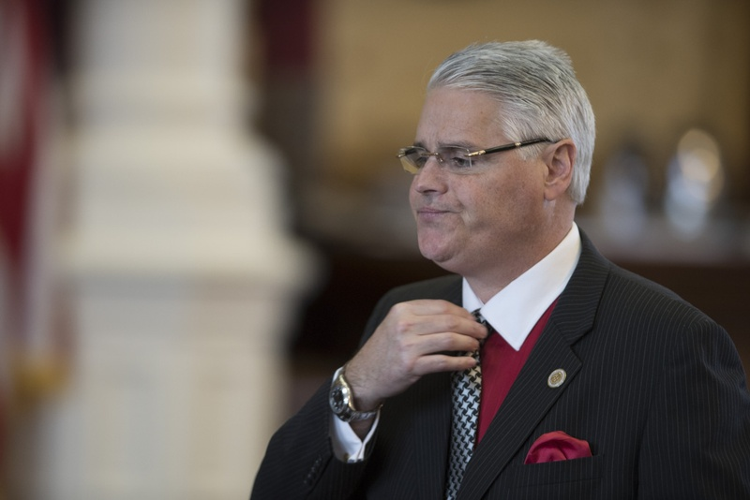
What to Expect in the 88th
FUND BALANCES
Champion for fund balance reforms is retiring, but concerns remain
Assign and designate what you can
Make strategic choices with ESSER dollars
Notes:
We also had some questions about fund balances. When Dan Huberty announced his retirement, it’s perhaps fair to say they are safer, but not safe. As you recall, Senator Larry Taylor has been very vocal about this topic (though he did not file legislation as Huberty did). And the Texas Public Policy Foundation continues to beat this drum. They are not going to go away. They are going to keep requesting and publishing data on fund balance amounts and totals. Please be strategic with ESSER dollars. I know many of you are putting quite a bit in your fund balance as you spend ESSER dollars on allowable purposes this year. I’m not going to tell you that is a bad idea. What I am going to tell you is that you need to have a good story to tell in regards to how you spent your ESSER dollars and what was accomplished through that. Spending on things you would have already spent isn’t the most compelling story.

Slide 40
Robin Hood Recapture in 2021
Notes:
Now I am going to give you a little sample of the presentation I’ve been fortunate enough to travel to different parts of the state to deliver. This presentation is available for you to download in the Members Area of our website (sign-in with your email address and password you select). And please feel free to use all or part of this presentation in your community.

Slide 41
Formulas determine the size of the glass (district’s entitlement) based on:
Basic Allotment (per student)
District characteristics
Student characteristics
Other additional funding not on a per-student basis (such as transportation, teacher incentives)
District tax effort
Notes:
You can think of our school finance system like a glass of water. The size of the glass is determined by the school finance formulas and how they calculate a school district’s funding entitlement. The more students you serve, the bigger your glass. The more students you serve with certain characteristics also increases the size of your glass. District characteristics (such as being small or mid-sized) can also increase the size of the glass. A district’s tax effort also relates the size of the glass. A higher tax rate increases the size and a lower tax rate reduces the size.

Slide 42
Local property taxes fill the glass first, and the state will fill in any space that is left.
Local Revenue in Excess of Entitlement is recaptured.
Notes:
So you take that glass and you use local property taxes to fill the glass. If local property tax revenue doesn’t provide enough “water,” then the state will subsidize the funding and fill the remaining space with water of its own. But in the case of a recapture district, you collect so much in taxes that it spills over outside your glass. That’s local revenue in excess of entitlement, which is the technical name of recapture in state law.

Slide 43
To reduce recapture, you must either increase the size of your glass (entitlement) or reduce the amount of water flowing in (taxable values)
Notes:
There are two ways you can reduce how much water spills outside your glass. You have to either get a bigger glass (by increasing the entitlement the state school finance formulas calculate—by increasing student counts/student characteristics that draw down additional funding weights or increasing your tax rate) OR you can reduce the amount of water flowing into the glass via reduced property values (which is not great for the local economy).

Slide 44
Districts that pay recapture can afford it, as their students have many advantages
COMMON MISPERCEPTIONS
There is a difference in property wealth and personal wealth.
Many recapture districts serve a majority of students from severe poverty.
Formulas should adjust, but many recapture districts struggle to meet student needs.
Notes:
Sometimes there is a lack of sympathy for recapture districts because “they can afford it.” But there is a big difference in property wealth and personal wealth. While the formulas are intended to adjust entitlement amounts so that districts are allowed to keep what they need to serve the students enrolled in their district, the formulas are imperfect and often fall short. What many people don’t realize is that many recapture districts serve high percentages of students in poverty while sending millions of dollars to the state.

Slide 45
Recaptured funds benefit schools in need with low wealth levels.
COMMON MISPERCEPTIONS
Recapture benefits the state, not other school districts.
Formulas determine entitlement; growth of recapture doesn't change that.
Funding levels are the same, so it's simply a matter of the source of funding--who pays.
Notes:
You also have those who say they don’t mind recapture because they know the recaptured funds benefit others schools in need. If only that were true. Actually, the state treasury is the beneficiary. The more recapture dollars that are collected, the less state revenue that must be spent on education. State revenue is freed up to be spend elsewhere. This is demonstrated by the fact that increased recapture doesn’t translate into increased funding for schools. The funding formulas that determine entitlement amounts state the same, even if the state collects another billion in recapture.

Slide 46
The Texas Legislature reduced recapture in 2019 with HB 3
COMMON MISPERCEPTIONS
Sort of, but not really.
HB 3 reduced recapture compared to what it could have been absent change.
HB 3 provided a slight one-year reduction, but now recapture is back above pre-HB 3 levels.
Notes:
Finally, there are plenty of folks who believe that the Legislature reduced recapture in 2019 with the passage of HB 3. That’s actually a matter of perspective. We were on the trajectory for recapture to hit $6 billion in one year five years into the future. So if you compare our current circumstances against what could have been (absent of change), then you can make the case that recapture is reduced from what could have been. However, compared to the actual amounts, you will see that recapture, while it enjoyed a slight dip in 2020, is back to being higher than it was prior to passage of HB 3. So whether you consider recapture reduced or not depends on whether you are comparing it to actual or hypothetical numbers.

Slide 47
Statewide Recapture 1994-2022
Source: TEA Summary of Finance data
* Preliminary estimated amount
Notes:
This graph shows recapture amounts from 1994 (the first year of recapture) through the estimates for the total in the current school year. We landed just under $3 billion in 2021. The amount projected for 2023 in the General Appropriations Act adopted by the Legislature indicates that we will exceed $3 billion in 2023.

Slide 48
The Appropriations Shell Game
Every two years, legislators underestimate the total amount that districts will pay in recapture. Then, when districts pay more than projected, legislators use those recapture dollars to replace other state funding that would have gone to schools.
In 2021, supplemental appropriations reduced spending for Foundation School Program by $5.2 billion for FY 20 and 21.
$1.4 billion of that was due to higher than expected recapture.
Notes:
We live in a state where the legislature meets every other year (thank goodness) and that means they adopt a two-year budget (based on estimates). Then they adopt a supplemental appropriations act as a “true-up” of those estimates based on actual numbers. The pattern we’ve seen is that the legislature adopts a budget that says recapture will be less than it actually is. They appropriate enough state funds to pay for public education with less recapture than is actually collected. Then they adopt a supplemental appropriations act in which the increased amount of recapture that was actually paid is recognized as a state savings that frees up state dollars to be spent on other things.

Slide 49
Recapture districts can be found in nearly every region of the state.
Source: TEA Website 2022 Excess Local Revenue Notification List

Slide 50
The Top Tens
Top Ten Districts Paying the Most Recapture as Percent of Total M&O Tax Collections
Top Ten Districts Paying the Most Recapture
 | School District | Recapture
1 | Austin ISD | $710,562,924
2 | Houston ISD | $197,810,414
3 | Plano ISD | $191,901,269
4 | Midland ISD | $154,436,692
5 | Highland Park ISD | $104,751,098
6 | Eanes ISD | $101,813,483
7 | Pecos-Barstow-Toyah ISD | $99,468,684
8 | Wink-Loving ISD | $87,060,824
9 | Spring Branch ISD | $61,264,358
10 | Grapevine-Colleyville ISD | $56,507,928
School District | Recapture | % of collections
Sands CISD | $10,982,769 | 99.6%
Glasscock County ISD | $36,087,261 | 86%
Rankin ISD | $45,577,034 | 84%
McMullen County ISD | $25,320,913 | 83%
Grady ISD | $34,440,456 | 83%
Wink-Loving ISD | $87,060,824 | 82%
Kenedy County Wide CSD | $6,995,670 | 80%
Port Aransas ISD | $18,601,544 | 75%
Palo Pinto ISD | $4,047,137 | 75%
Klondike ISD | $14,019,634 | 71%
Source: TEA Near Final Data, 2020-2021, as of September 24, 2021

Slide 51
COST OF EDUCATION ADJUSTMENT
Possible Solutions
The cost of doing business is much greater in certain districts, yet formulas don't account for that when calculating entitlement.
STOP THE SHELL GAME
Ensure money paid for recapture benefits schools, rather than just generating a state savings.
INCREASE TRANSPARENCY FOR TAXPAYERS
At the very least, ensure taxpayers know where their dollars are going.
Notes:
Here are three possible solutions that could help. They aren’t the only solutions, but it will hopefully start the conversation. This first one has to do with the cost of education. This is an adjustment that was once made in the school finance formulas, but it was never updated and was eventually repealed. The Legislature agreed to study it and revisit the issue later, but then they ignored the report that was issued in January 2021 (https://tea.texas.gov/sites/default/files/hb3-transportation-report.pdf). Adopting such an adjustment would increase the size of the glass.
Next, we could stop the shell game and ensure that if additional dollars are paid in recapture that it results in additional dollars for schools (on top of entitlement funding).
Finally, we can increase transparency for taxpayers so that everyone is aware of where their dollars are going. This heightened awareness could help lead to reforms down the road.

Slide 52
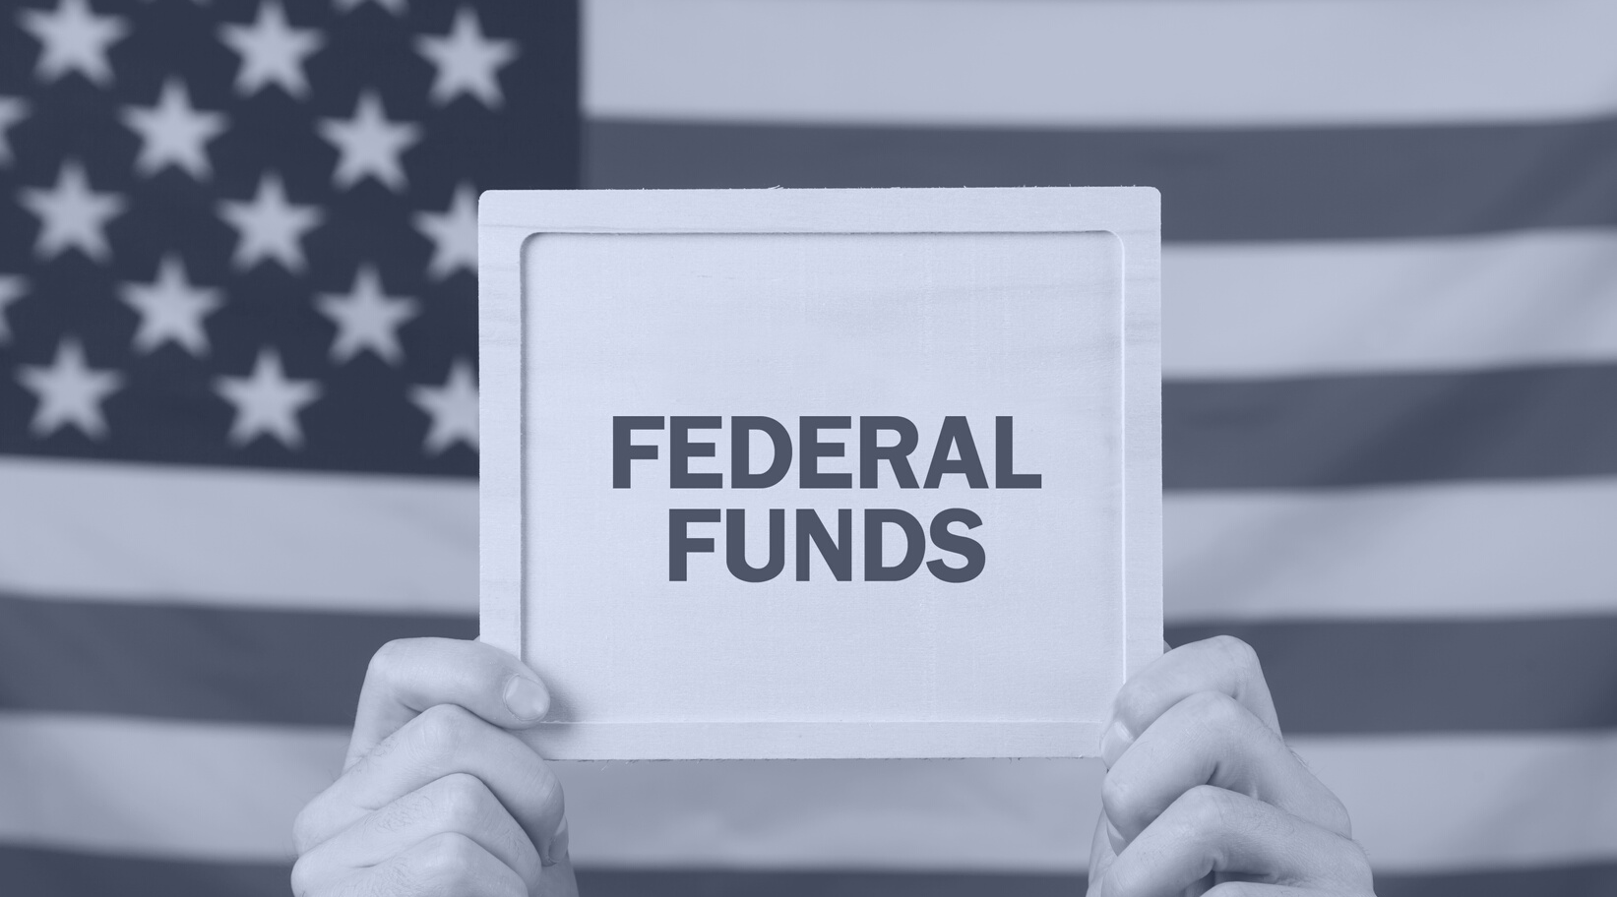
Questions?
Christy Rome
512-732-9072
christy@txsc.org
Notes:
Happy to answer any questions.

