Slide 1


Update in-between
special sessions
September 15, 2021
The road goes on forever
and the party never ends
February 5, 2021

Slide 2



Thank you to our Sponsors!

Slide 3
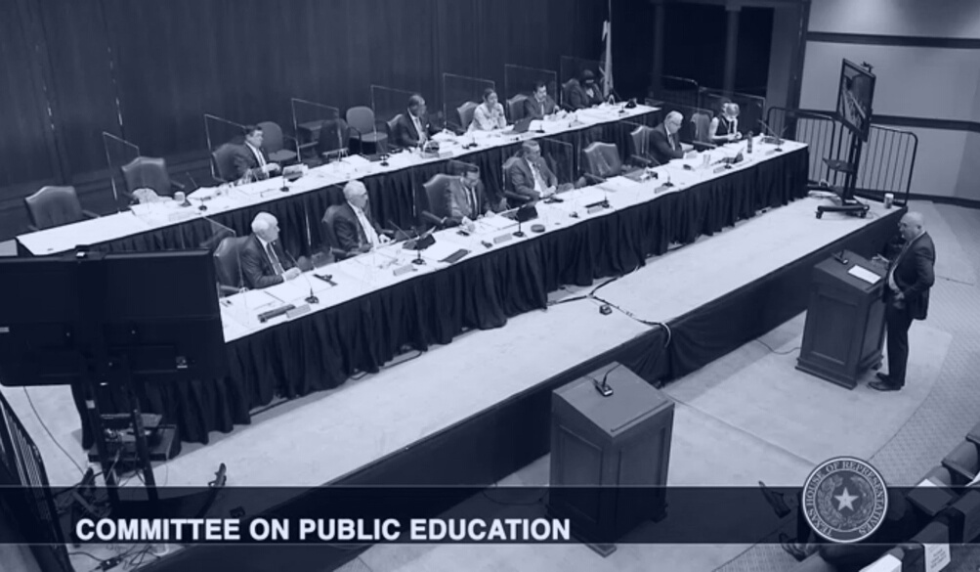
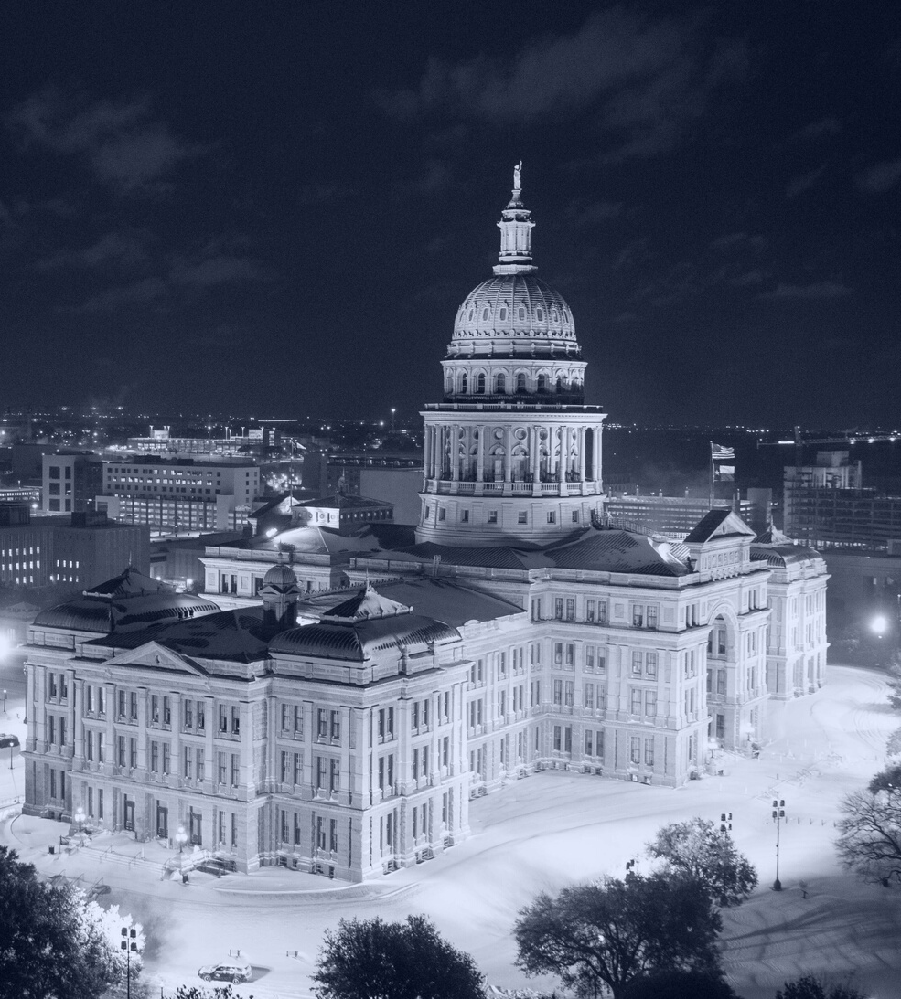

The 87th Regular Legislative Session
The legislative session like no other, that began in a quiet Capitol, requiring COVID testing, and then ended with a bang...and some unfinished business.
Notes:
A brief recap of the Regular Session (which frankly feels like it took place 10 years ago at this point.

Slide 4
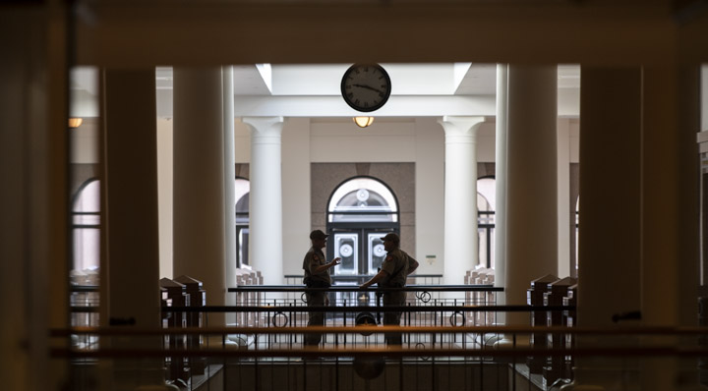
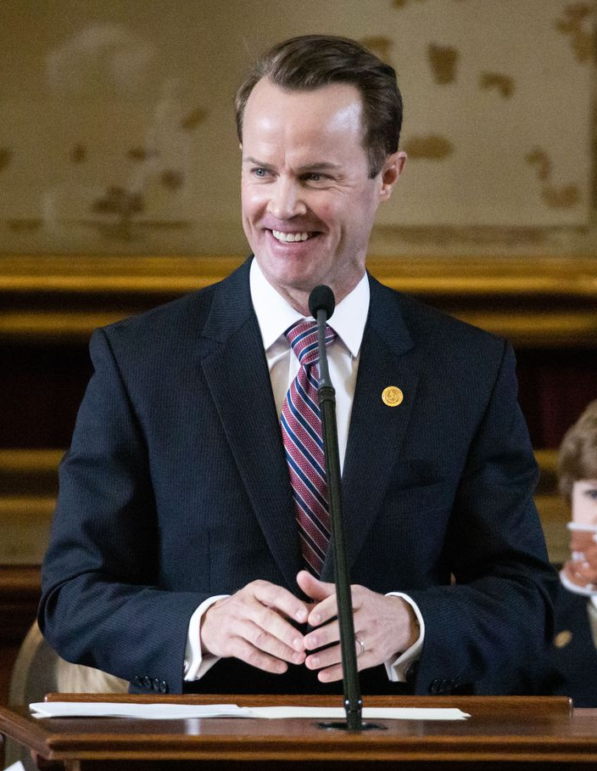
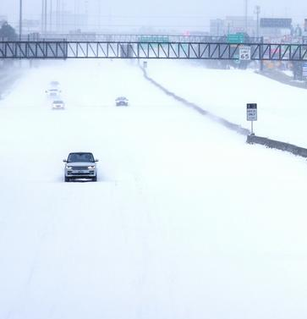
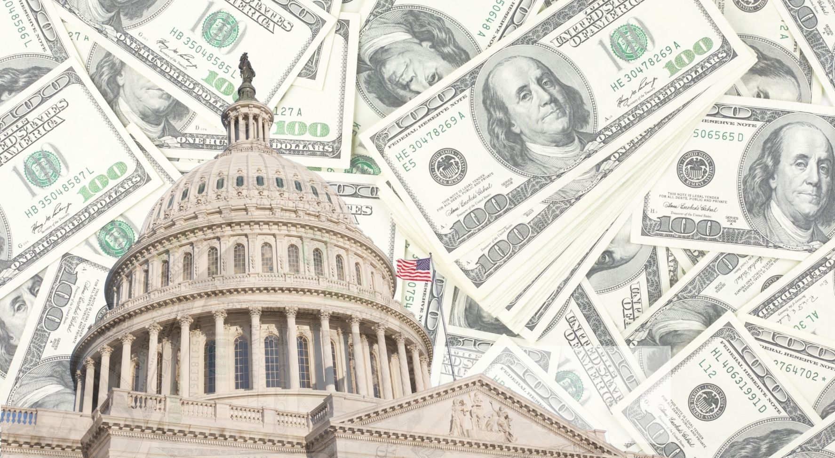
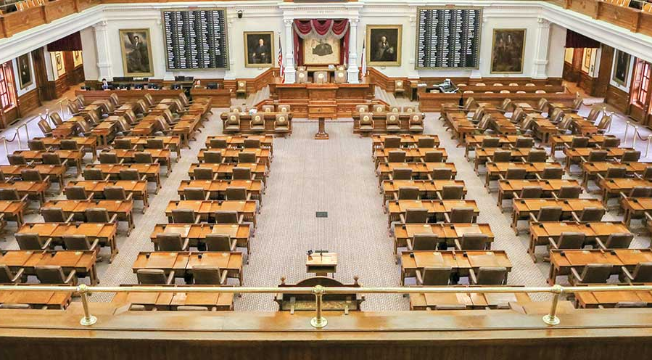
87th Regular Session Recap
Notes:
The session began with a pretty empty Capitol (except the heavily armed guards), with lots of locked doors and COVID tests. Speaker Phelan was elected, an ice storm shut down the entire state. The feds sent the state A LOT of money, and ultimately the session ended in dramatic fashion as the democrats busted quorum and caused several Republican priorities to fail to pass before the regular session came to a close.

Slide 5

Unfinished business
Bills that did NOT pass:
SB 7 (Hughes) – Elections Integrity Reforms
SB 10 (Bettencourt) –Taxpayer-Funded Lobbying Prohibition
SB 29 (Perry) – Transgender Participation in UIL
HB 1468 (Bell, Keith) – Remote Instruction
HB 3445 (Huberty) - Fund Balance Restrictions
HB 4242 (Meyer) – Reauthorization of Chapter 313
Notes:
As a reminder, here are some of the key bills that did not pass during the regular session (for better or worse).

Slide 6
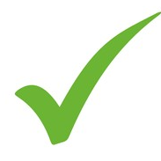
Lt. Governor Dan Patrick’s 31 Priorities
Passed
Failed to Pass
SB 1 – The State Budget
SB 2 – ERCOT Reform
SB 3 – Power Grid Stability
SB 4 – Star Spangled Banner Protection Act
SB 5 (HB 5) – Statewide Broadband Access
SB 6 – Pandemic Liability Protection Act
SB 8 – The Heartbeat Bill
SB 9 (HB 1280) – Abortion Ban Trigger
SB 13 – Oil & Gas Investment Protection
SB 15 – Ban Sale of Personal Data from Certain State Agencies
SB 17 (HB 19) – Protect Texas Trucking
SB 18 (HB 1500) – Protect Second Amendment Businesses
SB 19 – Stop Corporate Gun Boycotts
SB 20 – Second Amendment Protections for Travelers
SB 22 – First Responders Pandemic Care Act
SB 23 – Stop Local Police Defunding
SB 24 – Law Enforcement Transparency Act
SB 25 – Family Nursing Home Visitation Rights
SB 26 (HB 1239) – Protect Our Freedom to Worship
SB 30 – Remove Racist Restrictions from Real Estate Deeds
SB 7 – Election & Ballot Security
SB 10 – Stop Taxpayer Funded Lobbying
SB 11 – Appellate Court Reorganization
SB 12 – Protect Free Speech on Social Media
SB 14 – Business Freedom and Uniformity Act
SB 16 – Protect State-held Personal Data
SB 21 – Bail Reform
SB 27 – Expanding Virtual Learning
SB 28 – Charter School Equity Act
SB 29 – Fair Sports for Women & Girls
SB 31 – Senate Redistricting Act
Notes:
Lt. Governor Dan Patrick got 20 out of 31 priorities to the Governor’s desk.

Slide 7
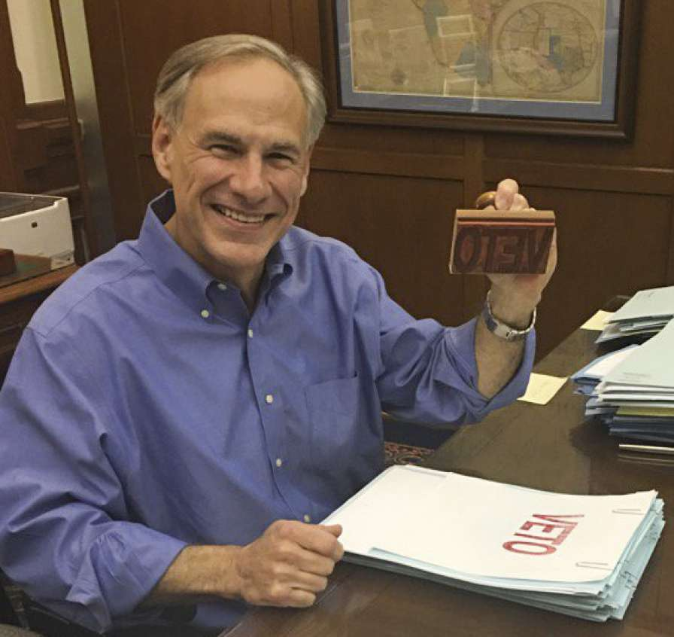
Vetoed by Governor
20 bills vetoed + 1 line-item budget veto
Article X of budget (legislative appropriations)
SB 1109 (West/Anchia), relating to health curriculum on abuse & dating violence, and the requirement that schools must make age-appropriate materials to students seeking help for dating violence.
HB 3207 (Herrero/Menendez), relating to TRS retirees returning to work during declared disaster without penalty.
SB 474 (Lucio/Collier), relating to the unlawful restraint of a dog.
Notes:
Then after the session, Governor Abbott vetoed 20 bills and one very specific aspect of the state budget—funding for the entire legislative branch. I’ve also listed the two education bills he vetoed here, along with one seemingly random bill (but stay with me…you’ll see why I included unlawful restraint of a dog later…). So if the fact that Abbott’s priority election integrity bill didn’t pass wasn’t enough of an indication that legislators would be called back for a special session, this veto of Article X made it crystal clear that legislators would be back, and they would be back over the summer.

Slide 8

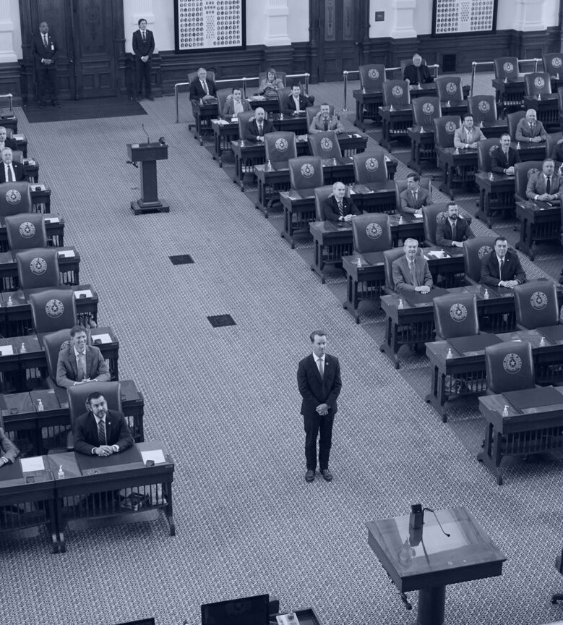
First Called Special Session
July 8 - August 6
Notes:
The first called special session began on July 8.

Slide 9
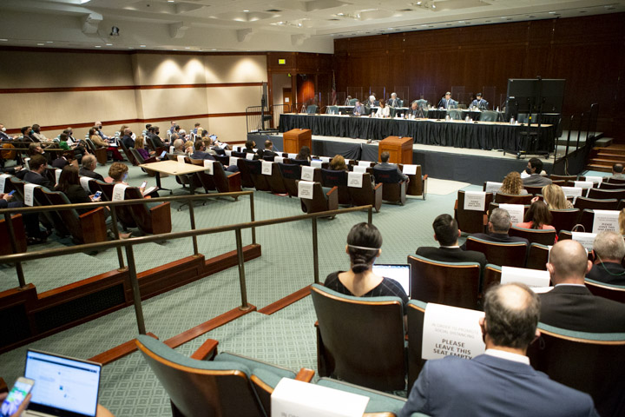
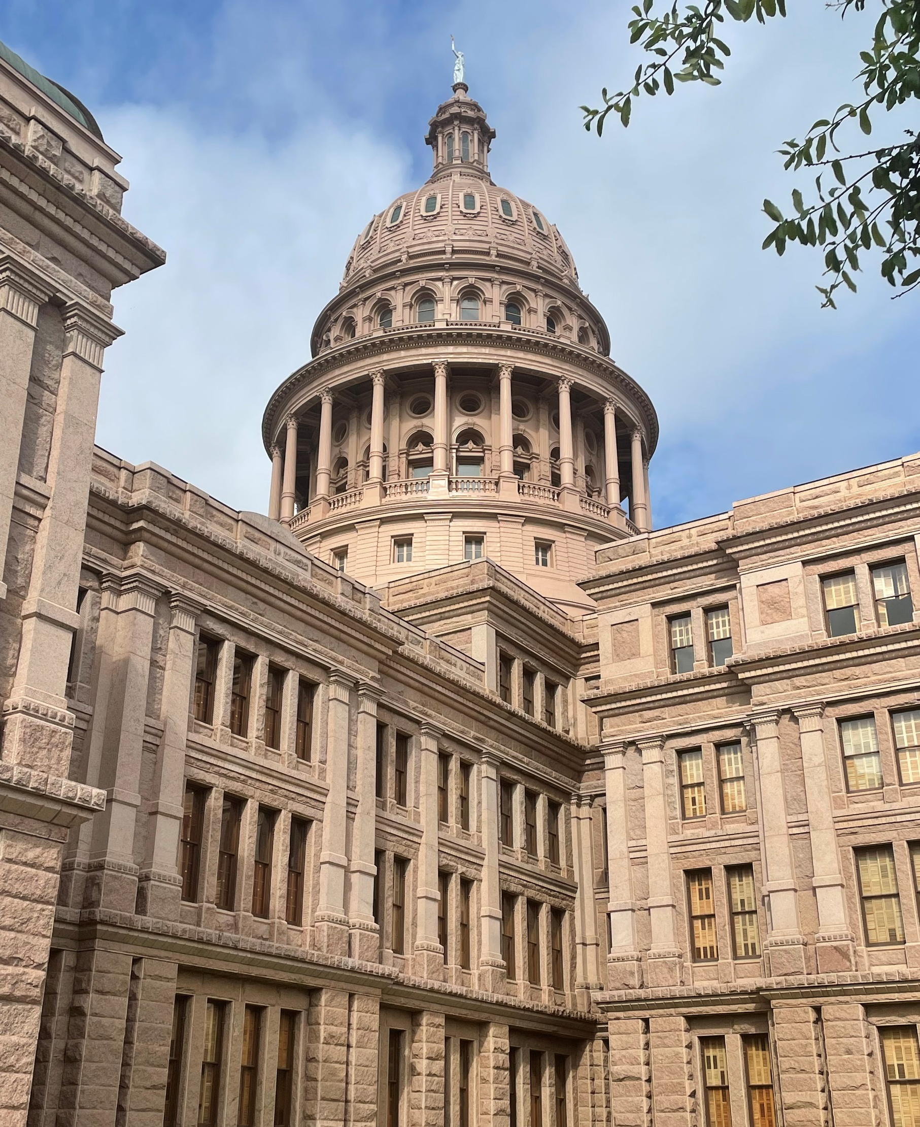
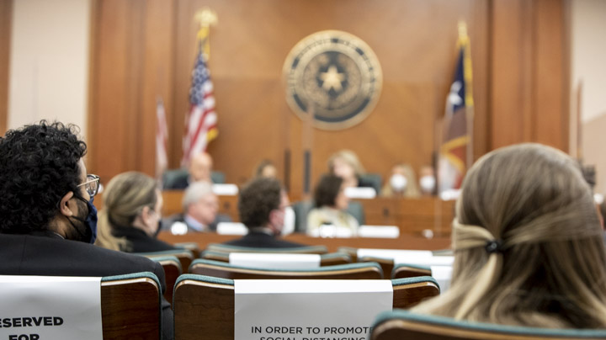
1st Called Special Session Recap
Notes:
I took this photo on the left as I was walking into the Capitol to testify on a Saturday in July. Legislators met in hearings all weekend long.

Slide 10
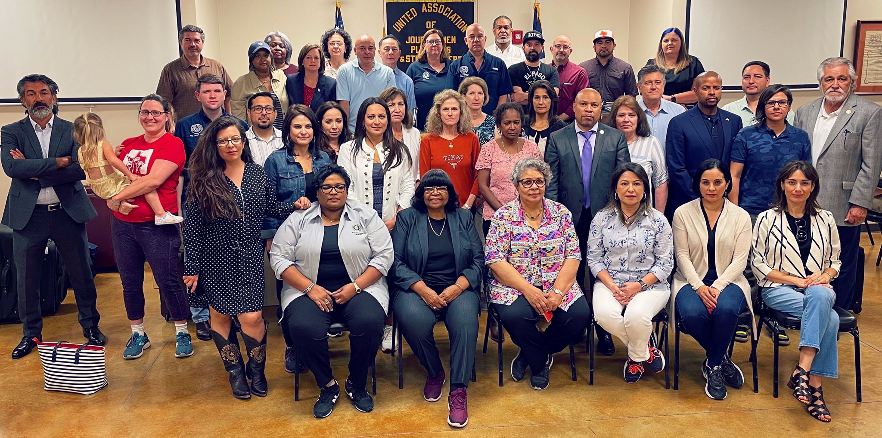
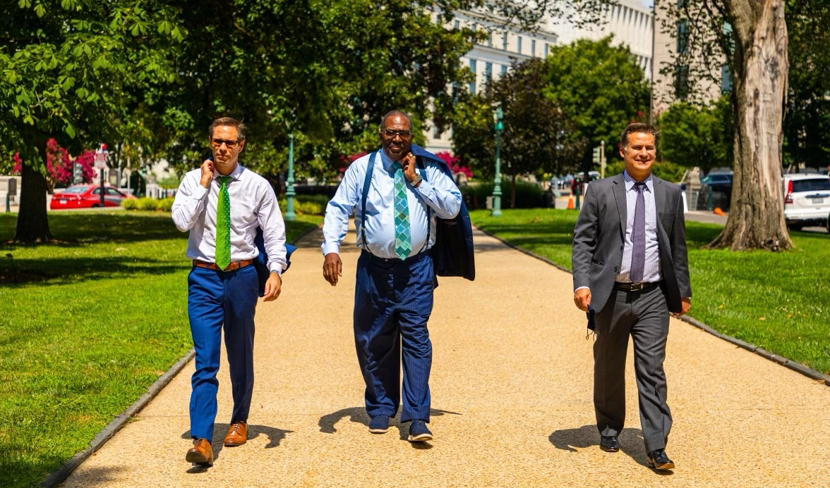
1st Called Special Session Recap
Notes:
Then on Monday, enough House democrats left the state and flew to Washington, DC so that the Texas House lost a quorum and could not meet. Then the guys from the Senate joined them (though the Senate never lost a quorum and proceeded to pass bills to address every item on the Governor’s call).

Slide 11
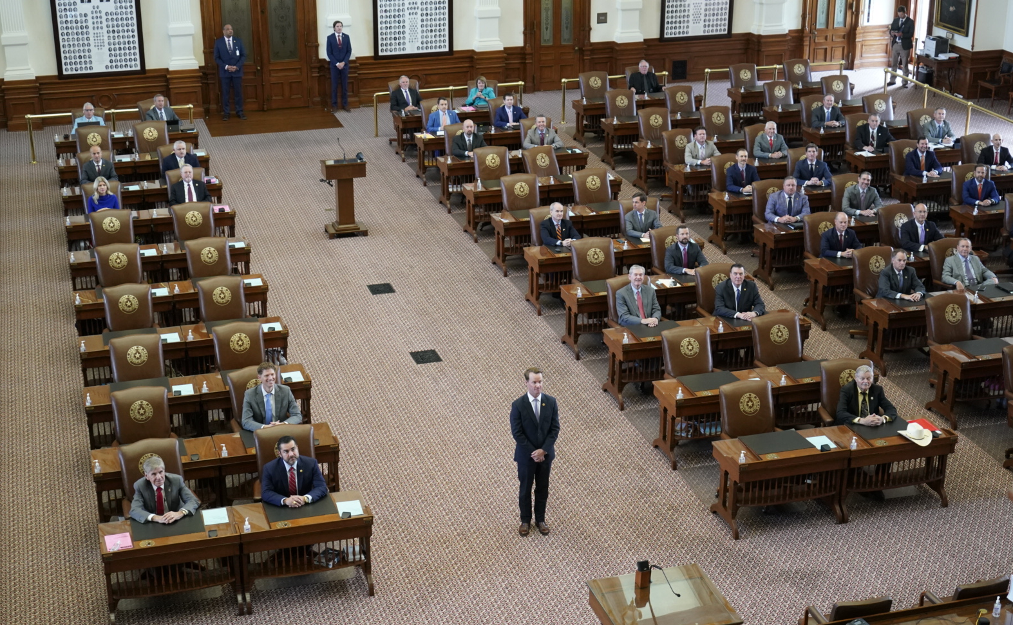
Notes:
Meanwhile Speaker Phelan and House Republicans (and a handful of democrats who stayed behind) spent their time taking photos, because there wasn’t much else they could do without a quorum…and then the session ended without a quorum (or the passage of any legislation).

Slide 12

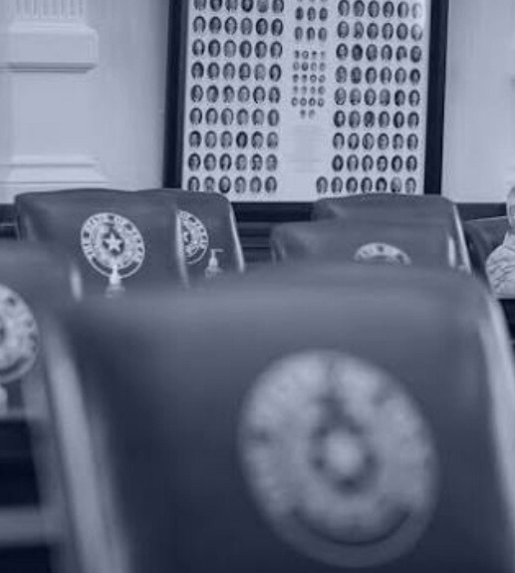
Second Called Special Session
August 7 - September 2
Notes:
Then the 2nd special session began the very next day.

Slide 13
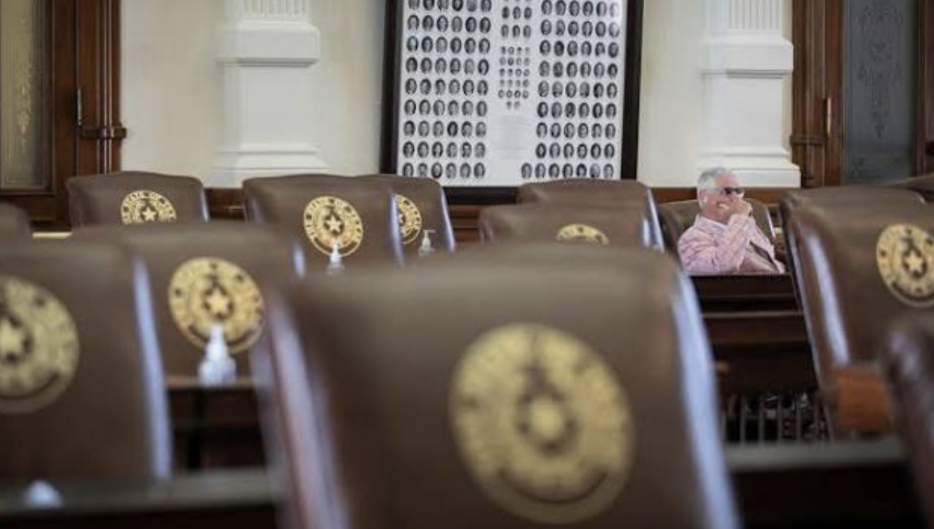
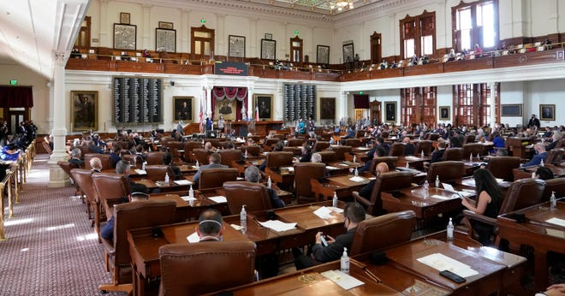
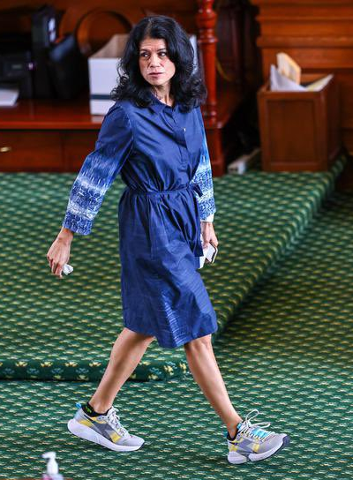
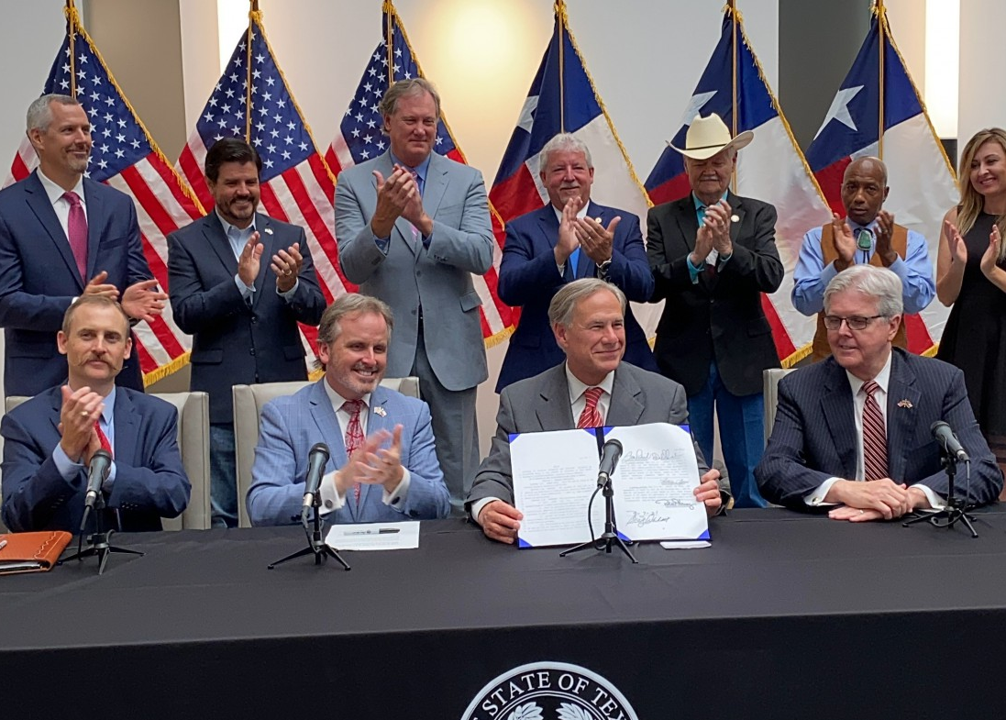
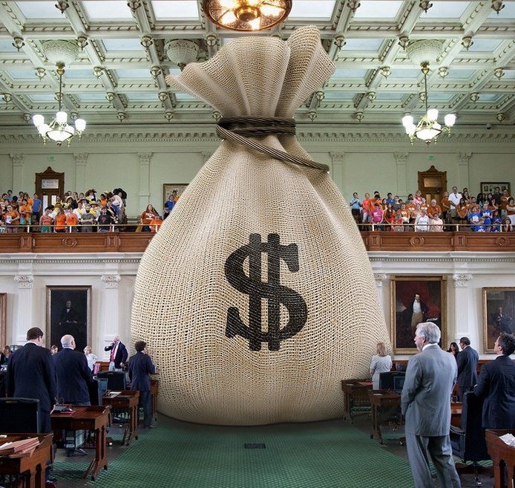
2nd Called Special Session Recap
Notes:
The second special began with an equally empty House chamber at first. But then a quorum was achieved and the House began to conduct business. We had a Senate filibuster of the controversial elections bill, though it was in the middle of the session and therefore didn’t have much effect. And eventually the elections bill over which members of both parties had some very strong feelings passed and was signed into law. And only after that bill passed did the legislature finally approve of appropriations to continue the legislative branch of government. (an appropriations bill that has once again been sent to the Governor, but that he has not yet signed into law)

Slide 14
Education/school finance bills passed in
2nd Special Session
SB 3 (Hughes/Huberty), anti-Critical Race Theory (CRT)
SB 7 (Huffman/Rogers), the "13th check" for TRS retirees
SB 8 (Bettencourt/Meyer) homestead exemption tax refund for certain homebuyers
SB 9 (Huffman/Dutton) instruction, materials & policies for prevention of child abuse, family violence, and dating violence (requires a parental opt-in)
SB 12/SJR 2 (Bettencourt/Meyer) - property tax rate compression for those on frozen levy (once approved by voters in May 2022).
SB 15 (Taylor/Keith Bell), funding for remote instruction
Notes:
Here is a quick recap of what passed that affects schools in some way during the 2nd special session. The election bill isn’t listed here; while changes to elections certainly affect schools, there was nothing in the bill that singles schools out or impacts school elections in any way that doesn’t impact all elections in general.

Slide 15
HB 3979 (Toth/Creighton)
Social studies curriculum – The “Anti-Critical Race Theory Bill”
Prohibits a teacher from being compelled to discuss a particular current event or widely debated and currently controversial issue of public policy or social affairs, and requires that a teacher who does choose to discuss such a topic must make an effort to explore the topic from diverse perspectives, without giving deference to any one perspective.
Prohibits school districts and teachers from requiring or awarding course credit for a student's political activism or participation in an internship, practicum, or activity involving social or public policy advocacy;
Prohibits a school district employee from being required to attend certain types of training - including any that presents any form of race or sex stereotyping or blame on the basis of race or sex;
Prohibits schools from accepting private funding for the purpose of developing, purchasing or selecting curriculum or provide teacher training for such a course that presents any form of race or sex stereotyping or blame.
Signed by the Governor; effective September 1, 2021.
Notes:
Remember when we talked about this bill in our previous post-legislative workshop? Well, forget everything you learned. While it is technically still law today, it won’t be for long!

Slide 16
SB 3 – Civics and Social Studies Curriculum
Repeals HB 3979, to be replaced with:
  School districts and school employees may not require or make part of a course concepts generally associated with Critical Race Theory (CRT) such as topics involving superiority, racism, or responsibility based on a person’s race or sex.
  Prohibits acceptance of private funding for CRT curriculum or training
  Civics training for school district personnel to ensure curriculum is taught as required by law
  Parents must have log-in info for learning management system or online portal used for instruction or instructional materials
Notes:
That old new law was repealed and replaced with what will soon be new, new law. This bill came close to not passing, and then some serious threats were made by he who calls special sessions. So Rep. Dan Huberty became the bill’s sponsor, and honestly, he worked hard to compromise with other members-holding varying points of view. Because of that, it became a much better bill than it started.
This bill is the Critical Race Theory bill (though the bill never uses those words). Superiority based on race or sex cannot be taught in schools, cannot be funded, staff cannot be trained. School district employees will, however, be trained in civics, to ensure compliance with this new law. Also, if you use an online learning management system or portal, parents must be provided with their student’s log-in info so they have full access to materials and teachings.

Slide 17
SB 3 – Civics and Social Studies Curriculum
Specific instructions for SBOE on social students TEKS
No course requirements or credits for work/service with organization engaged in lobbying/advocacy/activism.
Prohibitions and requirements for discussions of “a widely debated and currently controversial issue of public policy or social affairs” and that any such discussions must “explore that topic objectively and without political bias.”
Class activities that involve communications with elected officials are permitted, so long as content is not influenced
Notes:
There are some very specific instructions given to the State Board regarding social studies TEKS. Some specifics that various House members worked hard to have included were left out of the bill, but Huberty recognized how important the specific individuals, movements, and details were to his colleagues, so that list, while not in law, still exists in the bill to help inform the SBOE’s process.
There was also a lot of discussion about prohibiting a student from receiving credit for internships and the like with a variety of community organizations that also lobby (such as hospitals and fire departments). Attempts to amend that language failed, as Huberty maintained that the bill only prevents credit if the student is engaging in lobbying/advocacy in the internship.
We also saw some tightening and clarity added to the language about the discussion of current events, which you see here.
And language was added to make it clear that a teacher having all students write to an elected official as a class activity is not prohibited, so long as that teacher does not influence the content of the communication. (Hopefully English teachers are still allowed to influence grammar.)

Slide 18
SB 9 – Instruction on child abuse, family violence, and dating violence
SHAC must recommend appropriate grade levels and curriculum for instruction on child abuse, family violence, and dating violence (conducting at least two public meetings before adopting recommendations)
Upon advice of SHAC, school board makes selection of materials and instruction
District must provide written notice to parents of instruction to be provided and parents’ right to review curriculum and instructional materials on these topics
District must obtain separate written consent from parent before providing this instruction to a student
Curriculum materials in the public domain used for instruction must have a link to those materials posted on the district’s website
District must have policy stating dating violence is not tolerated at school, and a means of reporting for victims
Applies beginning with 2022-23 school year
Notes:
This bill is similar to one that was passed in the regular session and then vetoed by the Governor. Now there is another topic each district’s SHAC must consider (during at least two public meetings), bringing a recommendation to the board on what grade levels should receive instruction and what curriculum should be to teach students about child abuse, family violence, and dating violence. Parents must opt-in to any such instruction via separate written consent. You also have to make these materials available to parents, and districts need a policy to say dating violence is not tolerated at school, as well as a means of reporting for victims. You did not receive any additional funding to cover the cost of these new mandates.

Slide 19
Property Tax Relief
SB 8 allows for proportional refund of $25,000 homestead exemption for persons who purchase their home after January 1 of a tax year. Provides additional state aid to make up for lost property tax revenue.
SB 12 provides for a reduction of the frozen levy to reflect property tax compression since 2019, contingent on SJR 2.
SJR 2 takes constitutional amendment for adjustment to frozen levy to the voters for approval in May 2022.
Notes:
Legislators also passed property tax relief bills in the 2nd special. All of these were by Bettencourt and sponsored by Meyer. SB 8 addressed the issue of a homebuyer who purchased a home that was not previously receiving a homestead exemption, as it was not owner occupied before. That homeowner then had to pay higher taxes in the first partial year of ownership before they could apply for the exemption. Now they will be entitled to a refund for their proportional share of the taxes—that refund will be funded by the state.
All of these bills were heard on the first Saturday of the first special session in July. Remember that picture I showed you? Well, I testified for the property tax relief THAT THE STATE SHOULD PAY FOR, not school districts. And Senator Bettencourt listened and amended the bill with our language. The bills didn’t pass in the first special. But when they came back in the second special (and did pass), he filed them with our language providing funding, and that is what ultimately passed. They provided all of five minute’s notice for the hearing on these bills in the second session, and there was no way for me to make it there in time to testify then. So the lesson here is that when presented with an opportunity to weigh in on an issue, take it. You never know if you will get the opportunity again or not.
The last two bills on the list here affect the elderly (65 and older) and disabled on the frozen tax levy. Those folks did not benefit from the tax relief offered through HB 3 in 2019 (because their taxes were frozen). Now, under SB 12 they will be entitled to the same tax relief as everyone else if the constitutional amendment proposed through SJR 2 is adopted in May. Because of the requirement for voter approval, this change will not take effect until tax year 2022.
Again, our recommended language was added to ensure that it is fully funded by the state and will not result in a loss of funding for districts.

Slide 20
SB 15 – Remote Learning
Allows districts rated C or better to receive funding for up to 10% of eligible enrolled students in a remote learning program
Allows synchronous, asynchronous and blended programs
Authorizes MOUs between districts
Accountability for virtual programs must be separate
Teachers may not be required to teach remote & in-person simultaneously
Students are not eligible for funding if they were remote 50% last year and:
  Did not pass state assessment in 2021 (or local equivalent if did not take STAAR);
  Had more than 10 unexcused absences in 6-month period; or
  Did not earn grade of C or higher in courses in foundation curriculum
Allows certain existing programs to continue without enrollment cap
September 1, 2023 expiration date
Notes:
The clock ran out on HB 1468 in the regular session and it looked like all hope was lost. But a bill was finally passed that allows schools to receive ADA funding for up to 10% of enrolled students (if eligible, more on that in a few). The bill that passed doesn’t allow the same degree of local control on this that we had hoped for, but it does open a door of possibility that wasn’t there before. Districts that were operating programs before this new law were in effect will receive funding for eligible students in the program meets requirements. Districts can partner for remote offerings. Remote programs will be treated as a separate campus for accountability purposes. Lots of provisions were added to the bill to protect against students who might be unsuccessful or not as well served in a remote program. These changes do not impact those programs previously operating under the Virtual School Network. The bill also allows a few select full-time virtual programs to continue without the 10% enrollment cap.

Slide 21

Student funding eligibility under SB 15
Notes:
Who doesn’t love a good complicated board game? This is kind of what I think of when they took a nice simple local control bill and add state influence.

Slide 22
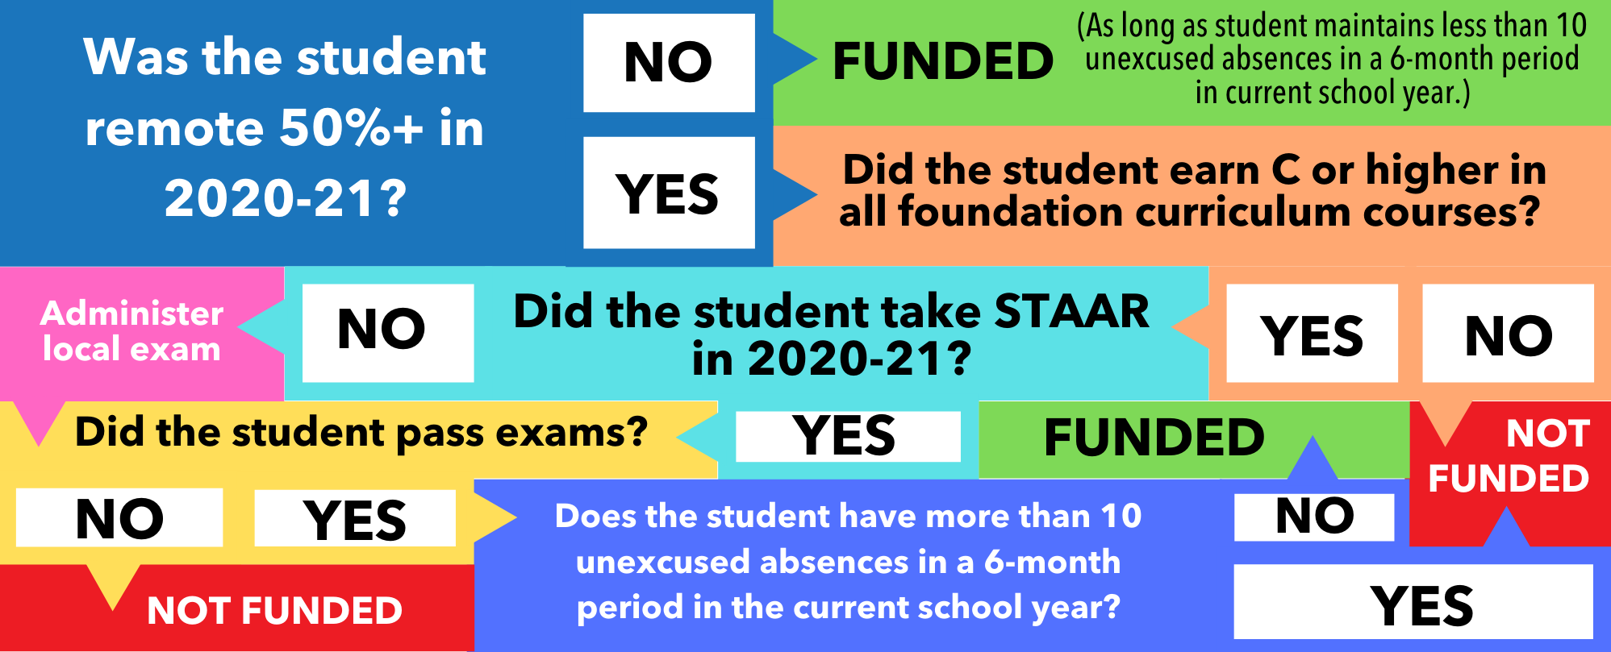
Student funding eligibility under SB 15
Notes:
You have to perform a lot of checks to ensure that a student is eligible for funding under SB 15. Some of this information, you may not even have. TEA will be providing a list through TEAL to help districts obtain this information for students who may be new to their district. It’s also challenging because you may not have a clear knowable answer for a parent about whether their child qualifies when they call to inquire.

Slide 23
What is next for remote instruction?
Commissioner must adopt rules (TEA posted DRAFT rules)
Rules open for public comment
Districts must develop programs. Options under consideration:
  Some students fully remote all year
  Remote options for students only when they must be absent
  Hybrid options
SB 15 included language to provide funding for entire 2021-22 school year, even before passage of bill if eligible students in program specified by the new law.
Notes:
SB 15 isn’t all we were hoping for and it doesn’t address the issue of forced closures like we had hoped, but it’s the best we have at the time. It’s the stop gap that will help to some degree. So now the Agency writes rules, you must develop programs and boards must adopt those. And then we will work to provide information to the commission that is going to meet this interim (once we ever have an interim) to inform what laws the legislature should adopt on this topic in 2023. Remember that all the SB 15 laws will expire in September of 2023, absent of further legislative action to keep them.

Slide 24
Lt. Governor Dan Patrick’s 31 Priorities
Passed in 87R
Passed in 2nd Special
SB 1 – The State Budget
SB 2 – ERCOT Reform
SB 3 – Power Grid Stability
SB 4 – Star Spangled Banner Protection Act
SB 5 (HB 5) – Statewide Broadband Access
SB 6 – Pandemic Liability Protection Act
SB 8 – The Heartbeat Bill
SB 9 (HB 1280) – Abortion Ban Trigger
SB 13 – Oil & Gas Investment Protection
SB 15 – Ban Sale of Personal Data from Certain State Agencies
SB 17 (HB 19) – Protect Texas Trucking
SB 18 (HB 1500) – Protect Second Amendment Businesses
SB 19 – Stop Corporate Gun Boycotts
SB 20 – Second Amendment Protections for Travelers
SB 22 – First Responders Pandemic Care Act
SB 23 – Stop Local Police Defunding
SB 24 – Law Enforcement Transparency Act
SB 25 – Family Nursing Home Visitation Rights
SB 26 (HB 1239) – Protect Our Freedom to Worship
SB 30 – Remove Racist Restrictions from Real Estate Deeds
SB 1 – Election & Ballot Security
HB 20 – Protect Free Speech on Social Media
SB 6 – Bail Reform
SB 15 – Expanding Virtual Learning
Failed to Pass
Stop Taxpayer Funded Lobbying
Appellate Court Reorganization
Business Freedom and Uniformity Act
Protect State-held Personal Data
Charter School Equity Act
Fair Sports for Women & Girls
Senate Redistricting Act
Notes:
Following the 2nd special, let’s check back in on where the Lt. Governor’s priorities stand now…(click)

Slide 25
Unfinished Business – 2nd Special
Bills that did NOT pass:
SB 2 (Perry) – Transgender Participation in UIL
SB 91 (Bettencourt) – Temporary Property Tax Relief
HB 233 (Huberty) – Accelerated Instruction changes (only for reading and math, not all assessments; maximum of 10 rather than 3 for small groups)
Mask legislation
Notes:
While a lot of bills made it to the finish line that didn’t make it before, there were still some that fell short too. A bill to require that UIL participation be tied to a student’s sex at birth has now failed to pass in the regular, first, and second special sessions. SB 91 was filed and heard very late in the 2nd special and didn’t quite make it, but not because there isn’t widespread support, just because the clock ran out. The same can be said about HB 233, regarding accelerated instruction. They also had a hearing on legislation both allowing schools to require masks and banning the practice. Some of the scientific experts that have been testifying at some of your school board meetings showed up for that hearing. But neither bill ever advanced out of committee.

Slide 26
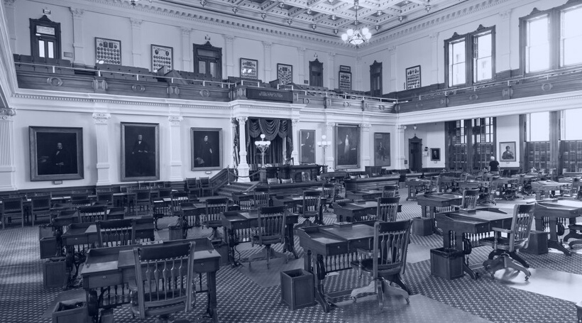
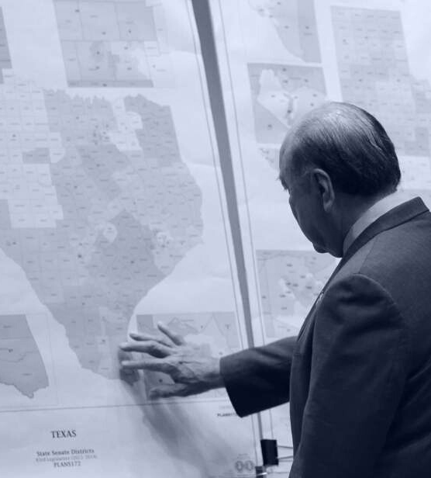
Third Called Special Session
September 20 - October 19*
Notes:
So now in less than a week, we get to do this all over again. Starting Monday, September 20, they must conclude their business by October 19 (or else we get to have a fourth special session).

Slide 27
3rd Special Session - On the Call
Redistricting: reapportioned maps for Texas legislative districts, as well as the SBOE and US Congress.
Additional appropriations from the American Rescue Plan Act (ARPA);
Whether any state or local governmental entities in Texas can mandate COVID-19 vaccinations, and if so, what exemptions should apply to such a mandate.
UIL athletics participation tied to a student’s sex at birth, similar to SB 29 from the 87th Regular Session (and SB 2 from the specials).
The unlawful restraint of a dog, similar to bill passed during the 87th Regular Session, and vetoed by Governor Abbott.
Notes:
So far, the Governor has identified five matters that are of supreme importance to the functions of our state and therefore on the call for the 3rd special. [CLICK] Redistricting. We knew this special was going to happen in the fall of 2021 ever since the census was delayed. They couldn’t do this before now because they didn’t have the data that we now have. Even so, there is also a lawsuit pending that would delay redistricting further. But I think they will move ahead with it this year. [CLICK] Also on the call is the federal funding that legislators want to have some say over (rather than the Governor and a select group of leaders deciding in vacuum). This is the carrot to buy the votes they might need to get the maps they might want. [CLICK] At this point in the pandemic, there is much talk of vaccine mandates and whether that should be allowed or not. It is a topic President Biden weighed in on last week, and this item on the call allows Texas to consider legislation on this topic in the special. Also of great importance at this time [CLICK] is participation in UIL athletic competitions and [CLICK] the unlawful restraint of a dog (a bill that passed in the regular session and was vetoed by the Governor). You might be thinking of a few other issues you would have added to this list, but the dogs won the day.

Slide 28

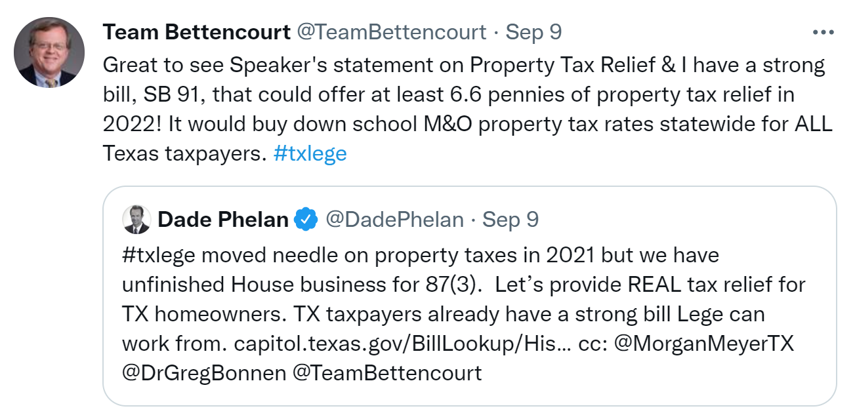
Not on the call (yet)
Notes:
Here is a topic that is not yet on the Governor’s call, but could be soon (given his propensity towards tax relief). As mentioned earlier, Senator Bettencourt got SB 91 passed by the Senate in the closing days of the session, without enough time for the House to take it up. But it certainly looks like there is support in both chambers to pass this bill if Governor Abbott is willing to add it to the call.

Slide 29
Property Tax Relief (not on the call yet)
SB 91 (87-S2) would have reduced all MCRs by roughly 6 cents in tax year 2022
Rates would revert back up the following year
Also would have added new language on the ballot comparing rate if TRE passes vs. if it does not pass
    “If the adopted tax rate is not ratified, the (name of school district) may not adopt a tax rate that exceeds ____ (insert the school district ’s voter-approval tax rate)."
Notes:
While it’s not on the call yet, let’s talk about this bill a bit. I testified ON SB 91 in the Senate Finance Committee and what I told legislators is that while we support property tax relief (and the reduction of recapture it brings), we are concerned about the temporary nature of this tax relief. Comptroller Hegar found that the state had several billion they didn’t spend (you know, because the feds sent a bunch of money for schools that the state supplanted), and so state leaders would like to give that back to property taxpayers (an admirable goal). The problem is that when you give temporary tax relief that is not sustainable, tax rates are going to jump back up again the following year and that is going to make people angry. And they aren’t as likely to be angry with the state about that as they are to be angry with their local school officials. I testified asking them to ensure tax relief can be sustainable over time.
Additionally, there is language in that bill that is gong to make it even harder than before to pass a tax rate election. The bill would require language on the ballot to tell voters what the tax rate would be if the measure fails compared to the rate for which the district is seeking ratification. Many of you are very transparent about this already when talking to voters. This just puts it on the ballot.

Slide 30

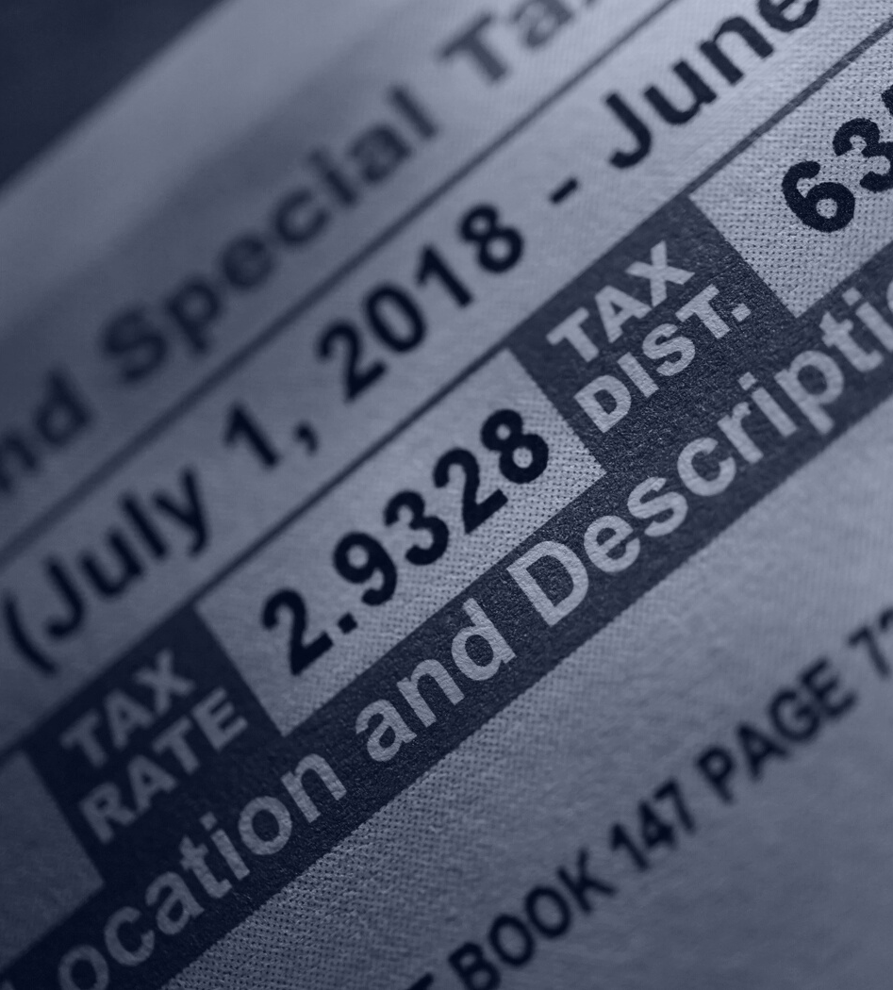
Property Taxes
The state of property taxes and effects of rate compression
Notes:
Speaking of property taxes…

Slide 31
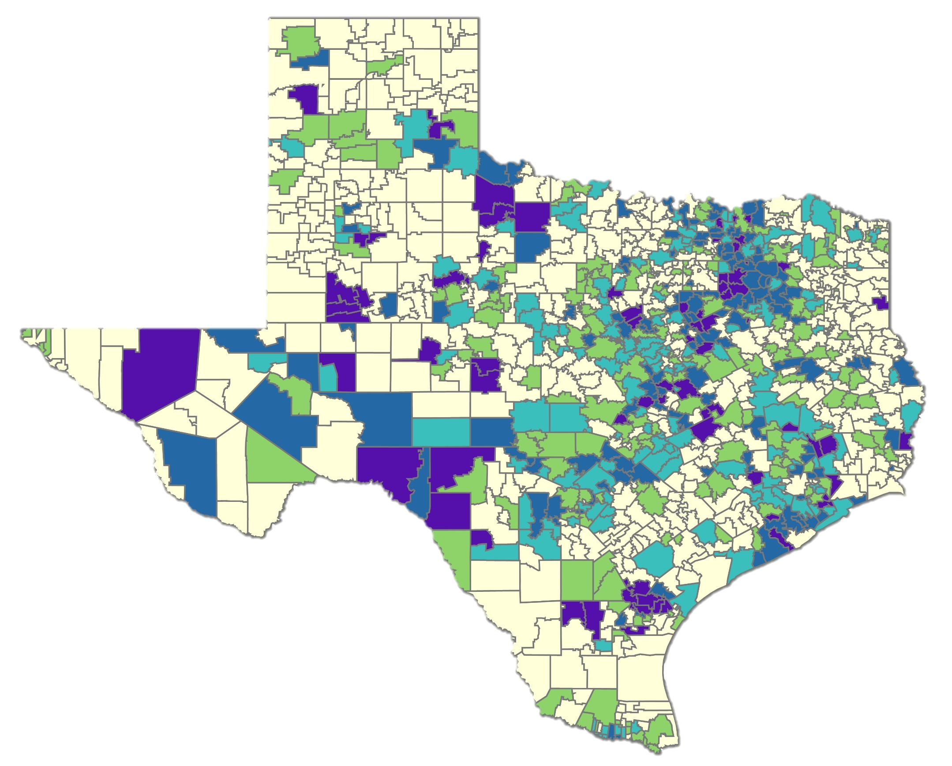
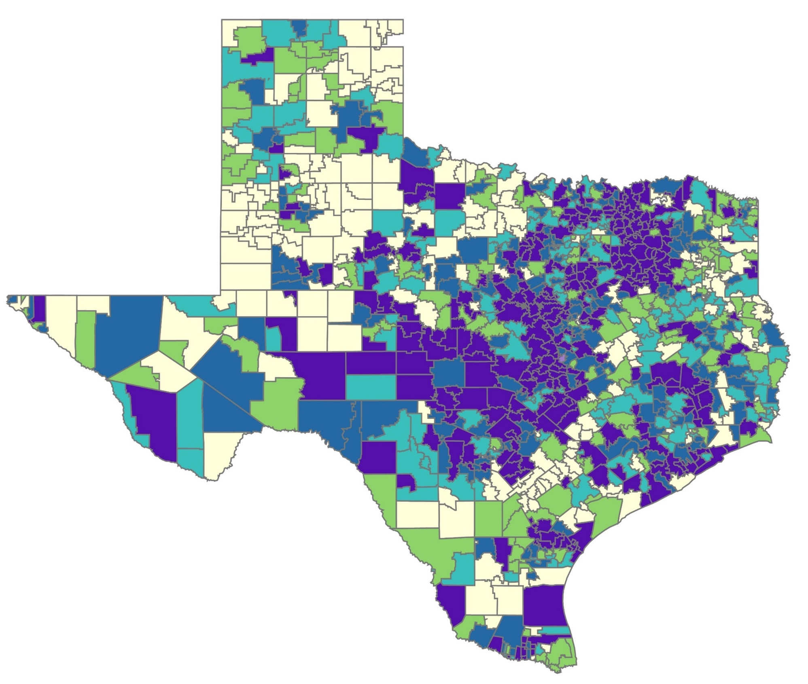
TAX RATE COMPRESSION: 2020 vs 2021
PRELIMINARY
$0.9164
475 districts
$0.8908 – 0.9163
$0.9134
207 districts
181 districts
$0.8821 – 0.9133
$0.8665 – 0.8907
153 districts
152 districts
$0.8248 – 0.8664
$0.8521 – 0.8820
169 districts
134 districts
$0.8221 – 0.8520
$0.8247
72 districts
173 districts
$0.8220
314 districts
©2021 Texas Association of School Business Officials. All rights reserved. Do not duplicate or distribute without express permission.
Notes:
Here are the maps produced by TASBO comparing tax rates statewide to show how compression put in place by HB 3 is working. Tax rates are being compressed.

Slide 32
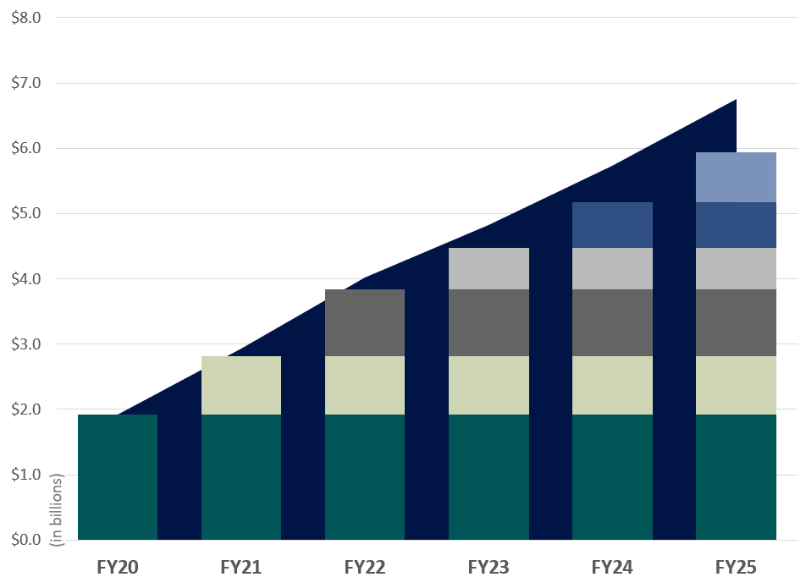
PRELIMINARY Cost of Tax Rate Compression
Year | Pennies Compressed | Cost (in billions)
2019-20 | $0.07 | $1.92
2020-21 | $0.03 | $0.90
2021-22 | $0.03 | $1.06
$0.02
$0.02
$0.02
$0.02
$0.02
$0.02
$0.03
$0.03
$0.03
$0.03
The columns show the original cost of each round of compression at the time it occurs.
The area behind the columns shows the cumulative cost of compression. Cumulative cost is higher because of growth in the tax base over time. The cumulative number of pennies “purchased” through compression is shown below the graph.
$0.03
$0.03
$0.03
$0.03
$0.03
$0.07
$0.07
$0.07
$0.07
$0.07
$0.07
$0.07
$0.10
$0.13
$0.15
$0.17
$0.19
©2021 Texas Association of School Business Officials. All rights reserved. Do not duplicate or distribute without express permission.
Notes:
And speaking of sustainability…you’ve seen this before and now it has been updated with the most recent preliminary data. The cost of continued tax rate compression continues to climb. And that means that state resources are going to be dedicated towards paying for that rather than investing in things like increasing the basic allotment or providing any new resources for schools. Investing $2-$4 billion in temporary tax relief on top of this compression doesn’t contribute to the sustainability of our system. How are we going to be able to afford this when the legislature adopts the budget for 24-25 when they convene in 2023?

Slide 33
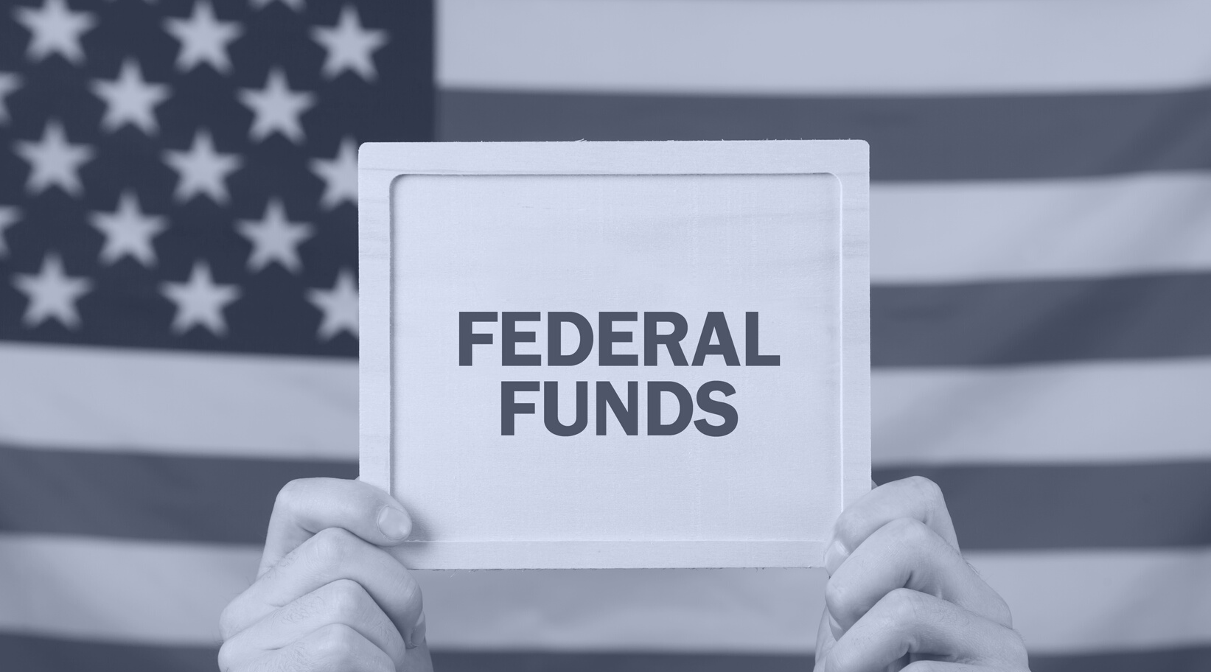
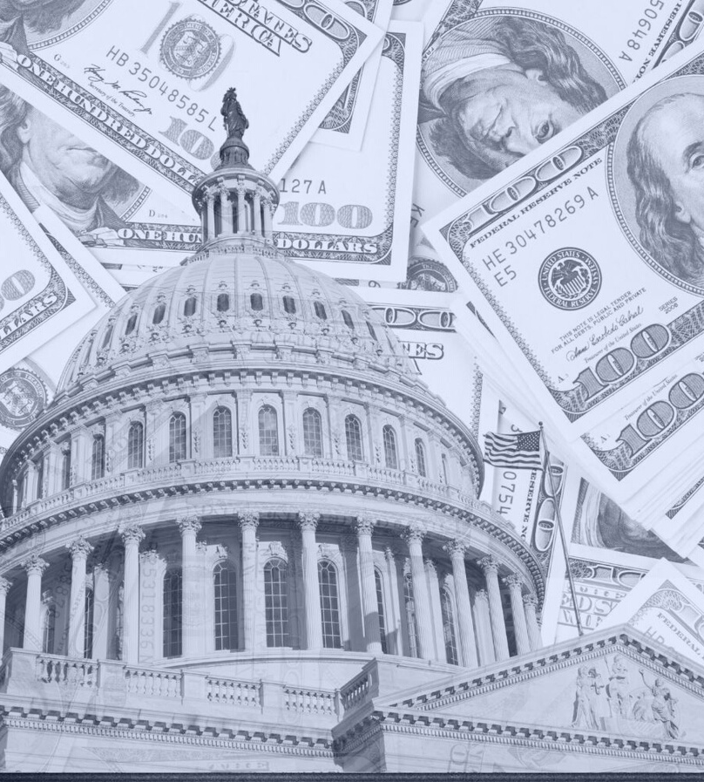
ESSER
Elementary and Secondary School Emergency Relief Fund
Notes:
Finally, we’ll end with a word about ESSER.

Slide 34
Comparing the Federal Funding Packages
CARES Act CRRSA Act ARP Act
 | ESSER I (March 2020) | ESSER II (December 2020) | ESSER III (March 2021)
Total Funding (nationwide) | $13.2 billion | $54.3 billion | $122 billion
Total Allocation to Texas | $1.29 billion | $5.53 billion | $12.4 billion
Allowed for State reservation | $130 million | $553 million | $1.24 billion
Must be Allocated to LEAs | $1.16 billion | $4.98 billion | $11.18 billion
(supplanted) (partially supplanted)
Notes:
You’ve seen these details before. What’s important to know at this point is that State aid to be supplanted for ESSER II is not final. Figures keep changing, and it’s impossible to know where these numbers will land. We expect somewhere north of a billion dollar swing statewide. Within the next few days (maybe even today) we will know for certain and then you can finally make plans.

Slide 35
Comparing the Federal Funding Packages
CARES Act CRRSA Act ARP Act
 | ESSER I (March 2020) | ESSER II (December 2020) | ESSER III (March 2021)
Funds to schools? | supplanted | partially supplanted | $ to schools
TRS treatment | like state funds | combination: (depends how much was supplanted) | like local funds
Use a comparison of Near Final runs with ADA hold harmless counts to final ESSER adjusted to see how much was supplanted in your district.
Notes:
When it comes to how TRS treats these dollars and what type of contribution districts are expected to make, the funds from ESSER 1 are treated like they are state fuds (because they were). The funding you received from ESSER 3 and used to pay staff are treated like local funds and you are expected to make those contributions accordingly. But when it comes to ESSER 2, it all depends. You won’t know what level of contribution is expected until you know what share of your ESSER 2 dollars are supplanted (and therefore treated like state funds) and which share are not (and therefore treated like local funds).

Slide 36
Strategy requires stability
Before spending ESSER 2 and 3…
  How much will you need to cover losses in 2020-2021?
  Will you need to cover continued losses in 2021-2022 given ADA declines, other issues?
  Have you considered long term financial sustainability?
Notes:
The state keeps calling on districts to make strategic plans, but that’s difficult to do given the unstable environment you’ve been in. As you work out your strategies, here are some things to consider as you figure out the best use of those dollars.

Slide 37
Sustainability
 | End of Availability (Including Carryover) | Statewide Amount
ESSER 1 | September 30, 2022 | $1.16 billion
ESSER 2 | September 30, 2023 | $4.98 billion
ESSER 3 | September 30, 2024 | $11.18 billion
Formula Transition Grant | September 1, 2024 | $400 million
Notes:
These are dates to keep in mind for when these sources of funding end or must be spent by. Everything on this list are temporary sources of funding that will expire. Districts will be left to function without these dollars in a relatively short amount of time so you must spend these funds wisely to lay the foundation for when the funding goes away entirely and you are left to make do with less. Not an idea situation, but it’s the one we’re in.

Slide 38


Questions?
Christy Rome
512-732-9072
christy@txsc.org
Notes:
Happy to answer any questions.

