Slide 1
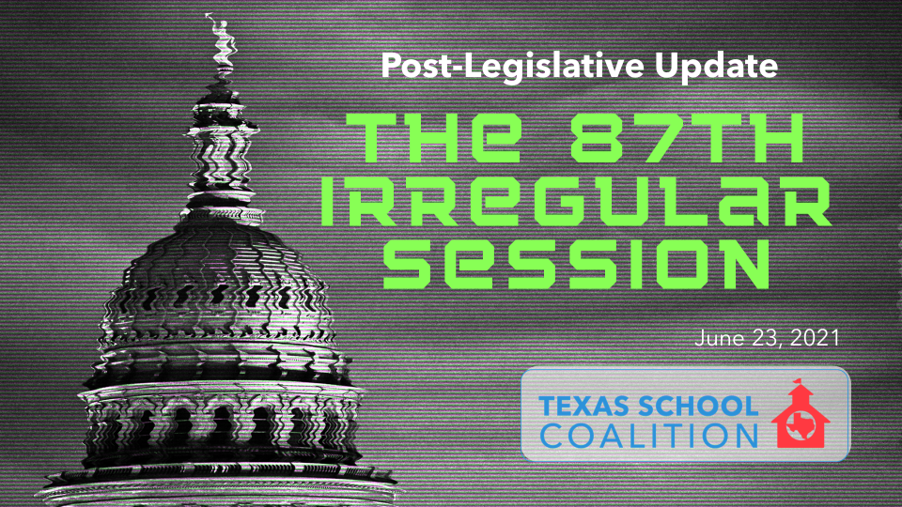

Slide 2
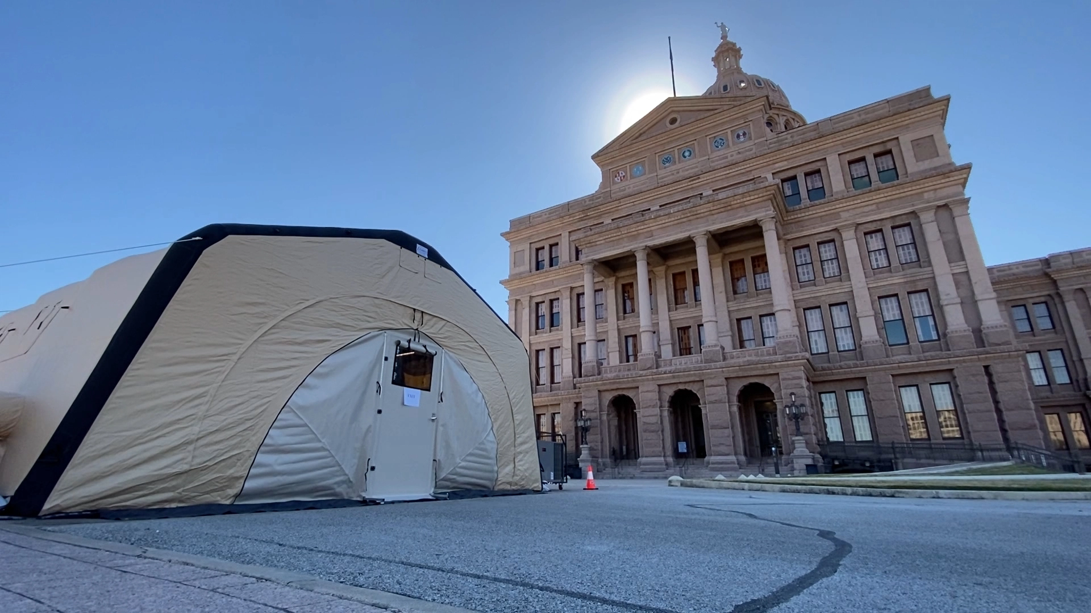

A Legislative Session like no other
On January 12, the 87th legislative session began unlike any before, in a quiet Capitol anticipating a no-frills session to address COVID-19 and economic recovery.
Notes:
This session was one like no other. You had to test (in one of these lovely tents) in order to enter many locations of the Capitol. And even with the test, there were many doors that remained locked and people who remained unavailable. On some visits, the only folks I got to see were the armed guards. Given the pandemic, many said it would be a “lighter session” where they would only focus on a few key priorities and then adjourn. But if they did that, what would anyone have to say in their campaign newsletters?

Slide 3
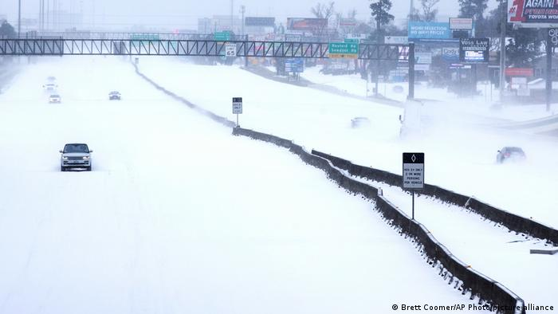
One month after the session began, the catastrophic February storm froze the legislature in its tracks, reshaping priorities around energy reliability and regulatory reform.
Notes:
Is this what you guessed for the additional EMERGENCY items? It was an emergency indeed. And this topic and the State’s response dominated much of the session.

Slide 4
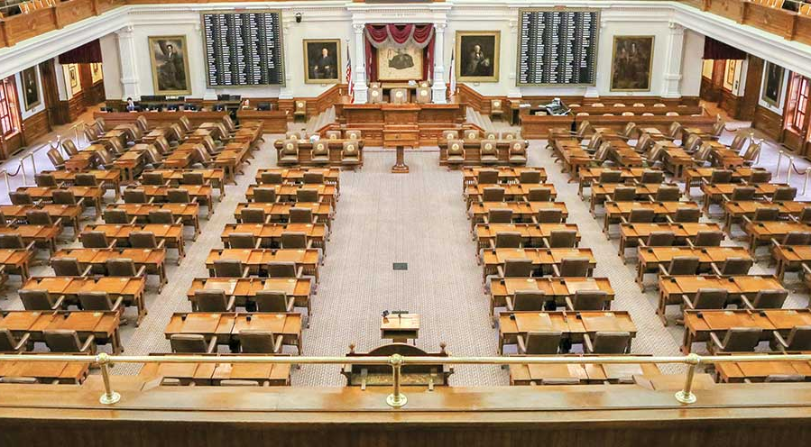
Notes:
This chamber emptied out and the House didn’t have a quorum to pass SB 7 or any other bill that evening, so they adjourned early, killing several bills that were priorities for state leaders. What that means is this chamber will again be filled with 150 plus people for multiple special sessions.

Slide 5
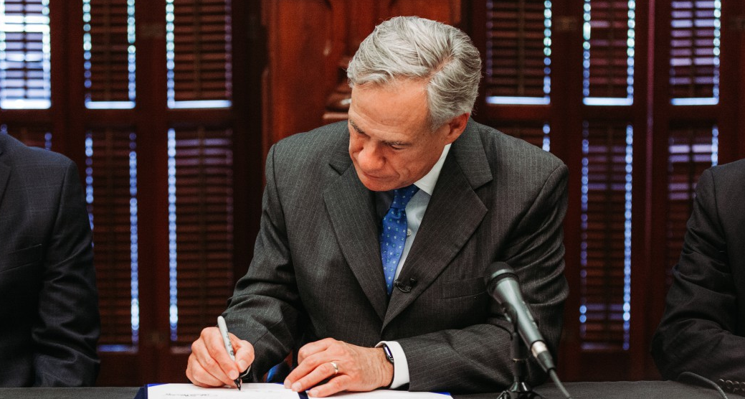
Legislation THAT Passed
Notes:
Now let’s talk about what DID pass.

Slide 6



State Appropriations
Post-Legislative Update following the 87th Irregular Session- June 23, 2021

Slide 7
House Bill 2: Supplemental Appropriations for 20-21 Biennium
Total GR Savings: $5.113 billion
Total All Funds Savings: $3.384 billion
Incudes $44 million in supplemental special education funding, coming to districts in August 2021.
Foundation School Program Reduction
$5.2 billion
Notes:
There's a supplemental appropriations bill, every session, and it's designed to true up spending for the current biennium. They always need to spend either a little more or a little less than they appropriated when they met two years ago as reality sets in. But notice the foundation school program reduction of $5.2 billion. This includes a $1.4 billion increase to recapture above where they thought it would be.
And the point made during the legislative session was lawmakers are very proud of the investment they made, in HB 3 of $11 billion, but they took 5.2 of it back right in the beginning of the session. And that was due to a couple of things, the most significant of which was higher than projected property value growth.
That faster than projected property value growth is part of what saved the state significant money. And frankly, the school community saved the state budget because of that, because they were able to take this $5.2 billion back. Another thing though, is that property value growth is likely not to be there to save them to the same degree looking forward as it was this past time. That's because increased property value growth in the future will result in further compression of the tax rate. And you'll notice as we talk through the school finance provisions of legislation passed the session, we're going to see a lot of limits on spending and it's because lawmakers are very mindful of future state budget constraints that they worry they're going to have.

Slide 8
Recapture 2018-2023 – Appropriations vs. Actual
$1.36 billion more than appropriated
$3 billion expected in ‘23
$1.6 billion in Lottery proceeds expected per year
Notes:
When you look at recapture amounts in the appropriations act, they ended up with $1.4 billion more in recapture than what they said it was going to be when they passed HB 3 two years ago. Typically, the appropriations act estimates recapture that is a slightly lower amount than where it actually ends up. They are estimating that recapture is growing so that it will reach $3 billion in one year in FY23. So if that trend continues, we can expect recapture to exceed $3 billion in 23. That's an annual amount, and it’s a big number. Especially when you consider that the lottery proceeds bring in $1.6 billion per year. So by FY 23, recapture will bring in nearly double the amount of the revenue from the lottery.

Slide 9
What the $5.2 billion FSP Reduction in HB 2 Means
What legislators said they were investing in public schools through HB 3 in 2019 | $11.6 billion
FSP Reduction in Supplemental Appropriations for 20-21 Biennium | -$5.2 billion
What lawmakers REALLY invested in public schools | $6.4 billion
The $11.6 billion investment was split between new money for schools and property tax compression; it’s not possible to know the exact breakdown of the $6.5 billion yet.
Notes:
And what that reduction really means is that while they still like to brag about the $11.6 billion investment that they made into our public schools through HB 3 in 2019, they really can't call it $11.6 billion anymore.
They need to start correcting their newsletters and websites to reflect $6.4 billion. Because they reduced the investment that they made by $5.2 billion, keep in mind that the $11.6 billion was a combination of new money for schools and the new money that they spent on compressing tax rates. We can't quite break down the $6.4 to tell you how much of that is new money for schools and how much of that is property tax compression.
But you get the idea here that it is a shared Investment between schools and property tax payers. One of them helps schools and helps us to pay teachers and do things for students. And the other one puts money in property taxpayers’ pockets.
But, we have to keep in mind that that full $6.5 billion investment didn't make it to the classroom.

Slide 10
SB 1 (Nelson/Bonnen) – General Appropriations Act
$248.6 billion total ALL state funds
(5.2% decrease over the last biennium)
$116.3 billion total General Revenue
(5.5% increase from the last biennium)
$46.5 billion state funds for public education
(4.5% increase over the last biennium)
Coronavirus Relief federal funds not appropriated in this Act.
Notes:
The General Appropriations Act…we thought this was going to be a huge hit. They called for all the agencies to make across the board 5% reduction (the FSP was exempt from that). We thought they were going to be some major cuts. And in fact it wasn't so bad at all. You did see a decrease in all funds, but you made that up in other ways through the budget was all was said and done.
It's not a bad budget at all. They didn’t have to make substantial cuts. And they were in the black—leaving the state with a slight surplus rather than a deficit. It's a balanced, conservative budget, and this doesn’t even account for most of the federal funds yet.

Slide 11
SB 1 - Honoring the Commitment of HB 3
Funds Enrollment growth
Basic Allotment remains $6,160
Golden Penny yield remains $98.56; copper penny yield stays at $49.28
NIFA funding reduced by $60 million ($30 million per year)
New supplemental services accounts to be managed by parents of special education students adds $60 million ($30 million per year)
Notes:
Whenever they talk to the budget, they want to emphasize to you that they are honoring the commitment of House Bill three.
And in fact, they didn't cut funding, so we grateful for that. They funded enrollment growth.
The golden penny yield (which used to automatically increase) remained the same. So did the copper penny yield.
So while they honored the commitment of HB 3, I think it's a matter of your perspective on really what is that commitment? Because there were a lot of statements made when they passed HB 3, two years ago that this was just the beginning and they were going to continue to grow the system.
That's why formula transition grants are transitional because they were going to grow the system so that you didn't need them anymore. That's how that was supposed to work, but if you don't grow the system, then it's hard to address the cliff that's set up by this formula transition grants for districts.
Are they really honoring the commitment to HB 3 when they put a cap on how much formula transition grants can receive? Are they really honoring the commitment of HB 3 when they reduced funding for the new instructional facilities allotment (NIFA) in order to pay for special ed vouchers? They reduced NIFA by a total of $60 million for the biennium and lo and behold, it was $60 million that they needed for the new supplemental services for special education student vouchers that can be managed by parents.
In name, they can make the statements that they honored the commitments of HB 3-- they didn't cut funding. But they didn't make the adjustments to the system to continue growing it either. They are relying completely on the increase you're receiving in federal funds primarily to keep the system afloat. And those federal funds are going to go away. So these are all things for you to keep in mind, as you are making plans for how to strategically use those federal funds, knowing that the State didn't take the steps that they really should have to continue growing the foundation school program and our overall system.

Slide 12
HB 1525 Contingency Rider
Includes increases as well as reductions in GR (in a manner that reduces locally controlled dollars and redistributes them through grants with greater state control)
Spends commissioner reserve/state set-aside portion of ESSER
Includes an IMA reduction
Initial Appropriation | $1,045,438,721
Contingency Rider Reduction | - $620,680,931
Remaining | = $424,757,790
This leaves roughly 40% of the amount originally appropriated. Adoptions this biennium include pre-k, PE, and health. However, hoped for funding for technology and other purchases may not materialize
Notes:
The next thing we want to talk about: the contingency rider for HB 1525, It included both increases and reductions in general revenue, it spends the portion of ESSER dollars that the commissioner, gets to reserve for use at the state level; it includes a significant reduction to the instructional materials allotment, and then it, it counts on about $1 billion in positive settle-up, which relates to the supplant of ESSER 2 money to pay for the ADA hold-harmless.

Slide 13

School Finance
HB 1525 (Huberty/Taylor)
“HB 3 Clean-Up Bill”
Post-Legislative Update following the 87th Irregular Session- June 23, 2021

Slide 14
Fast Growth Allotment
Based on enrollment growth over a six-year time-frame, ending with the prior year.
  For FY 22, 2016 enrollment is compared to 2021enrollment
  250 is subtracted from the difference
  Districts are sorted from most to least growth
  Variable weight based on size of enrollment growth relative to other districts in Texas
  Appropriations limit (starts at $270 million, increases to $320 million over time)
  Hold-harmless for 2021-22 for districts that earned the allotment in FY 2020, limited to $40 million statewide
Notes:
One of the more significant changes was a change in the fast-growth allotment. This produced, winners and losers, and like all things in school finance where you stand likely depends on where you sit. But what this did was instead of using three years of data to determine who qualifies for the fast-growth allotment, we're now using six and instead of sorting districts, based on percentage growth in enrollment, we are sorting based on numeric growth.
What you'll tend to see if you look inside the data is that larger districts are likely getting the fast growth allotments, some smaller districts likely aren't getting the fast growth of allotment anymore. We had districts that were getting the Fast Growth Allotment that don't have 250 students. So we know they didn't grow by more than 250 students.
The Legislature said it maintained its commitment to HB 3, and on a statewide basis, it did. But that doesn't mean every district was fully funded under HB 1525.
We're going to compare enrollment in 2021 to enrollment in 2016, we're going to subtract that and then subtract 250 from that gain and enrollment. And that's the key number in all of this. That's the number that we're going to use to sort districts, to decide who qualifies for which weight. And that's the number that the weight is going to be applied to (which is a variable weight).
This, like many allotments in the bill, has an appropriations limit, in their attempt to control spending.
There is a second piece here though, which is a hold harmless for districts that earn the fast-growth allotment in 19-20, but that expect to lose money next year in comparison to how they did in 19-20; that one is significantly prorated.

Slide 15
Return of the Gifted & Talented Allotment
GT Weight of .07
GT ADA limited to 5% of total ADA
Total GT allotment limited to $100 million
Notes:
We had a return of the gifted and talented allotment. This was a Senate provision, and the house was a little bit resistant to it, but this is the closest thing we got to just an increase in the basic allotment. This is the closest thing this session to state funded, general purpose increases in funding. The other thing it does that is helpful is if you're a district who receives formula transition grant, this helps reduce your FTG amount slightly.
It's a weight of 0.07. It's applied to the full basic allotment of $6,160. So that's likely more GT funding than we used to get. It's limited to 5% of total ADA and it too is appropriations limited. They're only going to spend $100 million dollars a year. If every district identified 5% of their students, it would cost a little more than that limited amount. Normally, most districts identify 5% of their students, but not all. So it will be right at that appropriations limit or they may have to reduce this just a little bit. If you're running your templates, you may see a GT allotment amount that’s a little bigger than what you end up with. We assume the spending requirement of 55% applies to these dollars as well.

Slide 16
Career and Technology Education (CTE) Allotment
For small and mid-sized districts, base for funding =
Sum of basic allotment + per student small or midsized allotment
Weights vary based on courses:
  No approved program of study: 1.1
  Levels 1 and 2 courses: 1.28
  Levels 3 and 4 courses: 1.47
Notes:
Career & Technology…also had a significant change. The first is a real positive, correcting an unintended error in HB 3, which caused small and mid-sized districts to not receive additional funding for CTE students. It was a result of an interaction of the small/mid allotment and the career and technology allotment. And so they corrected that. That increase in funding may too help a bit to decrease reliance on Formula Transition Grants.
But the second piece is important. The weights for career and technology education will vary now, depending on which CTE courses your students are enrolled in.
The idea is to drive students toward those higher level courses. It’s going to make revenue estimates for this year even more challenging though, as districts don’t have good data for this enrollment to help make those estimates just yet. You'll have a little bit of truing up to do once the information becomes available.
They did repeal the $50 allotment for advanced CTE courses and codified the P-TECH and New Tech allotments. So that's not a change; they're just making it catch-up with TEA implementation.

Slide 17
Cap on Formula Transition Grant
$400 million annual cap on formula transition grant. Current estimates are right at $400 million. But
  2019-2020 FTG: $445 million
  2020-2021 FTG (estimated): $533 million
Factors that could influence FTG:
  Formula changes that increase formulas and thus reduce the need for FTG
    GT weight, CTE change, fast growth (some increases and some decreases)
    Increases in school district tax effort (some VATREs, some 5th pennies)
  Second year of biennium (FY 23) cost likely to remain higher than first year (FY 22)
Won’t have final answer until settle-up
Notes:
And then there is a cap on Formula Transition Grants. As we model the bill right now, it spends right at about $400 million. That makes us very nervous, because formula transition grants are sensitive your tax collections and property values, which can change.
We won’t know until final settle-up whether statewide it comes in under the $400 million cap or not.
You should think about that money as at-risk of some potential proration. In 19-20 formula transition grants spent $445 million. And in 2021, they are estimated to cost $533 million (as of right now, subject to change).
FTGs are always going to spend more in the second year of the biennium because of the way the law is written.
Any formula changes that improve formula funding reduce the draw on formula transition grants, which is helpful. The GT weight, potentially changes in fast-growth, and possibly the changes to CTE could all help.
The other thing that could help is an increase in district tax effort. Some districts have agonized about whether to take the 5th penny, for example. When an FTG district makes additional tax effort, that puts more of a burden on taxpayers and reduces the amount of state aid the district qualifies for under the FTG. Depending on your local circumstances, this could change that for some districts. As things stand today, Formula Transition Grant funding is not secure and could result in a funding reduction for the district. Increased tax effort will deliver a reliable source of funding, without the threat of proration.
If enough FTG districts make additional tax effort, it also helps prevent the likelihood of proration as less than $400 million per year would be required to fully fund the FTGs.

Slide 18
Addition to College, Career, & Military Readiness (CCMR)
Outcomes Bonus
Students who earn an associate’s degree
Students who enlist in the Texas National Guard
Notes:
They did add two new categories of students to earn a CCMR Outcomes Bonus. Now, the students that we work with on study skills and perseverance and social and emotional learning, yet didn’t hit the SAT/ACT benchmark, but they went on and got their associate's degree….those kids have now been added to the eligibility for the CCMR outcomes bonus. And also students who enlist in the Texas National Guard (in a separate bill) were added as well. We still need to work through timelines and data sources and things like that to figure this out.

Slide 19
New Flexibility for Compensatory Education Allotment
Funds can be used for:
  Instructional coaches
  Attendance officers to support educationally disadvantaged students
  Programs to teach managing emotions, establishing positive relationships and teaching responsible decision-making
Notes:
We continued with the healthy trend of giving additional flexibility as it relates to some of the spending requirements for comp ed. You won't be successful if you go ask the legislature to change the direct and indirect spending requirement, but where you can be successful is if you have a good idea for how to spend that money, that makes sense to them, they will add it in for you. That seems to have been the most successful strategy on the spending limits. As it relates to compensatory education, you can now use it for instructional coaches and attendance officers to support educationally disadvantaged students and programs to teach social and emotional learning (but they don't like the words, “social and emotional learning”).

Slide 20
School Safety Allotment
School safety allotment can be used for counselors, social workers and restorative discipline.
New TEA reporting on use of funds
Notes:
The school safety allotment can now be used for counselors, social workers and restorative discipline. They’re not sure what restorative discipline means, but they liked the idea of restoring discipline. So you can use your school safety allotment on it. TEA is directed to report on how you're spending your school safety allotment. Unfortunately for districts, when TEA has to report something, that means you have to report it to them.

Slide 21
Instructional Materials Allotment
Can be used to facilitate distance learning
Potential reduction to IMA due to contingency rider for HB 1525 that reduced the total appropriation by $620 million
Notes:
What would have been helpful…you could use your instructional materials allotment to support distance learning. But there are two problems here: 1) a significant cut to the instructional materials allotment and 2) the remote learning bill didn't make it across the finish line.

Slide 22
Winter Storm Uri
TEA to provide reimbursements for costs incurred as a result of winter storm Uri. Capped at $35 million.
Notes:
There is $35 million available to help districts who face costs, such as burst pipes and broken heating systems…things like that that you had to fix following Winter Storm Uri. There will be opportunities to apply for these funding sources.

Slide 23
PTA Donations
Districts must accept and spend PTA donations that would fund supplemental staff positions at a school or campus
Expires September 1, 2025
Notes:
And then you must accept and spend your PTA donations to fund supplemental staff positions on a school or campus. And you must spend them how the PTA told you to. That provision expires September 1st, 2025. If you are accepting these donations and spending them, make sure you're getting paid for all of the cost of hiring staff, which is more than just the salary. If there are benefits costs, and those kinds of things, make sure all of that's also covered.

Slide 24
And More….
Texas Commission on Special Education Funding
Limitations on ability to reverse 2019-2020 salary increases
Notes:
There will be a new interim committee on special education funding. We'll be studying special education funding in the interim.
There are limitations on your ability to take away the 19-20 salary increases, but they include all the normal, options that you have under current law…like declaring financial exigency and things like that. If you need to reduce that base salary.
There's a new tutoring program staffed by retirees. And there's a specific exemption on paying the retire rehire surcharge for certain, tutors that you might hire with your ESSER dollars. , but that's very specific to those ESSER dollars. So make sure you, really researched that before you commit to it.
Remember that if you wanted a waiver from expanding to full day pre-K, you had to solicit partnerships? Now TEA gets to issue guidance about what it means to solicit partnerships. So your ability to have those waivers might be somewhat limited going forward.

Slide 25
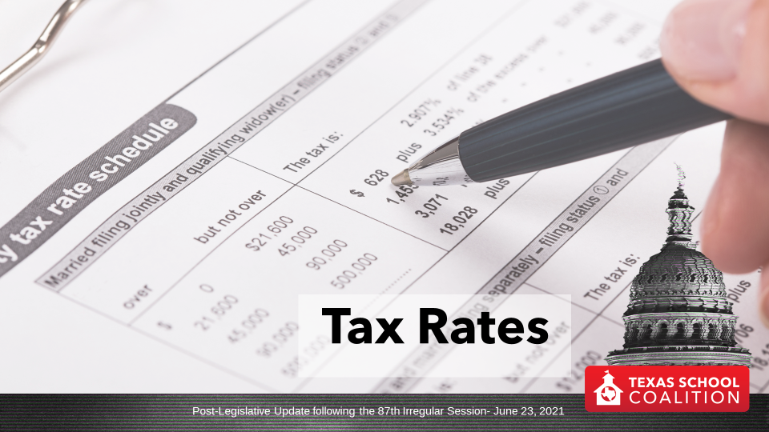
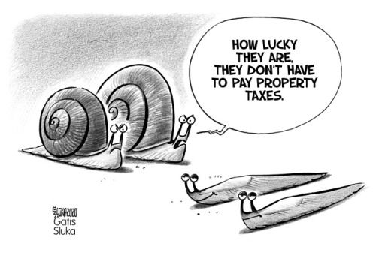
Tax Rates
Notes:
There are some changes to tax rate adoptions, and then I wanted to spend a few minutes just urging caution as it relates to tax rates.

Slide 26
Tier 1 Tax Rate Compression
The legislature reduced the state ceiling for Tier 1 tax rates to 0.9134. This results in a lower floor as well, of $0.8220.
You should wait to adopt the rate until you have completed the local property value survey with the July certified value
Notes:
We told you all at the beginning of session, we didn't expect Tier One tax rates on a statewide basis to fall next year, because property values were projected to grow by less than 2.5%.
The legislature appropriated just a little bit of money to bring those Tier One tax rates down just a little bit. Just be mindful that both the ceiling and the floor for Tier One tax rates have fallen just a little bit next year, and that is now updated in the template on the TEA website.
Don't adopt your tax rate until you have the official answer from TEA, because you don't want to inadvertently adopt a rate that's either too high or too low. That'll have negative financial consequences for the district.

Slide 27
No Pandemic Pennies
Senate Bill 1438 (Bettencourt/Meyer) removed pandemics from the disasters that can trigger the availability of additional taxing authority within the VATRE
The board of trustees must specify the disaster that is triggering the additional pennies
The same disaster may not be used for two years
Notes:
There are no pandemic disaster pennies available. So if you were planning to use the pandemic as a reason to adopt disaster pennies next year, that option is off the table. If you have another disaster, you can still use other disasters. And not this year, but next year, there's a statewide disaster declaration right now related to Winter Storm Uri. So in Tax Year 22, districts could use Winter Storm Uri for disaster pennies., New in SB 1438, there is a requirement that your board specify what the disaster was that's allowing you to adopt those disaster pennies. And there are some restrictions on being able to use the same disaster for multiple years. There were some districts that used Harvey for multiple years, because the disaster spanned multiple years, but that that ability has been restricted.

Slide 28
New Language in Notice
HB 2723 by Meyer/Bettencourt
  A school district notice of public meeting to discuss budget and proposed tax rate must include statement directing readers to a state website that provides links to local property tax databases.
  The state's Department of Information Resources will be required to establish and maintain a website that contains links to the property tax databases of each Central Appraisal District.
“Visit Texas.gov/PropertyTaxes to find a link to your local property tax database on which you can easily access information regarding your property taxes, including information about proposed tax rates and scheduled public hearings of each entity that taxes your property.”
Notes:
There will be a requirement for new language in your tax rate notice, this is not effective with this tax year. So if you've already published your notice don't panic.
But, going forward there is an effort to begin collecting all of your truth and tax calculations and publishing them on a website. Now, in your notice, you have to post a link to that statewide website, that will allow access to a database where people can go and look up everyone's truth in taxation calculations. You'll have to include that language on your notice. If you put it on your notice right now, it links to a website that doesn't exist. Starting next year, you will have to include it.

Slide 29
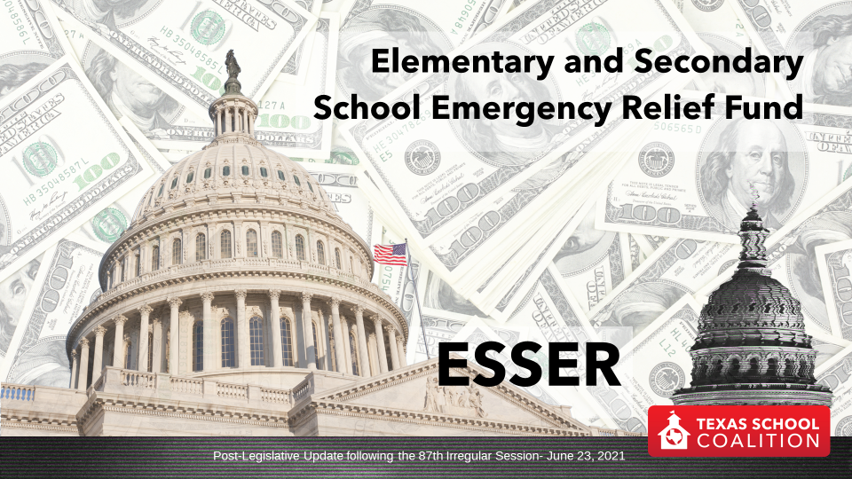

ESSER
Elementary and Secondary School Emergency Relief Fund

Slide 30
Comparing the Federal Funding Packages
CARES Act CRRSA Act ARP Act
 | ESSER I (March 2020) | ESSER II (December 2020) | ESSER III (March 2021)
Total Funding (nationwide) | $13.2 billion | $54.3 billion | $122 billion
Total Allocation to Texas | $1.29 billion | $5.53 billion | $12.4 billion
Allowed for State reservation | $130 million | $553 million | $1.24 billion
Must be Allocated to LEAs | $1.16 billion | $4.98 billion | $11.18 billion
(supplanted) (partially supplanted)
Notes:
If you detail the federal stimulus packages passed by the US Congress, there are some similarities and differences. Some improvements were made in ESSER II and ESSER III, and obviously we’re talking about a much larger dollar amount (4x the amount of the first package).

Slide 31
ESSER II Funding Swap
ESSER II Allocations announced
However, ESSER 2 is a method of finance for ADA hold harmless
ADA reductions at Near Final settle-up will mean the need to effectively use a portion of ESSER II to make up for GR reduction in FY 21
Notes:
ESSER 2 allocations have been announced, but it is first and foremost, a method of finance for the ADA hold harmless. The way this will work, as you're going to draw down all of your ESSER 2 funding, what it means is you likely won't get all of the ADA hold harmless. Or some of you may not get really any ADA hold harmless because your ESSER 2 allocation is fully supposed to be covering that. So what you're getting ready to do is amend your budget to reduce FSP revenue compared to projections, for those of you who were counting on that ADA hold harmless. That will all happen at near final settle-up.

Slide 32
ESSER Provisions
Commissioner authority to increase FSP entitlements as necessary to meet maintenance of effort, equity
Commissioner to adjust FIRST ratings as necessary to account for COVID-19 responses
Notes:
The commissioner has the authority to increase FSP, entitlements as necessary to meet maintenance of effort equity. It's not clear to me that he will need that authority. But it's interesting that $400 million is set aside in the appropriations bill for that.
And then, the commissioner is directed to adjust FIRST raisings as necessary because of all this. We do think there will be some financial accountability indicators that will have to be adjusted going forward.

Slide 33
Grants Related to ESSER
Commissioner to provide grants for:
  P-Tech, regional pathways and JET: $118 million
  Supplemental educational supports: $100 million
  COVID-19 learning acceleration supports: $1.35 billion.
  Technical support for broadband
  Funding for technology purchases made before February 28, 2021
Notes:
Then there are a host of other grant programs related to ESSER that we talked about a little bit when showed you the contingency rider language from the appropriations bill. So those sync up here. One that is interesting is funding for technology purchases made before February 28th, 2021.

Slide 34
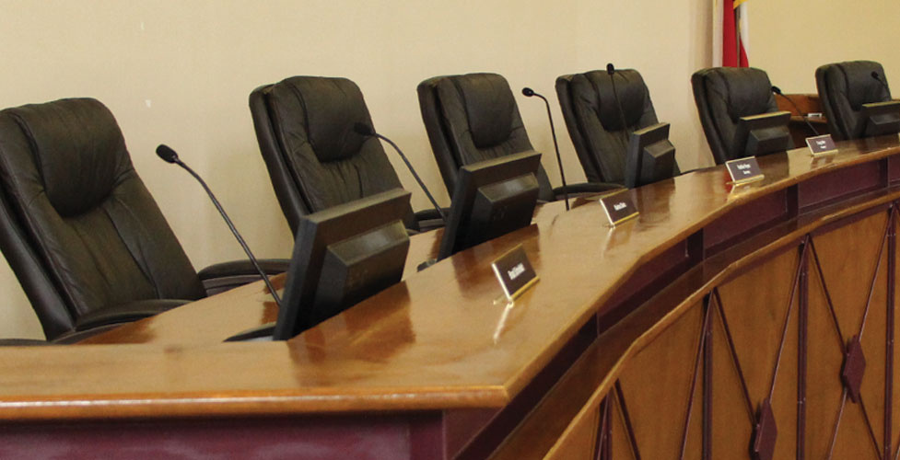
Administration
& Governance
Post-Legislative Update following the 87th Irregular Session- June 23, 2021

Slide 35
SB 1365 (Bettencourt/Huberty)
Public school organization, accountability & fiscal management
Due Process:
  Establishes procedures to ensure fairness for districts during TEA investigations
  Authorizes districts to know the identity of TEA witnesses and gives districts access to all evidence
  Authorizes districts to have a full hearing for TEA sanctions
  Gives districts appeal authority over commissioner decisions
Effective June 18, 2021.

Slide 36
HB 1252 (Moody/Hall)
Period for filing complaint & requesting special education due process
  Prohibits TEA from establishing a shorter period for filing complaints alleging a violation of special education laws than the maximum timeline required under federal law.
  Could result in more due process hearing requests, which would result in increased costs for school districts related to those hearings.
Effective September 1, 2022.
SB 1116 (Bettencourt/Bucy)
Posting election notices and results on an Internet website
Requires a county, city, or school district that holds an election to post election results to their website.
Effective September 1, 2021.

Slide 37

SB 797 (Hughes/Oliverson)
Display of the national motto
  Requires schools to display a poster or framed copy of the US national motto “In God We Trust” if the poster is privately donated for display.
Effective June 16, 2021.

Slide 38

SB 1696 (Paxton/Wilson)
Sharing of information regarding cyber attacks or other cybersecurity incidents
  Requires school districts to report to TEA any cybersecurity incident that constituted a break of system security. TEA is to establish and maintain a system to coordinate the sharing of information concerning cyberattacks or other cybersecurity incidents.
Effective September 1, 2021.
SB 2081 (Menendez/Talarico)
Class size limits for Pre-Kindergarten
Prohibits enrolling more than 22 students in a prekindergarten class (applies same class size limits for K-4 to PK) Effective for the 2021-22 school year.
Effective September 1, 2021.

Slide 39
HB 1525 (Huberty/Taylor)
School finance reform bill
School Health Advisory Committees are now subject to some provisions of the Open Meetings Act
Parental consent is required for human sexuality education
Human sexuality education materials must be made public
Effective September 1, 2021.
Notes:
School health advisory committee meetings are now subject to some provisions of the open meetings act.
You now have the requirement to make your sex education materials public, and parents can have to explicitly opt into that.

Slide 40

Assessments & Accountability
Post-Legislative Update following the 87th Irregular Session- June 23, 2021

Slide 41

SB 1365 (Bettencourt/Huberty)
Public school organization, accountability & fiscal management
Accountability:
Allows D accountability ratings to be reported as “Needs Improvement,” with three consecutive ratings triggering the same sanctions as a campus with an F rating
Allows for optional performance review for campuses with D & F ratings in 2020-21
Provides for campuses to receive ratings of A, B, C, and Not Rated in 2021-22
Effective June 18, 2021.

Slide 42
HB 4545 (Dutton/Taylor)
Student assessment & accelerated instruction
Removes statutory high-stakes requirements for students in grades 3-8 pass required exams for promotion.
Requires schools to establish accelerated learning committee for each student who did not perform satisfactorily on the state grade 3, 5 & 8 math or reading exams (replacing grade placement committees).
Each time a student fails to perform satisfactorily on a grade 3-8 STAAR assessment or an EOC assessment, a school district must provide accelerated instruction to the student in the applicable subject area during the subsequent summer or school year.
Accelerated Instruction must be provided individually or in groups of no more than three students to one teacher.
Prohibits a district from pulling a student from instruction in foundation or enrichment curriculum or from recess for accelerated instruction
Requires the district to place the student that failed to pass with with a Master, Exemplary or Recognized certified teacher the following year or provide at least 30 hours of supplemental instruction.
Allows parents to request specific teacher(s) under certain circumstances.
Effective June 16, 2021.

Slide 43

HB 3261 (Huberty/Taylor)
Electronic administration of assessments
Allows funds from the TIMA to be used to purchase services, equipment and technology infrastructure necessary to ensure internet connectivity and adequate bandwidth as well as to pay for training personnel in the electronic administration of assessment instruments.
Requires commissioner to assess technology needs of districts and provide cost estimate to SBOE.
SBOE is limited to issuing proclamations for instructional materials that are capped at 75% of the total amount used to fund the allotment, thereby leaving at least 25% of funds that could be used for technology.
Effective June 18, 2021.

Slide 44
HB 773 (VanDeaver/Powell)
Indicators of achievement
Adds a new post-secondary indicator in Domain I in the A-F rating system.
Requires TEA to include students who successfully completed a program of study in CTE as a performance indicator when evaluating the performance of high school campuses and districts that include high school campuses, beginning with the 2021-2022 school year.
Effective May 28, 2021.
HB 1147 (Huberty/Taylor)
Military readiness indicator
Adds Texas National Guard as a new indicator for military readiness.
Includes enlisting in the Texas National Guard as an indicator of military readiness to quality a school to receive CCMR bonus.
Effective September 1, 2021.

Slide 45

Curriculum
& Instruction
Post-Legislative Update following the 87th Irregular Session- June 23, 2021

Slide 46
HB 3979 (Toth/Creighton)
Social studies curriculum – The “Anti-Critical Race Theory Bill”
Prohibits a teacher from being compelled to discuss a particular current event or widely debated and currently controversial issue of public policy or social affairs, and requires that a teacher who does choose to discuss such a topic must make an effort to explore the topic from diverse perspectives, without giving deference to any one perspective.
Prohibits school districts and teachers from requiring or awarding course credit for a student's political activism or participation in an internship, practicum, or activity involving social or public policy advocacy;
Prohibits a school district employee from being required to attend certain types of training - including any that presents any form of race or sex stereotyping or blame on the basis of race or sex;
Prohibits schools from accepting private funding for the purpose of developing, purchasing or selecting curriculum or provide teacher training for such a course that presents any form of race or sex stereotyping or blame.
Effective September 1, 2021.

Slide 47
HB 4509 (Bonnen/Taylor) - Civics curriculum
Requires the SBOE to adopt TEKS that develop students' civic knowledge, including the foundations of the American experiment in self-government, the history and traditions of civics in the US; the structure, function & process of government institutions at the federal, state, and local levels; and an understanding of the Founding documents of the US.
Effective June 18, 2021.
SB 1063 (Alvarado/King, Ken) - Personal Financial Literacy
Provides the option for a student to satisfy the requirement for a half credit in economics through a course in personal financial literacy & economics. Specifies requirements for personal literacy & economics course.
Effective June 8, 2021.

Slide 48

HB 3643 (King, Ken/Taylor)
Texas Commission on Virtual Education
Creates the Texas Commission on Virtual Education to study develop recommendations on the delivery of virtual education under the Foundation School Program.
The commission, modeled after the Texas Commission on Public School Finance, shall deliver a report to the 88th Texas Legislature.
Effective June 15, 2021.

Slide 49

Students
Post-Legislative Update following the 87th Irregular Session- June 23, 2021

Slide 50
SB 1697 (Paxton/King, Ken) - Parent choice for retention
A parent or guardian may elect for a student to do any of the following:
  Repeat prekindergarten OR enroll in prekindergarten, if the student would have been eligible to enroll in free prekindergarten during the previous school year and the student has not yet enrolled in kindergarten
  Repeat kindergarten OR enroll in kindergarten, if the student would have been eligible to enroll in kindergarten in the previous school year and has not yet enrolled in first grade
  For grades 1-3, repeat the grade in which the student was enrolled during the previous school year
During the 2021-2022 school year only, a parent or guardian may elect for a student to do any of the following:
    For grades 4-8, repeat the grade the student was enrolled in during 2020-2021 school year; and/or
    For courses taken for high school credit, repeat any course in which the student was enrolled in during the 2020-2021 school year
Effective June 16, 2021.
Notes:
Students retained by parents qualify for full ADA for purposes of school district funding.

Slide 51
SB 1697 (Paxton/King, Ken) - Parent choice for retention
If school disagrees with a parent's decision, a retention committee would meet with the parent to discuss student's readiness for the next grade/course. After participating, parents may decide whether the student should be retained. The school must abide by the parent's decision. If parents do not meet with retention committee, student may not be retained.
A student who received a passing grade or who earned credit for a high school course would retain that when the student was retained, unless the school adopted a different policy.
Students retained by parents qualify for full ADA for purposes of school district funding.
Effective June 16, 2021.

Slide 52
SB 1716 (Taylor/Bonnen)
Supplemental Special Education Services Voucher
Establishes supplemental special education services and instructional materials program for students enrolled in public school who met the eligibility requirements.
Each participating student would receive a credit of up to $1,500 in an online account under the direction of the student’s parent or guardian to purchase supplemental special education services and instructional materials, including occupational therapy, physical therapy, speech therapy, private tutoring, textbooks, computer hardware or software, other technological devices.
Effective June 18, 2021.

Slide 53

HB 999 (Bernal/Menendez)
Special Individual Graduation Committees for 2020-21 (No EOC)
Provides that an individual graduation committee may determine that a student is qualified to graduate without considering performance on EOCs if the student is a senior during the 2020-21 school year.
Effective May 31, 2021.
HB 1603 (Huberty/Seliger)
Permanent Individual Graduation Committees
Extends individual graduation committees and makes them permanent in law as an alternative to high school graduation requirements for students who have failed to pass all of their five required EOCs.
Effective June 7, 2021.

Slide 54
HB 785 (Allen/Zaffirini)
Behavior plans for special education students
Requires that a behavior improvement or intervention plan that is included in a student's IEP must be reviewed at least once a year and at times more frequently.
Requires schools notify a student’s parent/guardian of any use of restraint and/or time out for student with disabilities.
In cases where the student has a behavior improvement or intervention plan, the school must document each use of time-out prompted by behavior of the student.
Signed by Governor; effective 2021-2022 school year.
SB 279 (Hinojosa/Bucy)
Suicide prevention info on student IDs
Requires that contact information for the National Suicide Prevention Lifeline; the Crisis Text Line; and a local suicide prevention hotline be printed on student ID cards issued by public schools in grades 7 through 12.
Effective June 14, 2021.

Slide 55
HB 699 (Rosenthal/Zaffirini)
Students with serious or life-threatening illness or related treatment
Requires school districts to excuse the absence of a student that results from a serious or life-threatening illness or related treatment.
Requires a school district offer additional counseling and prohibit student from referring a student to truancy court if their absence is a result of severe or life-threatening illness or related treatment.
Prohibits a school from denying promotion to a student if it is determined that failure to meet the requirements for advancement or to perform satisfactorily on an assessment was primarily due to circumstances resulting from serious or life threatening illness or related treatment.
Effective 2021-2022 school year.

Slide 56

HB 547 (Frank/Paxton)
UIL participation for home-schooled students
School districts may allow home-schooled students to participate in UIL activities (and UIL may not prohibit such participation).
Participating students must demonstrate grade-level academic proficiency on nationally standardized tests.
Effective September 1, 2021.
HB 1080 (Patterson/Nelson)
UIL participation for students receiving mental health services
Prohibits exclusion of enrolled students who receive outpatient mental health services from a mental health facility from eligibility for participation in UIL activities.
Commissioner is to adopt rules that ensure students who receive mental health services have reasonable opportunities to participate in UIL activities.
Effective June 4, 2021.

Slide 57

Personnel
Post-Legislative Update following the 87th Irregular Session- June 23, 2021

Slide 58

SB 1444 (Taylor/Bonnen)
TRS ActiveCare opt-out
Authorizes ISDs to elect to discontinue participation in TRS ActiveCare program.
Prohibits an ISD that elects to discontinue participation in the program from electing to participate in the program for 5 years after discontinuation.
Each ESC is to conduct a study of the health care needs of schools in their respective region and report findings to state leaders by November 2022.
Effective September 1, 2021; applies to participation as of September 1, 2022.

Slide 59

SB 179 (Lucio/Huberty)
School Counselor Worktime
Requires school districts to have a policy that a school counselor must spend at least 80 percent of their total work time on duties included in the school's comprehensive school counseling program.
Time spent administering or providing other assistance in connection with state testing, except time spent interpreting test data, would not be considered time spent on counseling.
If a school board determined that, because of staffing needs in the district or at a campus, a counselor could not meet the 80 percent threshold, the policy would have to: include the reasons why the 80 percent threshold cannot be met; list the duties the counselor was expected to perform that are not components of the counseling program; and set the percentage of work time that the counselor was required to spend on components of the counseling program.
Each district must annually assess compliance with policy and, on request by the commissioner, provide a written copy of the assessment.
Effective September 1, 2021.

Slide 60
SB 1356 (Hughes/Dutton)
Supplemental Instruction Tutoring Program
Authorizes a member of a nonprofit teacher organization to participate in a tutoring program to provide supplemental instruction to K-12 public school students on an individualized or small-group basis.
Participants must be an active or retired teacher; individuals must designate whether they intend to provide tutoring for compensation, on a volunteer basis, or both, and whether tutoring will be provided in-person, online, or both.
Each school district must designate someone to oversee the tutoring program within the district and provide contact information.
If an active or retired teacher who had been approved for the tutoring program contacted a district to provide tutoring, the district would have to use the teacher's volunteer services or, depending on available funds, employ the teacher as a tutor, as applicable.
TRS must provide information about the program to retirees and direct them to contact local school districts for further guidance.
TRS may not withhold a monthly benefit payment from a retiree employed as a tutor under the bill's provisions.
Effective June 16, 2021.

Slide 61

SB 1191 (Seliger/VanDeaver)
School Resource Officer definition
Clarifies that the definition of a "school resource officer" does not include a peace officer who provides law enforcement at a public school or public school event only for extracurricular activities.
Effective September 1, 2021.
SB 1267 (West/Lozano)
continuing education and training requirements for school district personnel
Streamlines training and continuing education requirements for school staff.
Creates more opportunities for educators to select meaningful training.
Effective June 18, 2021.

Slide 62

HB 1585 (Lambert/Lucio)
Operations and functions of TRS
Requires outreach plan for members and employers.
Moves retire / rehire prohibition date to January 1, 2021.
Requires notice, opportunity to solve problem before denial of benefits for those who retire and return to work.
Adjusts employment after retirement penalties to reduce the impact on certain TRS retirees who return to work and exceed existing limitations. (also found in SB 288 by Seliger/Wu)
Effective May 26, 2021.

Slide 63
SB 202 (Schwertner/Anchia)
Payment of employer contributions for employed retirees
Prohibits school districts from passing along the cost of mandated employer contributions for retirees on to the retired employee (the burden must be paid by the district).
Effective June 14, 2021.
SB 288 (Seliger/Wu)
Retiree benefits/limits on penalties
Exempts certain retirees from penalties and surcharges if they are paid by specific federal funds related to learning loss (defined in the bill), and hired in addition to normal staff levels.
They are exempt from work penalties and district surcharges until December 2024.
Rule adopted by the TRS Board in May exempts all retirees who are hired between June and August 2021 from both penalties and surcharges.
Effective 2021-2022 school year.

Slide 64
HB 1525 (Huberty/Taylor)
School finance reform
Extends Reading Academy deadline to 2022-2023
Non-certified teachers can receive Teacher Incentive Allotment (TIA).
TIA compensation is TRS eligible
Effective September 1, 2021.
Notes:
One helpful change is the deadline for getting your teachers through reading academies has been extended to the end of the 22-23 school year.
Also non-certified teachers can now receive teacher incentive allotment, and probably more importantly, TIA compensation is now just automatically TRS eligible. If you were trying to implement one of those plans and make sure that the pay was TRS eligible, you kind of had to jump through some hoops that made it very challenging.

Slide 65

Transportation
Post-Legislative Update following the 87th Irregular Session- June 23, 2021

Slide 66
SB 204 (Schwertner/Huberty)
School district transportation for out-of-district transfers
Allows a school district to transport any student who is enrolled in the district, regardless of where the student lives; does not require interlocal agreement.
In order for a district to transport enrolled students who live outside the district’s boundaries, the district must:
  Have a policy that prohibits screening transfer students based on academic performance, disciplinary history, or attendance
  Have an overall performance rating of a C or higher, an accountability score of 70 or higher, and the same or better overall performance rating as the district from which the transfer student would be transported from
Effective June 14, 2021.

Slide 67




Post-Legislative Update following the 87th Irregular Session- June 23, 2021
Notes:
Sometimes the success of a session can be marked by what DID NOT pass.

Slide 68

What DID NOT Pass
SB 7 (Hughes) – Elections Integrity Reforms
SB 10 (Bettencourt) – Prohibitions for Taxpayer Funded Lobbying
SB 29 (Perry) – Transgender Participation in UIL
HB 1468 (Bell, Keith) – Remote Instruction
HB 3445 (Huberty) - Fund Balance Restrictions
HB 4242 (Meyer) – Reauthorization of Chapter 313
Notes:
Not only did that bill not pass, but we worked to keep it clean of provisions that would be detrimental to schools—such as requirements for a super-majority to pass a bond, requirements for all bond elections to be in November.
The bill to ban taxpayer funded lobbying passed the Senate in a form that did not apply to schools at all. It then took on a form in the House that applied to schools but primarily dealt with transparency of for tax dollars spent on the expense of lobbying (thought there were certainly some amendments House members wanted to force votes on that would have forced a ban that would have applied to schools). Ultimately the bill met its end without that vote, but it could well be back in a special session.
This list includes some bills many schools may wish had passed…such as HB 1468, which would have provided districts with the ability to continue providing remote instruction to students, according to policy established at the local level.
Chapter 313 of the Tax Code has been a valuable tool for many districts and communities, and it will now expire December 31, 2022. Existing deals remain, as well as any agreement signed before that date. We hope that a similar program will be added to law in 2023 (or maybe in one of the specials) that will continue this tool, but it is unlikely to be quite as good of a deal for districts—we’ll try to make the most of it.
Legislation that would limit school district fund balances failed to pass.
While it’s not a bill, I have included the 40% requirement the Senate tried to add to the school finance bill as well.

Slide 69

July 8
Special Session
Post-Legislative Update following the 87th Irregular Session- June 23, 2021

Slide 70
Possible items to be added to the call
Election Integrity
Bail system reforms
Critical Race Theory
Electricity
Taxpayer Funded Lobbying
Transgender participation in UIL
Article X Appropriations

Slide 71
