Slide 1
Update on the
87th Legislative Session
IN THE DARK
& the cold
without water
AMID A
PANDEMIC
& Recession
March 3, 2021
Notes:
This has been one irregular session…from the pandemic, to the Capitol shutdown down for security reasons in January, to the ice storm that shut down the Capitol (and the entire state) for a week in February…the 87th has been a session like no other.

Slide 2
Presentation Overview
State Budget
Federal Funds
Bills of Interest
What do we need to do?
Questions?

Slide 3
How much?
State budget overview

Slide 4
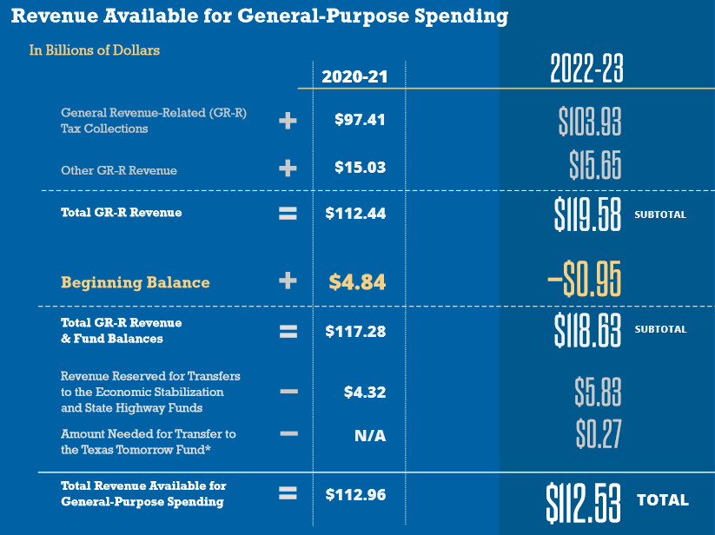
Biennial Revenue Estimate
-$0.95 billion
20-21 Shortfall
$112.5 billion
GR available to spend 22-23
Notes:
What we learned the day before the session began was that we were only facing a shortfall of less than a billion. However the State also had less to spend for the 22-23 than it spent in the current cycle, which in no way accounts for growth. This estimate did not take into account billions in federal dollars the state will have available to spend though.

Slide 5
$5.5 billion in State Savings from Public Education
Supplemental Appropriations for FY20-FY21
Sources of savings included:
$1.3 billion - higher than expected recapture
$1.5 billion - higher property values/property tax collections
$1.2 billion - supplanting state funds with federal ESSER dollars
House Bill 2
Supplemental Appropriations Act
Scheduled for hearing tomorrow
Notes:
Or maybe it was an indication of just how much the State has actually saved from Pubic Education Funding they didn’t have to spend in the current biennium that they once thought they would. Property values climbed much higher than they expected, so schools collected more in property taxes (and paid more in recapture) than originally anticipated. On top of that, they were able to supplant state funds with the federal CARES Act/ESSER funds, generating more savings. So when you see the Supplemental Appropriations bill make that funding reduction, that’s not a reduction you will ever feel, but it’s one the state certainly benefits from because they got to keep more money in their pocket.

Slide 6
State Budget – Senate Bill 1
Where are we now?
Senate passed SB 1 unanimously April 6
House Appropriations Committee will hear SB 1 April 12
HAC has pretty well completed work on their substitute for SB 1, and committee will vote it out April 12 and full house is expected to take up SB 1 on April 22

Slide 7
When budget bills have passed in the past
 | Budget Passed by First Chamber | Budget Passed by Second Chamber
2015 | March 31 (H) | April 14 (S)
2017 | March 28 (S) | April 6 (H)
2019 | March 27 (H) | April 9 (S)
2021 | April 6 (S) | April 22? (H)
Comptroller said to expect updated BRE in late April/early May
Month-long Conference Committee, with final passage on:
May 29, 2015
May 27 , 2017
May 26, 2019
Notes:
The House is planning to consider SB 1 on April 22, so they are a little behind this year (but that is not unexpected)

Slide 8
General Revenue Available vs. Required
Available to Spend (BRE) | Base Bill (SB 1) | Difference
$112.5 Billion | $119.7 Billion | $7.2 Billion
Tools Available in the Fiscal Toolbox
Tool | Amount
Economic Stabilization Fund (Rainy Day) | $11.6 Billion
Delay August FSP Payment | $2 Billion
Federal Stimulus (ESSER 2 + ESSER 3) | $18 Billion
Other Federal Stimulus (not education) | $20 Billion
$11.6 expected in
Rainy Day Fund
Notes:
I showed you what the Comptroller said lawmakers have available to spend, right? $112.5 billion. Well, the budget that was introduced spends more than what they have they have available. I gave you the Senate figure, and the House bill spends $7.3 billion more. That isn’t to say there aren’t ways to make that money available. As you can see, they have tools available in the toolbox to get the job done. They have $11.6 billion in the Rainy Day Fund. They can also use the tried and true trick of delaying the August 2023 FSP payment until September 2023. That is a one-time thing they will eventually have to pay back, but it could make the money they need available now, available now. Also, the manner in which they choose to spend all (or part) of the federal funds could also go a long way to fill their budgetary holes—and they have certainly done that before.

Slide 9
Foundation School Program
(House and Senate budget bills are nearly identical)
Both fully fund HB 3, with no reductions to the school finance formulas
$3.1 billion increase to the FSP for enrollment growth (likely overstated due to the impact of ESSER in 20-21)
$1 billion increased spending for ongoing property tax rate compression
Notes:
The budget bills filed by the House and Senate are almost nearly identical, especially in the big ticket items of the Foundation School Program in Article 3. The big news for schools is the commitments made in HB 3 are fully funded. They also added on top of what was spent in the last two years another $3 billion to fund enrollment growth. (Two points on that: 1) we learned in 2011 not to take the funding of enrollment growth for granted; it wasn’t funded then, so now every budget when it is we have to be grateful and 2) our state enrollment is not going to grow by $3 billion this biennium. Rather, this number is derived (in part) based on the overstated growth in enrollment due to the way the state supplanted federal stimulus dollars, which artificially drove down ADA to save state money).
And that $1 billion they included for ongoing property tax compression, we believe that is a placeholder as more than $1 billion will be required for that.
Both of these are placeholders for now, but we are glad they are there, as it is difficult for the State to pass a bill that spends less on education than what was originally proposed.
This budget bill made it clear that public education remains a priority for the Texas Legislature.

Slide 10
What’s not in the budget?
$38.6 billion in federal stimulus money
Including $18 billion in funding for K-12 schools
Notes:
The absence of the federal dollars means that state leaders just adopted a budget that is missing 24% of what they could be spending to maintain current services and spend the federal dollars as intended. Can you imagine adopting a school district budget that is 24% off the mark?
When it comes to education, Unless dollars are supplanted, this is a 16% increase

Slide 11
The Morrison Rider (included in House bill)
The Distribution of Federal Education Funds Related to the Coronavirus Pandemic. Notwithstanding any other provision of this Act, and to the extent allowable under federal statute or regulation, no public education funds provided to the State of Texas by the federal government in response to the coronavirus pandemic shall be used to reduce state funding for local education agencies. It is the intent of the Legislature that the Commissioner of Education shall allocate the maximum award possible to local education agencies from public education funds provided to the State of Texas through the Coronavirus Relief Fund and the Elementary and Secondary School Emergency Relief Fund.

Slide 12
Comparing the Federal Funding Packages
CARES Act CRRSA Act ARP Act
 | ESSER I (March 2020) | ESSER II (December 2020) | ESSER III (March 2021)
Total Funding (nationwide) | $13.2 billion | $54.3 billion | $122 billion
Total Allocation to Texas | $1.29 billion | $5.53 billion | $12.4 billion
Allowed for State reservation | $130 million | $553 million | $1.24 billion
Must be Allocated to LEAs | $1.16 billion | $4.98 billion | $11.18 billion
Notes:
If you detail the federal stimulus packages passed by the US Congress, there are some similarities and differences. Some improvements were made in ESSER II and ESSER III, and obviously we’re talking about a much larger dollar amount (4x the amount of the first package).

Slide 13
Comparing the Federal Funding Packages
 | ESSER II (December 2020) | ESSER III (March 2021)
Total Texas Allocation | $5.53 billion | $12.4 billion
Allowed for State reservation | $553 million | $1.24 billion
Must be Allocated to LEAs | $4.98 billion | $11.18 billion

Slide 14
State Maintenance of Effort
ESSER I
ESSER II
Under the CARES Act, a State must maintain support for elementary and secondary education and State support for higher education in each of fiscal years (FY) 2020 and 2021 at least at the level of such support that is the average of the support for elementary and secondary education and higher education provided in the three fiscal years preceding the date of enactment of the CARES Act (FYs 2017, 2018, 2019).
Under the CRRSA Act, a State must maintain support for elementary and secondary education and higher education in FY 2022 based on the proportional share of the State’s support for elementary and secondary education and higher education relative to the State’s overall spending averaged over FYs 2017, 2018, and 2019.
Notes:
So what’s the hold up? The State of Texas has not yet agreed to receive the ESSER II funds because they are still negotiating and requesting waivers for how this provision applies. The MOE language changed so that it isn’t quite as easy for the state to completely supplant the funding as they did before. These negotiations and waiver requests are why schools are having to wait so long to receive word about these funds.

Slide 15
State Maintenance of Effort
ESSER II
ESSER III
Under the CRRSA Act, a State must maintain support for elementary and secondary education & higher education in FY 2022 based on the proportional share of the State’s support for elementary and secondary education and higher education relative to the State’s overall spending averaged over FYs 2017, 2018, and 2019.
Under the American Rescue Plan Act, a State must maintain support for elementary and secondary education & higher education in FY 2022 and FY 2023 based on the proportional share of the State’s support for elementary and secondary education and higher education relative to the State’s overall spending averaged over FYs 2017, 2018, and 2019. AND Maintenance of Equity Requirement for FY 22 and FY 23
Notes:
ESSER III took things a step further. The MOE requirement applies to both FY 22 and FY 23. Additionally, it included a Maintenance of Equity requirement that seeks to maintain the proportionality of the funding for students that qualify for Title I.

Slide 16
What else do we need to know?
With so many issues out there, what else needs to be on your radar?

Slide 17
Broadband
The need for available and reliable internet services is essential for public education, as well as higher education, hospitals, businesses, residents, and many others
SB 5 (Nichols/Ashby) – passed by Senate and final passage expected in the House April 9
Notes:
I always like to lead with a piece of good news (and there isn’t much), so enjoy this slide. We’ve all experienced in some shape or form over the past year how important available and reliable internet connections are, and this is probably the topic we see the most unity around than any other (even more than blame and hatred for ERCOT and the PUC!). Broadband is an infrastructure issue that affects education, but extends well beyond our schools and should therefore be paid for in the state budget in a manner that in no way uses money designated for schools to address this state utilities and infrastructure need. One of the top priorities identified by the Governor, Lt. Governor and Speaker is broadband connectivity.

Slide 18
Remote learning
What happens in 2021-22 and beyond?
HB 1468 (by Rep. Keith Bell): Would allow a school district to provide ongoing full-time virtual offerings for the district’s students according to district-determined criteria (voted out of Public Education Committee April 7)
HB 3643 (by Rep. Ken King): would establish the Texas Commission on Virtual Education a commission to study virtual learning and schools to inform policy for the future (voted out of House Public Education April 7)
SB 27 (by Senator Taylor): broadens the State Virtual School Network to statewide and doesn’t require previous enrollment in public school for eligibility
Notes:
The Commissioner has said the agency allowed for the current flexibility with ADA for remote learning for a one-time emergency and that any use of such beyond that will need a stamp of approval from the Legislature. That leaves us in the lurch until we see if any legislation may actually pass, as we won’t know until late May, and that makes it awfully hard to plan for next year. There have been some bills filed on this topic, and I have highlighted one here. On anything related to virtual and remote learning, the devil is always in the details.

Slide 19
District Fund Balances – HB 3445
HB 3445 (by Rep. Huberty) would require districts deemed to have "excess revenue" to use those funds to pay down debt, lower the district tax rate, provide additional employee compensation, or pay for deferred maintenance. Additional revenue defined to mean cash on hand in excess of 110 days of operating expenses. FSP reductions and bond elections/issuances prohibitions apply for schools that do not comply.
Huberty cited growth in fund balances over the past decade
Huberty said the state shouldn’t continue to provide/increase funding for schools if all that’s doing is going into bank accounts
Huberty spoke to both total and unobligated amounts
Notes:
Huberty said school fund balances for districts statewide exceed $21 billion. $6.6 billion of that amount is in excess of operating expenses for 110 days. Huberty took particular offense to the $600 million growth in fund balances after the passage of HB 3

Slide 20
In response…on HB 3445
Chairman Ken King addressed districts that have lost funding and have cause for caution; he cautioned against a few “bad actors” causing punishment for effective conservative stewards of tax dollars
Rep. Gary VanDeaver cited pattern of “yo-yo funding” and applauded wise, cautious managers

Slide 21
In response…on HB 3445
Different districts have different reasons/needs, and recapture districts (and close to recapture districts) must close the year with at least five months of operating expenses on hand, not 110 days
Districts need the ability to plan for the unexpected—be that hurricane, tornado, pandemic, or plunging property values—to ensure students will continue to be served
A healthy fund balance saves taxpayer dollars because it allows for a better credit rating when borrowing funds

Slide 22
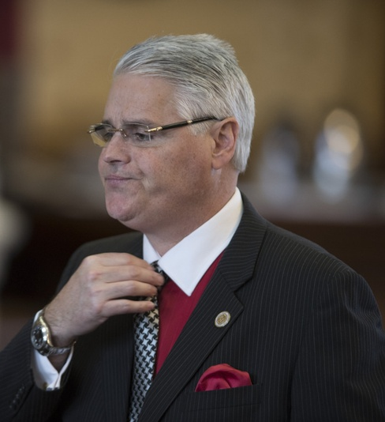
Next steps for HB 3445?
Favorably vote from committee appears… challenging
Huberty vowed to propose as an amendment on the House floor because he believes issue should be brought before the full House

Slide 23
HB 3 Clean up – HB 1525/SB 1536
HB 1525 (Huberty) Substitute (voted out of House Public Education Committee):
Allows Small & Mid-Size districts to receive CTE funding
CTE weight modified for all districts to tiered incentives structure that provides a reduced weight for non-approved CTE programs, and the highest weight amount for approved CTE programs in Levels 3 & 4. In addition, districts would be entitled to $50 for each P-TECH/New Tech student.
Fast Growth Allotment eligibility no longer tied to being in top quartile (percentage) of growth, but based on the volume of growth of students that exceeds 50 when compared to enrollment from three years prior. A weight is applied to each of the number of students above 50.
Extends deadline for Literacy Achievement Academies
Provide the highest possible comp ed weight for homeless students
Allow CCMR outcomes bonus for students who earn an associate degree within a timeframe established by the commissioner
Notes:
No change for tuition.

Slide 24
HB 3 Clean up – HB 1525/SB 1536
House Committee Substitute (voted out of House Public Education Committee):
Allows districts to net their recapture payments against state aid
Require recapture "catch-up payments" for districts not identified in a given year (whereas such under-identified recapture payments are currently forgiven). This could cause some districts to be required to make two recapture payments in one year.
Prohibits district from taxing at an M&O rate intended to create a surplus for the purpose of paying down the district's debt. Requires TEA to develop manner to identify districts in violation of this provision, and impose corrective actions.
No changes to ability to charge/pay tuition in substitute
Notes:
No change for tuition.

Slide 25
HB 3 Clean up – HB 1525/SB 1536
SB 1536 (Taylor) to be heard tomorrow (filed version with a “fix” that doesn’t fix things for small/mid districts yet)
The future of these bills…
HB 3445

Slide 26
Chapter 313 Legislation
Chapter 313 is subject to expiration December 31, 2022
HB 1556 (by Murphy) would renew the Chapter and make significant changes, many of which are not beneficial to school districts and might make such agreements far less of an appealing tool.
No supplemental payments for schools (tax abatement in Tier 1 and district would receive payments only for Tier 2 pennies taxed)
No Revenue Protection Payments
Loss of ability to work with professional consultants looking out for best interest of district (evaluation performed by Comptroller)
Possibility for automatic continuous renewals for improvements
HB 1502 (by Deshotel) would reauthorize through 2032, without changes
SB 1255 (by Birdwell) would reauthorize through 2032, with minimal changes, HOWEVER would exclude renewable projects from eligibility

Slide 27
School District Tax Rates
HB 1391 (by Rep. Middleton) in the event of a failed VATR Election, district tax rate would be the lesser of the VATR or the No-New-Revenue Tax Rate. (left Pending in Ways & Means Committee 2 weeks ago)
HB 3376 (by Rep. Meyer) & SB 1438 (by Senator Bettencourt) would prevent districts from assessing temporary disaster aid pennies (without an election) in response to an epidemic or pandemic; could apply to Tax Year 2021 Rate adoption if passed by 2/3 of voting members (HB 3376 was left pending in House Ways & Means Committee April 6; SB 1438 is set for hearing in Senate Local Government Committee on April 12)
SB 1428 by Senator Bettencourt) would prevent districts from assessing temporary disaster aid pennies (without an election) in response to an epidemic or pandemic, effective Tax Year 2022 (as currently written) (Set for hearing in Senate Local Government Committee on April 12)

Slide 28
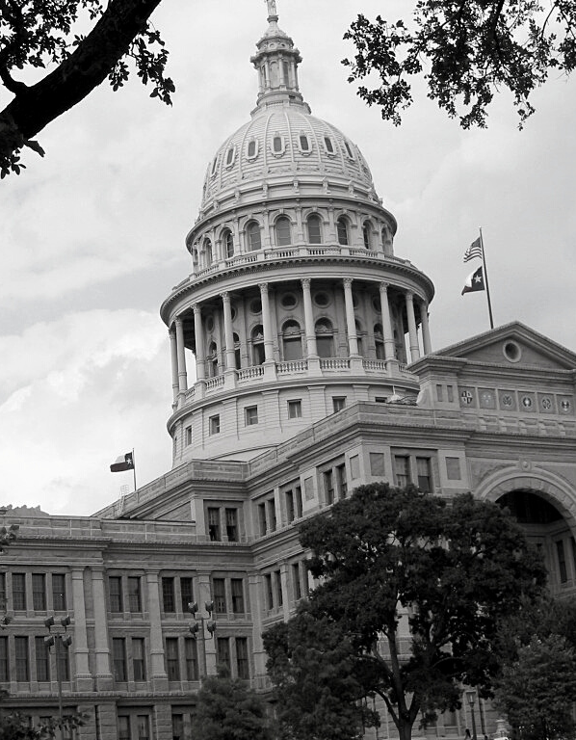
What do we need to do?
As educators and public school advocates, what can we do to help?

Slide 29
Acknowledge Learning Loss
Commissioner is reporting that students are 3.2 months behind in math.
Every district lost months of classroom instruction
Both students who have not yet re-enrolled and those that have all experience learning loss
Learning loss has occurred in every district statewide
Learning loss requires additional staff time (and therefore additional resources) to address
Notes:
we’ve lost a lot of ground with students and that is including the students we’ve worked so hard to recover, those who we’ve yet to recover, and those who have been trying to engage in learning all along through these trying circumstances. The mental health challenges the pandemic has caused, not mention the constant disruptions, have taken their toll.
Commissioner Morath loves to talk about what happened in Argentina in the 1980’s due to learning losses that were never addressed. We can’t have that in the case of Texas students. We must address these losses and talk about the additional time and resources they are going to require in order to address them. We can’t wish this away. It’s going to take hard work and some significant investments, and we have to make the case for that.

Slide 30
Plan to address learning loss
How will your address specifically address learning loss?
Who will you target?
When will you address it?
How much does that cost?
Summer school
After school tutoring
Saturday tutoring
Pull-out with specialists
Smaller class sizes
Notes:
The best way to make our case is to plan for exactly your district will address learning loss. If we don’t want to end up with a statewide program and Mike Morath telling us how his program is going to solve all the world’s problems, then we have to come up with plans of our own. We have to determine what the specifics of our plans cost and share those details with the state leaders who can help us to get access to that money.
We can’t keep saying “we need more resources” in the general sense. We need to say “I need this much money to cover the cost of the additional staff time to provide summer school for this many students who have demonstrated they are behind.” I need $X to hire an additional teacher in each grade level so that students identified with gaps in their learning can be in smaller classes and get the attention they need to catch them up to grade level again.
Write a plan as though you are getting these additional dollars to make the case for why you need them.
We cannot simply say that we want to pay our teachers more for the jobs they are already doing. We have to explain the extra time and effort that will be required and how much it will cost to pay for that.

Slide 31
Food for thought…
$18 billion sounds like a BIG number
Federal dollars may be spent over the course of three years—that’s $6 billion per year
5.4 million students
8,872 schools
369,462 teachers
Average teacher salary: $57,641
Cost per hour of tutoring: $25
Incremental Cost per pupil of each instructional day: $50
What would it cost statewide to provide:
3 hours of tutoring per week for 1/3 of students for 36 weeks? | $4.8 billion
30 extra days for 50% of students in grades 6-12? | $2.1 billion
5 extra planning days for teachers | $0.6 billion
1 additional Teacher per campus | $0.6 billion
1 additional Educational Aide per campus | $0.2 billion
1 additional Counselor per campus | $0.7 billion
HVAC upgrade for 50% of school buildings | $1.8 billion
$10.2 billion
Notes:
Some people say that $18 billion is a lot of money. And it is. But it’s always important to keep things in perspective. This funding can be spent over the course of three years. While $6 billion is a lot, let’s also keep in mind how many students are served in Texas schools and just how many schools there are. We ran some numbers on a hypothetical basis, based on average costs. It wasn’t too hard to come up with a list that very quickly spent more than $6 billion in one year to address these needs. We’re not at all saying this is HOW the dollars should be spent. It’s just for the purpose of illustration.

Slide 32
Where can I go for info?
With so many issues out there, what else needs to be on your radar?

Slide 33
Questions?
Christy Rome
Executive Director
Texas School Coalition
christy@txsc.org
512-732-9072

