Slide 1



Update on the
87th Legislative Session
IN THE DARK
& the cold
without water
AMID A
PANDEMIC
& Recession
March 3, 2021

Slide 2


Presentation Overview
Who’s Who?
How much?
What do we need to do?
When can we expect to know?
What else do we need to know?
Questions?
Notes:
We just covered why, now we’re going to touch on who, how much, what, what, when, and where.

Slide 3
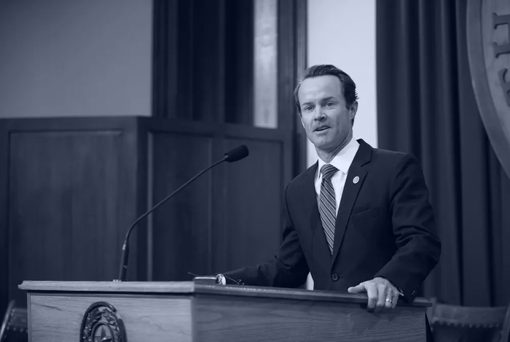
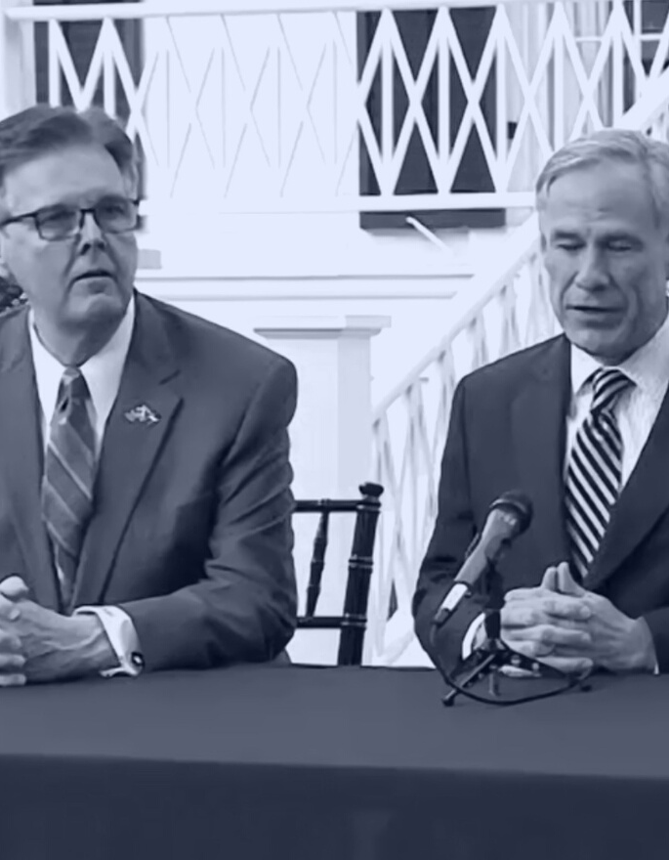

Who's Who
in the
87th Legislature?
Let’s take a look at legislative leadership.
Notes:
So the Big Three—our Governor, Lt. Governor, and Speaker have a new member rounding out the three.

Slide 4
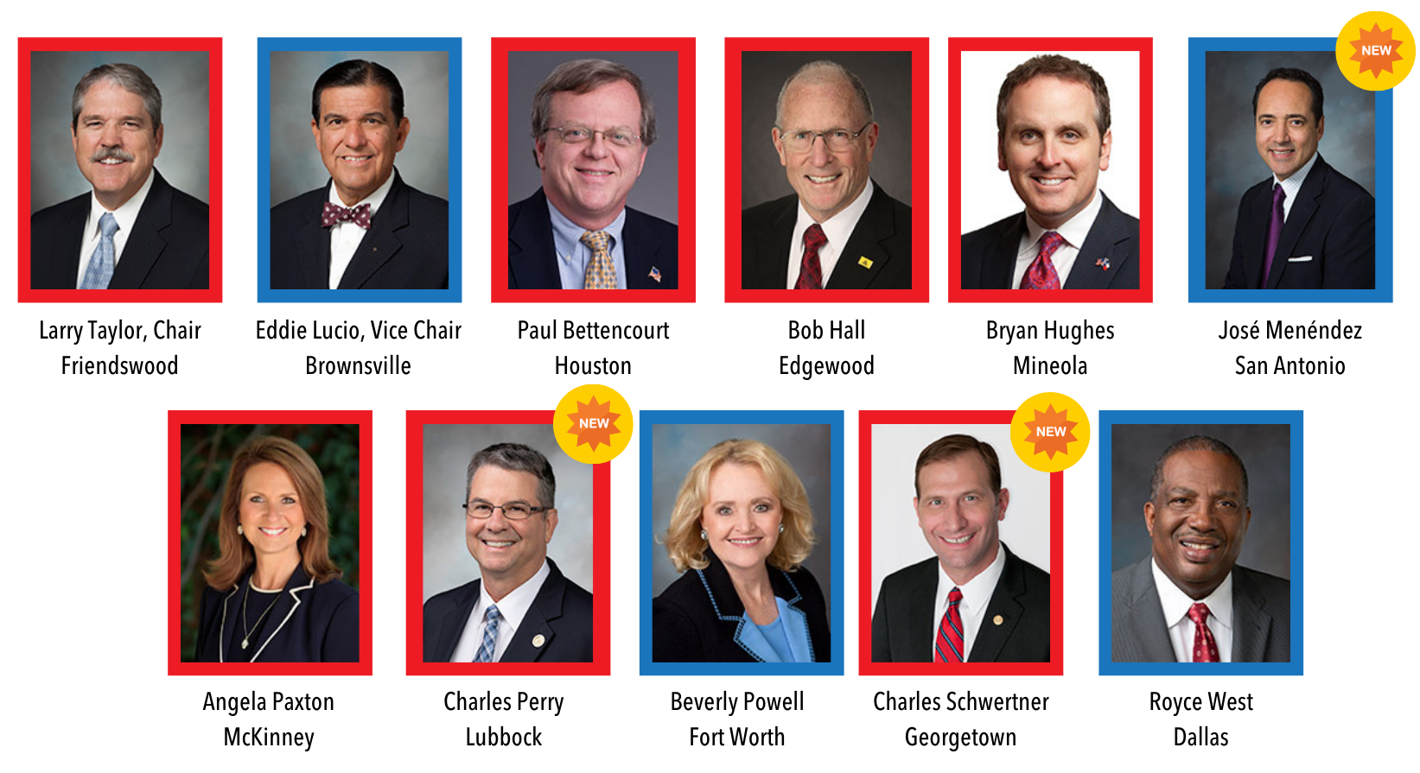
Senate Education Committee
Notes:
These are the members appointed to the Senate Education Committee. We see a lot of familiar faces returning to the committee, and three new additions. They haven’t met yet, but when they do meet, it’s going to be on Thursdays.

Slide 5

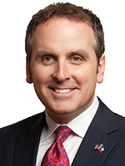
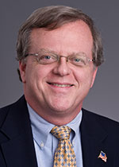
Other Senate Committee Chairs to note
Jane Nelson
(R-Flower Mound)
Senate Finance Committee
Chair
Bryan Hughes
(R-Mineola)
Senate State Affairs Committee
Chair
Paul Bettencourt
(R-Houston)
Senate Local Government Committee
Chair
Notes:
Other chairs to note include obviously Jane Nelson, who is chairing Senate Finance and responsible for shepherding the state budget bill, Bryan Hughes, who now chairs State Affairs. and Paul Bettencourt who chairs the new Local Government Committee, rather than the committee on property taxes he chaired last session. The committee’s scope has been broadened, and we suspect that some of the bills referred to this committee will pertain to local schools.

Slide 6
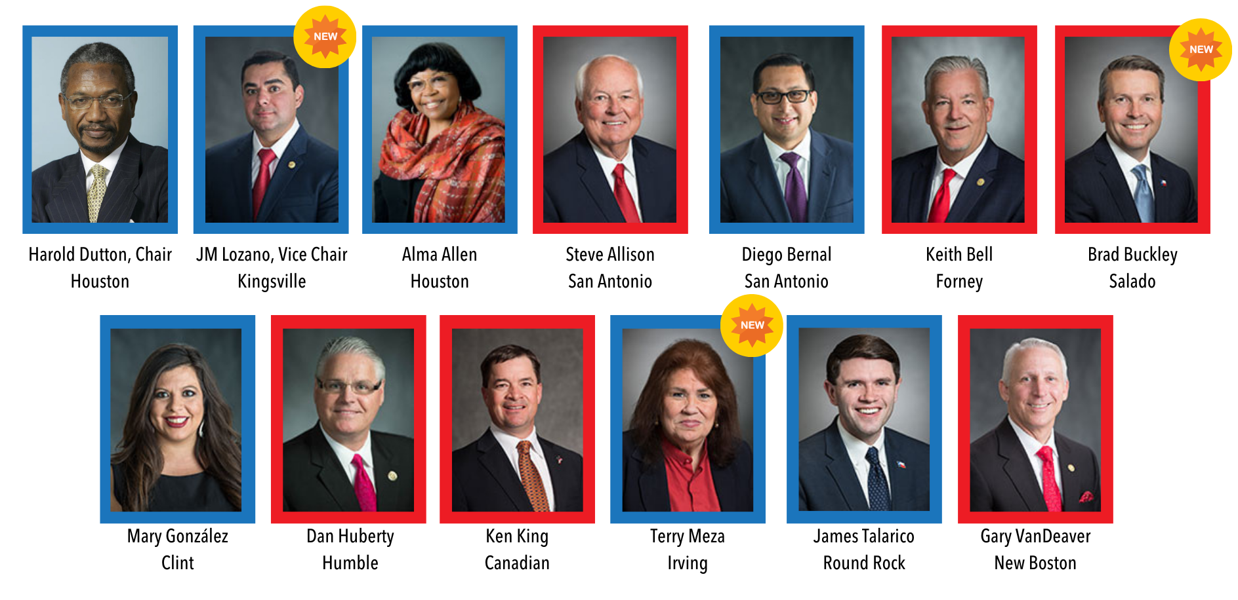
House Public Education Committee
Notes:
And with a new Speaker, often come new committee chairmanships. Harold Dutton of Houston was appointed as Chair of the House Public Education Committee. He has been a member of the House since 1984, and spent 24 years on this committee he is now leading.
This committee also picked up three new members, with the remainder returning. What I can tell you about our new Chairman is that he is the first Democrat to serve as chair of this committee since 2002. In the past, he has been a big supporter of charter schools.

Slide 7
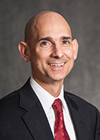
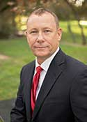
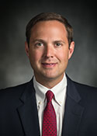
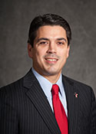

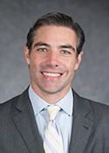
Other House Committee Chairs to note
Greg Bonnen
(R-Friendswood)
House Appropriations Committee Chair
Terry Wilson
(R-Marble Falls)
House Appropriations Subcommittee
Chair for Article III
Dustin Burrows
(R-Lubbock)
House Calendars Committee
Chair
Chris Paddie
(R-Marshall)
House State Affairs Committee
Chair
Briscoe Cain
(R-Deer Park)
House Elections Committee
Chair
Morgan Meyer
(R-Dallas)
House Ways & Means Committee
Chair
Notes:
Other new chairs to note include Appropriations Chair Greg Bonnen. Last session, Chairman Bonnen oversaw Article III of the Budget for the House. Dustin Burrows will serve in the very powerful post of chairing the Calendars Committee. Briscoe Cain of Deer Park, who has been very vocal about concerns regarding election fraud, will be chairing the House Elections Committee. Chris Paddie will be chairing the State Affairs Committee. Finally, Morgan Meyer will leading the Ways & Means Committee, overseeing revenue and taxes, including many of the property tax bills that may be filed, and those pertaining to Chapter 313 Agreements.

Slide 8


How much?
State budget overview
Notes:
At one point, we thought the sky was falling with our economy, but Comptroller Glenn Hegar was pretty optimistic about the rate of recovery for the State’s economy, so this next session of the presentation isn’t going to be as dreary as I once thought it would be.

Slide 9
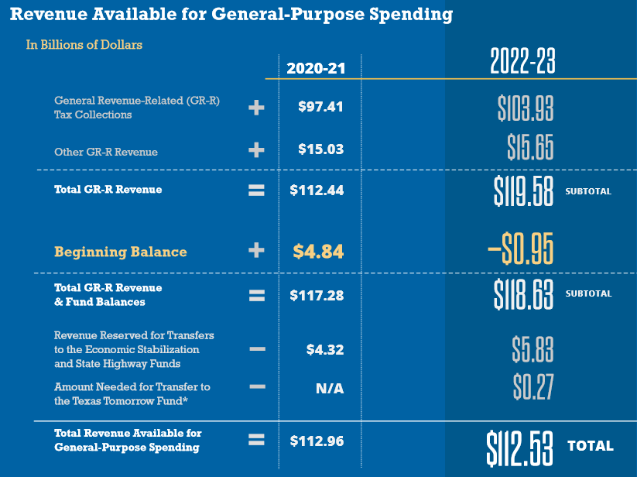
Biennial Revenue Estimate
-$0.95 billion
20-21 Shortfall
$112.5 billion
GR available to spend 22-23
Notes:
What we learned the day before the session began was that we were only facing a shortfall of less than a billion. However the State also had less to spend for the 22-23 than it spent in the current cycle, which in no way accounts for growth. This estimate did not take into account billions in federal dollars the state will have available to spend though.

Slide 10
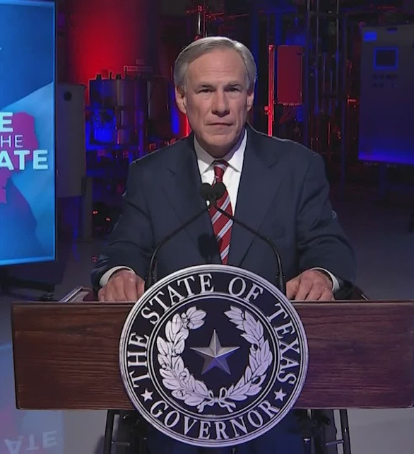
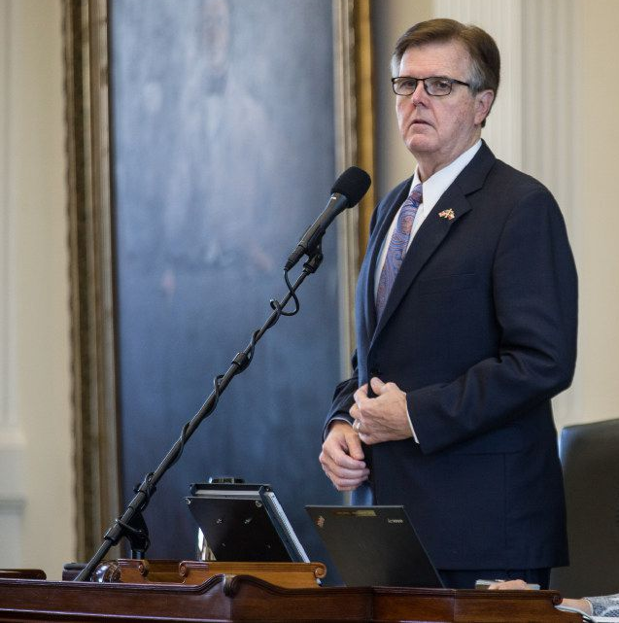
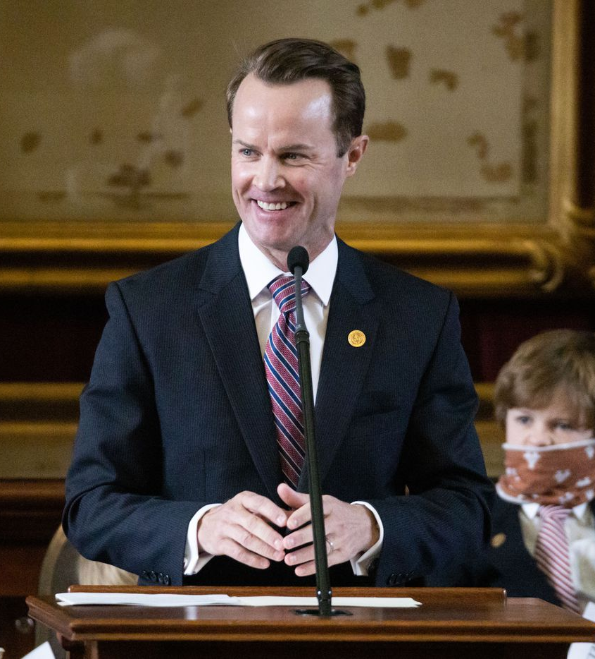
“This session we must continue to fund education as we promised.”
-Governor Greg Abbott
February 1, 2021
“This budget reflects our commitment to… maintaining the historic education funding increases and teacher pay raises established in 2019.”
-Lt. Governor Dan Patrick
January 21, 2021
“When the House last adjourned, we celebrated landmark property tax and school finance reform. But now, Texas children are at risk of falling behind because of disruptions caused across the state as a result of the pandemic. We cannot fail them when they need us most.”
-Speaker Dade Phelan
January 12, 2021
Notes:
State leaders (including other legislative leaders not shown here) all seem to agree that the state must honor its commitments to public schools, made in House Bill 3.

Slide 11
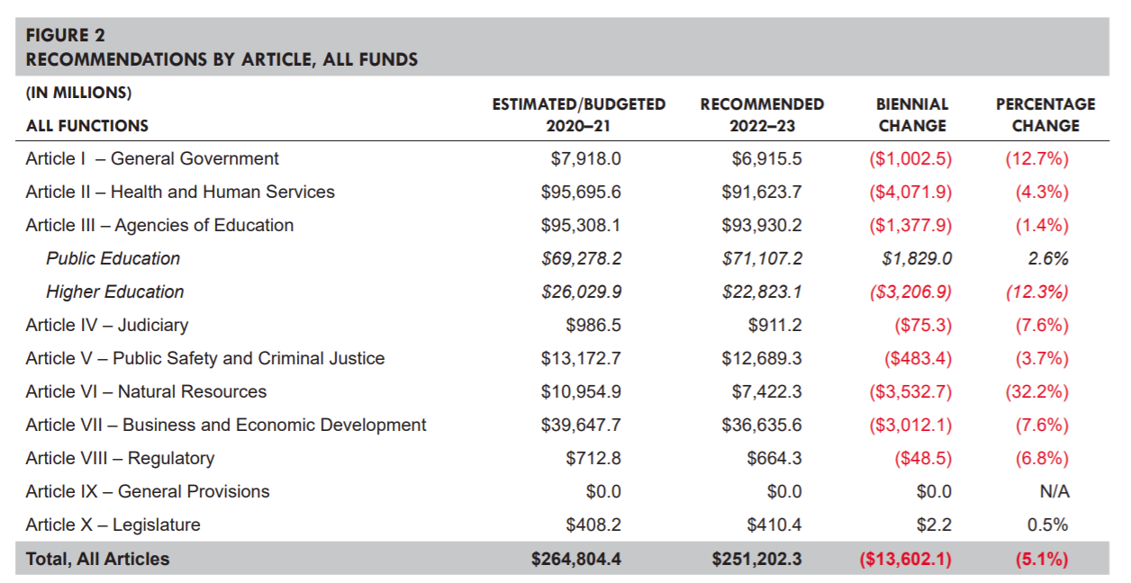
Senate Bill 1 By Article, All Funds
Notes:
And they did just that in the budget bills that were filed. This table is very telling about what our perspective should be in public education. We are only 1 of 2 lines in the black. When every other area of the state budget appears in red, it is hard for us to complain (much). While we are far from where things will end up, this was a signal of priorities in the base budget bill.

Slide 12
$5.4 billion in State Savings from Public Education
Sources of savings included:
$1.3 billion - higher than expected recapture
$1.5 billion - higher property values/property tax collections
$1.2 billion - supplanting state funds with federal ESSER dollars
Supplemental Appropriations Act
House Bill 2
Notes:
Or maybe it was an indication of just how much the State has actually saved from Pubic Education Funding they didn’t have to spend in the current biennium that they once thought they would. Property values climbed much higher than they expected, so schools collected more in property taxes (and paid more in recapture) than originally anticipated. On top of that, they were able to supplant state funds with the federal CARES Act/ESSER funds, generating more savings. So when you see the Supplemental Appropriations bill make that funding reduction, that’s not a reduction you will ever feel, but it’s one the state certainly benefits from because they got to keep more money in their pocket.

Slide 13
Foundation School Program
(House and Senate base budget bills are nearly identical)
Both fully fund HB 3, with no reductions to the school finance formulas
  $3.1 billion increase to the FSP for enrollment growth (likely overstated due to the impact of ESSER in 20-21)
  $1 billion increased spending for ongoing property tax rate compression
Notes:
The base bills filed by the House and Senate are almost nearly identical, especially in the big ticket items of the Foundation School Program in Article 3. The big news for schools is the commitments made in HB 3 are fully funded. They also added on top of what was spent in the last two years another $3 billion to fund enrollment growth. (Two points on that: 1) we learned in 2011 not to take the funding of enrollment growth for granted; it wasn’t funded then, so now every budget when it is we have to be grateful and 2) our state enrollment is not going to grow by $3 billion this biennium. Rather, this number is derived (in part) based on the overstated growth in enrollment due to the way the state supplanted federal stimulus dollars, which artificially drove down ADA to save state money).
And that $1 billion they included for ongoing property tax compression, we believe that is a placeholder as more than $1 billion will be required for that.
Both of these are placeholders for now, but we are glad they are there, as it is difficult for the State to pass a bill that spends less on education than what was originally proposed.
This budget bill made it clear that public education remains a priority for the Texas Legislature.

Slide 14
General Revenue Available vs. Required
Available to Spend (BRE) | Base Bill (SB 1) | Difference
$112.5 Billion | $119.7 Billion | $7.2 Billion
Tools Available in the Fiscal Toolbox
Tool | Amount
Economic Stabilization Fund (Rainy Day) | $11.6 Billion
Delay August FSP Payment | $2 Billion
Federal Stimulus (ESSER 2) | $5.5 Billion
$11.6 expected in
Rainy Day Fund
Notes:
I showed you what the Comptroller said lawmakers have available to spend--$112.5 billion. The budget that was introduced spends more than what they have they have available. That isn’t to say there aren’t ways to make that money available. As you can see, they have tools available in the toolbox to get the job done. They have $11.6 billion in the Rainy Day Fund, but if they spend all of that now and things don’t improve before they meet again in 2023, what then? They can also use the tried and true trick of delaying the August 2023 FSP payment until September 2023. That is a one-time thing they will eventually have to pay back, but it could make the money they need available now, available now. Also, the manner in which they choose to spend all (or part) of the $5.5 billion the feds sent our way could also go a long way to fill their budgetary holes—and they have certainly done that before.

Slide 15
Questions over sustainability of HB 3
Given budget challenges, can lawmakers sustain the:
  Additional $6.4 billion invested into public schools
  Additional $5.2 billion (and growing) for property tax rate compression
?
Notes:
When House Bill 3 was passed in 2019, lots of folks were grateful for the investment in schools and local property taxpayers, but lots of folks questioned the long-term sustainability of those investments. Little did we know how short “long-term” would be. Can the state manage to maintain those investments beyond school year 2020-21 or not?

Slide 16
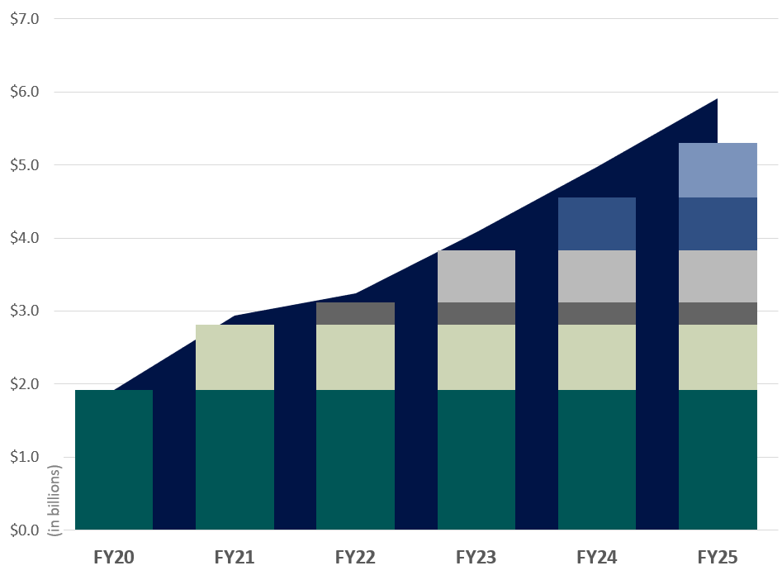

Estimated Cost of Tax Rate Compression through FY25
Comptroller’s Estimates are Statutorily Required October 1st of even-numbered years & March 1st odd-numbered years
The columns show the original cost of each round of compression at the time it occurs.
The area behind the columns shows the cumulative cost of compression. Cumulative cost is higher because of growth in the tax base over time. The cumulative number of pennies “purchased” through compression is shown below the graph.
$0.02
$0.02
$0.02
$0.02
$0.02
$0.02
$0.01
$0.01
$0.01
$0.01
$0.03
$0.03
$0.03
$0.03
$0.03
$0.07
$0.07
$0.07
$0.07
$0.07
$0.07
$0.07
$0.10
$0.11
$0.13
$0.15
$0.17
Developed in collaboration with the Texas Association of School Business Officials (TASBO)
Notes:
This graph shows you the increasing cost of property tax compression, based on the most recent property value data that became available in February. You can see the original 7 cents of compression in FY 20 that applied to every district and what that cost the state. Then we have stacked on the average compression statewide and what that will cost the state through FY 25. Obviously some districts will see more compression due to variable rate compression, but this shows what we expect the averages to be and what that will cost overall. Is this increasing cost something the state can afford to pay with no increasing source of revenue in place to cover the cost? We need our state leaders to be aware of this.

Slide 17
Recapture Reduction Promises vs. Reality
Notes:
Let’s spend a moment talking about recapture. legislators promised $3.5 billion in recapture reductions over the course of the 20-21 biennium (the red line). The issue is that they were not promising to cut recapture by that much from where it was, but rather the cut was compared to how bad it would have been without HB 3, and those are very different numbers. The blue area shows how bad recapture was estimated to be before HB 3. We were on a steep climb. But as the gray area indicates, it looks as though it will end up being a $2.3 billion 2-year reduction instead. Still a reduction, and still a change that prevented recapture from growing to $5 billion in one year, but I will also not be surprised if we begin to see a greater difference in the gray area and that red line when the numbers for reality become final. Recapture is still expected to climb to a record-setting $3 billion in one year by 2023.

Slide 18
Events leading up to 2011 funding cuts
2008
2009
2011
Economic Recession, coupled with increasing cost of property tax compression
Texas receives federal stimulus funding from Congress, preventing need for funding cuts
With stimulus dollars gone, holes remain, making funding cuts necessary
Notes:
We’ve talked before about how following the last economic recession, the influx of federal funds helped to postpone the effects of any state funding cuts for schools.

Slide 19
Events leading up to 2011 funding cuts
2008
2009
2011
Economic Recession, coupled with increasing cost of property tax compression
Texas receives federal stimulus funding from Congress, preventing need for funding cuts
With stimulus dollars gone, holes remain, making funding cuts necessary
2020
2021
2023
U R
HERE
Notes:
Right now, 2021 is shaping up to look an awful lot like 2009. It’s important to make sure legislators are aware of this so that they can take steps to avoid 2023 becoming the next 2011. [CLICK] One of the ways they can do that is how they manage the federal stimulus dollars.

Slide 20
Comparing the Two Federal Packages
 | ESSER I (May 2020) | ESSER II (December 2020)
Total Funding (nationwide) | $13.2 billion | $54.3 billion
Total Allocation to Texas | $1.29 billion | $5.53 billion
Allowed for State reservation | $130 million | $553 million
Must be Allocated to LEAs | $1.16 billion | $4.98 billion
ESSER I required LEAs reserve/spend some funding on equitable services with private schools; ESSER II does not, as private schools receive dollars from a different pot of funding.
ESSER II requires schools to track use of funds to measure and address learning loss among students affected by the coronavirus and school closures.
Notes:
If you detail the two packages already passed by the US Congress, there are some similarities and differences. Some improvements were made in ESSER II, and obviously we’re talking about a much larger dollar amount (4x the amount of the first package).

Slide 21
Federal Stimulus Dollars
March 2020
$1.3 billion
CARES Act delivered $1.3 billion through ESSER I
Largely supplanted for state savings
Dec. 2020
$5.5 billion
Coronavirus Response and Relief Supplemental Appropriations Act (CRRSAA) provided $5.5 billion to Texas in ESSER II funds
March 2021?
$12.9 billion?
Notes:
It is important to keep asking state leaders about these dollars, which are intended for our public schools to help schools respond to the effects of the pandemic.

Slide 22
Federal Dollars for Texas K-12 Schools
March 2020
$1.3 billion
CARES Act delivered $1.3 billion through ESSER I
Largely supplanted for state savings
Dec. 2020
$5.5 billion
Coronavirus Response and Relief Supplemental Appropriations Act (CRRSAA) provided $5.5 billion to Texas in ESSER II funds
March 2021?
$12.9 billion?
Current proposal includes $130 billion for K-12 schools nationwide, meaning an estimated $12.9 billion for Texas schools
Notes:
And oh by the way, there is likely to be a lot more on the way. The US House passed the $1.9 trillion package over the weekend, and the US Senate is hard at work with intent to pass it as well so that President Biden might sign it by mid-March. If Texas appropriators didn’t know what to do with all that stimulus money before, now they are really going to be overwhelmed.

Slide 23
ADA Hold Harmless
Currently, the ADA Hold Harmless floor only applies to the first 3 six-weeks of the 2020-21 school year
  All or nothing for special program counts
  Attendance rate cap applies
Potential extension to the hold harmless to remainder of school year under consideration
  Commissioner said to expect decision in February (now it’s March)
  State leaders have expressed concern that not all districts are doing their due diligence to find missing students
Notes:
So why on earth are we still waiting to hear about the hold harmless for the current school year? Commissioner says he is fairly optimistic and told schools “don’t stress about your budgets” He’s said we will hear very, very soon (two verys).

Slide 24
Will they or won’t they?
State Budget Shortfall
State Has the $$
Budget deficit of $1 billion for 20-21
Shortfall expected for the 22-23 biennium
Need to save dollars for potentially larger budgetary challenges in 2023
Removes “incentive” for schools to recover missing students
Dollars were appropriated last session for an ADA count that is quite a bit higher than what is called for by ADA floor
One-third of districts are not expected to need the floor
State saved $5.4 billion in the 20-21 biennium due to "shifts in estimated methods of finance based on updated estimates."
$5.5 billion in federal stimulus dollars that must be spent by January 2022
Notes:
Why was February the time we expected to hear the answer? They just received updated property values, PEIMS submissions, and Comp Ed counts to give them a better idea of how much money they have (more so than the BRE), and this information will be used to make that decision. It’s important to note that appropriators would rather tell schools much later in the process, but there is the understanding (through a lot of hard work and conversations) that schools need to know NOW, not months from now.

Slide 25
State Maintenance of Effort
ESSER I
ESSER II
Under the CARES Act, a State must maintain support for elementary and secondary education and State support for higher education in each of fiscal years (FY) 2020 and 2021 at least at the level of such support that is the average of the support for elementary and secondary education and higher education provided in the three fiscal years preceding the date of enactment of the CARES Act (FYs 2017, 2018, 2019).
Under the CRRSA Act, a State must maintain support for elementary and secondary education and higher education in FY 2022 based on the proportional share of the State’s support for elementary and secondary education and higher education relative to the State’s overall spending averaged over FYs 2017, 2018, and 2019.
Notes:
So what’s the hold up? Perhaps it’s this: the State of Texas has not yet agreed to receive the ESSER II funds because they are still negotiating and trying to determine options for how this provision applies. The MOE language changed so that it isn’t quite as easy for the state to completely supplant the funding as they did before. They want to use ESSER II funds to pay for the hold harmless, so it doesn’t cost the state anything.

Slide 26

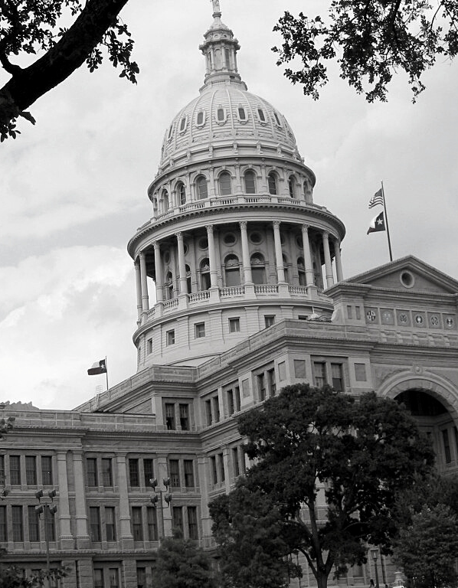

What do we need to do?
As educators and public school advocates, what can we do to help?

Slide 27
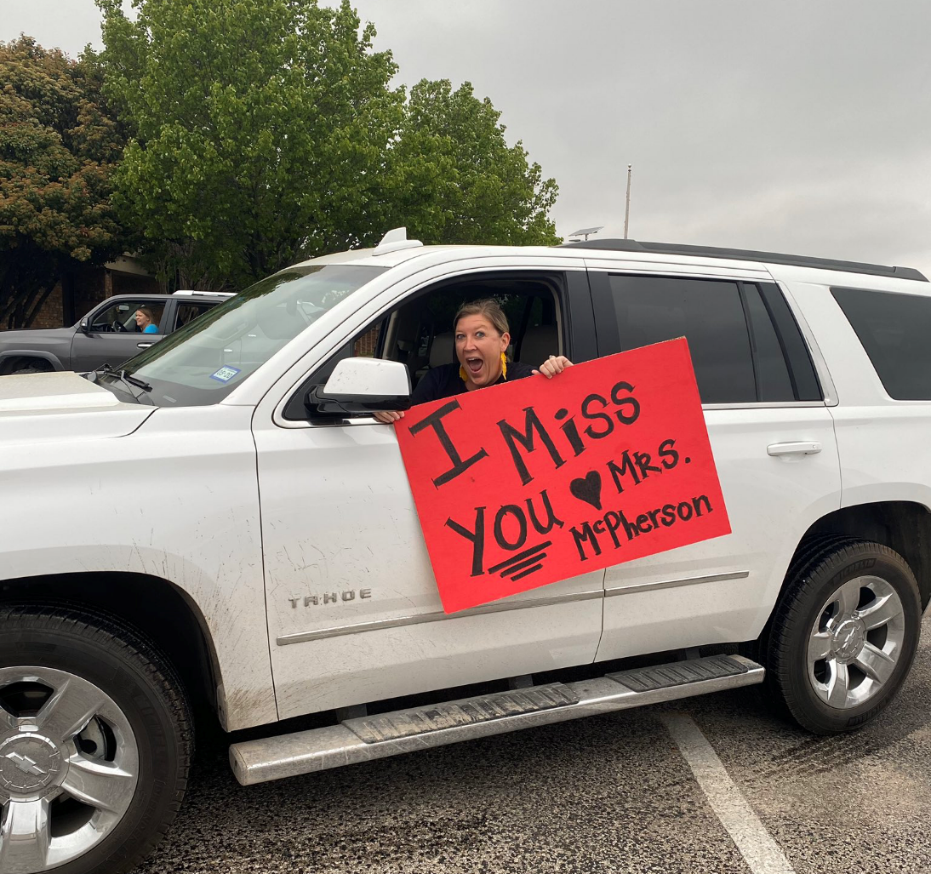

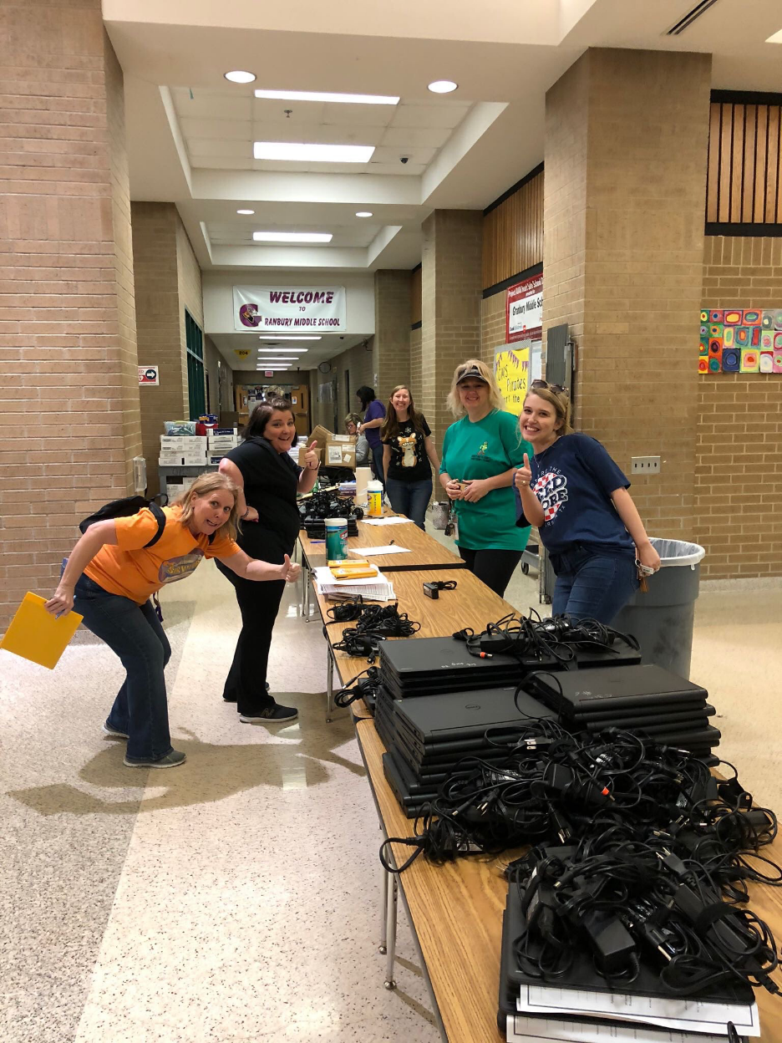
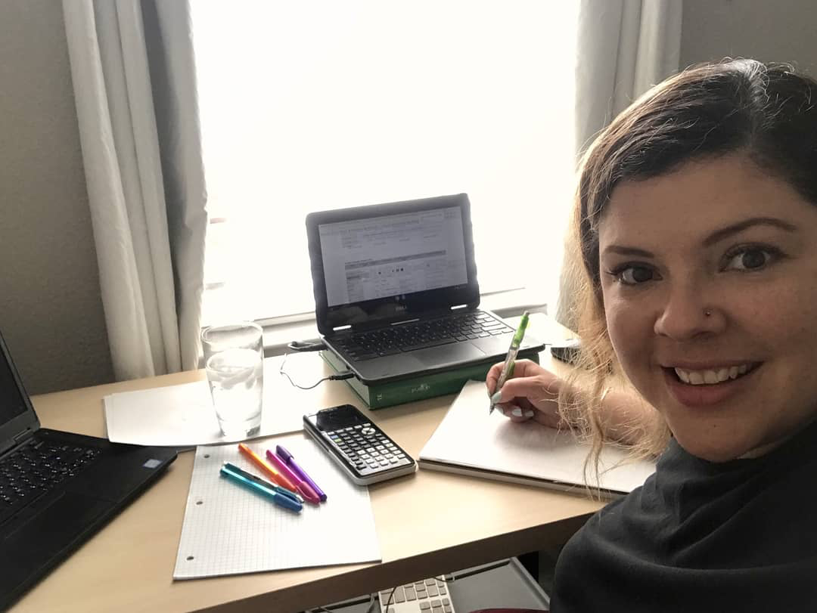
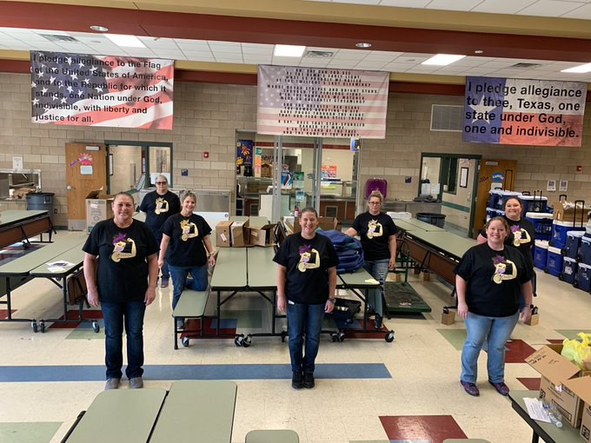
Remind leaders schools can be trusted
Notes:
When the coronavirus first hit a year ago, public schools showed up for their students and communities. We served meals, we deployed remote learning in some cases overnight, we made deliveries to students’ homes, and did literally every thing possible to ensure our students never stopped learning and never stopped receiving the vital services schools provide. None of this was motivated by money. Schools are in this business because we care about kids and want to do what is best for them.

Slide 28

Inform legislators of student recovery efforts
Criticism that schools are not putting forth every effort continue
Provide data to local legislators regarding students who are already re-enrolled and re-engaged
Provide documentation of efforts taken by district to recover students
Talk about how funding uncertainty makes the budgeting process so challenging
Notes:
Sometimes we are so busy doing the work, that we forget to brag about the work and the results we have achieved. Whether this is the true reason or not, a lot has been said about the reason that the announcement about extending the hold harmless continues to be delayed is that its extension removes the incentive for schools to recover missing students. Anyone who honestly thinks that hasn’t been paying attention. We’re not in this business for the money.
I also don’t think this is really the reason we don’t yet have an answer on the hold harmless. But that really doesn’t matter. Our job right now is to dispel these false rumors and wrong thinking. Out job is to educate others of our efforts in a manner that leaves no room for doubt.
We also need to make it clear that to be fiscally responsible in our operations, we need to know now rather than later.

Slide 29
Acknowledge Learning Loss
Commissioner is reporting that students are 3.2 months behind in math.
Every district lost months of classroom instruction
Both students who have not yet re-enrolled and those that have all experience learning loss
Learning loss has occurred in every district statewide
Learning loss requires additional staff time (and therefore additional resources) to address
Notes:
As Doug Williams so eloquently put it last week, we’ve lost a lot of ground with students and that is including the students we’ve worked so hard to recover, those who we’ve yet to recover, and those who have been trying to engage in learning all along through these trying circumstances. The mental health challenges the pandemic has caused, not mention the constant disruptions, have taken their toll.
Commissioner Morath loves to talk about what happened in Argentina in the 1980’s due to learning losses that were never addressed. We can’t have that in the case of Texas students. We must address these losses and talk about the additional time and resources they are going to require in order to address them. We can’t wish this away. It’s going to take hard work and some significant investments, and we have to make the case for that.

Slide 30
Plan to address learning loss
How will your address specifically address learning loss?
Who will you target?
When will you address it?
How much does that cost?
Summer school
After school tutoring
Saturday tutoring
Pull-out with specialists
Smaller class sizes
Notes:
The best way to make our case is to plan for exactly your district will address learning loss. If we don’t want to end up with a statewide program and Mike Morath telling us how his program is going to solve all the world’s problems, then we have to come up with plans of our own. We have to determine what the specifics of our plans cost and share those details with the state leaders who can help us to get access to that money.
We can’t keep saying “we need more resources” in the general sense. We need to say “I need this much money to cover the cost of the additional staff time to provide summer school for this many students who have demonstrated they are behind.” I need $X to hire an additional teacher in each grade level so that students identified with gaps in their learning can be in smaller classes and get the attention they need to catch them up to grade level again.
Write a plan as though you are getting these additional dollars to make the case for why you need them.
We cannot simply say that we want to pay our teachers more for the jobs they are already doing. We have to explain the extra time and effort that will be required and how much it will cost to pay for that.

Slide 31
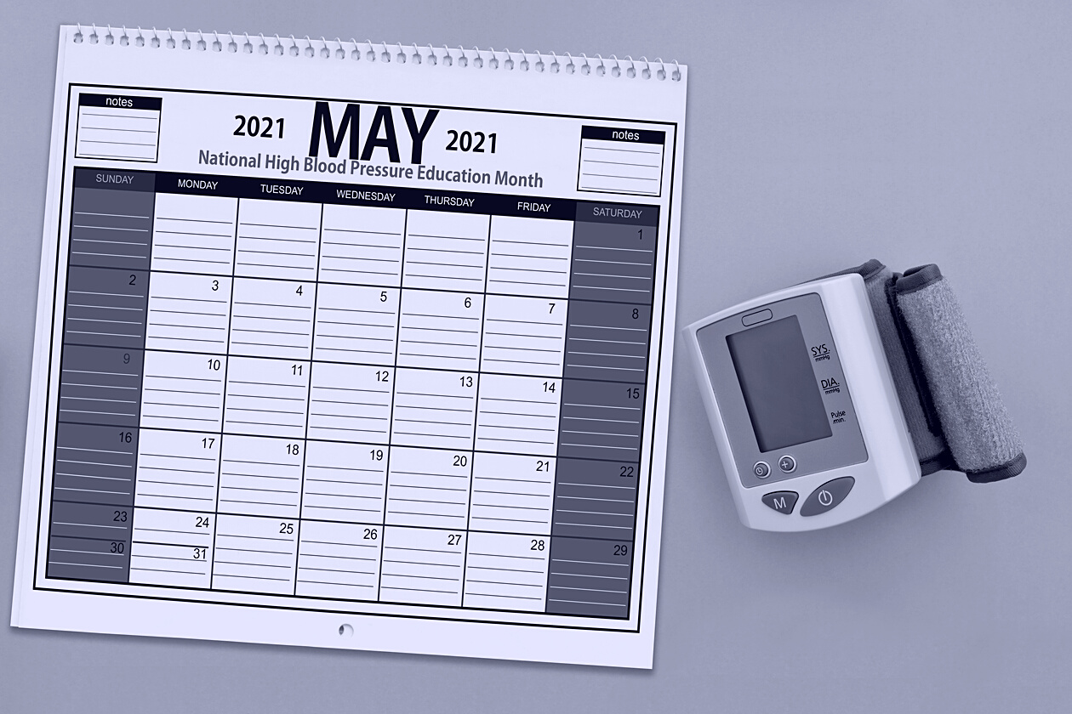

When can we expect to know?
Schools need to know sooner rather than later in order to plan responsibly. You might want to plan for later though...

Slide 32
When budget bills have passed in the past
 | Budget Passed by House | Budget Passed by Senate
2015 | March 31 | April 14
2017 | April 6 | March 28
2019 | March 27 | April 9
Comptroller said to expect updated BRE in late April/early May
Month-long Conference Committee, with final passage on:
  May 29, 2015
  May 27 , 2017
  May 26, 2019
Notes:
If we look at the

Slide 33


What else do we need to know?
With so many issues out there, what else needs to be on your radar?

Slide 34
HB 3: Pandemic Response Act (by Burrows)
Details and plans for state response, including powers and duties of the Governor
Civil liability protections
Local and Interjurisdictional Pandemic Emergency Management
Limitation on property tax rates of certain counties and municipalities
Off-Campus Programs Approved for Average Daily Attendance During Pandemic Disaster
  Allows instructional program by entity other than a public school
  Student ADA funding goes to district of residence, and district must compensate off-campus instructional program, according to the bill submitted by that program
Referred to House State Affairs Committee
VOUCHER
Notes:
This bill, filed by Calendars Committee Chairman Dustin Burrows. This bill is one of the Speaker’s top priorities. There are quite a few legislators with some very strong opinions about the state’s response to the pandemic, and how they were largely cut out of the process. So this is their opportunity to weigh in. It covers a broad range of topics that we can leave them to decide, but the section I want to bring to your attention is the one that impacts schools. It would allow for off-campus programs (run by private entities) to educate students and then have those entities send the local school district a bill for those services. That’s why I think we can safely label this provision as a voucher. This type of arrangement can already happen should the duly elected trustees of a local school district see it as the best way to provide for students, and no additional statutory change is needed on this topic—at least not language like this.

Slide 35
Remote learning
What happens in 2021-22 and beyond?
HB 1468 (by Rep. Keith Bell): Would allow a school district to provide ongoing full-time virtual offerings for the district’s students according to district-determined criteria
Notes:
Where we might need some help is on the topic of remote learning. The Commissioner has said the agency allowed for the current flexibility with ADA for remote learning for a one-time emergency and that any use of such beyond that will need a stamp of approval from the Legislature. That leaves us in the lurch until we see if any legislation may actually pass, as we won’t know until late May, and that makes it awfully hard to plan for next year. There have been some bills filed on this topic, and I have highlighted one here by House Pub Ed Committee member (and former trustee) Rep. Keith Bell that would allow for local district decisions on this topic. On anything related to virtual and remote learning, the devil is always in the details.

Slide 36
Broadband
The need for available and reliable internet services is essential for public education, as well as higher education, hospitals, businesses, residents, and many others
SB 5 (by Nichols, Hancock, Perry, and West)
HB 5 (by Ashby, Anderson, Paddie, Price, and Canales)
Notes:
We’ve all experienced in some shape or form over the past year how important available and reliable internet connections are, and this is probably the topic we see the most unity around than any other (even more than blame and hatred for ERCOT and the PUC!). Broadband is an infrastructure issue that affects education, but extends well beyond our schools and should therefore be paid for in the state budget in a manner that in no way uses money designated for schools to address this state utilities and infrastructure need. One of the top priorities identified by the Governor, Lt. Governor and Speaker is broadband connectivity. Senate Bill 5 with 4 joint authors, and 11 other Senate co-authors not listed here. House Bill 5 has 5 joint authors and 29 House co-authors.

Slide 37
Notes:
Many times when a school finance bill passes, no one ever bothers to go back and check to see if the estimates were on the money, or if they missed the mark. Kudos to TEA for going through the exercise of comparing their estimates from 2019 to the reality of FY2020. This chart shows us that place where they missed the mark the most was on the Formula Transition Grants. What would happen if your district was this far off on the numbers you budgeted?

Slide 38
Formula Transition Grants
TEA estimated $110 million cost missed the mark
Actual cost of Formula Transition Grants: $1.3 billion
Stop-gap required by one-third of districts
What happens when they expire?
Any one-time money provided to address learning loss must be provided ON TOP OF school finance formulas so those dollars can be used to help students, not simply off-set transition grant dollars that would have already been provided by the state.
Notes:
The Transitions Grants cost A LOT more than the state projected. The reason provided for this discrepancy is that actual property value growth far exceeded the assumptions as well as the move from prior year to current year values, which removed the "lag amounts“ In other words, the Transition Grants cost so much because they are attempting to mitigate the losses districts experience due to the move to current year values from prior year values. Our ability to say I told you so is cold comfort. Even though the cost is $1.2 billion more than expected, don’t forget the state still managed to save $5.4 billion off the backs of the public schools.
So while I am no longer concerned that the formula transition grants are at risk of being cut this session (in a session when the are looking for ways to spend on education in a temporary basis, spending on a grant that already has an expiration date in statute is a pretty easy sell), I am concerned that the cliff is growing larger for a number of districts and we will soon face another ASATR funding cliff scenario.

Slide 39
District Fund Balances
Rep. Dan Huberty has not let the topic drop
Statewide districts have $15.3 billion in fund balances
$7 billion of that exceeds the minimum requirement to maintain funding for 90 days of operations
Notes:
We have not yet seen legislation filed on this topic (as least not that I am aware of), but we have heard it continue to come up, even though the State is not facing the budget shortfall we once thought they would be. It was also mentioned (briefly) in Senate Finance, so the topic has not gone away.

Slide 40
Elections
HB 330 (by Cain): would require a supermajority for a political subdivision to pass a bond and participation from at least 20% of registered eligible voters (as well as many other statutory changes related to election integrity not covered in HB 329)
HB 664 (by Landgraf): would require all bond elections in November
In a democracy, the majority rules; super-majority requirements give disproportionate influence to a minority of voters.
Notes:
There are a lot of changes we would love to see lawmakers propose to improve the requirements and process for conducting elections. However, there are a lot of ways legislators could make elections worse rather than better, so my assessment is that the best we can hope for this go round is that things don’t get worse and that we get to at least keep things the way they are.

Slide 41
Chapter 313 Agreements for School Districts
Chapter 313 is subject to expiration December 31, 2022, unless the Legislature acts to continue it.
HB 1556 (by Murphy) would renew the Chapter and make significant changes, many of which are not beneficial to school districts and might make such agreements far less of an appealing tool.

Slide 42


HB 3 Clean up
Bills expected to be filed by Senator Taylor and Rep. Huberty
CTE for small and mid-sized districts
Spending requirements flexibility?
Fast Growth Allotment
CCMR bonuses
Notes:
We expect Rep. Huberty and Senator Taylor (author and sponsor of HB 3) to file legislation to clean up the unintended consequences of that robust bill. You can see the list of items they may address, and I also expect this bill to be the “dog with fleas” or the “Christmas tree” of the session because anything and everything could be added to it. This bill will be one to watch.

Slide 43
In Summary
Limited access due to the Pandemic
Limited attention due to weather/energy crisis
Not limited on funds due to the Feds
Limited information on what to expect until late in the game
Challenge of getting our points across to address needs for learning loss, health & safety (including mental health), and addressing both short and long-term shortcomings of HB 3
Challenge of defending against bills that would limit local control, open the door to private school/vendor choice, and otherwise harm standing of public schools

Slide 44


Questions?
Christy Rome
Executive Director
Texas School Coalition
christy@txsc.org
512-732-9072

