Slide 1

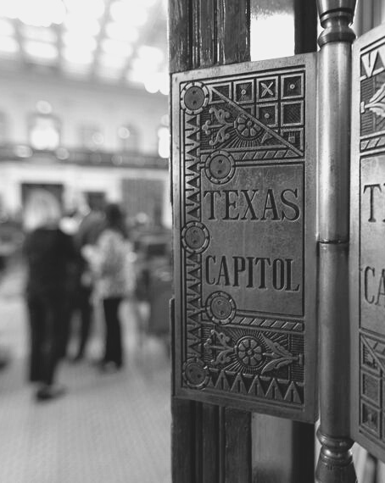

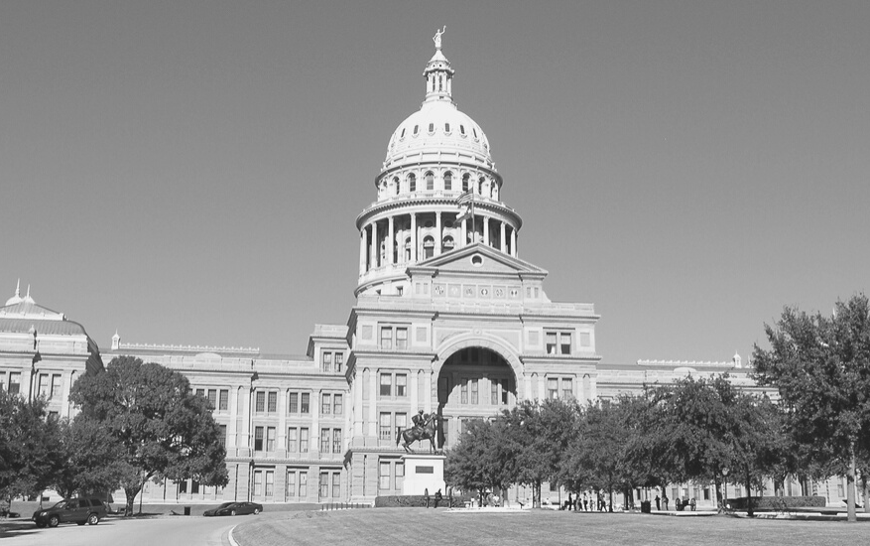

Will the 87th Texas Legislature leave us whole or with holes?
February 5, 2021

Slide 2

Presentation Flow
TOPICS TO BE DISCUSSED
  Who’s Who
  The State Budget
  Looking to the future of HB 3
  What to Expect from the 87th Regular Session
Notes:
Just to give an idea of what we will cover, the election, the economy, other issues and what to expect for the 87th.

Slide 3
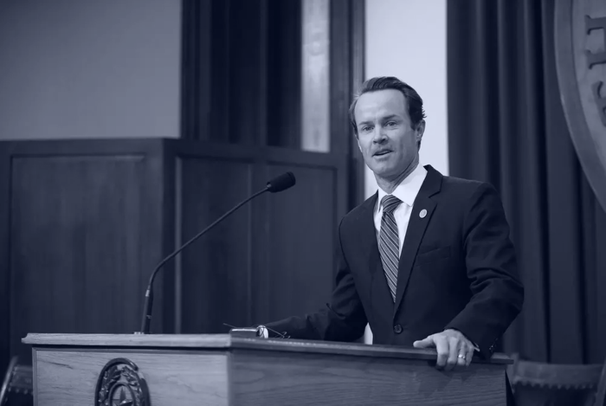
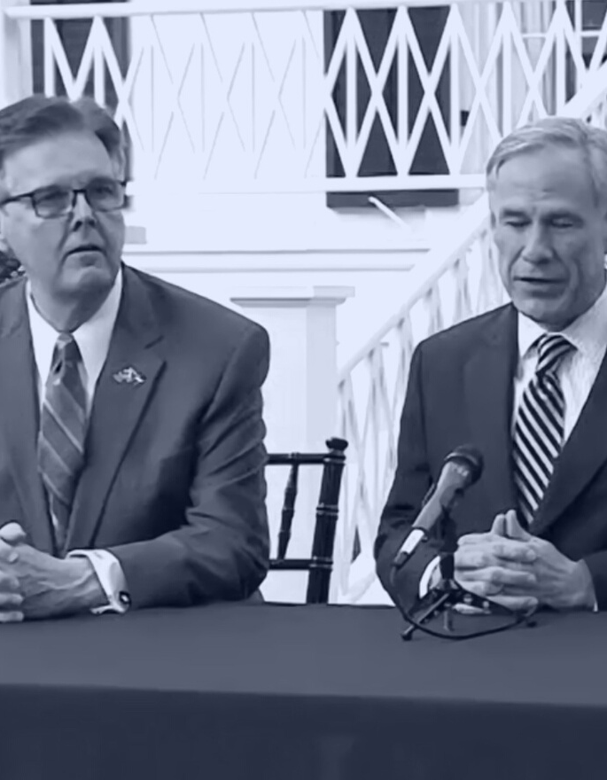

Who's Who
in the
87th Legislature?
The Big Three have a new member. We see consistency in the Senate, but not in the House...
Notes:
So the Big Three—our Governor, Lt. Governor, and Speaker have a new member rounding out the three. He’s so new that the only photo I could find of the three of them together was from a campaign rally in 2018. I’m sure we will get lots of chances for a photo op later this spring.

Slide 4
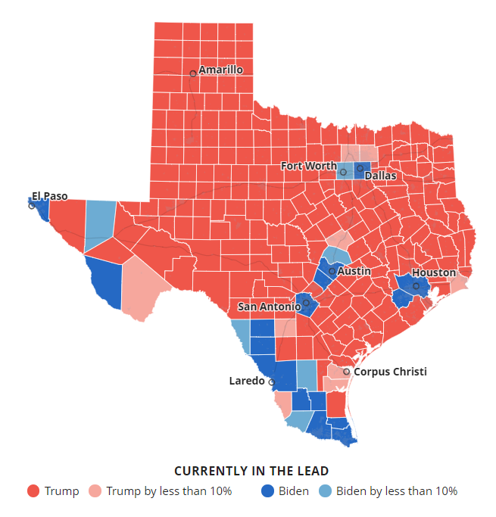
Texas is still a Red state
Texas demonstrated overall statewide support for Republican candidates
  Donald Trump won Texas
  Senator John Cornyn was re-elected
  64% of the US Congressional delegation from Texas will remain Republican
  Republican Jim Write won 53% of the vote for statewide Railroad Commission post
Courtesy of the Texas Tribune
Notes:
As we talk about who’s who, we need to first acknowledge the results of the November election: Texas is still a red state.
Typically, when you see record-setting voter TURN-out, you also see a lot of TURN-over. That wasn’t the case in Texas. A record number of people voted, and they said we prefer Republican candidates—including the ones we’ve already got.
I think we can likely expect state leaders to govern in the manner reflected by this map in the next legislative session.

Slide 5
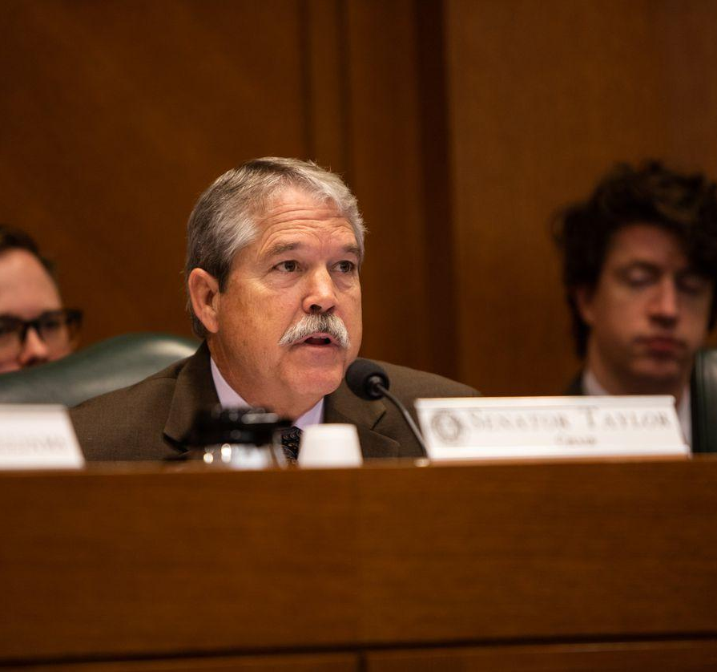
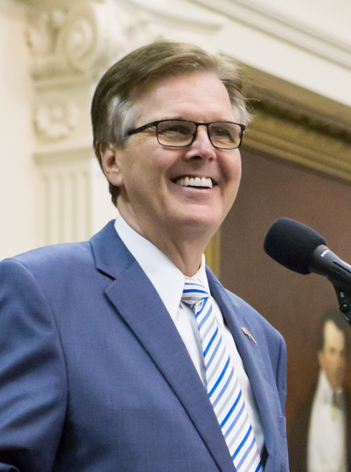
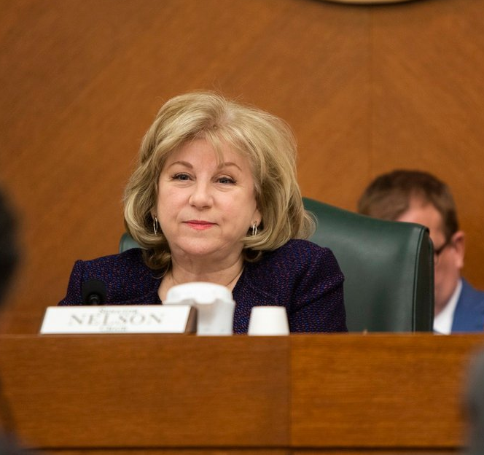
Consistent Leadership
Senator Larry Taylor
Senate Education Committee Chair
Senator Jane Nelson
Senate Finance Committee Chair
Lt. Governor
Dan Patrick
Notes:
Dan Patrick’s term extends through the 2022 elections, so there is more consistency in the Senate chamber, [CLICK] including the chairs of the committees. Senator Taylor and [CLICK] Senator Nelson remain in their posts as Chairs of these two important committees.

Slide 6
Partisan Composition of the Texas Senate
 | Republicans | Democrats
85th (2017) | 21 | 10
86th (2019) | 19 | 12
87th (2021) | 18 | 13
The Texas Senate includes
18 Republicans
& 13 Democrats
Notes:
The Democrats picked up one seat in the Texas Senate as Senator Roland Gutierrez defeated incumbent Pete Flores (in what has traditionally been thought of as a Democratic-learning district). That change brings the number of Democrats in the Senate up to 13, with 18 Republicans.
13 is the most seats Democrats have occupied during Dan Patrick’s time as Lt. Governor, and this required a change to the Senate rules so that now only 18 votes (not 19 or the previous 21) are required to bring a bill to the Senate floor for consideration so that the Democrats aren’t able to block any legislation on a party-line basis.

Slide 7
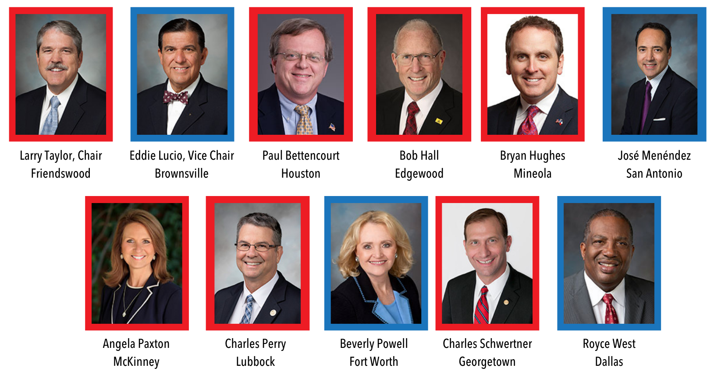
Senate Education Committee
Notes:
These are the members appointed to the Senate Education Committee. Click

Slide 8

Senate Education Committee
Notes:
We see a lot of familiar faces returning to the committee, and three new additions. I expect this committee to operate in a manner very similar to what we’ve seen in sessions past (only with less hearings, Plexiglas, and COVID testing)

Slide 9
The Texas House in 2021
With 83 seats, Republicans retain majority of the 150-member House, with Democrats maintaining 67 seats
Notes:
Over on the House side, the break-down of seats between the two parties remains unchanged. The two parties traded a couple of seats in the November election, but Republicans retained the majority with 83 seats.
We see a MUCH larger number of incumbents returning this session, and far fewer freshmen. There are only 17 new faces (one of which is a returning member)…and soon to be 18 once the seat vacated by Drew Springer is filled on February 23.

Slide 10
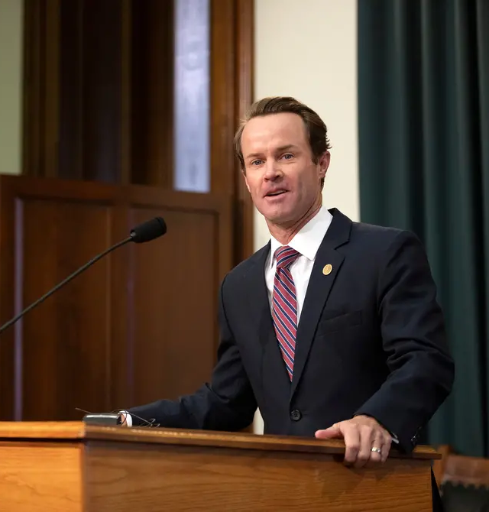
Speaker Dade Phelan
Hails from Beaumont
First elected to the House in 2014
Father to four school-aged boys
Chairman of House Committee on State Affairs in 2019, and ally of then-Speaker Dennis Bonnen
Sponsor of 2019 legislation that would have prohibited the use of public money for lobbying
Notes:
With the Republican majority in the House secure, it became clear our next Speaker would be elected from those ranks and the day following the election then-State Affairs Committee Chairman Dade Phelan announced that he had the necessary support from the membership to be elected as the next Speaker, and he was (with only two members dissenting).

Slide 11
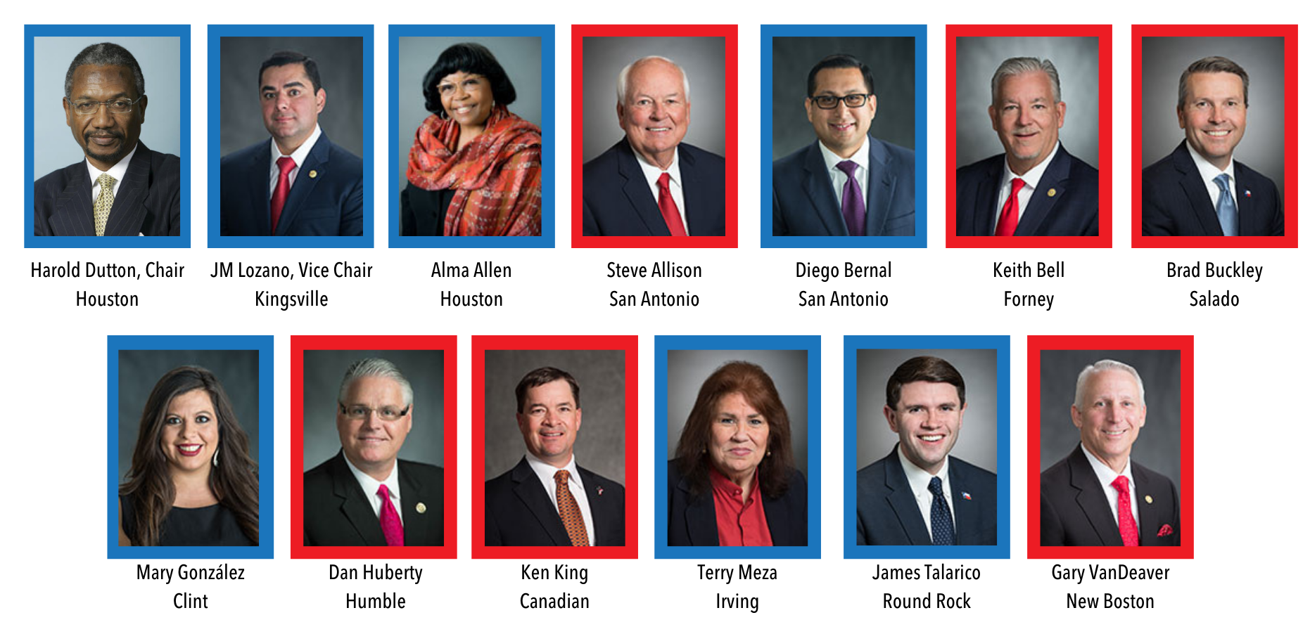
House Public Education Committee
Notes:
And with a new Speaker, often come new committee chairmanships…and that is exactly what happened yesterday. This is the breaking news portion of the presentation. Harold Dutton of Houston was appointed as Chair of the House Public Education Committee. He has been a member of the House since 1984, and spent 24 years on this committee.

Slide 12
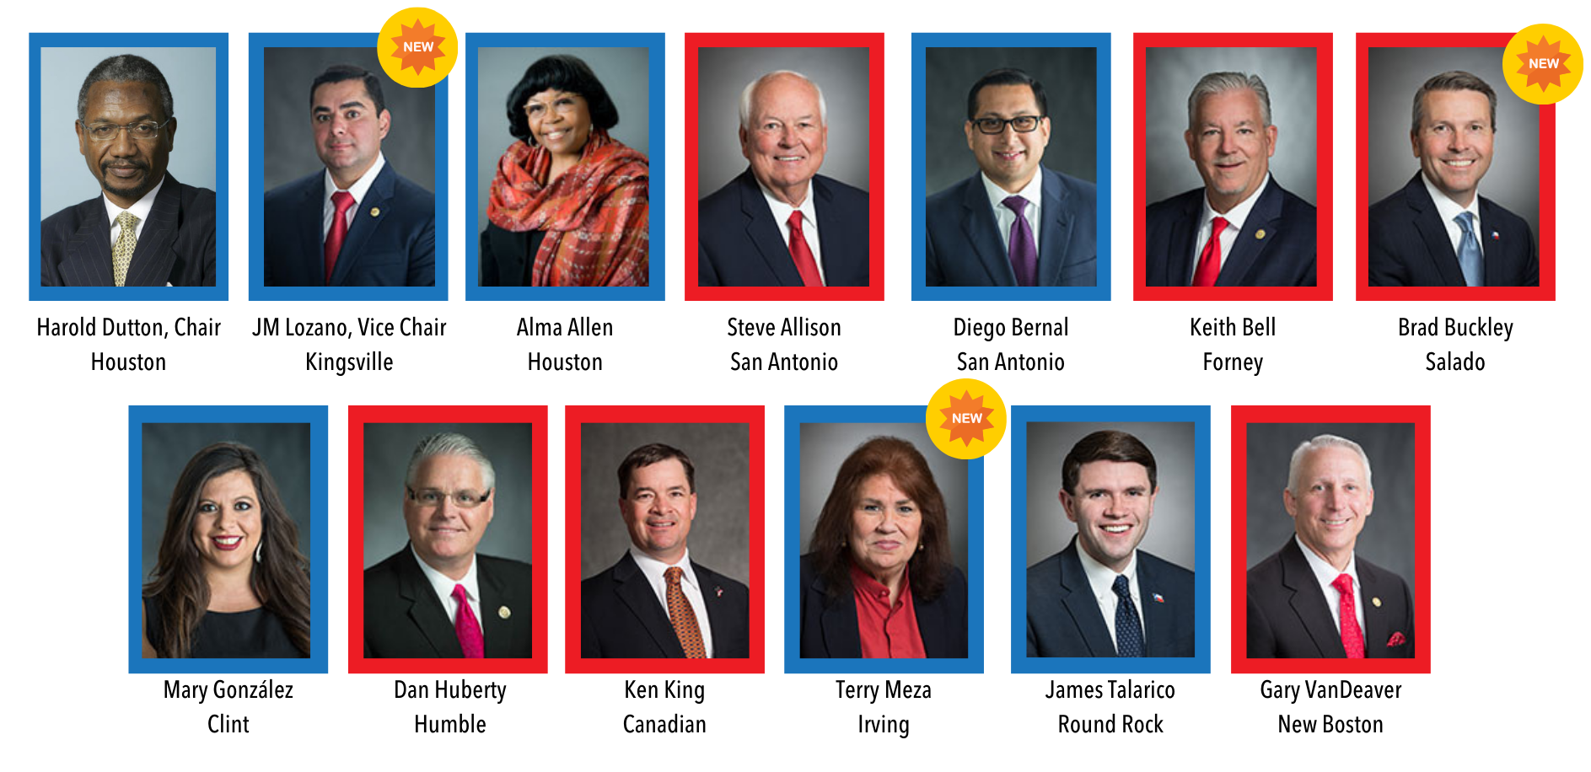
House Public Education Committee
Notes:
This committee also picked up three new members, with the remainder returning. What I can tell you about our new Chairman is that he is the first Democrat to serve as chair of this committee since 2002, when it was Paul Sadler. In the past, he has been a big supporter of charter schools.

Slide 13
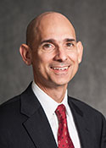

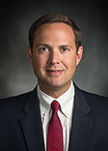


Other House Committee Chairs to note
Greg Bonnen
(R-Friendswood)
House Appropriations Committee Chair
Chris Paddie
(R-Marshall)
House State Affairs Committee
Chair
Dustin Burrows
(R-Lubbock)
House Calendars Committee
Chair
Morgan Meyer
(R-Dallas)
House Ways & Means Committee
Chair
Briscoe Cain
(R-Deer Park)
House Elections Committee
Chair
Notes:
Other new chairs to note include Appropriations Chair Greg Bonnen. Last session, Chairman Bonnen oversaw Article III of the Budget for the House. Dustin Burrows will serve in the very powerful post of chairing the Calendars Committee. Briscoe Cain of Deer Park, who has been very vocal about concerns regarding election fraud, will be chairing the House Elections Committee. He has also already filed legislation this session that would require a 2/3 super-majority approval from voters in school district bond elections. Chris Paddie will be chairing the State Affairs Committee, which could be significant because last session, Chris Paddie was among those Republican members who opposed prohibitions against “taxpayer funded lobbying.” It remains to be seen if this is significant or not. Finally, Morgan Meyer will leading the Ways & Means Committee, overseeing revenue and taxes, including many of the property tax bills that may be filed.

Slide 14



State Budget Overview
Does “not as bad as we thought” mean good news?
Notes:
At one point, we thought the sky was falling with our economy, but Comptroller Glenn Hegar was pretty optimistic about the rate of recovery for the State’s economy, so this next session of the presentation isn’t going to be as dreary as I once thought it would be.

Slide 15
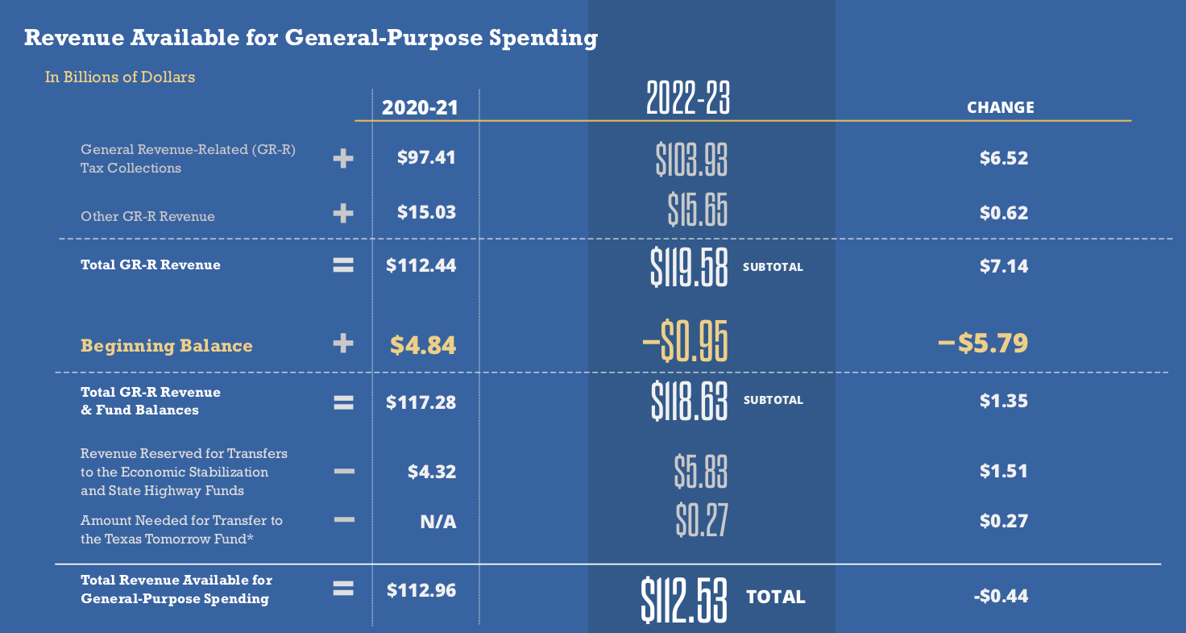
Biennial Revenue Estimate
Notes:
Each January before the start of the session, the Comptroller has to give an assessment of things before the session begins. This time around, Hegar told us we still have a deficit in the current biennium, but not the $4.7 billion he told us it would be back in August. Instead, just about a $1 billion shortfall. He is optimistic about what the state’s economy will bring in over the next two years, so all in all it wasn’t so bad. It still doesn’t give a lot of breathing room, but it isn’t likely to lead to the massive budget cuts we once thought we might be facing.

Slide 16
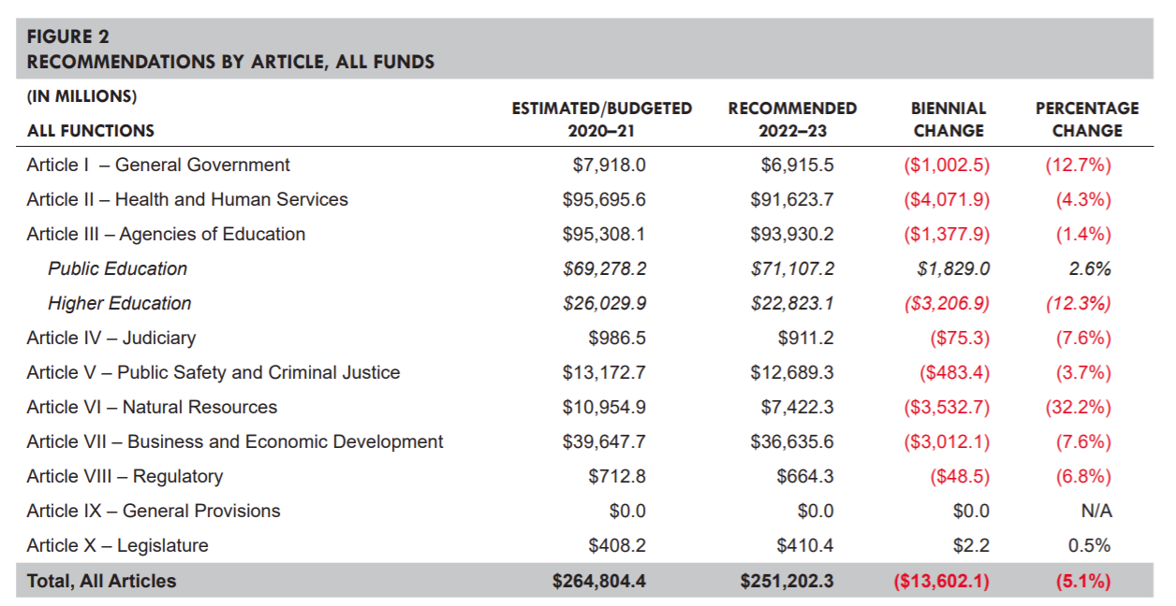
SB 1 By Article, All Funds
Notes:
I usually focus on General Revenue funds and ignore All Funds, since many of these don’t have state discretion over how or where they are spent. But I think this table is very telling about what our perspective should be in public education. We are only 1 of 2 lines in the black. When every other area of the state budget appears in red, it is hard for us to complain (much).

Slide 17
Foundation School Program
(House and Senate base budget bills are nearly identical)
Both fully fund HB 3, with no reductions to the school finance formulas
  $3.1 billion increase to the FSP for enrollment growth (likely overstated due to the impact of ESSER in 20-21)
  $1 billion increased spending for ongoing property tax rate compression
Notes:
So the base bills filed by the House and Senate are almost nearly identical, especially in the big ticket items of the Foundation School Program in Article 3. The big news for schools is the commitments made in HB 3 are fully funded. They also added on top of what was spent in the last two years another $3 billion to fund enrollment growth. (Two points on that: 1) we learned in 2011 not to take the funding of enrollment growth for granted; it wasn’t funded then, so now every budget when it is we have to be grateful and 2) our state enrollment is not going to grow by $3 billion this biennium. Rather, this number is derived (in part) based on the overstated growth in enrollment due to the way the state supplanted federal stimulus dollars, which artificially drove down ADA to save state money).
And that $1 billion they included for ongoing property tax compression, we believe that is a placeholder as more than $1 billion will be required for that.
Both of these are placeholders for now, but we are glad they are there, as it is difficult for the State to pass a bill that spends less on education than what was originally proposed.
This budget bill made it clear that public education remains a priority for the Texas Legislature.

Slide 18
General Revenue Available vs. Required
Available to Spend (BRE) | Base Bill (SB 1) | Difference
$112.5 Billion | $119.7 Billion | $7.2 Billion
Tools Available in the Fiscal Toolbox
Tool | Amount
Economic Stabilization Fund (Rainy Day) | $11.6 Billion
Delay August FSP Payment | $2 Billion
Federal Stimulus (ESSER 2) | $5.5 Billion
$11.6 expected in
Rainy Day Fund
Notes:
So I showed you what the Comptroller said lawmakers have available to spend, right? $112.5 billion. Well, the budget that was introduced spends more than what they have they have available. I gave you the Senate figure, and the House base bill spends $7.3 billion more. That isn’t to say there aren’t ways to make that money available. As you can see, they have tools available in the toolbox to get the job done. They have $11.6 billion in the Rainy Day Fund, but if they spend all of that now and things don’t improve before they meet again in 2023, what then? They can also use the tried and true trick of delaying the August 2023 FSP payment until September 2023. That is a one-time thing they will eventually have to pay back, but it could make the money they need available now, available now. Also, the manner in which they choose to spend all (or part) of the $5.5 billion the feds sent our way could also go a long way to fill their budgetary holes—and they have certainly done that before.

Slide 19

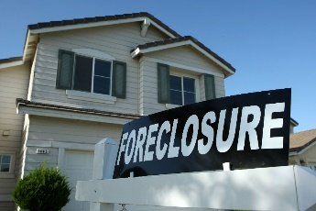
Present circumstances are very similar to what led to 2011 funding cuts
2009-2013
2020-???
Major property tax compression from HB 1 in 2006
National & State economic recession (“The Great Recession”) .
Federal stimulus used to supplant, not supplement (ARRA)
$27 billion state budget shortfall
Request for 5% state agency budget reductions
Major property tax compression from HB 3 in 2019
National & State economic recession (caused by virus, market crash, economic shut-down, etc.)
Federal stimulus used to supplant, not supplement (CARES Act/ESSER)
$1 billion budget shortfall from 20-21; $7 billion shortfall expected 22-23
Request for 5% State Agency budget reductions
Notes:
Looking to history can be predictor of the future. We have talked about how eerily familiar circumstances are now compared to what led up to the cuts adopted by the Legislature in 2011, that took affect in 2012 and 2013. Right now, 2021 looks an awful lot like 2009. In 2009, the feds sent the state significant cash through the American Recovery and Reinvestment Act (ARRA). What lawmakers chose to do at that time was to supplant some of the money, and then provide districts with an amount per WADA on top of state formula funding at the time. They didn’t make it one-time money for schools (though they could have). Because what that that all set into motion were the significant cuts in 2011. We hope we don’t repeat that in 2023.

Slide 20
Federal Stimulus Dollars
May 2020: CARES Act delivered $1.3 billion through ESSER
  These funds were used to supplant state funding for public schools (creating a savings for the State)
December 2020: Coronavirus Response and Relief Supplemental Appropriations Act (CRRSAA) provided $5.5 billion to Texas in ESSER II funds
  Will these dollars also be used to supplant state funds?

Slide 21
Comparing the Two Federal Packages
 | ESSER I (May 2020) | ESSER II (December 2020)
Total Funding (nationwide) | $13.2 billion | $54.3 billion
Total Allocation to Texas | $1.29 billion | $5.53 billion
Allowed for State reservation | $130 million | $553 million
Must be Allocated to LEAs | $1.16 billion | $4.98 billion
ESSER I required LEAs reserve/spend some funding on equitable services with charter schools; ESSER II does not, as private schools receive dollars from a different pot of funding.
ESSER II requires schools to track use of funds to measure and address learning loss among students affected by the coronavirus and school closures.

Slide 22

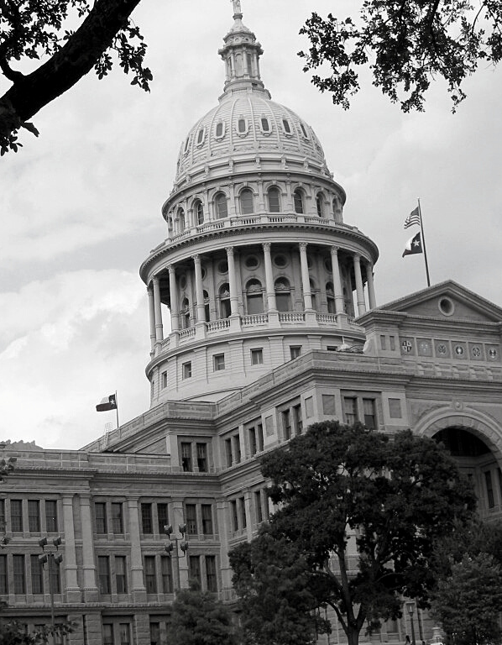
The Future of
HB 3 Funding
State leaders made an awful lot of promises in 2019, but will they keep them?

Slide 23
ADA Hold Harmless
Currently, the ADA Hold Harmless floor only applies to the first 3 six-weeks of the 2020-21 school year
  All or nothing for special program counts
  Attendance rate cap applies
Potential extension to the hold harmless to remainder of school year under consideration
  Commissioner said to expect decision in February
  State leaders have expressed concern that not all districts are doing their due diligence to find missing students
Notes:
Commissioner says he is fairly optimistic and told schools “don’t stress about your budgets”

Slide 24
Will they or won’t they?
State Budget Shortfall
State Has the $$
Budget deficit of $1 billion for 20-21
Shortfall expected for the 22-23 biennium
Need to save dollars for potentially larger budgetary challenges in 2023
Dollars were appropriated last session for an ADA count that is quite a bit higher than what is called for by ADA floor
One-third of districts are not expected to need the floor
State saved $5.4 billion in the 20-21 biennium due to "shifts in estimated methods of finance based on updated estimates."
$5.5 billion in federal stimulus dollars that must be spent by January 2022
Notes:
Why is February the time we expect to hear the answer? They just received updated property values, PEIMS submissions, and Comp Ed counts to give them a better idea of how much money they have (more so than the BRE), and this information will be used to make that decision. It’s important to note that appropriators would rather tell schools much later in the process, but there is the understanding (through a lot of hard work and conversations) that schools need to know NOW, not months from now.

Slide 25
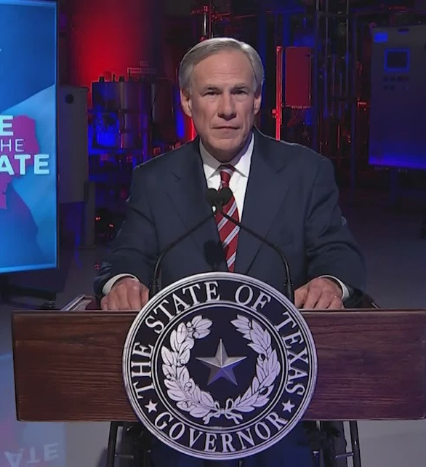
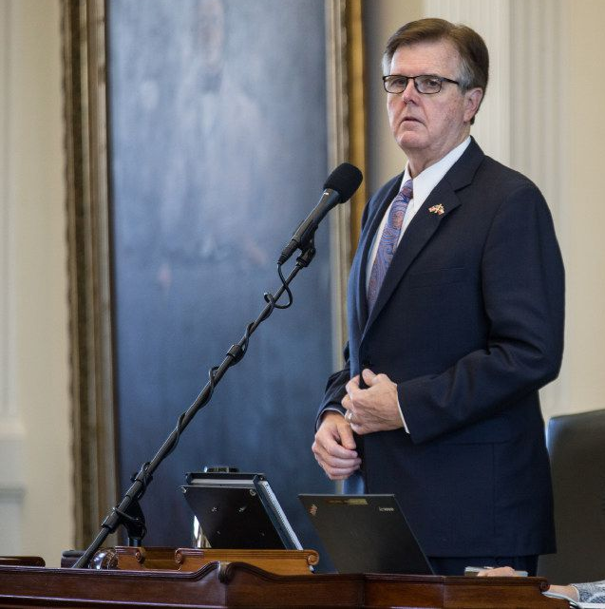
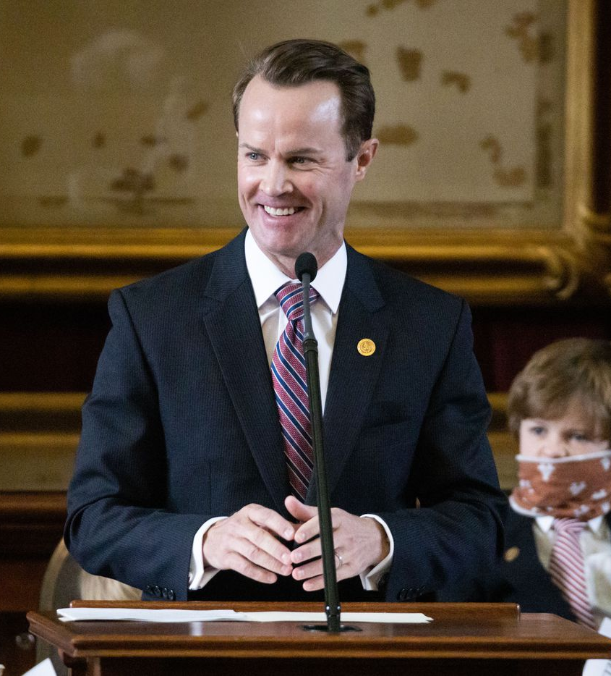
“This session we must continue to fund education as we promised.”
-Governor Greg Abbott
February 1, 2021
“This budget reflects our commitment to… maintaining the historic education funding increases and teacher pay raises established in 2019.”
-Lt. Governor Dan Patrick
January 21, 2021
“When the House last adjourned, we celebrated landmark property tax and school finance reform. But now, Texas children are at risk of falling behind because of disruptions caused across the state as a result of the pandemic. We cannot fail them when they need us most.”
-Speaker Dade Phelan
January 12, 2021

Slide 26
Questions over sustainability of HB 3
Given budget challenges, can lawmakers sustain the:
  Additional $6.4 billion invested into public schools
  Additional $5.2 billion (and growing) for property tax rate compression
?
Notes:
When House Bill 3 was passed in 2019, lots of folks were grateful for the investment in schools and local property taxpayers, but lots of folks questioned the long-term sustainability of those investments. Little did we know how short “long-term” would be. Can the state manage to maintain those investments beyond school year 2020-21 or not?

Slide 27
2020-21 Tier 1 Tax Rate (MCR) Distribution by District
How did the inaugural round of 2.5% Tier 1 compression shake out?
Close to half of districts were assigned the highest Tier 1 rate $0.9164 because their value growth was reported to be <= 4.01%
475
$0.9164
Number of Districts
About 7% of districts were assigned the lowest possible Tier 1 rate for 2020-21 $0.8247
72
$0.8247
less than or equal to 4.01%
15.58% or greater
Source: Texas Education Agency

Slide 28
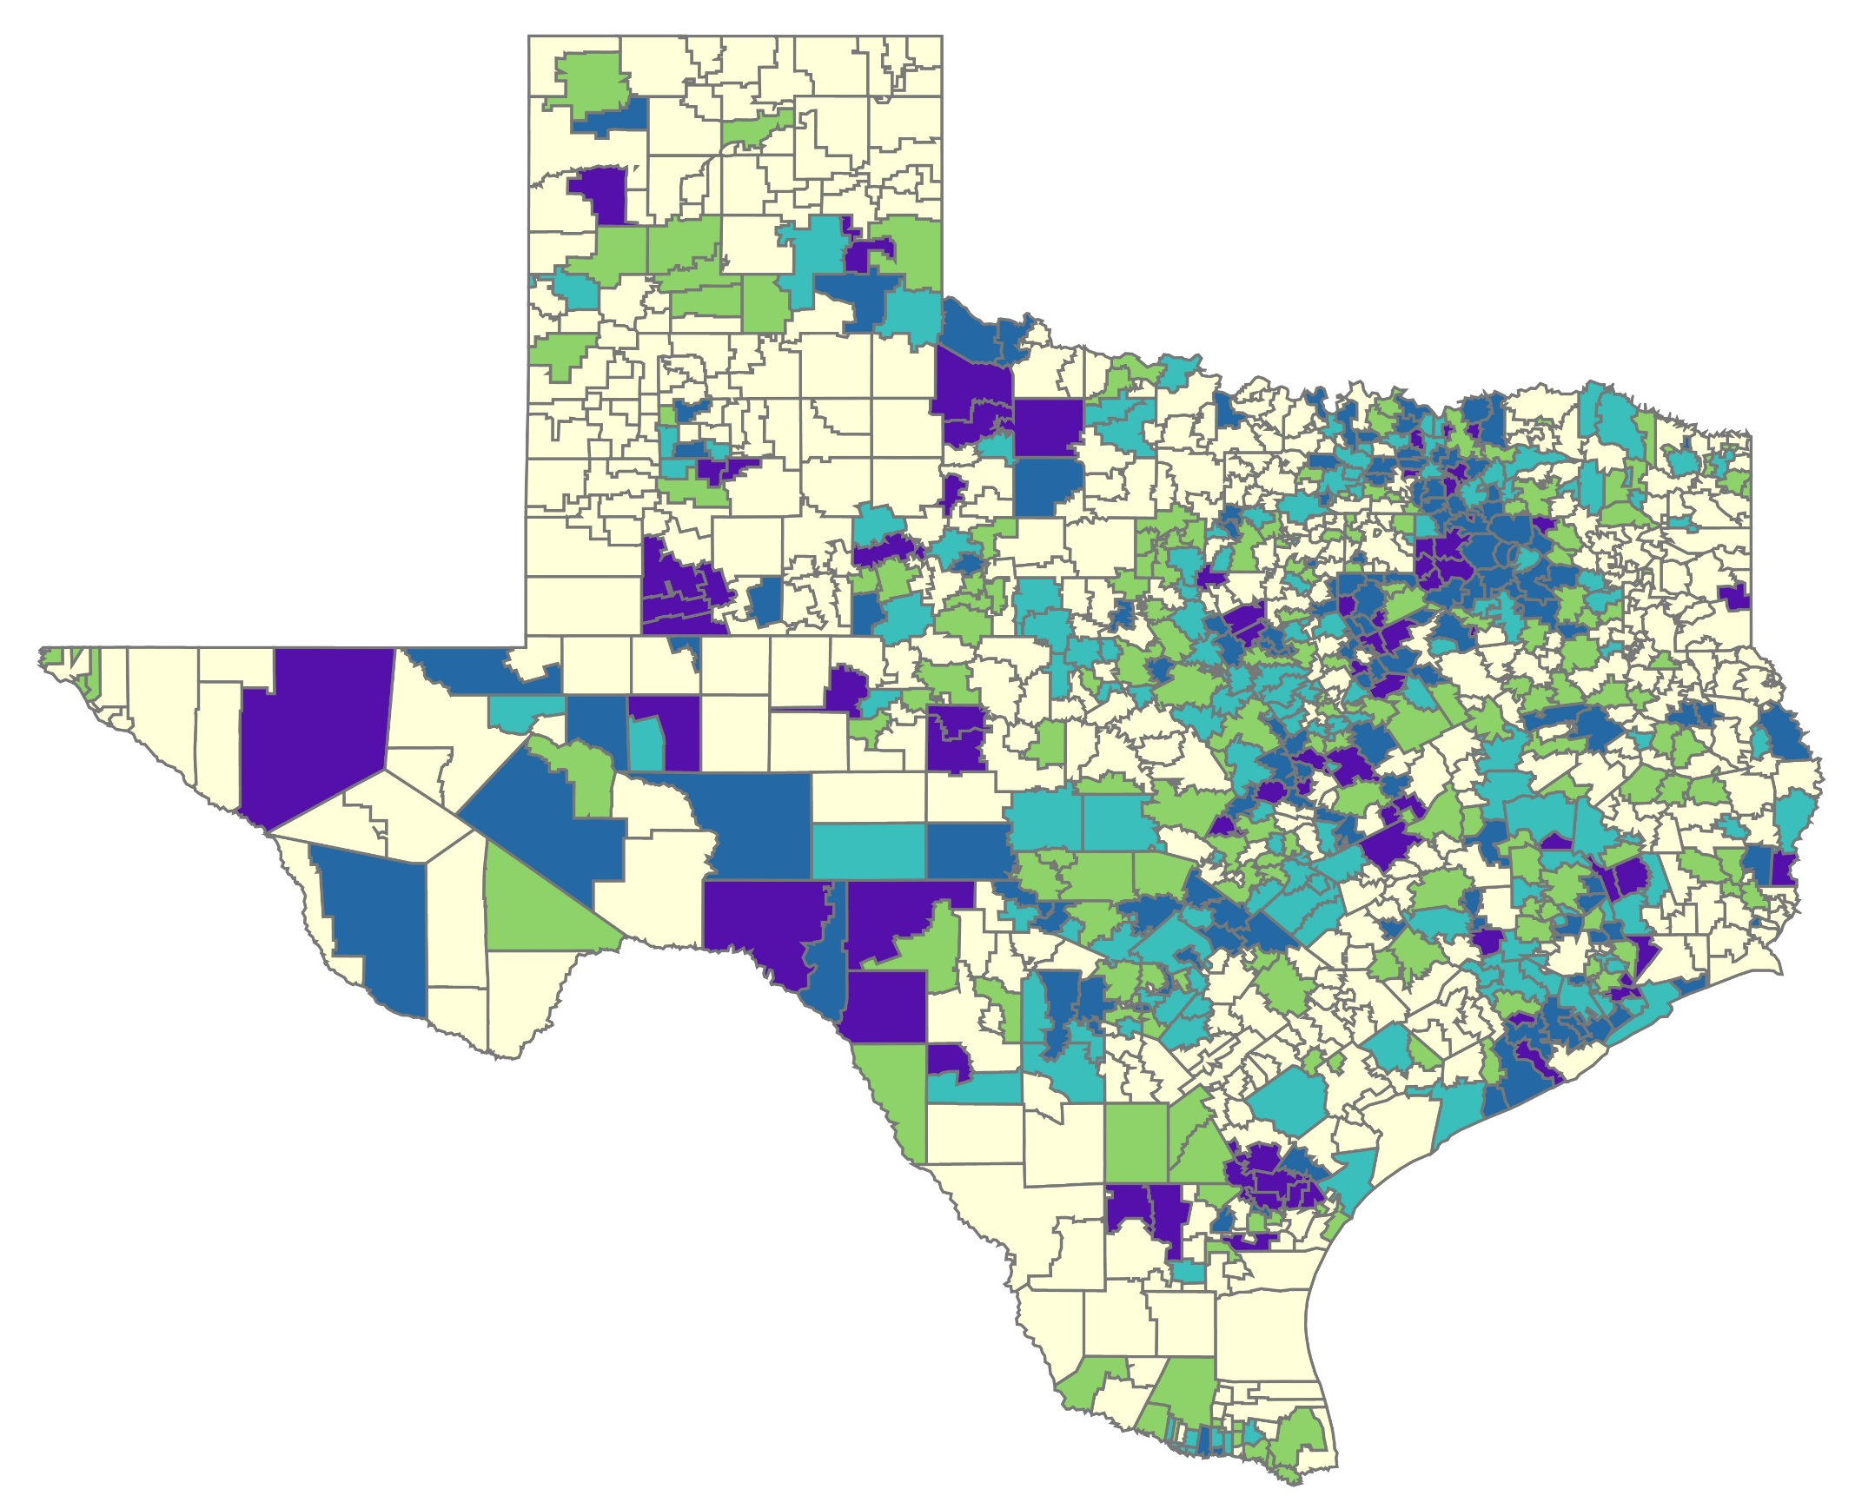
Tax Year 2020
Tier 1 MCR Rates
Larger Urban – mostly at $0.9164
those with lower MCR
include Austin,
San Antonio,
Brownsville, Ysleta
Larger Suburban – mixed along full
spectrum
NonMetro & Rural – mixed along full
spectrum
Final MCR Rates by District
as of August 31, 2020
Posted on the TEA Website at:
https://tea.texas.gov/sites/default/files/school-year-final-mcr.pdf
$0.9164
475 districts
$0.8908 – 0.9163
181 districts
$0.8665 – 0.8907
153 districts
$0.8248 – 0.8664
134 districts
$0.8247
72 districts
Source: Texas Education Agency
Notes:
Mapped

Slide 29

87th Legislature – Statewide Tier 1 Compression
Comptroller’s Estimates are Statutorily Required October 1st of even-numbered years & March 1st odd-numbered years
Tax Year | October 1, 2020 Comptroller’s Estimated Property Value Growth over Prior Year
2020 | 6.15%
2021 | 0.29%
2022 | 3.92%
Statute looks to this estimate in the formula setting the state compression percentage. The estimate will be updated in March 2021. When estimated growth is less than 2.5%, the state compression percentage is equal to the prior year’s percentage (0.9164). The law does allow the legislature to adopt a lower percentage if they choose.
Notes:
Just a reminder that based on current assumptions (which will be updated in March 2021), the state compression percentage will remain at $0.9164 in FY22. There will still be variable compression for districts whose local value growth exceeds 2.5%.

Slide 30
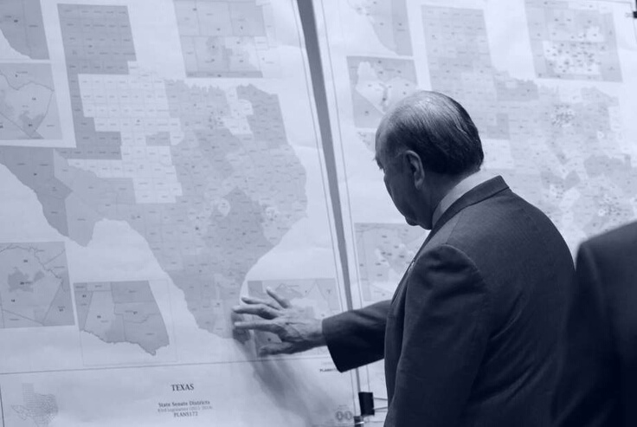
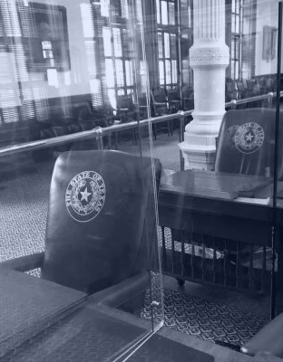
What to Expect from the 87th
181 people have 140 days to redistrict and manage and a multi-billion-dollar shortfall. What could go wrong? And exactly how many special sessions are we talking about?

Slide 31
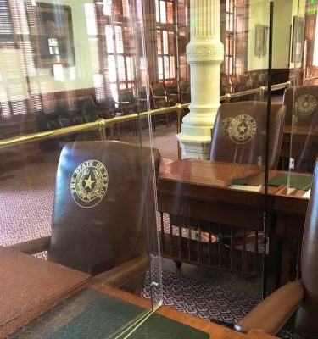
What will the 87th Legislative Session look like?
So far, limited time in the chambers; will number of hearings be limited?
Only invited virtual testimony is allowed at hearings; public testimony to be delivered in person
Virtual advocacy
  Limited in-person visits (appointments usually required)
  COVID testing (or proof of vaccination) is required for Senate, not for House; individual members set policies for their offices

Slide 32
The 87th Legislature
2021 is when Legislature must redistrict and draw new maps, but that work is likely to continue all summer…
How will legislators choose to address learning loss?
Will school district fund balances be raided?
How will leaders address limited broadband access for students?
What will the “HB 3 Clean-up” include?
What about “taxpayer funded lobbying”?

Slide 33


Questions?
Christy Rome
Executive Director
Texas School Coalition
christy@txsc.org
512-732-9072

