Slide 1
House Bill 3 and the Impact of the
86th Legislative Session on
Grapevine-Colleyville ISD
February 25, 2020

Slide 2
Share of State and Local Funding
Pre-HB 3
Local
State
Notes:
The state share of funding was on the decline…

Slide 3
Recapture from 1994-2021 (estimated)
Pre-HB 3
By 2021:
$4 billion
Notes:
And absent legislative change, recapture was going to exceed $4 billion in ONE year by 2021.

Slide 4
Basic Allotment 2010-2019
Pre-HB 3
Notes:
While local revenue and recapture were climbing…the basic allotment stayed flat.

Slide 5
Basic Allotment 2010-2019
Pre-HB 3
Notes:
While local revenue and recapture were climbing…the basic allotment stayed flat. And it certainly didn’t keep up with inflation, much less deliver additional dollars to schools.

Slide 6

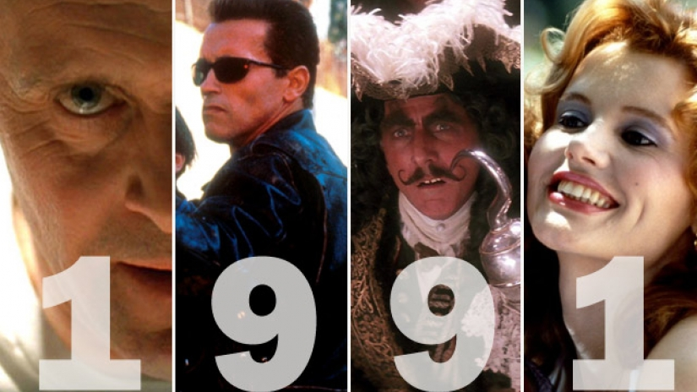
Stuck in the Past
Pre-HB 3
School Finance Element | Last Updated
Bilingual Weight for English Language Learners | 1984
Comp Ed Weight for students in poverty | 1984
Transportation Allotment | 1984
Cost of Education Index | 1991
Notes:
And we complained about our out-of-date formulas that weren’t keeping up with the times.

Slide 7

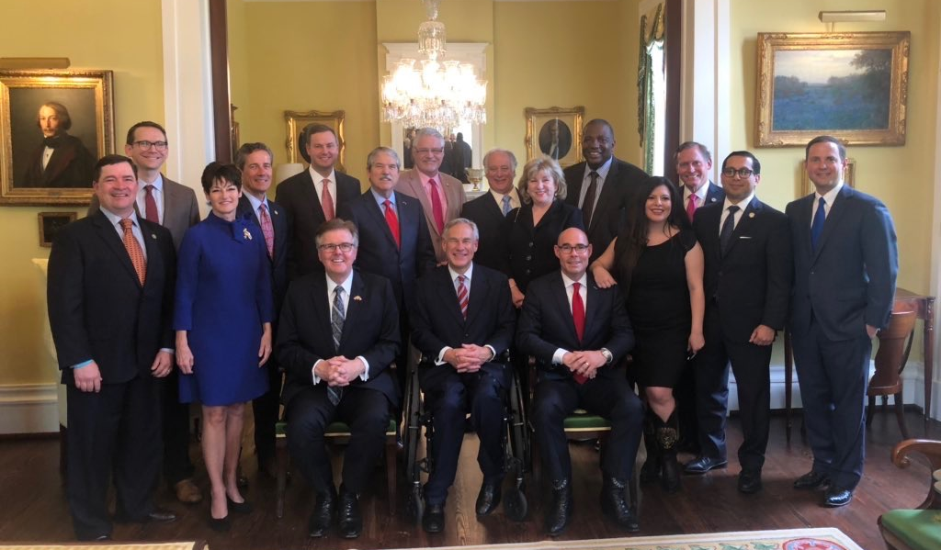
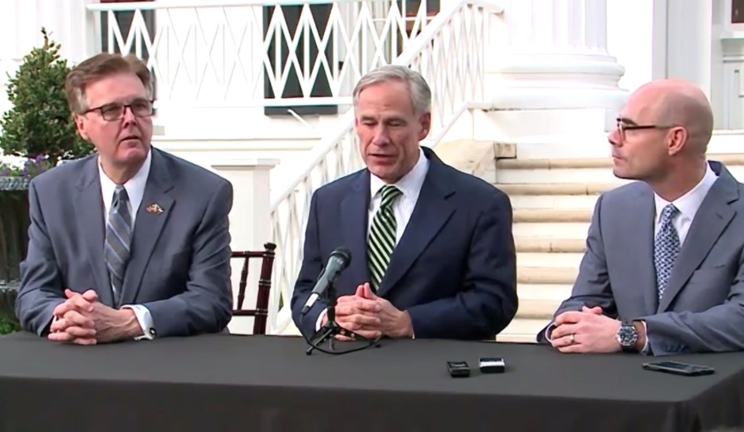
86th Legislative Session
Notes:
Then the 86th Legislative Session happened and school finance was the priorities for state leaders and legislators alike.

Slide 8
Under HB 3
State share to 45% (and will remain there)
Recapture reduced by 46%
Basic Allotment increased by 20%
Funding elements from 1980’s & 1990’s updated
Notes:
And therefore HB 3 fixes all that folks were complaining about (and then some).

Slide 9
Share of State and Local Funding under HB 3
Local
State
Notes:
The trend line has taken an upwards turn. And it’s going to flatline now, but it’s not down at that embarrassing 38% number anymore.

Slide 10
Recapture from 1994-2021 under HB 3
Notes:
And now instead of that continuous spike, we have seen a sharp decline in recapture.

Slide 11
Recapture from 2012-2021 – old law vs. new law
$3.5 billion biennial reduction
Notes:
Just to illustrate the difference we’re talking about between a world without HB 3 and one with it, we’re talking about a [CLICK] reduction of $3.5 billion (46%) over the biennium compared to what districts (and taxpayers) would have had to pay without HB 3.

Slide 12
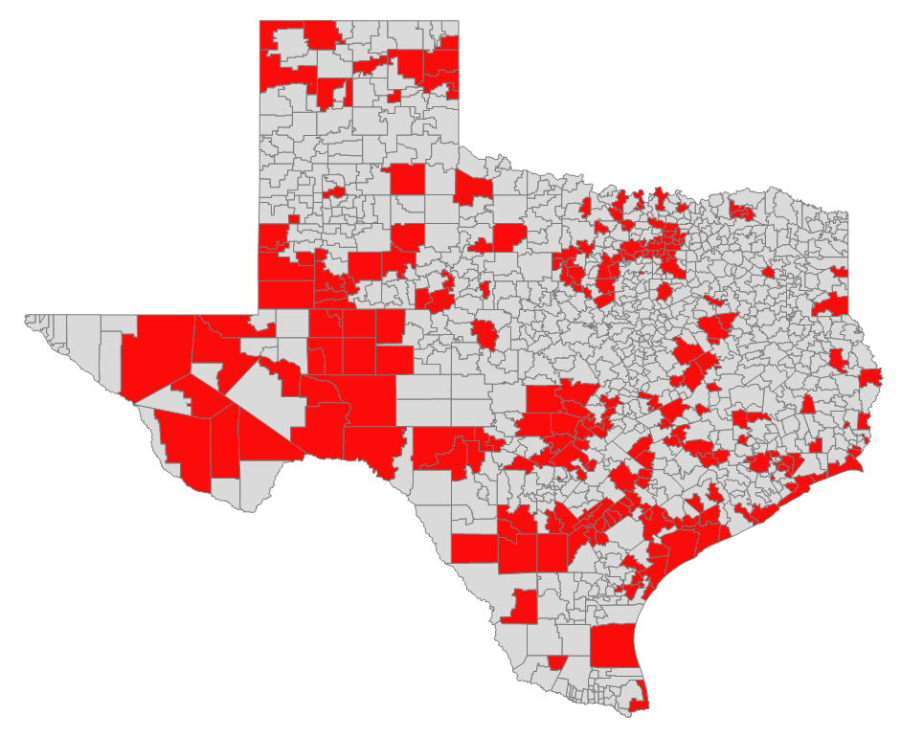
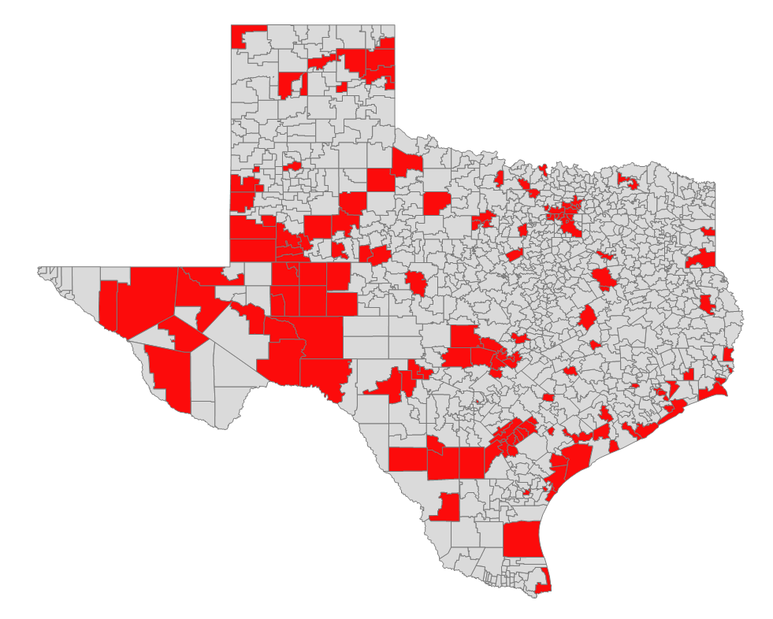

Districts Required to Pay Recapture
2018-19
219 districts
2019-20
141 districts
Notes:
There are also 78 districts in the state that sent checks to the state last year that get to keep 100% of their local revenue local this school year (you aren’t one of them, but we can still be happy for the other 78).

Slide 13
Basic Allotment 2010-2021
19.8% increase
Notes:
And the Basis Allotment isn’t flat anymore. We’re looking at an almost 20% increase.

Slide 14
Stuck in the Past
Pre-HB 3
School Finance Element | Last Updated
Bilingual Weight for English Language Learners | 1984
Comp Ed Weight for students in poverty | 1984
Transportation Allotment | 1984
Cost of Education Index | 1991
Notes:
Good-bye 80’s and 90’s

Slide 15
Stuck in the Past
School Finance Element | Last Updated
Bilingual Weight for English Language Learners | 1984 2019
Comp Ed Weight for students in poverty | 1984 2019
Transportation Allotment | 1984 2019
Cost of Education Index | 1991
Notes:
Welcome to 2019. From now on we are going to be complaining about everything that was last updated “all the way back in 2019…”

Slide 16
Everything schools & taxpayers asked for…
$11.6 billion invested over the biennium ($6.4 billion into schools & $5.2 billion into tax rate compression)
State share to 45% (and will remain there)
Reduces Tier 1 Rates by 7 cents in FY 20 (from $1.00 to $0.93), with further compression in FY 21, based on district value growth
Recapture reduced by 46%
Basic Allotment increased by 20%
Funding elements from 1980’s & 1990’s updated
Notes:
We got everything we asked for. A SIGNIFICANT investment in education ($6.4 billion for schools, and $5.2 billion for property tax reform). But it’s the reduction in property taxes that increase the state share and reduce recapture. It’s not the same as reducing recapture by allowing districts to keep more of their local dollars…it’s a matter of telling districts that they can collect less instead. And they certainly increased the Basic Allotment (though they paid for that increase not with a 20% increase in funds, but rather revisions to update the formulas).

Slide 17
Except…
Moves to current year values
Local revenue limits will increase in cost, so no new state money to benefit classrooms, just taxpayers (and even that is limited to reform rather than relief)
No across-the-board teacher pay increase, and broken state promises to teachers are hard to manage at local level
Formula Transition Grants expire in five years, and some schools don’t benefit and receive less $$
No new revenue to sustain these changes past FY 21
Notes:
And while it addressed what we asked for, it’s like a parent asking a child to complete a task at home…the child may literally do what they were asked, but not in the way the parent intended.

Slide 18
Voter-Approval Tax Rate (aka Rollback Rate) for FY 2020 (tax year 2019)
  The state compression percentage ($0.93) plus the greater of:
    District’s 2018 tax rate minus $1.00, or
    $0.04
    $1.04 rate from tax year 2018 produced a $0.97 tax rate for GCISD in tax year 2019.
Notes:
For the current tax year, it wasn’t hard for your board of trustees to set your tax rate, as the state legislature pretty well told them (to the penny) what it would be. Since you previously had a TRE and were taxing at a rate of 6 golden pennies above $1.00, your new tax rate is 6 cents above the new state compressed rate for Tier 1 (93 cents), so 93+6 gives you your rate of $0.99.

Slide 19

M&O Tax Rate Compression for GCISD
Total M&O Tax Rate
$1.04
$0.97
$0.945 (est.)
Tier 2
$0.04
$0.04
$0.05*
Tier 1
$1.00
$0.93
$0.895*
2018-2019 School Year
2019-2020 School Year
2020-2021 School Year*
*hypothetical
Notes:
This graphic is meant to illustrate how tax rate compression will work in the future for your district. Please note that the 2020-21 school year is completely hypothetical and solely for the purpose of illustration.
For the previous school year, your tax rate was $1.04, and you can see the breakdown of that rate. Tier 1 “silver pennies” are subject to recapture and therefore not worth quite as much. Tier 2 “golden pennies” are completely free of recapture and therefore worth more to your district (hence the name “golden pennies”). You have the same amount of golden pennies in the current tax/school year, but as we have discussed, your Tier 1 rate was compressed by 7 cents.
As we move forward into 2020-21 and future years, your Tier 1 rate will continue to be compressed, and for this district experiencing more property value growth than most, it will likely be compressed at a more rapid pace. I used the more conservative number of 2 cents of compression (but I imagine it will be more). The state will make up the difference for the loss of funding due to the lower rate. We’re not entirely sure where the state is going to come up with the billions of dollars required to continue to buy down that Tier 1 tax rate, but hopefully they will begin to figure that out…
Then you come to Tier 2 pennies of tax effort in the future. Your board of trustees may choose to access a 5th recapture-free golden penny without an election (which is what I chose for the illustration), or they may also choose to propose up to 8 recapture-free pennies to voters via an election.

Slide 20
HB 3 Grapevine-Colleyville ISD Impact
 | 2019-20 (old law) | 2019-20 (new law) | Difference
M&O Tax Rate | $1.04 | $0.97 | -$0.07 (-7%)
M&O Tax Collections | $161,447,928 | $150,581,241 | -$10,866,687 (-7%)
Recapture | ($62,729,595) | ($46,284,103) | $16,445,492 (-26%)
Notes:
Let’s look at the details that are specific to GCISD and compare what would have been (under the old law) to the new law, and new reality, we have under HB 3. Your M&O tax rate was reduced by 7 cents this year. Therefore, even though property values increased in the district overall, your community paid 7% less in property taxes. And that means that (congratulations!), your recapture payment was reduced by 26%!

Slide 21
HB 3 Grapevine-Colleyville ISD Impact
 | 2019-20 (old law) | 2019-20 (new law) | Difference
M&O Tax Collections | $161,447,928 | $150,581,241 | -$10,866,687 (-7%)
Recapture | ($62,729,595) | ($46,284,103) | $16,445,492 (-26%)
M&O Revenue kept for use in GCISD | $98,718,333 | $104,297,138 | $5,578,805 (6%)
Notes:
When you combine those two factors together to see what that means for the school district, it doesn’t mean a net a positive of 26% though—you don’t automatically have that additional $16 million to spend on students and teachers just because you don’t have to send it to the state. Remember that reduction in your recapture is due in large part to the reduction in the taxes you collected. But we’re still talking about a net positive of 6% in terms of the local tax revenue that you get to keep in GCISD.

Slide 22
HB 3 Grapevine-Colleyville ISD Impact
 | 2019-20 (old law) | 2019-20 (new law) | Difference
M&O Tax Collections | $161,447,928 | $150,581,241 | -$10,866,687 (-7%)
Recapture | ($62,729,595) | ($46,284,103) | $16,445,492 (-26%)
M&O Revenue kept for use in GCISD | $98,718,333 | $104,297,138 | $5,578,805 (6%)
Total State Aid | $8,914,306 | $6,564,481 | -$2,349,825 (-26%)
Local + State Aid | $107,632,639 | $110,861,619 | $3,228,980 (3%)
Notes:
But then you have to consider the fact that due to the restructuring at the state level, your state aid declined by over two million dollars. So now we’re looking at a net gain of 3%.

Slide 23
HB 3 Grapevine-Colleyville ISD Impact
 | 2019-20 (old law) | 2019-20 (new law) | Difference
M&O Tax Collections | $161,447,928 | $150,581,241 | -$10,866,687 (-7%)
Recapture | ($62,729,595) | ($46,284,103) | $16,445,492 (-26%)
M&O Revenue kept for use in GCISD | $98,718,333 | $104,297,138 | $5,578,805 (6%)
Total State Aid | $8,914,306 | $6,564,481 | -$2,349,825 (-26%)
Local + State Aid | $107,632,639 | $110,861,619 | $3,228,980 (3%)
Total Funding per student in attendance | $8,057 | $8,299 | $242 (3%)
Notes:
On a per student basis, that turns into an additional $242 per student, to pay for the increased requirements of HB 3. That 3% gain is the standard minimum gain for districts throughout the state (some received 7% gains, some received as much as 12% more, but almost no district received less than 3%).

Slide 24
Formula Transition Grant
    The new way to say “hold harmless”
    Guarantees that a district receives at least 3% more in 2019-2020 under the new law than they would have been entitled to under the previous law on a per-student basis (unless that amount would exceed 128% of state average revenue per student)
    New dollars for the district (through outcomes funding, other incentives, etc.) don’t result in additional funding, just less transition grant.
    Expires after 2023-24 school year
Notes:
Want to know why? Right now, GCISD is a district that qualifies for the Formula Transition Grant (which created both a floor and a ceiling for the new funding levels). Transition Grant dollars are designed to ensure the new formulas didn’t cause districts to end up with less money. The fact that your district receives this grant means you didn’t fare as well as other districts in terms of the new formula, and you are being granted additional funding just to make sure HB 3 doesn’t result in negative numbers for you.
So while it is nice to have that grant to make up the difference for now, there are a couple of things that are a little frightening about this position: 1) it means that as you qualify for additional funding this year, or in the future, it isn’t going to increase your bottom line, but will only change the source of the funding. 2) The other thing that may keep you up at night is the fact that this grant will expire after the 2023-24 school year, so unless some changes are made at the state level (or your tax rate increases), your outlook for having any increased funds with which to provide teacher and staff pay raises or add/sustain programs is bleak by the 2024-25 school year (and while that may sound like it is a long way away, it’s really not).

Slide 25
HB 3 Grapevine-Colleyville ISD Impact
(without $3 million Formula Transition Grant)
 | 2018-19 (old law) | 2019-20 (new law) | Difference
M&O Tax Collections | $161,447,928 | $150,581,241 | -$10,866,687 (-7%)
Recapture | ($62,729,595) | ($46,284,103) | $16,445,492 (-26%)
M&O Revenue kept for use in GCISD | $98,718,333 | $104,297,138 | $5,578,805 (6%)
Total State Aid (no FTG) | $8,914,306 | $3,400,225 | -$5,514,081 (-62%)
Local + State Aid | $107,632,639 | $107,697,363 | $64,724 (0.1%)
Total Funding per student in attendance | $8,057 | $8,062 | $5 (0.1%)
Notes:
If we subtract out the $3 million GCISD is currently receiving in Formula Transition Grant (which we already know will expire in less than five years), then this is the impact of HB 3 for your district, and what your board of trustees must consider as they are planning for the future of the district. It’s designed to be a transition, so it does allow the time for decisions to be made for how to plan for the loss of this funding in the future.

Slide 26
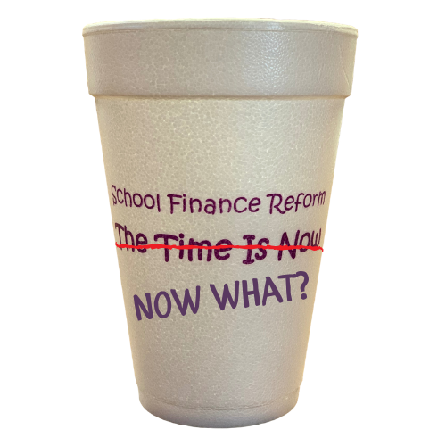
The Future of School Finance
A new day under HB 3
HB 3 fixed a lot, but doesn’t fix everything
Concerns about sustainability and the revenue sources to pay for reforms
Other topics will be the focus in 2021
Notes:
So what does the future hold for school finance in Texas? Well, under HB 3, it is certainly a new day in a new world. The significant changes brought by HB 3 are taking a lot of adjustment as we sift through the details and figure out how to implement this new law. That means the discovery of some unintended consequences, or some things that just really don’t work quite like they thought they would.
They are also going to have to begin having the uncomfortable conversation about where the source of billions in state revenue may come from in order to pay for the property tax relief they put in motion. If they don’t pay for it by some new source of revenue, then that means either something else in the budget must be cut dramatically (we don’t really need those highways anymore, right?) or schools will be facing dramatic budget cuts.
And while HB 3 fixed a lot, even those who wrote and passed this bill said at the time that they have more to do. When they may get around to that is an important question, because there will be other topics that dominate the majority of the session. One big topic in 2021 will be redistricting, but there are plenty of other topics that were given a backseat in 2019 as school finance took center stage, and those topics (transportation, water, health and human services, you name it) will be clamoring for attention. In the past, after the Legislature has passed major school finance reform, we tend to here a lot of “we fixed that last session, so leave me alone about it.” Hopefully, we will be able to bring attention to the items in need of immediate fix.

Slide 27

Questions?
Christy Rome
Executive Director
Texas School Coalition
512-732-9072
christy@txsc.org
www.txsc.org

